Slide 1

WEEK 16 · WEDNESDAY · 75 MINUTES
Exam 4 Review II - Weeks 14-15, Mock Exam & Strategy
Deep Review 14-15 · Mock-Exam Walkthrough · Final Q&A
CIS 350: AI for Cybersecurity — Smart Defense for the Digital Business
Ramadan Abdunabi, Ph.D. · Computer Information Systems
Notes:
Open with encouragement: 'Last review session - we'll finish Weeks 14-15, walk a mock exam by question type, and answer your remaining questions.' Keep it interactive and confidence-building. Exam 4 is next week (Week 17), open-notes. Reach Part 1 by ~minute 8. ~1 min.

Slide 2

🔁 WARM-UP · 5 MIN
Your open questions
With a neighbor, 3 minutes:
What did you review since Monday?
What's the ONE topic you most want cleared up today?
What's your plan for taking an open-notes exam well?
CIS 350: AI for Cybersecurity · Wednesday
2
Notes:
Surface remaining gaps and prime exam strategy. Pairs 3 min; note the most-requested topics for the Q&A. Expected: trust pillars, incident response, transfer/few-shot, and 'how to use notes efficiently.' ~5 min.

Slide 3
WEDNESDAY · 75 MINUTES
Today's Plan
🔁
Warm-up & open questions
Target the gaps
8 min
🧠
Deep review: Weeks 14-15
Recaps + mock questions
18 min
📝
Mock-exam walkthrough
By question type, with strategy
22 min
🎓
Final Q&A & send-off
Clear it up; exam-day checklist
7 min
✍️
In-class task
Write & score a Part-D scenario
14 min
🎯
Wrap & exit
Good luck; Exam 4
6 min
CIS 350: AI for Cybersecurity · Wednesday
3
Notes:
Walk the plan; the row minutes add up to exactly 75. Finish the review, then practice each question type with strategy, then final Q&A. ~1 min.

Slide 4
EXAM 4 REVIEW, PART 2
Today's Goals
1
Actively recall Weeks 14-15 (trustworthy AI, incident response, advanced topics).
2
Practice each Exam-4 question type with a clear strategy.
3
Self-score and target any last gaps.
4
Leave confident, with an exam-day checklist.
CIS 350: AI for Cybersecurity · Wednesday
4
Notes:
State the goals. Emphasize the mock-exam walkthrough - practicing HOW to answer each type is as valuable as knowing the content. ~1 min.

Slide 5
PART 1 · DEEP REVIEW: WEEKS 14-15 · ~18 MIN
Recaps + Mock Questions
Notes:
Transition: 'The second half of the exam material.' ~22 minutes of active recall.

Slide 6
WEEK 14
Week 14 Recap - Trustworthy AI & Incident Response
Four pillars: transparency, explainability, robustness, accountability.
Transparency = how the system works; explainability = why THIS decision.
Robustness must be MONITORED over time (data drift), not tested once.
Accountability: named owners, audits, human override, appeals.
IR lifecycle: prepare; detect & analyze; contain/eradicate/recover; post-incident.
Four pillars; transparency vs explainability; IR lifecycle.
CIS 350: AI for Cybersecurity · Wednesday
6
Notes:
Rapid recall of Week 14. Stress the four pillars and the transparency/explainability distinction (commonly confused), plus the IR lifecycle from the tabletop. ~5 min.

Slide 7
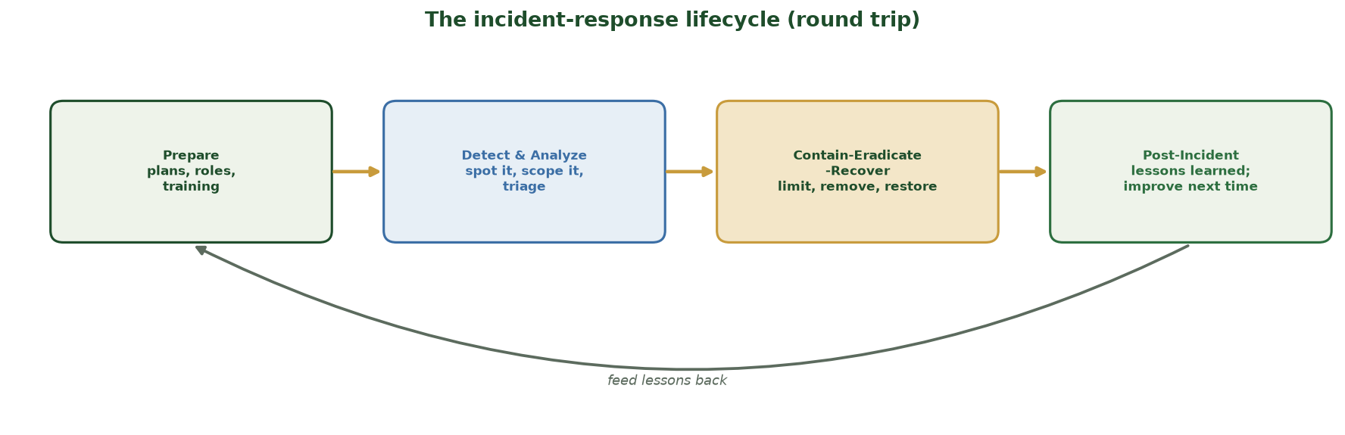
THE FOUR NIST PHASES AS A LOOP
The Incident-Response Lifecycle (Round Trip)
Prepare -> Detect & Analyze -> Contain/Eradicate/Recover -> Post-Incident, then feed lessons learned back into Prepare - it's a continuous loop, not a one-shot.
CIS 350: AI for Cybersecurity · Wednesday
7
Notes:
Refresh the IR lifecycle from the Week-14 tabletop - a likely scenario item. Walk the four phases left to right: PREPARE (plans/roles), DETECT & ANALYZE (spot and scope), CONTAIN-ERADICATE-RECOVER (limit, remove, restore), POST-INCIDENT (lessons learned). Emphasize the RETURN arrow: lessons feed back into Prepare, so every incident improves the next response. For a Part-D scenario, naming two phases and what you'd do in each earns credit. ~2 min.

Slide 8
🧠 MOCK QUESTIONS · 5 MIN
Week 14
Answer aloud with a neighbor:
MC: Explainability is about (a) GPU speed (b) why one decision was made (c) file size (d) the server room?
Short: How do transparency and explainability differ? Give an example.
Scenario: An AI fraud model misbehaves - name two IR phases and one trust pillar that would help.
CIS 350: AI for Cybersecurity · Wednesday
8
Notes:
Run Week-14 mock questions. Answers: (b); transparency=system-level (model card), explainability=one decision's reason; IR phases e.g. detect & analyze + contain/recover; pillar = robustness/accountability. Cold-call. ~5 min.

Slide 9
WEEK 15
Week 15 Recap - Advanced Topics & Emerging Threats
Transfer, few-shot, federated learning all fight LABEL SCARCITY.
Transfer reuses a pretrained model (far fewer labels needed).
Emerging threats: AI-generated malware, poisoning at scale, deepfakes, autonomous agents.
It's an arms race - no permanent win; raise cost, detect, adapt.
Fundamentals endure: defense in depth, human oversight, trade-offs.
Transfer/few-shot/federated vs label scarcity; emerging threats; arms race.
CIS 350: AI for Cybersecurity · Wednesday
9
Notes:
Rapid recall of Week 15. Reinforce that the three advanced techniques all address label scarcity, and that emerging threats extend attacks students already know. ~5 min.

Slide 10
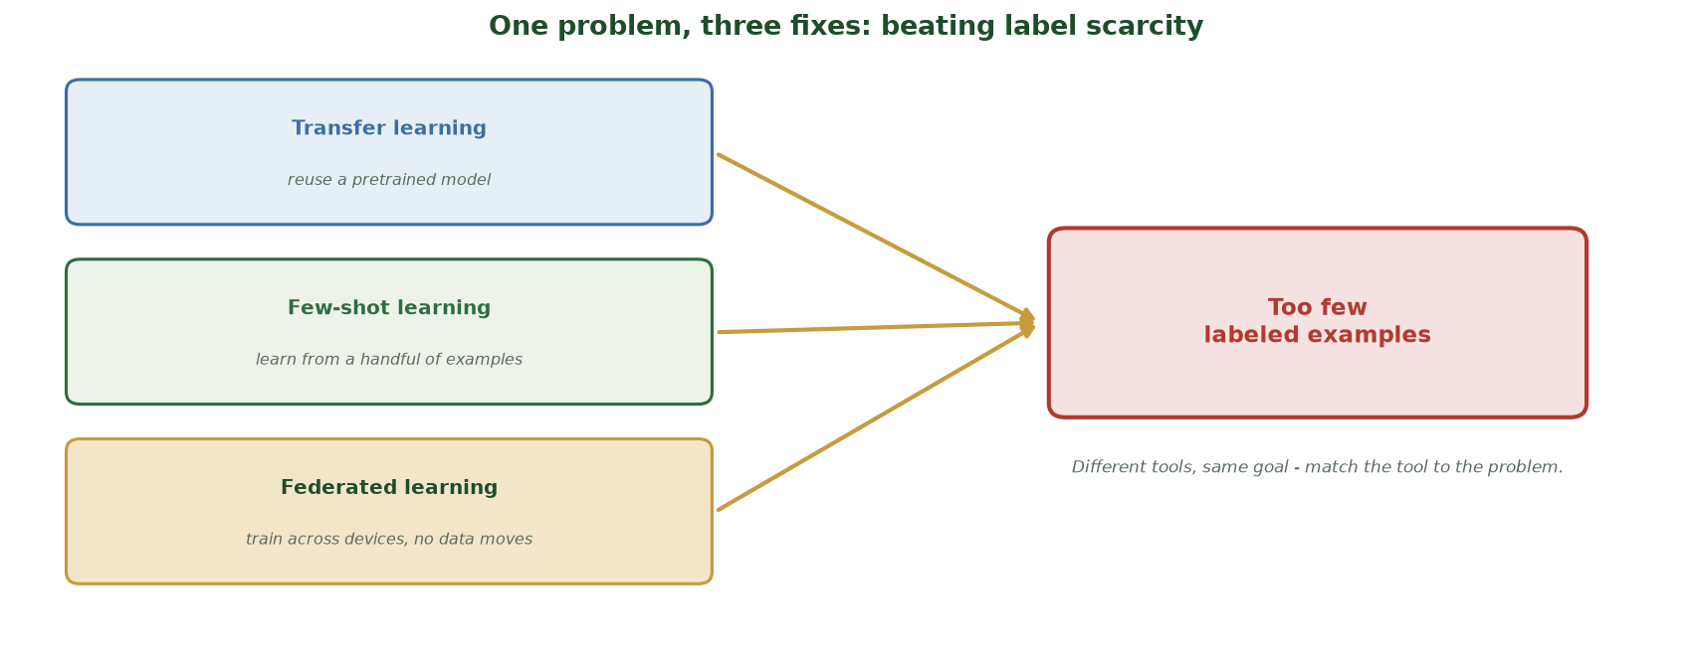
TRANSFER, FEW-SHOT, FEDERATED ALL CONVERGE
One Problem, Three Fixes: Beating Label Scarcity
Transfer learning, few-shot learning, and federated learning are three different tools aimed at the SAME core problem: too few labeled examples - match the tool to the situation.
CIS 350: AI for Cybersecurity · Wednesday
10
Notes:
Consolidate the Week-15 synthesis with this convergence figure. All three advanced techniques point at one target: TOO FEW LABELED EXAMPLES. Transfer learning reuses a pretrained model; few-shot learns from a handful; federated trains across sites without moving data. The exam-relevant point is the through-line 'match the tool to the problem' - if a scenario says 'we have almost no labels,' these are your candidate answers. ~2 min.

Slide 11
🧠 MOCK QUESTIONS · 5 MIN
Week 15
Answer aloud with a neighbor:
MC: Transfer learning mainly helps because (a) bigger screens (b) it needs fewer labels (c) faster internet (d) cheaper GPUs?
Short: What problem do transfer, few-shot, and federated learning all address?
Scenario: AI-generated malware keeps changing its signature - name one defense.
CIS 350: AI for Cybersecurity · Wednesday
11
Notes:
Run Week-15 mock questions. Answers: (b) fewer labels; all address label scarcity; behavior/anomaly detection (not signatures). Cold-call. ~5 min.

Slide 12
THE SYNTHESIS
Tie It Together: the Through-Lines
Defense in depth; keep a human in the loop; every choice is a trade-off.
Match the tool to the problem, and the metric to the harm.
Trust is designed in and documented - Part D loves these connections.
Recurring through-lines - reason from these on scenarios.
CIS 350: AI for Cybersecurity · Wednesday
12
Notes:
Quick synthesis reminder: the recurring through-lines are what Part D scenarios reward. If students reason from these five ideas, they can handle any applied question. ~2 min.

Slide 13
PART 2 · MOCK-EXAM WALKTHROUGH · ~22 MIN
By Question Type, With Strategy
Notes:
Transition: 'Knowing the content is half of it - now HOW to answer each type well.' ~27 minutes.

Slide 14
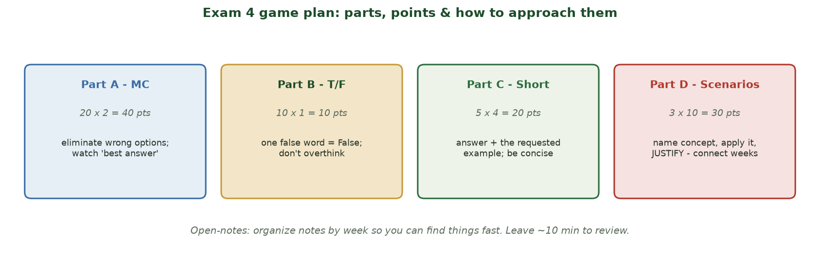
PARTS, POINTS & HOW TO APPROACH THEM
Exam 4 Game Plan
MC (40), T/F (10), short answer (20), scenarios (30) - with an approach and a time budget for each.
CIS 350: AI for Cybersecurity · Wednesday
14
Notes:
Walk the strategy figure. Give the time budget and per-type approach: MC = eliminate wrong options, watch 'best answer'; T/F = one false word makes it False; short = answer + the requested example; scenarios = name, apply, JUSTIFY. Leave ~10 min to review. ~4 min.

Slide 15
MC & T/F TACTICS
Parts A & B: Multiple Choice & True/False
Read the WHOLE question; watch for 'best,' 'not,' 'always/never.'
Eliminate clearly-wrong options first, then choose among the rest.
T/F: if any part is false, the statement is False.
Don't overthink - your first, reasoned answer is usually right.
It's open-notes: confirm a fact quickly, but don't burn time hunting.
Eliminate wrong options; one false word = False; don't over-hunt notes.
CIS 350: AI for Cybersecurity · Wednesday
15
Notes:
Give concrete MC/TF tactics. The most common errors: misreading 'not,' and over-using notes on easy items. Model elimination on one example. ~4 min.

Slide 16
📝 MOCK MC/TF · 6 MIN
Try these under time
90 seconds, no discussion, then we check:
T/F: Federated learning centralizes all raw data on one server.
MC: The IR lifecycle order is (a) recover-first (b) prepare; detect & analyze; contain/eradicate/recover; post-incident (c) code-compile-ship (d) buy-sell-trade?
T/F: A strong system prompt alone fully stops prompt injection.
CIS 350: AI for Cybersecurity · Wednesday
16
Notes:
Timed mini-set to practice pace. Answers: False (only updates are shared); (b); False (need guardrails/least privilege). Debrief the reasoning, not just the letter. ~6 min.

Slide 17
WRITTEN-ANSWER TACTICS
Parts C & D: Short Answer & Scenarios
Short answer: give the concept AND the requested example - be concise, not long.
Don't pad; graders look for the key element(s), not word count.
Scenarios (Part D): NAME the concept, APPLY it to the situation, JUSTIFY.
Label lettered parts (a), (b)... and answer every part.
Connect across weeks - that's what earns full scenario credit.
Concept + example (short); name-apply-justify + label parts (scenarios).
CIS 350: AI for Cybersecurity · Wednesday
17
Notes:
Give written-answer tactics. The biggest point-losers: missing the requested example (Part C) and stating a concept without JUSTIFYING it in the scenario (Part D). Stress labeling parts and answering all of them. ~5 min.

Slide 18
📝 MOCK SCENARIO · 5 MIN
Answer Part-D style
With a neighbor, answer all parts (name-apply-justify):
A bank's AI loan model is accurate overall but denies one group far more.
(a) Which per-group metric shows the harm? (b) One mitigation? (c) One governance step before redeploying?
CIS 350: AI for Cybersecurity · Wednesday
18
Notes:
Run a full Part-D style scenario. Model answer: (a) per-group false-positive/selection rate or equal-opportunity gap; (b) drop proxy features / relabel / group-aware threshold, then re-audit; (c) model card with per-group fairness + human oversight/appeal. Emphasize JUSTIFYING each. ~5 min.

Slide 19
CLOSE THE GAPS
Self-Score & Target Gaps
After the practice exam, mark what you missed and WHY (concept vs. careless).
Turn each miss into a one-line note in your open-notes packet.
Re-drill the two or three weakest topics - not everything.
Confidence comes from a few focused reps, not cramming everything.
Score the practice; note each miss; re-drill the weakest few.
CIS 350: AI for Cybersecurity · Wednesday
19
Notes:
Coach efficient final prep: diagnose misses (concept vs careless), convert to notes, re-drill only the weak spots. Discourage cram-everything. ~3 min.

Slide 20
PART 3 · FINAL Q&A & SEND-OFF · ~7 MIN
Clear It Up, Then Go Get It
Notes:
Transition: 'Open floor - let's clear up whatever's left.' ~10 minutes.

Slide 21
DON'T LOSE THESE POINTS
Top Misconceptions - One More Time
Poisoning = training time; evasion = test time.
Overall accuracy can HIDE per-group unfairness - disaggregate.
SMALLER epsilon = MORE privacy (more noise, less accuracy).
A system prompt alone doesn't stop injection - add guardrails + least privilege.
Humans stay accountable - 'the algorithm decided' is not an answer.
The five highest-yield corrections, one last time.
CIS 350: AI for Cybersecurity · Wednesday
21
Notes:
Recap the highest-yield corrections one final time - these recur on the exam. Read each and have the room confirm. ~4 min.

Slide 22
🎓 OPEN Q&A · 3 MIN
Ask anything
Open floor (use your warm-up 'clear up' topic):
Any concept from Weeks 10-15 you want re-explained?
Any question about the exam format or logistics?
Any 'how should I answer this kind of question' question?
CIS 350: AI for Cybersecurity · Wednesday
22
Notes:
Targeted Q&A on the gaps surfaced in the warm-up. Re-explain the top one or two. Capture anything you can't finish for a Canvas announcement. ~3 min.

Slide 23
BEFORE YOU SIT DOWN
Exam-Day Checklist
Test Respondus LockDown Browser BEFORE exam day.
Have your organized, by-week notes ready (it's open-notes).
Read each question fully; budget time; leave ~10 min to review.
Answer every part; for scenarios, name-apply-justify.
Individual work only - no collaboration, no AI.
Test LockDown; organized notes; budget time; answer every part.
CIS 350: AI for Cybersecurity · Wednesday
23
Notes:
End with a practical checklist that prevents avoidable losses (LockDown setup, time budget, answering all parts). Reiterate integrity. ~3 min.

Slide 24
✍️ IN-CLASS TASK · 14 MIN
Write & Score a Part-D Scenario (Exam Conditions)
Scenario: a company's AI fraud-detection system starts misbehaving after attackers feed it AI-generated transactions that keep changing shape. You are the on-call analyst. Write a full Part-D answer under exam conditions, then peer-score a neighbor's - exactly like Exam 4 Part D (draws on Weeks 14-15: IR + trust pillars + emerging threats).
(5 min, silent, open-notes) Write a LABELED answer: (a) name TWO IR phases you'd use + what you'd do; (b) name ONE trust pillar that helps + why; (c) name ONE defense against the shape-shifting malware + JUSTIFY why signatures fail.
Follow the exam pattern for each part: NAME, APPLY, JUSTIFY; label parts (a)(b)(c).
Trade papers; score the peer's answer out of 6 (2 pts/part: 1 name + 1 applied justification) + one sentence of feedback.
Return papers; revise your own using the feedback you got.
CIS 350: AI for Cybersecurity · Wednesday
24
Notes:
The course's final rehearsal - a written, timed, self-scored Part-D answer (distinct from the verbal mock scenario; this one draws on Weeks 14-15). Model answer: (a) DETECT & ANALYZE (confirm it's an attack, scope which transactions) + CONTAIN/ERADICATE/RECOVER (route flagged traffic to human review, retrain/patch, restore service) - Prepare and Post-Incident also creditable. (b) ROBUSTNESS - it must be MONITORED over time for drift and adversarial input, not tested once - or ACCOUNTABILITY (named owner, human override, appeals); explainability helps analysts see WHY a transaction was flagged. (c) BEHAVIOR/ANOMALY detection rather than signatures, because AI-generated malware changes its signature every time so signatures fail; it's an arms race - raise cost, detect, adapt, human in the loop. Stress that FULL CREDIT requires the JUSTIFY step and LABELING every part - the two biggest point-losers from the written-answer tactics slide. Have 1-2 students read a revised answer. ~14 min.

Slide 25
Key Takeaways
✓
Weeks 14-15: trustworthy AI's four pillars + the IR lifecycle; transfer/few-shot/federated vs label scarcity; the arms race.
✓
Answer strategically: eliminate on MC, 'one false word = False' on T/F, concept+example on short answer.
✓
Part D scenarios: name-apply-justify and connect across weeks - that's where synthesis points live.
✓
Prep efficiently: timed practice, self-score, re-drill the weakest few, and organize your open notes.
Notes:
Recap the review and the strategy. Cold-call: 'What's the difference between transparency and explainability?' End on genuine encouragement - they're ready. ~3 min.

Slide 26
WHAT'S NEXT
Looking Ahead: Exam 4 (Week 17)
🧭 Exam 4 is next week during the final-exam window - Weeks 10-16, open-notes.
📄 Do the Practice Exam (timed) and review the Study Guide once more.
🧾 Organize your notes by week; test LockDown Browser early.
📧 I'll post answers to any leftover questions on Canvas.
🙌 Great work this term - you've built real, durable skills. Good luck!
Exam 4 next week (Weeks 10-16, open-notes); do the timed practice.
CIS 350: AI for Cybersecurity · Wednesday
26
Notes:
Assign the final prep and send students off confidently. Note the Canvas follow-up for leftover questions. Warm close to the term's teaching. ~3 min.

Slide 27
🎯 EXIT TICKET · 2 MIN
One minute before you go
On a card or the Canvas exit ticket:
One topic you now feel confident about.
One thing you'll review before Exam 4.
One skill from this course you'll carry beyond the exam.
CIS 350: AI for Cybersecurity · Wednesday
27
Notes:
Close with a reflective exit ticket. Use any 'still unsure' responses for a final Canvas review post. End the course's teaching on a high note. ~2 min.

Slide 28
SOURCES & STUDY RESOURCES
References & Further Reading
  Exam 4 Study Guide and Practice Exam (posted in Canvas).
  Handouts 8-13 and the Weeks 10-15 lecture decks.
  NIST AI RMF 1.0 (2023); OWASP Top 10 for LLM Applications; MITRE ATLAS.
  'Fairness and Machine Learning' (fairmlbook.org); EU AI Act (2024).
  C. Dwork & A. Roth (differential privacy, 2014); NIST SP 800-61 (incident handling).
CIS 350: AI for Cybersecurity · Wednesday
28
Notes:
Appendix slide: study resources. Post to Canvas or leave visible during the exit ticket - it is not part of the timed session. The Exam 4 Study Guide and Practice Exam are the highest-value prep.

