Slide 1

WEEK 16 · MONDAY · 75 MINUTES
Exam 4 Review I - Weeks 10-13 & Misconceptions
How Exam 4 Works · Deep Review 10-13 · Fix the Misconceptions
CIS 350: AI for Cybersecurity — Smart Defense for the Digital Business
Ramadan Abdunabi, Ph.D. · Computer Information Systems
Notes:
Open supportively: 'This week is all about YOU getting ready - today we review Weeks 10-13 actively and clear up the most common mix-ups.' Set expectations: it's interactive (mock questions), not a lecture. Exam 4 is Weeks 10-16, online, open-notes, in Week 17. Bring the Study Guide/Practice Exam. Reach Part 1 by ~minute 8. ~1 min.

Slide 2

🔁 WARM-UP · 5 MIN
Confidence check
With a neighbor, no notes for 3 minutes:
List the biggest topics from Weeks 10-13.
Rate each 1-3 (1 = shaky, 3 = solid).
We'll spend the most time on the shaky ones.
CIS 350: AI for Cybersecurity · Monday
2
Notes:
Start with retrieval + self-assessment. Pairs 3 min; quickly poll for the shaky topics and note them so the review targets real gaps. Expected topics: adversarial/poisoning, prompt injection, fairness metrics, differential privacy. ~5 min.

Slide 3
MONDAY · 75 MINUTES
Today's Plan
🔁
Warm-up & confidence check
Find the gaps
8 min
🧭
Exam 4 logistics & strategy
Format, rules, how to study
10 min
🧠
Deep review: Weeks 10-13
Recaps + mock questions
34 min
🩹
Misconceptions clinic
Fix the common mix-ups
6 min
🧩
In-class task
Build your open-notes cheat sheet
12 min
🎯
Wrap & exit
Takeaways; Wednesday
5 min
CIS 350: AI for Cybersecurity · Monday
3
Notes:
Walk the plan; the row minutes add up to exactly 75. Logistics first, then a deep active review of the first half of the exam material, then a misconceptions clinic. ~1 min.

Slide 4
EXAM 4 REVIEW, PART 1
Today's Goals
1
Know exactly what Exam 4 covers and how to study for it.
2
Actively recall the key ideas of Weeks 10-13.
3
Practice with mock questions and self-assess.
4
Correct the most common misconceptions before the exam.
CIS 350: AI for Cybersecurity · Monday
4
Notes:
State the goals. Emphasize active recall and misconception-fixing - the two highest-yield prep activities. Wednesday covers Weeks 14-15 and a full mock-exam walkthrough. ~1 min.

Slide 5
PART 1 · EXAM 4 LOGISTICS & STRATEGY · ~10 MIN
What It Covers and How to Study
Notes:
Transition: 'First, no surprises - here's exactly how the exam works.' ~12 minutes.

Slide 6
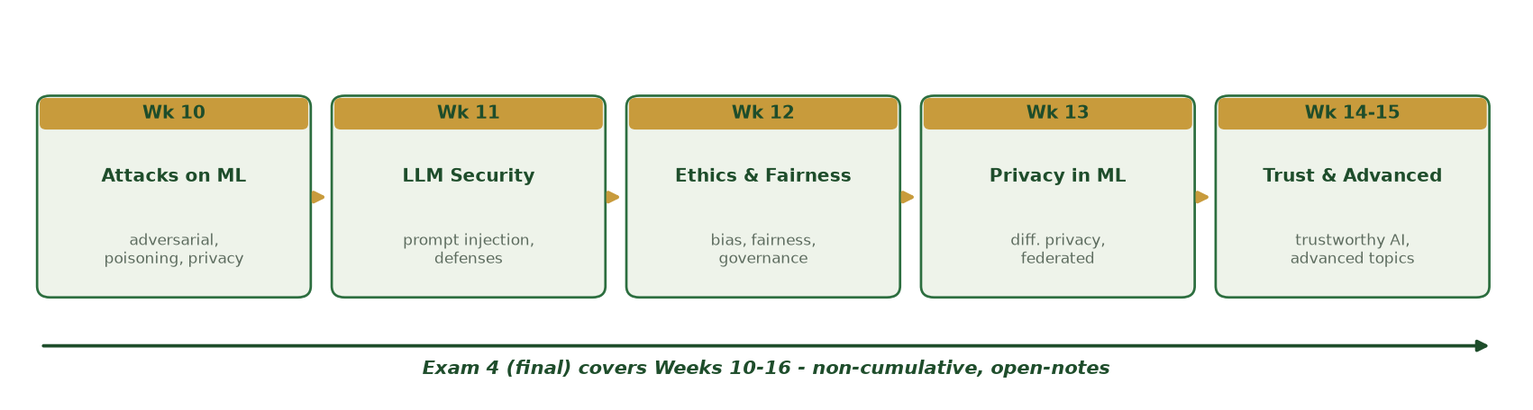
WEEKS 10-16, NON-CUMULATIVE
What Exam 4 Covers
Attacks on ML (10), LLM security (11), ethics & fairness (12), privacy (13), trust & advanced (14-15).
CIS 350: AI for Cybersecurity · Monday
6
Notes:
Walk the roadmap. Exam 4 is non-cumulative: Weeks 10-16 (Week 16 is review, so 10-15 content). It draws roughly evenly across the weeks. Today we deep-review 10-13; Wednesday does 14-15. ~3 min.

Slide 7
EXAM 4 FORMAT
Format & Rules
100 points: 20 MC (40), 10 T/F (10), 5 short answer (20), 3 applied scenarios (30).
Online via Canvas during the university's final-exam window (Week 17).
Open-notes; no heavy math, no coding. Individual - no collaboration, no AI.
Applied scenarios reward CONNECTING ideas across weeks.
Same format as Exams 1-3, so you know the drill.
100 pts, 4 parts; open-notes, individual, no AI; scenarios reward synthesis.
CIS 350: AI for Cybersecurity · Monday
7
Notes:
State the format precisely (mirrors Exams 1-3). Stress integrity rules (open-notes but no collaboration/AI) and that Part D rewards synthesis. Reassure: they've done this format three times. ~4 min.

Slide 8
STUDY STRATEGY
Study Smart (Not Just Long)
Use the Exam 4 Study Guide (Weeks 10-16) and each week's takeaway slides.
ACTIVE recall: cover the answer and retrieve it; redo self-checks.
Take the Practice Exam closed-book and timed, then check the key.
Practice APPLYING concepts to NEW scenarios (that's Part D).
It's open-notes - organize notes by week NOW so you can find things fast.
Study guide + timed practice + apply to scenarios; organize notes.
CIS 350: AI for Cybersecurity · Monday
8
Notes:
Give the evidence-based plan: active recall + application beat rereading. Point to the Study Guide and Practice Exam (posted). Practical open-notes tip: a well-organized note set is a real advantage - build it now. ~5 min.

Slide 9
PART 2 · DEEP REVIEW: WEEKS 10-13 · ~34 MIN
Recaps + Mock Questions
Notes:
Transition: 'Now the first half of the exam material, one week at a time, each with a mock question.' ~40 minutes of active recall.

Slide 10
WEEK 10
Week 10 Recap - Attacks on ML
Adversarial examples: tiny crafted input change flips a prediction (EVASION, test time).
Data poisoning: corrupt the TRAINING data (training time); backdoors plant a trigger.
Privacy attacks: model inversion, membership inference, model theft.
Why: models learn patterns, not meaning - and can memorize data.
Defenses: adversarial training, data vetting, detection, DP - defense in depth.
Adversarial (test) vs poisoning (train); privacy attacks; layered defenses.
CIS 350: AI for Cybersecurity · Monday
10
Notes:
Rapid recall of Week 10. Hammer the timing distinction (evasion=test, poisoning=train) - a classic exam item. Keep it brisk; the mock question tests it next. ~5 min.

Slide 11
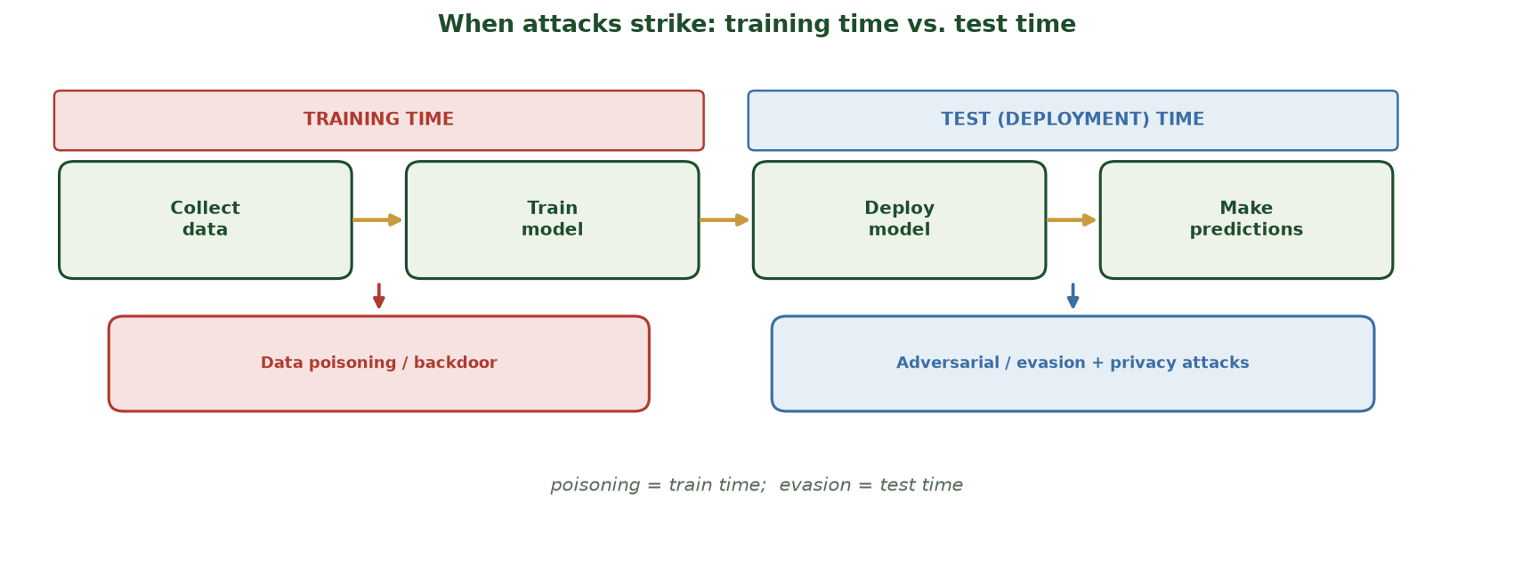
THE MOST-TESTED WEEK-10 DISTINCTION
Training Time vs. Test Time
Along the ML lifecycle: data poisoning & backdoors strike at TRAINING time; adversarial/evasion and privacy attacks strike at TEST (deployment) time - poisoning = train, evasion = test.
CIS 350: AI for Cybersecurity · Monday
11
Notes:
Nail the single most-tested Week-10 idea with this timeline. Walk the lifecycle: collect -> train -> deploy -> predict. The PINK 'training time' banner covers collect/train - that's where DATA POISONING and backdoors live. The SKY 'test time' banner covers deploy/predict - that's where ADVERSARIAL/EVASION and privacy attacks live. The mantra to memorize: poisoning = train time; evasion = test time. This is a guaranteed MC/TF/short item - the mock question next checks it. ~2 min.

Slide 12
🧠 MOCK QUESTIONS · 5 MIN
Week 10
Answer aloud with a neighbor (cover notes):
MC: An adversarial example is (a) a big obvious edit (b) a tiny crafted change that flips the prediction (c) a backup (d) a firewall?
Short: How does poisoning differ from evasion (timing)?
Scenario: An attacker tweaks malware to evade your model - name the attack and one defense.
CIS 350: AI for Cybersecurity · Monday
12
Notes:
Run Week-10 mock questions. Answers: (b); poisoning=training time, evasion=test time; evasion/adversarial -> adversarial training, behavior/anomaly detection, low-confidence detection. Cold-call. ~5 min.

Slide 13
WEEK 11
Week 11 Recap - Prompt Injection & LLM Security
LLMs predict the next word and FOLLOW instructions in their input.
Prompt injection (OWASP LLM #1): attacker text overrides the app's rules.
Variants: direct, indirect (hidden in a document), jailbreak, prompt leakage.
Root cause: no wall between trusted instructions and untrusted data.
Defenses: input & output guardrails, least privilege, human oversight - layered.
Injection variants; root cause; guardrails & least privilege.
CIS 350: AI for Cybersecurity · Monday
13
Notes:
Rapid recall of Week 11. Stress the root cause and least privilege. Distinguish direct vs indirect - a likely exam item. ~5 min.

Slide 14
🧠 MOCK QUESTIONS · 5 MIN
Week 11
Answer aloud with a neighbor:
MC: Indirect prompt injection hides the attack in (a) the password (b) the GPU (c) content the LLM reads (d) the clock?
Short: Why isn't a strong system prompt enough to stop injection?
Scenario: An LLM assistant can read and send email - name one guardrail and one least-privilege step.
CIS 350: AI for Cybersecurity · Monday
14
Notes:
Run Week-11 mock questions. Answers: (c); the model can be talked past a prompt, so you need independent checks; guardrail = validate input/output, least privilege = draft-only, human approval to send. Cold-call. ~5 min.

Slide 15
WEEK 12
Week 12 Recap - Ethics, Bias, Fairness & Governance
A model can be accurate OVERALL yet unfair - disaggregate metrics BY GROUP.
Bias enters via data, model design (proxies), deployment, and feedback loops.
Fairness definitions (parity, equal opportunity, equalized odds) can CONFLICT.
Governance: GDPR, EU AI Act (risk tiers), US/sector rules; model cards & audits.
Mitigation: fix data, drop proxies, group-aware thresholds - then re-audit.
Per-group metrics; conflicting fairness definitions; governance.
CIS 350: AI for Cybersecurity · Monday
15
Notes:
Rapid recall of Week 12. Core lesson: overall accuracy hides per-group harm; disaggregate. Fairness definitions conflict (a choice, not a formula). ~5 min.

Slide 16
🧠 MOCK QUESTIONS · 5 MIN
Week 12
Answer aloud with a neighbor:
T/F: Removing the sensitive attribute guarantees a fair model.
Short: Why can a model be accurate overall but unfair? Name one fairness definition.
Scenario: Your flagger has a higher false-positive rate for one group - name a metric and a fix.
CIS 350: AI for Cybersecurity · Monday
16
Notes:
Run Week-12 mock questions. Answers: False (proxies reintroduce bias); overall accuracy averages groups and hides harm; definition e.g. demographic parity/equal opportunity; metric = per-group FPR, fix = drop proxy/relabel/group-aware threshold + re-audit. Cold-call. ~5 min.

Slide 17
WEEK 13
Week 13 Recap - Privacy in ML
Models can leak data; 'just remove names' is weak (re-identification).
Differential privacy: add calibrated noise; epsilon = privacy budget (smaller = more privacy).
Federated learning: data stays on-device; only model updates are shared.
Encrypted computation: compute on ciphertext - strong but slow.
Trade-offs: privacy vs. accuracy (epsilon); security vs. privacy (balance).
DP/epsilon, federated learning, encryption; the two trade-offs.
CIS 350: AI for Cybersecurity · Monday
17
Notes:
Rapid recall of Week 13. Reinforce epsilon direction (smaller = more privacy = less accuracy) and the two trade-offs. ~5 min.

Slide 18
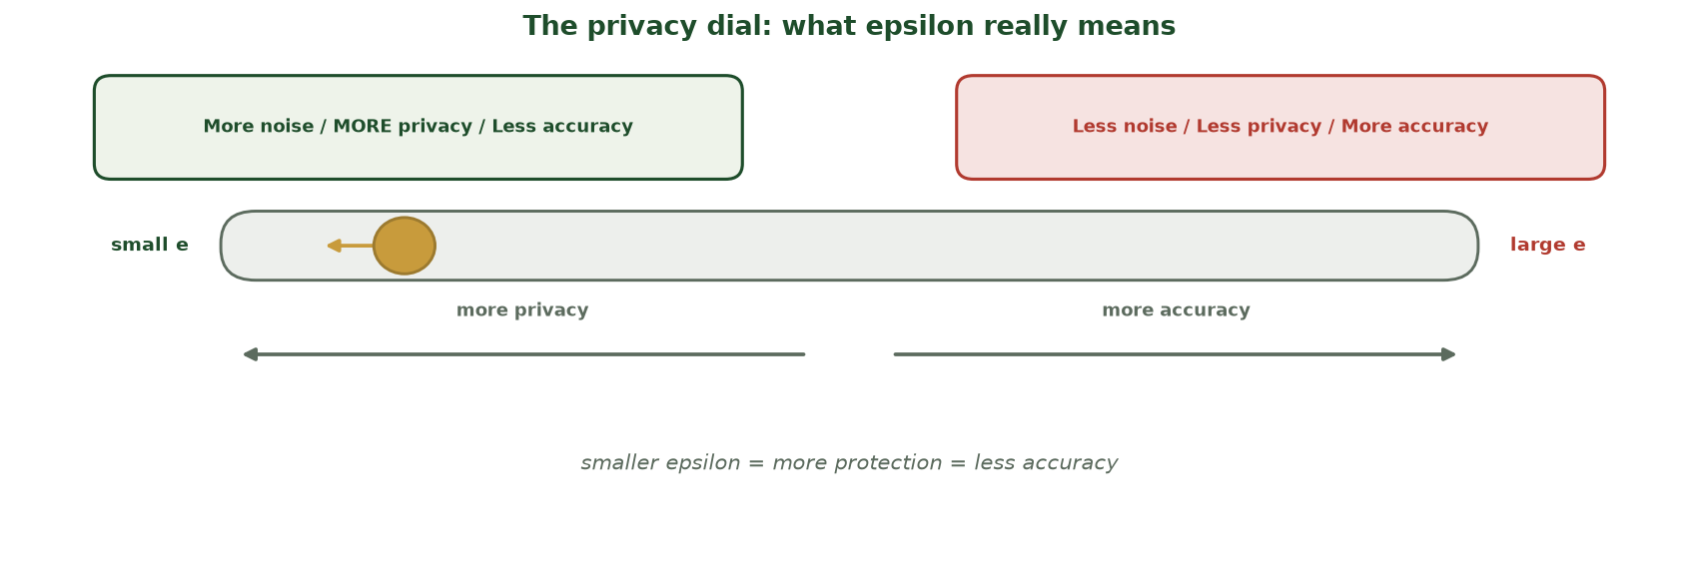
FIX THE TOP PRIVACY MISCONCEPTION
The Privacy Dial: What Epsilon Really Means
SMALLER epsilon = more noise = MORE privacy but LESS accuracy; larger epsilon is the reverse - the knob sits toward 'small e' for stronger protection.
CIS 350: AI for Cybersecurity · Monday
18
Notes:
Kill the most common privacy mix-up with the dial. Slide LEFT (small epsilon) = more noise = MORE privacy but LESS accuracy; slide RIGHT (large epsilon) = less noise, less privacy, more accuracy. Students routinely get the direction backwards, so say it out loud: SMALLER epsilon means MORE protection. This is a classic MC trap - the mock question next tests it. ~2 min.

Slide 19
🧠 MOCK QUESTIONS · 5 MIN
Week 13
Answer aloud with a neighbor:
MC: A SMALLER epsilon means (a) more privacy, less accuracy (b) less privacy (c) no effect (d) faster GPU?
Short: How does federated learning protect privacy?
Scenario: A cloud service must analyze data it may never see in the clear - which technique?
CIS 350: AI for Cybersecurity · Monday
19
Notes:
Run Week-13 mock questions. Answers: (a); federated keeps raw data on-device, shares only updates; encrypted computation. Cold-call. ~5 min.

Slide 20
PART 3 · MISCONCEPTIONS CLINIC · ~8 MIN
Fix the Common Mix-Ups
Notes:
Transition: 'These are the mistakes that cost the most points - let's kill them now.' ~8 minutes.

Slide 21
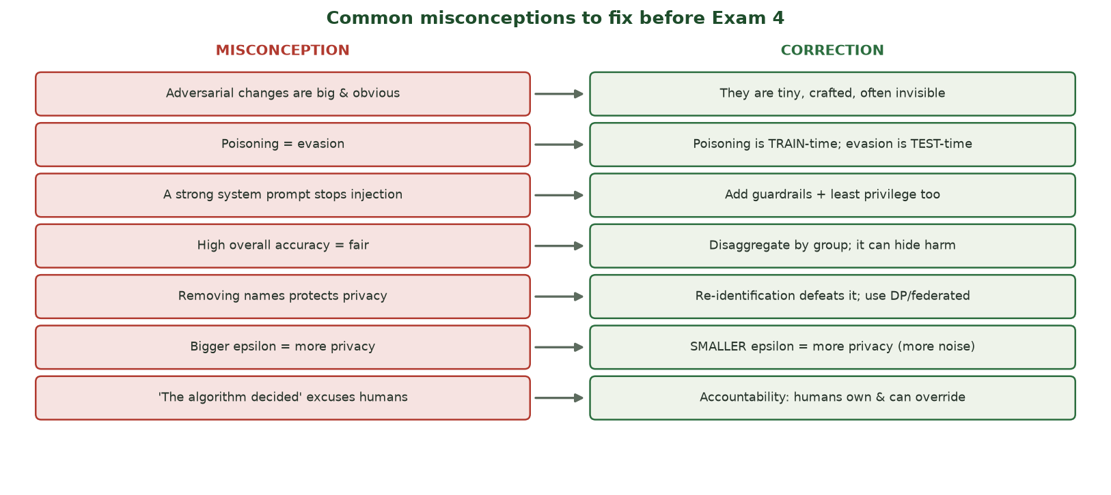
WRONG IDEA -> CORRECTION
Common Misconceptions to Fix
The most common exam mix-ups (left) and the corrections (right) - across Weeks 10-13.
CIS 350: AI for Cybersecurity · Monday
21
Notes:
Walk the misconceptions figure - each is a real point-loser. Read a few aloud and have students say the correction before you reveal it. These map to the exam's trickiest items. ~4 min.

Slide 22
🩹 ACTIVITY · 4 MIN
Correct the misconception
With a neighbor, correct each false statement:
'Poisoning and evasion are the same thing.'
'A high overall accuracy means the model is fair.'
'A bigger epsilon gives more privacy.'
CIS 350: AI for Cybersecurity · Monday
22
Notes:
Active correction. Answers: poisoning=train time, evasion=test time; overall accuracy hides per-group harm (disaggregate); SMALLER epsilon = more privacy. Cold-call and confirm. ~4 min.

Slide 23
🩹 IN-CLASS TASK · 12 MIN
Build Your Open-Notes Cheat Sheet (Weeks 10-13)
Exam 4 is open-notes - so build the note you'll actually use. Solo first (~8 min), then a 2-min peer swap: make a single-page, four-quadrant quick-reference card for Weeks 10-13.
Divide a page into 4 quadrants: W10 Attacks on ML, W11 Prompt Injection, W12 Fairness & Governance, W13 Privacy.
In each: the ONE core idea in your own words + 2-3 key terms with a one-line definition.
Add the make-or-break reminder per quadrant: poisoning=train/evasion=test (W10); 'no wall' + least privilege (W11); disaggregate by group (W12); smaller epsilon = more privacy (W13).
Add ONE attack->defense pair per quadrant; then swap with a neighbor (2 min), flag gaps, and fix yours.
CIS 350: AI for Cybersecurity · Monday
23
Notes:
The session's artifact - a real cheat sheet students can use on the open-notes exam. Circulate. Project a model card: W10 - adversarial example = a tiny crafted TEST-time change that flips a prediction (evasion) vs poisoning = corrupting TRAINING data; defense in depth / adversarial training / detection. W11 - injection overrides the app's rules because there's no wall between instructions and untrusted input, so a strong system prompt alone isn't enough - add guardrails + least privilege + human approval. W12 - a model can be accurate OVERALL yet unfair -> disaggregate by group; fix via drop proxies / group-aware threshold / re-audit; fairness definitions can conflict. W13 - differential privacy adds calibrated noise (smaller epsilon = more privacy, less accuracy); federated learning keeps raw data on-device. Emphasize: a well-organized card is a legitimate open-notes advantage, and the gaps found in the swap are exactly what to study next. ~12 min.

Slide 24
Key Takeaways
✓
Exam 4 is Weeks 10-16, online, open-notes, 100 points across MC/TF/short/scenarios - scenarios reward synthesis.
✓
Weeks 10-13 in one line each: attacks on ML; prompt injection; fairness by group; privacy trade-offs.
✓
Study by ACTIVE recall + timed practice; organize your notes by week (it's open-notes).
✓
Fix the misconceptions: poisoning vs. evasion, accuracy vs. fairness, and the epsilon direction.
Notes:
Recap the essentials. Cold-call one mock question from a shaky topic. Preview Wednesday: Weeks 14-15 and a full mock-exam walkthrough by question type. ~3 min.

Slide 25
WHAT'S NEXT
Looking Ahead: Wednesday & Exam 4
📊 Wednesday: deep review of Weeks 14-15 + a mock-exam walkthrough by question type.
📄 Use the Exam 4 Study Guide and Practice Exam (posted in Canvas) this week.
🧭 Exam 4 is in Week 17 (final-exam window): Weeks 10-16, open-notes, individual.
🧾 Bring your organized notes and your remaining questions on Wednesday.
💪 You've prepared for three exams already - this is the same drill.
Wed = 14-15 review + mock exam; Exam 4 in Week 17.
CIS 350: AI for Cybersecurity · Monday
25
Notes:
Assign and preview. Point to the Study Guide/Practice Exam. Wednesday finishes the review. Encourage students to come with questions. ~2 min.

Slide 26
🎯 EXIT TICKET · 2 MIN
One minute before you go
On a card or the Canvas exit ticket:
One topic from Weeks 10-13 you now feel solid on.
One you still want reviewed Wednesday.
One misconception you cleared up today.
CIS 350: AI for Cybersecurity · Monday
26
Notes:
Close with an exit ticket that feeds Wednesday's review list. ~2 min.

Slide 27
SOURCES & STUDY RESOURCES
References & Further Reading
  Exam 4 Study Guide and Practice Exam (posted in Canvas).
  Handouts 8-13 and the Weeks 10-15 lecture decks.
  NIST AI RMF 1.0 (2023); OWASP Top 10 for LLM Applications; MITRE ATLAS.
  'Fairness and Machine Learning' (fairmlbook.org); EU AI Act (2024).
  C. Dwork & A. Roth (differential privacy, 2014); NIST SP 800-61 (incident handling).
CIS 350: AI for Cybersecurity · Monday
27
Notes:
Appendix slide: study resources. Post to Canvas or leave visible during the exit ticket - it is not part of the timed session. The Exam 4 Study Guide and Practice Exam are the highest-value prep.

