Slide 1

WEEK 15 · WEDNESDAY · 75 MINUTES
Course Synthesis, Review & Exam-4 Prep
How It All Connects · Exam 4 (Weeks 10-16) · Careers & Q&A
CIS 350: AI for Cybersecurity — Smart Defense for the Digital Business
Ramadan Abdunabi, Ph.D. · Computer Information Systems
Notes:
Open with pride and purpose: 'Look how far you've come - from what a firewall is to defending AI systems and making them trustworthy. Today we connect it all and get you ready for Exam 4.' Keep the energy celebratory but focused. Note Exam 4 (Weeks 10-16) is Week 17; Week 16 is dedicated Q&A. Reach Part 1 by ~minute 8. ~1 min.

Slide 2

🔁 WARM-UP · 5 MIN
Brain-dump the course
With a neighbor, no notes for 3 minutes:
List the biggest ideas you remember from the whole course.
Circle the ONE you feel most confident teaching a friend.
Underline one you want reviewed for Exam 4.
CIS 350: AI for Cybersecurity · Wednesday
2
Notes:
Start with retrieval across the whole course. Pairs brain-dump 3 min; poll for confident vs. shaky topics and note the shaky ones for the review. This primes synthesis and surfaces exam-prep gaps. ~5 min.

Slide 3
WEDNESDAY · 75 MINUTES
Today's Plan
🔁
Warm-up brain-dump
Recall the whole course
8 min
🧩
Course synthesis
The four units as one arc
20 min
🧭
Exam 4 prep (Weeks 10-16)
Coverage, high-yield, strategy
20 min
🎓
Careers, Q&A & next steps
Your skills and what's next
9 min
✍️
In-class task
Author an Exam-4 applied scenario
12 min
🎯
Wrap & exit
Quiz 12; Week 16 & Exam 4
6 min
CIS 350: AI for Cybersecurity · Wednesday
3
Notes:
Walk the plan; the row minutes add up to exactly 75. Synthesis first, then focused Exam-4 prep, then careers and open Q&A. ~1 min.

Slide 4
SYNTHESIS, REVIEW & EXAM PREP
Today's Goals
1
Synthesize the course into one connected arc.
2
Identify the recurring through-lines that tie the weeks together.
3
Know what Exam 4 covers and how to study efficiently.
4
See your new skills and concrete next steps.
CIS 350: AI for Cybersecurity · Wednesday
4
Notes:
State the goals. Emphasize that connecting ideas (not memorizing) is what Exam 4's applied scenarios reward - so synthesis IS exam prep. ~1 min.

Slide 5
PART 1 · COURSE SYNTHESIS · ~20 MIN
The Four Units as One Story
Notes:
Transition: 'Let's see the whole map at once.' ~24 minutes with a figure and an activity.

Slide 6
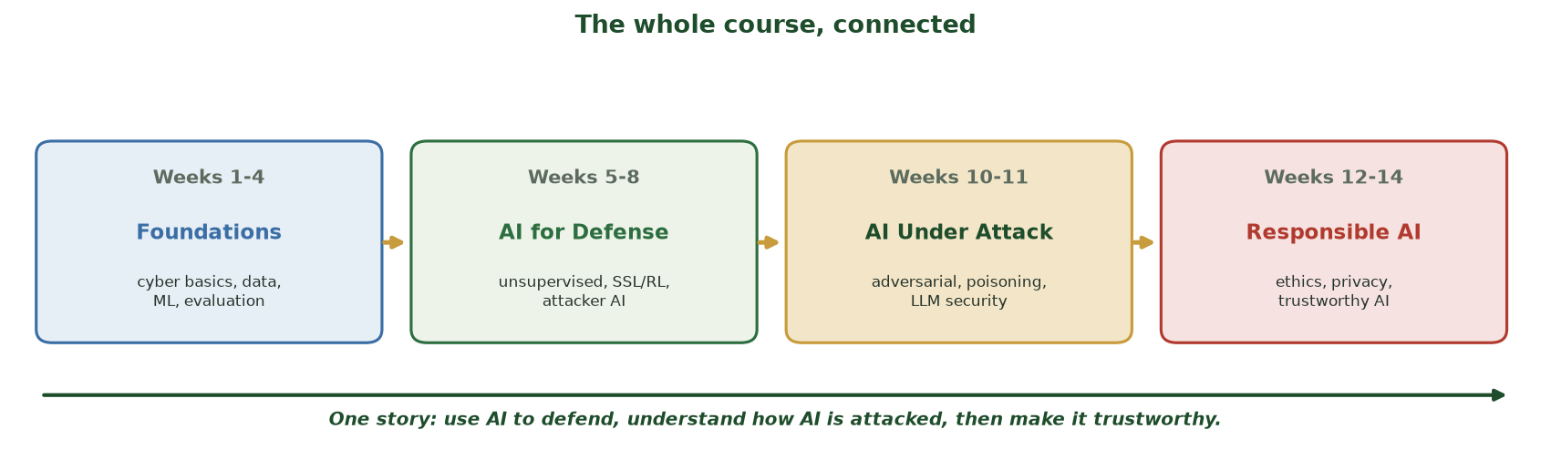
FOUR UNITS, ONE ARC
The Whole Course, Connected
Foundations (1-4) -> AI for defense (5-8) -> AI under attack (10-11) -> responsible AI (12-14).
CIS 350: AI for Cybersecurity · Wednesday
6
Notes:
Walk the course map - the big picture. Four units tell one story: learn the foundations, use AI to defend, understand how AI itself is attacked, then make AI trustworthy. Students often learn weeks in isolation; this slide is where it clicks into a whole. ~4 min.

Slide 7
THE ARC
The Four Units, in One Arc
Foundations (Wks 1-4): cyber basics, data, supervised ML, evaluation.
AI for defense (Wks 5-8): clustering, anomaly detection, SSL/RL, and attacker AI.
AI under attack (Wks 10-11): adversarial examples, poisoning, LLM/prompt-injection security.
Responsible AI (Wks 12-14): ethics & fairness, privacy, trustworthy AI + incident response.
Advanced/future (Wk 15): techniques and threats on the horizon.
Foundations -> defense -> attacks on AI -> responsible AI -> the future.
CIS 350: AI for Cybersecurity · Wednesday
7
Notes:
Give the narrative version of the map, one line per unit. Reinforce the progression: each unit assumed the last. This is the mental table of contents students should carry into Exam 4. ~5 min.

Slide 8
WHAT TIES IT TOGETHER
Recurring Through-Lines
Defense in depth: no single control is enough - layer them (every unit).
Keep a human in the loop for high-impact decisions (Wks 7, 8, 10, 14).
Every technique has trade-offs (accuracy/privacy/fairness/security).
Match the tool to the problem - and the metric to the harm.
Trust is designed in and documented - not bolted on (Wks 12-14).
Defense in depth, human oversight, trade-offs, matching, trust.
CIS 350: AI for Cybersecurity · Wednesday
8
Notes:
This is the highest-value synthesis slide. These through-lines recur across the whole course and are exactly what Exam-4 scenarios test. If students can reason from these five principles, they can handle any applied question. Have them note which weeks each shows up in. ~5 min.

Slide 9
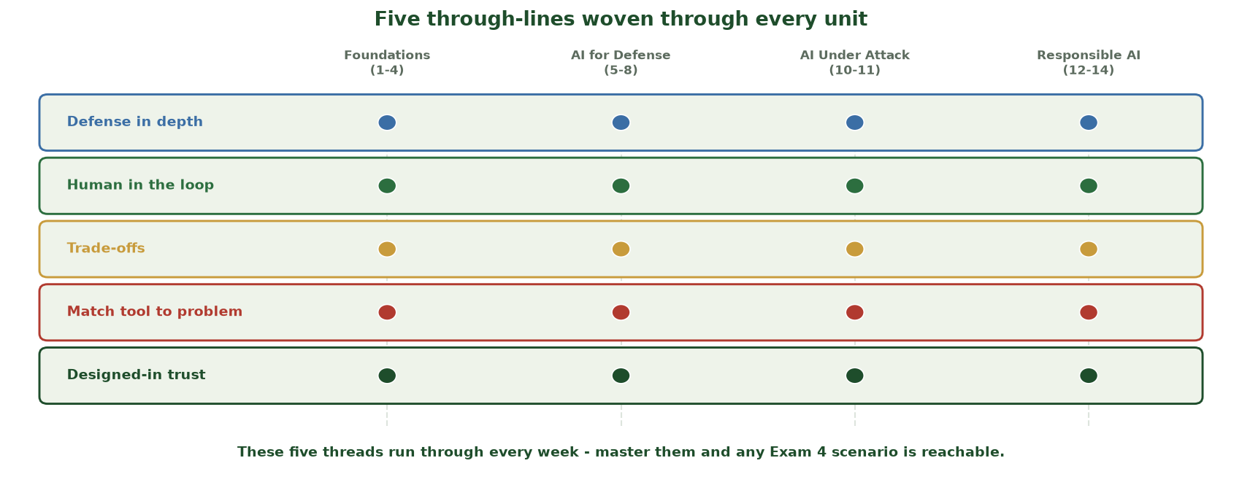
THE PRINCIPLES THAT CUT ACROSS THE COURSE
Five Through-Lines Woven Through Every Unit
Five threads - defense in depth, human in the loop, trade-offs, match tool to problem, designed-in trust - run through all four units, so Exam 4 rewards connecting ideas, not memorizing isolated facts.
CIS 350: AI for Cybersecurity · Wednesday
9
Notes:
Make the through-lines visual. Each colored bar is one principle; the dots show it TOUCHES every unit (foundations, AI for defense, AI under attack, responsible AI). Read one across: 'defense in depth' shows up as layered controls in every single unit. The message for Exam 4: if a scenario stumps you, pick a through-line and reason from it - these five are the scaffold that makes any applied question reachable. This is the highest-yield synthesis slide. ~2 min.

Slide 10
THE WHOLE COURSE, DISTILLED
The Story in One Sentence
'Use AI to defend systems, understand how AI itself can be attacked and biased,
then build AI that is robust, fair, private, and trustworthy - with humans accountable.'
Every week was a chapter in that sentence.
Business framing: trustworthy AI is what makes AI deployable and defensible.
You can now reason about AI + security in any business setting.
Defend with AI; secure the AI; make it trustworthy.
CIS 350: AI for Cybersecurity · Wednesday
10
Notes:
Give students a single sentence that captures the course - a memory hook and a confidence builder. Tie to the business value (the course's promise). Pause and let it land. ~4 min.

Slide 11
🧩 ACTIVITY · 6 MIN
Connect two concepts
With a neighbor, pick TWO concepts from DIFFERENT weeks and explain how they connect:
e.g., anomaly detection (Wk 6) + AI malware (Wk 15).
e.g., differential privacy (Wk 13) + federated learning (Wk 15).
Share your connection with the class.
CIS 350: AI for Cybersecurity · Wednesday
11
Notes:
Active synthesis - the best exam prep. Circulate and surface strong connections (e.g., poisoning Wk10 + data provenance Wk12; explainability Wk14 + incident response Wk14). Reward cross-unit links. Cold-call a few pairs. ~6 min.

Slide 12
PART 2 · EXAM 4 PREP (WEEKS 10-16) · ~20 MIN
Coverage, High-Yield Concepts & Strategy
Notes:
Transition: 'Now, exactly how to prepare for the final.' ~24 minutes with a figure and a self-test.

Slide 13
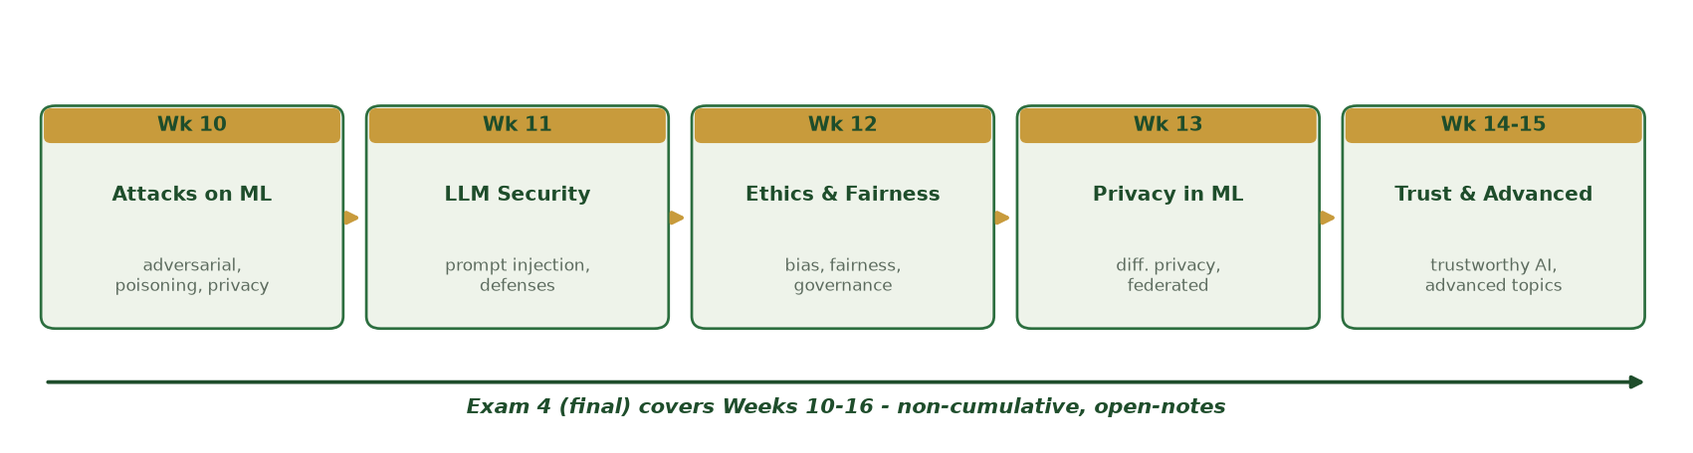
WEEKS 10-16, NON-CUMULATIVE
What Exam 4 Covers
Attacks on ML (10), LLM security (11), ethics & fairness (12), privacy (13), trust & advanced (14-15).
CIS 350: AI for Cybersecurity · Wednesday
13
Notes:
Walk the Exam 4 roadmap. It's non-cumulative: Weeks 10-16 only (Week 16 is Q&A, so effectively 10-15). It draws roughly evenly across these weeks. Tell students the format next. ~4 min.

Slide 14
EXAM 4 FORMAT
Exam 4 Format & Rules
Non-cumulative: Weeks 10-16 (effectively 10-15 content).
Format: multiple-choice, true/false, short-answer, and brief applied scenarios.
Open-notes; no heavy math, no coding. Individual - no collaboration, no AI.
Applied scenarios reward CONNECTING ideas across weeks (Part 1's through-lines).
Administered in Week 17 during the university's final-exam window.
Weeks 10-16; MC/TF/short/scenarios; open-notes, individual, no AI.
CIS 350: AI for Cybersecurity · Wednesday
14
Notes:
State the format precisely (mirrors Exams 1-3). Stress the integrity rules and that scenarios reward synthesis. Note it's during finals week per the registrar. ~4 min.

Slide 15
STUDY THESE COLD
High-Yield Concepts by Week (10-15)
Wk 10: adversarial vs. poisoning (timing); privacy attacks; defense in depth.
Wk 11: prompt injection (direct/indirect); why prompts aren't enough; least privilege.
Wk 12: overall accuracy hides per-group harm; fairness definitions conflict; governance.
Wk 13: differential privacy & epsilon; federated learning; privacy vs. accuracy.
Wk 14-15: the four trust pillars; IR lifecycle; transfer/few-shot; emerging threats.
One high-yield idea per week - know these solidly.
CIS 350: AI for Cybersecurity · Wednesday
15
Notes:
Give the concentrated study list - the single most-tested idea per week. Tell students if they know these cold and can apply them, they're ready. This slide is worth photographing. ~6 min.

Slide 16
HOW TO STUDY
Study Strategy (Smart, Not Long)
Use the Handouts (8-13) and each week's takeaways as your spine.
ACTIVE recall: cover the answer and retrieve it; redo self-check questions.
Practice APPLYING to new scenarios (that's where the points are).
An Exam 4 Study Guide & Practice Exam will be posted for Week 16's review.
It's open-notes - organize your notes now so you can find things fast.
Active recall + apply to scenarios; org your notes (open-notes exam).
CIS 350: AI for Cybersecurity · Wednesday
16
Notes:
Give an evidence-based plan (active recall + application beat rereading). Point to the handouts and the upcoming Exam 4 Study Guide/Practice (Week 16). Practical tip: since it's open-notes, a well-organized note set is a real advantage - build it now. ~4 min.

Slide 17
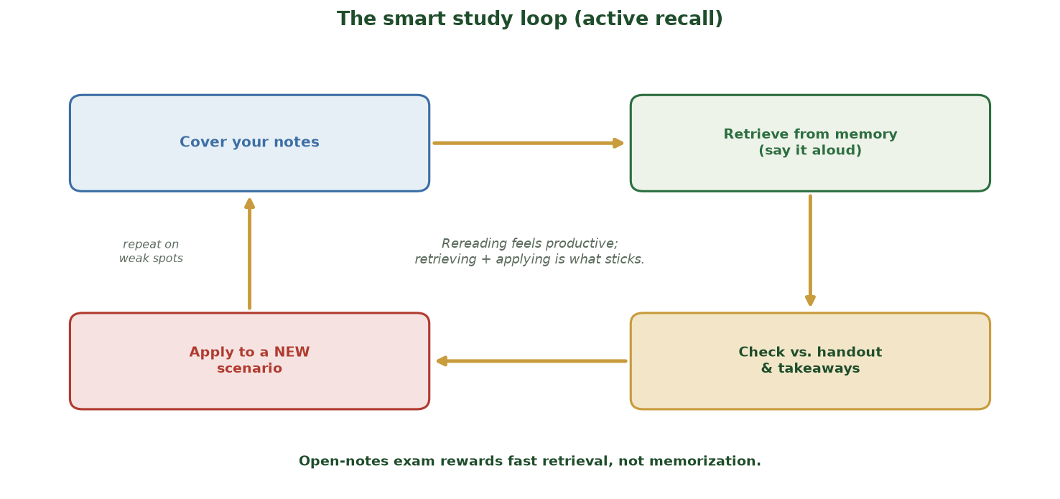
RETRIEVE AND APPLY, DON'T REREAD
The Smart Study Loop (Active Recall)
Cover your notes -> retrieve from memory (say it aloud) -> check vs. the handout & takeaways -> apply to a NEW scenario -> repeat on weak spots. Rereading feels productive; retrieving + applying is what sticks.
CIS 350: AI for Cybersecurity · Wednesday
17
Notes:
Give students a concrete study method, not just 'study more.' Walk the clockwise loop: COVER your notes, RETRIEVE the idea from memory (out loud), CHECK against the handout/takeaways, then APPLY it to a NEW scenario - and loop back on whatever was weak. The center line is the evidence: rereading feels productive but retrieval + application is what actually sticks, and the open-notes exam rewards fast retrieval, not memorization. This is exactly what the next self-test and the scenario task practice. ~2 min.

Slide 18
🧭 RAPID SELF-TEST · 6 MIN
Can you answer these?
Cover your notes. With a neighbor, answer aloud:
Poisoning vs. evasion - when does each happen?
Why isn't a strong system prompt enough against injection?
What does epsilon control, and which way is more private?
Name two trustworthy-AI pillars and the IR lifecycle phases.
CIS 350: AI for Cybersecurity · Wednesday
18
Notes:
Run a rapid retrieval self-test across the unit - the most effective prep. Answers: poisoning=train time, evasion=test time; the model can be talked past a prompt (need guardrails/least privilege); epsilon = privacy budget, smaller=more private; pillars (transparency/explainability/robustness/accountability) + IR (prepare/detect&analyze/contain-eradicate-recover/post-incident). Flag any the room struggles with for Week 16. ~6 min.

Slide 19
PART 3 · CAREERS, Q&A & NEXT STEPS · ~9 MIN
Your Skills and What Comes After
Notes:
Transition: 'Before we close, what you can now do - and where to take it.' ~11 minutes.

Slide 20
YOUR NEW SKILLS
What You Can Now Do
Explain, in business terms, how AI helps defenders and how AI is attacked.
Build and evaluate simple ML models, and read their metrics and explanations.
Reason about fairness, privacy, and trustworthy-AI trade-offs.
Respond to an AI incident and use governance frameworks (NIST, OWASP).
Portfolio proof: 12 labs, a CTF, and a tabletop exercise.
You can reason about AI + security in any business setting.
CIS 350: AI for Cybersecurity · Wednesday
20
Notes:
Celebrate concrete capabilities - many students undervalue what they've learned. Connect each to something they DID (a lab, the CTF, the tabletop). This builds confidence heading into the exam and into interviews. ~4 min.

Slide 21
WHERE TO GO NEXT
Careers & Staying Current
Roles: security analyst, AI/ML security engineer, AI governance/GRC, risk & audit.
Talk about your labs and the tabletop in interviews - they're real experience.
Follow NIST, CISA, OWASP, and MITRE ATLAS; read annual threat reports.
Keep hands-on: CTFs, Kaggle, open datasets, reproduce a paper.
Fundamentals + curiosity + ethics travel with you as tools change.
Concrete roles; follow NIST/CISA/OWASP; keep practicing.
CIS 350: AI for Cybersecurity · Wednesday
21
Notes:
Give a credible, encouraging path forward. Emphasize the durable combination (fundamentals + curiosity + ethics). Keep it brief and warm. ~4 min.

Slide 22
🎓 OPEN Q&A · 3 MIN
Ask anything
Open floor (use your brain-dump 'review' list):
Any concept from the course you want re-explained?
Any question about Exam 4 or Week 16?
Any career or 'what next' question?
CIS 350: AI for Cybersecurity · Wednesday
22
Notes:
Open Q&A targeted at the gaps surfaced in the warm-up. Re-explain the top one or two requests. Capture anything you can't cover for the Week 16 review. ~3 min.

Slide 23
✍️ IN-CLASS TASK · 12 MIN
Author an Exam-4 Applied Scenario
Exam 4's applied scenarios reward CONNECTING weeks - so the best prep is to build one. In pairs, write a realistic scenario spanning at least two weeks (10-15), pose an applied question, and write the model answer keyed to the five through-lines. Then swap with another pair and answer theirs cold.
Choose TWO concepts from DIFFERENT weeks (10-15) and one business setting (bank, hospital, SaaS, gov).
Write a 3-4 sentence scenario ending in one applied question ('What would you recommend and why?').
Write your model answer: name at least TWO through-lines and the key trade-off.
Swap cards with another pair, answer theirs cold (~3 min), then compare to their model answer and mark one thing you missed.
CIS 350: AI for Cybersecurity · Wednesday
23
Notes:
The final applied rehearsal - authoring a scenario forces exactly the synthesis Exam 4 tests, and swapping gives a cold-answer rep. Model card - Scenario: three hospitals want to jointly train a fraud-detection model but worry about patient privacy and about one partner secretly poisoning the shared model; what do you recommend? Model answer: use FEDERATED LEARNING so raw data stays local (Wk 13) + DIFFERENTIAL PRIVACY on the shared updates (Wk 13) - trade-off = privacy vs. accuracy; defend the malicious partner with update vetting / robust aggregation + monitoring (Wk 10, defense in depth); keep a human in the loop to review flagged claims; document under a governance framework (Wk 12/14, designed-in trust). Through-lines used: defense in depth, trade-offs, human oversight, designed-in trust. Emphasize that explicitly NAMING the through-lines and the trade-off is what earns scenario points on Exam 4. Collect the cards to seed the Week 16 review question bank. ~12 min.

Slide 24
USE THESE SLIDES AS YOUR STUDY GUIDE
This Week: Quiz 12 & the Road to Exam 4
📝 For Quiz 12, master...
🧭 Road to Exam 4...
Transfer, few-shot, and federated learning.
Emerging threats and the arms race.
How this week connects back to Weeks 10-13.
The recurring through-lines of the course.
Week 16: dedicated Q&A and review (Weeks 10-16).
Exam 4 Study Guide & Practice posted for Week 16.
Exam 4 (open-notes) in Week 17, during finals week.
Organize your notes now - it's open-notes.
CIS 350: AI for Cybersecurity · Wednesday
24
Notes:
Tie the session to Quiz 12 and the exam runway. Left = Quiz 12; right = the path to Exam 4. Remind that Week 16 is review and Exam 4 is Week 17. ~2 min.

Slide 25
Key Takeaways
✓
The course is one arc: foundations -> AI for defense -> AI under attack -> responsible AI -> the future.
✓
Five through-lines tie it together: defense in depth, human oversight, trade-offs, matching tool-to-problem, and designed-in trust.
✓
Exam 4 is non-cumulative (Weeks 10-16), open-notes, and rewards CONNECTING ideas - study by active recall and application.
✓
You have real, demonstrable skills: 12 labs, a CTF, and a tabletop - and the fundamentals to keep learning.
Notes:
Recap the synthesis and the exam plan. Cold-call: 'Name one through-line and a week it appears in.' End on confidence: they're ready to keep going. ~2 min.

Slide 26
WHAT'S NEXT
Looking Ahead: Quiz 12, Week 16 & Exam 4
📝 Finish Quiz 12 (online) and submit the Lab 12 tabletop write-up this week.
🗓️ Week 16: dedicated Q&A, common misconceptions, and mock questions.
📄 Exam 4 Study Guide & Practice Exam will be posted for Week 16.
🧭 Exam 4 (Weeks 10-16, open-notes) is in Week 17 during finals week.
🙌 Great work this term - come to Week 16 with your questions ready.
Quiz 12 & Lab 12 now; Week 16 = review; Exam 4 in Week 17.
CIS 350: AI for Cybersecurity · Wednesday
26
Notes:
Assign and preview. Quiz 12 and the Lab 12 write-up are due this week. Week 16 is the review; the Exam 4 study aids come then. Warm, encouraging close. ~2 min.

Slide 27
🎯 EXIT TICKET · 2 MIN
One minute before you go
On a card or the Canvas exit ticket:
One concept you now feel confident about.
One concept you want reviewed in Week 16.
One thing from this course you'll use beyond the exam.
CIS 350: AI for Cybersecurity · Wednesday
27
Notes:
Close with a reflective exit ticket that also feeds the Week 16 review list. End the term's new content on a high, forward-looking note. ~2 min.

Slide 28
SOURCES & FURTHER READING
References & Further Reading
  Course Handouts 1-13 and the Weeks 10-15 lecture decks.
  NIST AI RMF 1.0 (2023); OWASP Top 10 for LLM Applications; MITRE ATLAS.
  'Fairness and Machine Learning' (fairmlbook.org); the EU AI Act (2024).
  C. Dwork & A. Roth (differential privacy, 2014); NIST SP 800-61 (incident handling).
  Chio & Freeman, 'Machine Learning and Security' (O'Reilly).
CIS 350: AI for Cybersecurity · Wednesday
28
Notes:
Appendix slide: references and further reading. Post to Canvas or leave visible during the exit ticket - it is not part of the timed session.

