Slide 1

WEEK 15 · MONDAY · 75 MINUTES
Advanced Topics & Emerging Threats
Transfer & Few-Shot Learning · AI-Enabled Threats · The Future
CIS 350: AI for Cybersecurity — Smart Defense for the Digital Business
Ramadan Abdunabi, Ph.D. · Computer Information Systems
Notes:
Open with momentum: 'You've built real AI-security skills. Today we look at the cutting edge - advanced techniques used in practice, the threats coming next, and where the field is headed.' Note Lab 12 (the tabletop) is DUE this week and Quiz 12 is online this week. This is the last new-content week (Week 16 is review; Exam 4 is Week 17). Reach Part 1 by ~minute 8. ~1 min.

Slide 2

🔁 WARM-UP · 5 MIN
Scarce labels, real threats
With a neighbor, one sentence each:
Across the course, what made ML hard in security? (hint: labels)
Name one way you think attackers will USE AI next.
What skill from this course do you think will matter most in five years?
CIS 350: AI for Cybersecurity · Monday
2
Notes:
Activate prior learning and set up today. Pairs 2 min, cold-call 2-3. Expected: 'labels are scarce/expensive' (the recurring pain), 'AI writes malware / deepfakes / automated attacks,' and skills like 'thinking about defense in depth' or 'spotting bias.' Bridge: advanced techniques tackle the label problem; emerging threats are the next frontier. ~5 min.

Slide 3
MONDAY · 75 MINUTES
Today's Plan
🔁
Warm-up & why this matters
Cutting edge, still grounded
8 min
🚀
Advanced ML techniques
Transfer, few-shot, federated
22 min
⚠️
Emerging threats & the arms race
AI malware, poisoning at scale
18 min
🔮
The future of AI + cybersecurity
What's coming; careers
10 min
🧩
In-class task
Emerging-threat defense card
12 min
🎯
Wrap & exit
Takeaways; Quiz 12
5 min
CIS 350: AI for Cybersecurity · Monday
3
Notes:
Walk the plan; the row minutes add up to exactly 75. Today: advanced techniques (with a real demo), emerging threats, and the future. ~1 min.

Slide 4
ADVANCED TOPICS & EMERGING THREATS
Today's Objectives
1
Describe transfer, few-shot, and federated learning and their security uses.
2
Explain why these help when labeled data is scarce (with a real learning curve).
3
Identify emerging AI-enabled threats and the attacker-defender arms race.
4
Discuss the future of AI + cybersecurity and how to stay current.
CIS 350: AI for Cybersecurity · Monday
4
Notes:
State the four goals. Note this is Exam-4 material and builds directly on federated learning (Week 13) and attacks (Weeks 8, 10). Objective 2 is the hands-on insight - a real learning curve. ~1 min.

Slide 5
PART 1 · ADVANCED ML TECHNIQUES · ~22 MIN
Transfer, Few-Shot & Federated Learning
Notes:
Transition: 'These techniques exist because of a problem you've felt all semester - labels are scarce.' ~24 minutes with a real figure and an activity.

Slide 6
THE MOTIVATION
Why Advanced Techniques? Labels Are Scarce
Recurring theme: in security you have LOTS of data but FEW labels.
Labeling attacks is slow, expensive, and needs experts.
Attacks are also NEW - you may have zero examples of tomorrow's threat.
Advanced techniques squeeze more out of few labels (or none).
Today: transfer learning, few-shot learning, and federated learning.
Lots of data, few labels - advanced methods bridge the gap.
CIS 350: AI for Cybersecurity · Monday
6
Notes:
Motivate the whole part with the label-scarcity problem students already know (from SSL in Week 7, anomaly detection in Week 6). Frame these three techniques as different answers to 'how do I learn with few/no labels?' Explain the 'why' before the 'how.' ~4 min.

Slide 7
TECHNIQUE 1
Transfer Learning: Stand on a Pretrained Model
Start from a model already trained on a HUGE general task.
FINE-TUNE it on your small, specific security dataset.
It reuses general 'knowledge,' so you need far less of your own data.
Everyday analogy: a trained analyst learns YOUR network faster than a novice.
Security use: adapt a big language/vision model to phishing or malware detection.
Transfer = reuse a pretrained model, fine-tune on your small data.
CIS 350: AI for Cybersecurity · Monday
7
Notes:
Define transfer learning with the analyst analogy (a trained professional ramps up fast). Keep it intuitive - no architecture detail. The key idea: a pretrained model already learned useful general features, so your small dataset goes much further. The next figure proves it with real numbers. ~4 min.

Slide 8
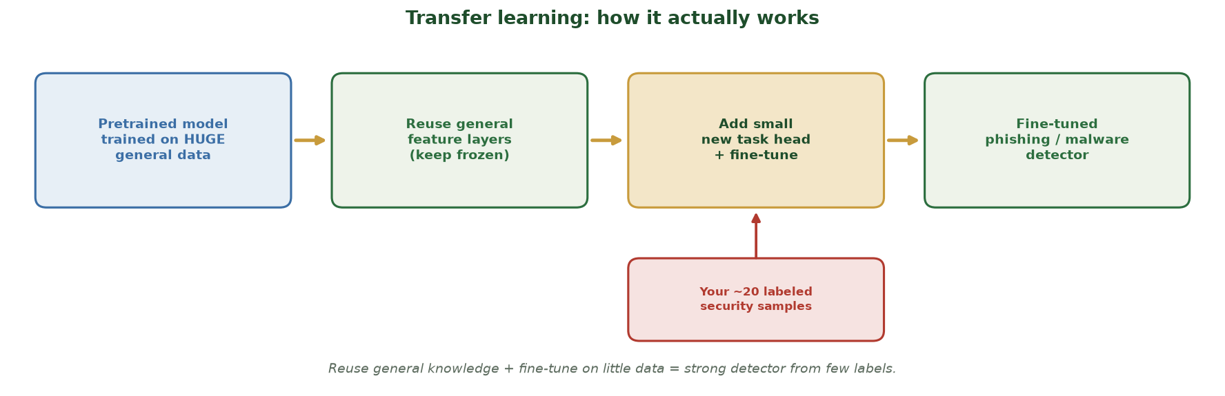
REUSE GENERAL KNOWLEDGE, FINE-TUNE ON A LITTLE DATA
Transfer Learning: How It Actually Works
Start from a model pretrained on HUGE general data -> reuse its general feature layers (frozen) -> add a small task head and fine-tune on your ~20 labeled security samples -> a working phishing/malware detector.
CIS 350: AI for Cybersecurity · Monday
8
Notes:
Show the MECHANISM before the numbers. Trace the pipeline: (1) a big pretrained model already learned general features from massive data; (2) you REUSE (freeze) those feature layers; (3) you add a small new 'head' and fine-tune it using just your handful of labeled security samples (the red callout feeding in); (4) out comes a strong detector. The point: you're standing on the pretrained model's knowledge, so a tiny labeled set goes a long way - which the real learning curve on the next slide quantifies (~20 labels matching ~640 from scratch). ~2 min.

Slide 9
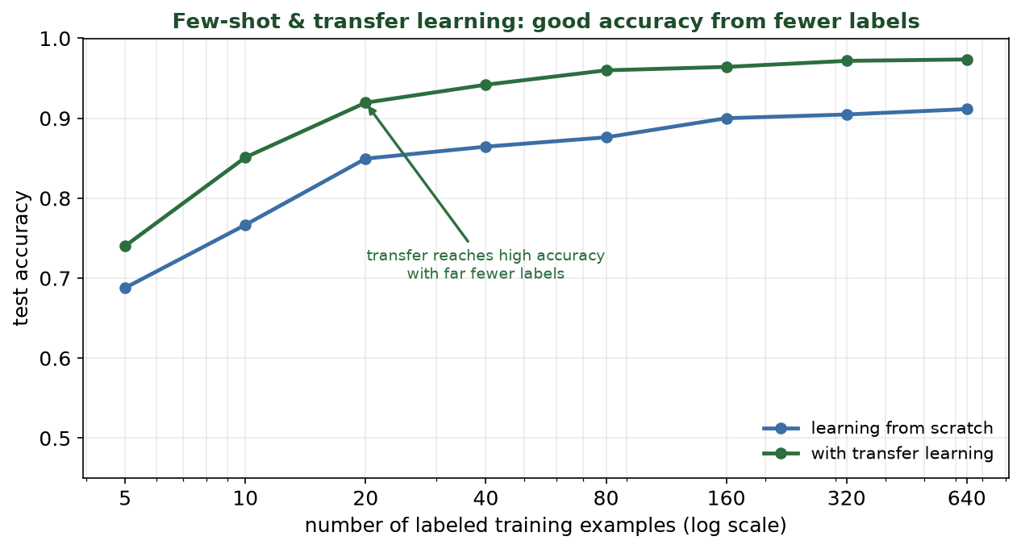
A REAL LEARNING CURVE
Transfer & Few-Shot: Good Accuracy From Fewer Labels
With transfer, ~20 labels reach ~0.92 accuracy - matching 'from scratch' with ~640 labels (about 30x fewer).
CIS 350: AI for Cybersecurity · Monday
9
Notes:
Walk the REAL learning curve. X-axis = number of labeled examples (log scale); Y = test accuracy. The green (transfer) line sits above blue (from scratch) everywhere, especially at small sizes. Punchline: transfer reaches ~0.92 with just ~20 labels - the same accuracy 'from scratch' needs ~640 labels for. That ~30x label savings is exactly why transfer/few-shot matter in security. ~5 min.

Slide 10
TECHNIQUE 2
Few-Shot Learning: Learn From a Handful
Goal: recognize a NEW class/threat from just a few labeled examples.
Often built ON transfer learning (a strong pretrained base makes few-shot possible).
Extreme case - zero-shot: describe the threat in words, no examples.
Security use: flag a brand-new scam type after seeing 3-5 samples.
Trade-off: fewer labels means more reliance on the pretrained model's quality.
Few-shot = learn a new threat from a handful of examples.
CIS 350: AI for Cybersecurity · Monday
10
Notes:
Define few-shot as the small-n extreme, enabled by transfer. Mention zero-shot briefly (describe, don't demonstrate) since students meet it via LLMs. Security relevance: novel threats appear with few examples, so few-shot is directly useful. Note the honest trade-off. ~4 min.

Slide 11
TECHNIQUE 3
Federated Learning in Security (Recall Week 13)
Train a shared model across many orgs/devices WITHOUT sharing raw data.
Each site trains locally; only model updates are combined.
Security use: banks jointly detect fraud patterns without exposing customers.
Bonus: more diverse data than any one org has - better coverage of attacks.
Often paired with differential privacy for stronger protection.
Federated = shared model, private data (Week 13) - great for cross-org defense.
CIS 350: AI for Cybersecurity · Monday
11
Notes:
Reconnect to Week 13's federated learning, now framed as an advanced technique for collaborative defense. The security angle: organizations that can't share data (competitors, privacy law) can still pool threat knowledge via a shared model - powerful against attacks no single org sees enough of. ~3 min.

Slide 12
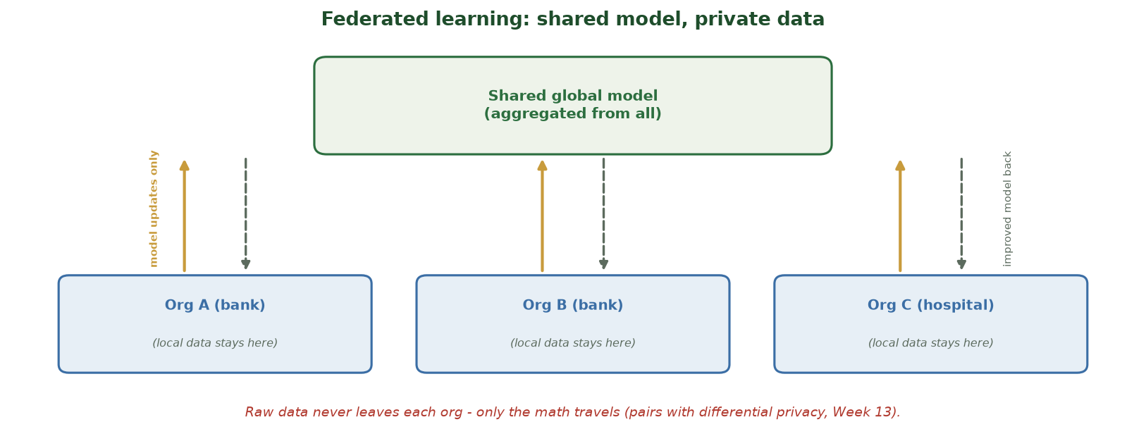
ONLY THE MATH TRAVELS, NOT THE DATA
Federated Learning: Shared Model, Private Data
Each org (banks, a hospital) trains on its LOCAL data and sends only model updates up to a shared global model; the improved model comes back down. Raw data never leaves any org.
CIS 350: AI for Cybersecurity · Monday
12
Notes:
Reinforce federated learning visually (recall Week 13). Point to the two flows: SOLID gold arrows carry model UPDATES up to the shared global model; DASHED arrows return the improved model down. The raw customer/patient data never leaves each building. The security payoff: competitors or privacy-regulated orgs (banks, hospitals) can jointly learn fraud/threat patterns none of them sees enough of alone - and it pairs with differential privacy for stronger protection. ~2 min.

Slide 13
🚀 ACTIVITY · 4 MIN
Match the technique to the problem
Which fits best - transfer, few-shot, or federated learning?
You have a huge general model and a small labeled malware set.
A brand-new scam appears; you have only 4 examples.
Ten hospitals want a shared threat model but can't share patient data.
CIS 350: AI for Cybersecurity · Monday
13
Notes:
Consolidate Part 1. Answers: transfer learning (fine-tune the big model); few-shot learning (4 examples); federated learning (no data sharing). Note they combine in practice (few-shot builds on transfer; federated pairs with DP). Pairs 2, discuss 2. ~4 min.

Slide 14
PART 2 · EMERGING THREATS & THE ARMS RACE · ~18 MIN
How Attackers Are Using AI Next
Notes:
Transition: 'The same advances help attackers too - here's what's emerging.' ~22 minutes with figures and an activity.

Slide 15
DUAL-USE, AGAIN
AI Cuts Both Ways (Recall Week 8)
Every capability we use for defense can be turned to offense.
AI makes attacks cheaper, faster, more personalized, and adaptive.
Emerging threats push this further - automation and scale.
Defensive goal isn't to 'win' forever - it's to raise cost and adapt.
Know the threat to defend against it (never to build it).
AI scales attacks too - study threats to defend (ethics).
CIS 350: AI for Cybersecurity · Monday
15
Notes:
Reframe Week 8's dual-use theme for the cutting edge. Set the ethical guardrail clearly: we study emerging threats to DEFEND, not to build them. Preview the four emerging threats next. ~3 min.

Slide 16
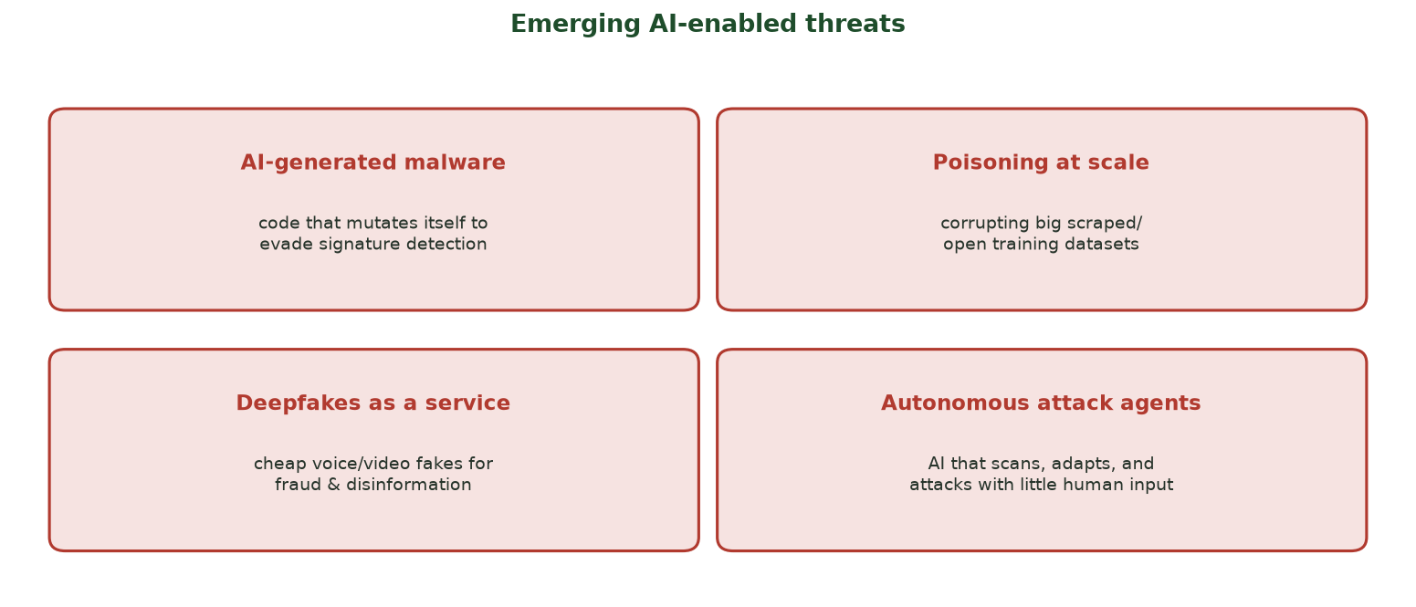
FOUR TO WATCH
Emerging AI-Enabled Threats
AI-generated malware, poisoning at scale, deepfakes-as-a-service, and autonomous attack agents.
CIS 350: AI for Cybersecurity · Monday
16
Notes:
Walk the four emerging threats at a high level (factual, not how-to). AI-generated/polymorphic malware; poisoning big scraped datasets; cheap deepfakes-as-a-service; and autonomous attack agents that scan/adapt with little human input. These extend threats students already know (Weeks 8, 10). ~4 min.

Slide 17
THREAT 1
AI-Generated & Adaptive Malware
AI can help generate or mutate malware to dodge signature detection.
Polymorphic behavior: it changes shape while keeping its function.
This defeats old signature-only antivirus (recall Week 8).
Defense: behavior- and anomaly-based detection, not just signatures.
Plus defense in depth - assume some malware gets through.
AI mutates malware to evade signatures -> use behavior/anomaly detection.
CIS 350: AI for Cybersecurity · Monday
17
Notes:
Go one level deeper on AI-assisted malware, tying to Week 8 (adaptive malware) and Week 6 (anomaly detection as the counter). Keep it conceptual. The defensive takeaway is concrete: behavior/anomaly detection beats signatures against mutating threats. ~4 min.

Slide 18
THREAT 2
Poisoning at Scale & the Data Supply Chain
Models increasingly train on huge scraped or open datasets.
Attackers can seed malicious content into that public data (recall Week 10).
At scale, even a small poisoned fraction can plant a backdoor.
It's a supply-chain problem: you may not control your training data.
Defense: vet & track data provenance, curate sources, test for backdoors.
Poisoning public/scraped data at scale -> vet provenance, curate sources.
CIS 350: AI for Cybersecurity · Monday
18
Notes:
Extend Week 10's poisoning to the modern reality: massive scraped training data is a supply chain attackers can seed. Emphasize provenance/curation as the defense. This connects data (Week 2), poisoning (Week 10), and governance (Week 12). ~3 min.

Slide 19
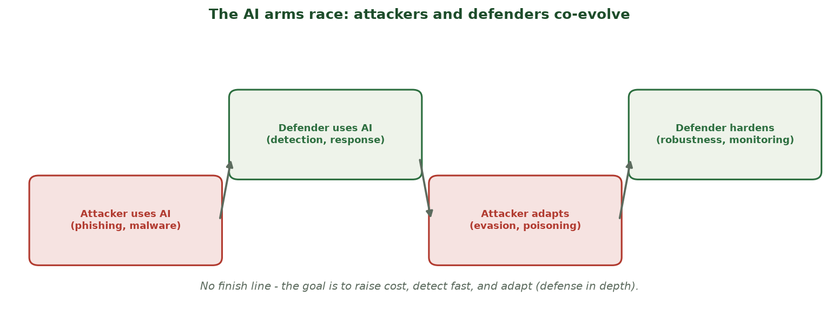
ATTACKERS AND DEFENDERS CO-EVOLVE
The AI Arms Race
Each side adopts AI, then adapts to the other - there is no finish line, only faster iteration.
CIS 350: AI for Cybersecurity · Monday
19
Notes:
Walk the arms-race figure - the meta-point of Part 2. Attackers use AI, defenders respond with AI, attackers adapt, defenders harden. There's no permanent win; the goal is to raise attacker cost, detect fast, and adapt - defense in depth, the course's spine. ~4 min.

Slide 20
⚠️ ACTIVITY · 4 MIN
Emerging threat -> defense
For each emerging threat, name ONE defense you've learned this term:
AI-generated malware that changes its signature.
A poisoned open dataset used to train your model.
A deepfake voice call to your finance team.
CIS 350: AI for Cybersecurity · Monday
20
Notes:
Reinforce that students already have the defenses. Answers: behavior/anomaly detection (Weeks 6, 8); data vetting/provenance + backdoor testing (Weeks 10, 12); out-of-band verification + MFA + awareness (Week 8). Empowering close to Part 2 - the fundamentals still work. Pairs 2, discuss 2. ~4 min.

Slide 21
PART 3 · THE FUTURE OF AI + CYBERSECURITY · ~10 MIN
What's Coming, and Your Place in It
Notes:
Transition: 'Where is this all heading, and what does it mean for you?' ~13 minutes with an activity.

Slide 22
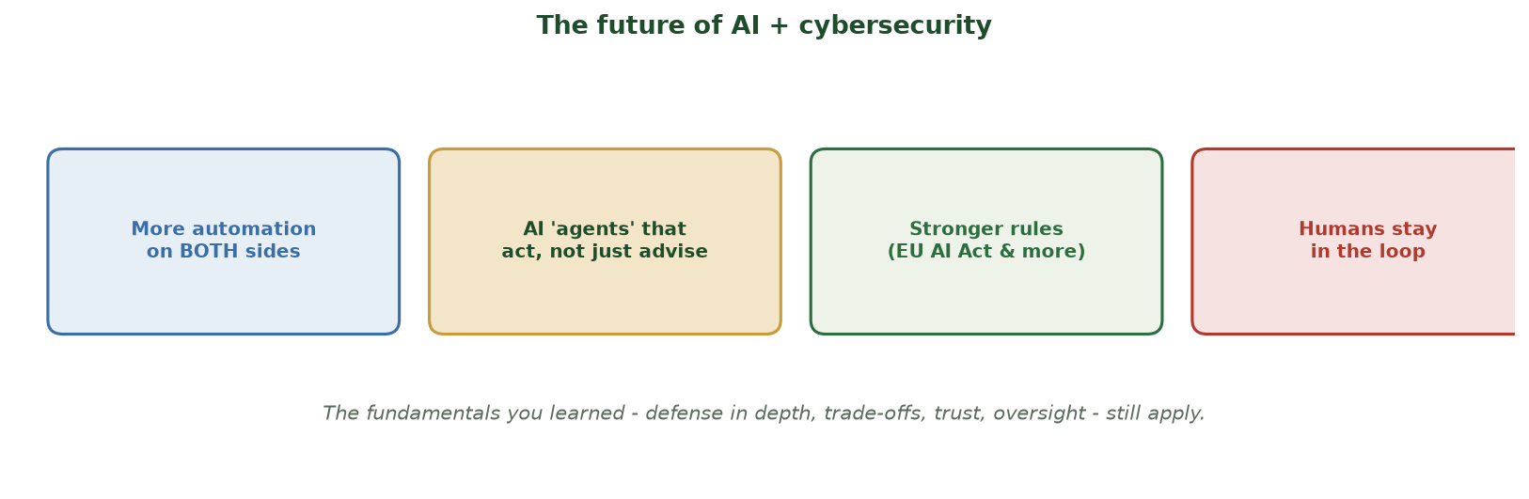
TRENDS TO WATCH
The Future of AI + Cybersecurity
More automation on both sides, AI 'agents' that act, stronger rules, and humans staying in the loop.
CIS 350: AI for Cybersecurity · Monday
22
Notes:
Walk the future figure. Four trends: more automation on both sides; AI agents that act (not just advise); stronger regulation (EU AI Act and successors); and - crucially - humans staying in the loop. Reassure students: the fundamentals they learned still govern all of it. ~4 min.

Slide 23
SIGNAL VS. NOISE
What's Coming (and What Stays the Same)
AI 'agents' will increasingly act - so oversight and least privilege matter MORE.
Regulation will tighten; trustworthy-AI skills become table stakes.
Attacks and defenses both accelerate - speed and adaptivity win.
Unchanging fundamentals: defense in depth, trade-offs, trust, human oversight.
The best defenders pair AI's speed with human judgment.
Tools change fast; the fundamentals you learned endure.
CIS 350: AI for Cybersecurity · Monday
23
Notes:
Separate the hype from the durable. Yes, agents and regulation are coming; but the principles from this course (defense in depth, human-in-the-loop, trade-offs, trustworthy AI) are exactly what keep you effective as tools change. This is a confidence-building message. ~3 min.

Slide 24
YOUR NEXT STEPS
Careers & Staying Current
Roles: security analyst, ML/AI security engineer, GRC/AI governance, risk & audit.
Your portfolio: 12 hands-on labs + a CTF + a tabletop - real, demonstrable skills.
Stay current: follow NIST, CISA, OWASP, and MITRE ATLAS; read threat reports.
Keep practicing: CTFs, Kaggle, open datasets, and reproducing papers.
Curiosity + fundamentals + ethics = a durable career.
Real skills built; follow NIST/CISA/OWASP; keep practicing.
CIS 350: AI for Cybersecurity · Monday
24
Notes:
Make it personal and motivating. Name concrete roles and remind students they have a real portfolio (the labs, CTF, tabletop). Give a short, credible 'stay current' list. Encourage curiosity grounded in fundamentals and ethics. ~3 min.

Slide 25
🔮 ACTIVITY · 3 MIN
Your prediction
On a card or with a neighbor:
Name one AI + cybersecurity change you expect in the next 5 years.
Name one course fundamental that will still matter then.
One thing you want to learn next.
CIS 350: AI for Cybersecurity · Monday
25
Notes:
A forward-looking, reflective close to Part 3. Collect a few predictions aloud. Reinforce that the fundamental they name is exactly what makes them adaptable. ~3 min.

Slide 26
⚠️ IN-CLASS TASK · 12 MIN
Build an Emerging-Threat Defense Card
In pairs, brief leadership on ONE emerging AI-enabled threat. For a named org (regional bank, hospital, SaaS startup, city government), produce a one-page 'Emerging Threat Defense Card' (~8 min), then trade cards with another pair for a peer review.
Pick ONE threat (AI-generated malware, poisoning at scale, deepfakes-as-a-service, autonomous agents); write a one-sentence scenario naming the org and what's at risk.
Fill 'How AI amplifies it' (cheaper/faster/personalized/adaptive) and 'Business impact' in plain terms.
List TWO layered defenses from DIFFERENT weeks + ONE detection signal to monitor + a human-in-the-loop checkpoint.
Write the attacker's likely NEXT adaptation (one arms-race move) and your counter; trade cards and annotate one gap on another pair's card.
CIS 350: AI for Cybersecurity · Monday
26
Notes:
The session's applied capstone - turns the threat list into a business-ready defense, the reasoning Exam 4 scenarios reward. Model card - Deepfake voice call to a bank's finance team: AI amplifies = cheap cloned CFO voice, personalized and urgent; impact = fraudulent wire transfer + reputational/regulatory harm. Layered defenses: out-of-band callback verification + awareness training (Wk 8) AND mandatory dual-approval / MFA on large transfers (defense in depth); detection signal = anomalous payment pattern / urgency flags (Wk 6 anomaly detection); human-in-the-loop = a second approver. Attacker's next move = spoof the callback number or add deepfake video -> counter with a pre-shared code word on a known channel. Draw out the two through-lines: no single control is enough (defense in depth), and the fundamentals students already learned still beat novel AI threats - the arms race raises attacker cost, it doesn't end. ~12 min.

Slide 27
USE THESE SLIDES AS YOUR STUDY GUIDE
How This Week Connects to Quiz 12
📝 For Quiz 12, master...
🧭 Looking to Exam 4 (Weeks 10-16)...
Transfer, few-shot, and federated learning (and when to use each).
Why advanced methods help when labels are scarce.
Emerging threats: AI malware, poisoning at scale, deepfakes, agents.
The arms race and matching each threat to a defense.
This week's advanced topics + emerging threats are fair game.
Connect them back to Weeks 10-13 (attacks, ethics, privacy).
Wednesday is a full synthesis + Exam-4 prep session.
Lab 12 (tabletop) is due this week.
CIS 350: AI for Cybersecurity · Monday
27
Notes:
Tie the lecture to Quiz 12 (this week) and Exam 4. Left = Quiz 12 concepts; right = how this fits the final. Remind that Lab 12 is due and there's no new lab this week. ~2 min.

Slide 28
Key Takeaways
✓
Transfer, few-shot, and federated learning all attack the label-scarcity problem central to security.
✓
A real learning curve showed transfer reaching ~0.92 with ~20 labels - vs ~640 from scratch (~30x fewer).
✓
Emerging threats (AI malware, poisoning at scale, deepfakes, autonomous agents) extend attacks you already know.
✓
It's an arms race with no finish line - the fundamentals (defense in depth, human oversight) still win.
Notes:
Recap one point per objective. Cold-call: 'Why does transfer learning need fewer labels?' Preview Wednesday: pulling the whole course together and preparing for Exam 4. ~2 min.

Slide 29
WHAT'S NEXT
Looking Ahead: Quiz 12, Lab 12 & Wednesday
📝 Quiz 12 is online this week (advanced techniques + emerging threats + synthesis).
🧪 Lab 12 (Tabletop) write-up is due this week - submit in Canvas.
📖 Read Handout 13: Advanced Topics and Future Threats.
📊 Wednesday: synthesize the whole course and prep for Exam 4 (Weeks 10-16).
🧭 Week 16 is dedicated Q&A; Exam 4 is Week 17 (open-notes).
Quiz 12 & Lab 12 this week; Wed = synthesis + Exam-4 prep.
CIS 350: AI for Cybersecurity · Monday
29
Notes:
Assign and preview. Quiz 12 is this week; Lab 12 is due. Assign Handout 13. Wednesday is synthesis + exam prep. Note Week 16 is Q&A and Exam 4 is Week 17. ~2 min.

Slide 30
🎯 EXIT TICKET · 2 MIN
One minute before you go
On the Canvas exit-ticket quiz or a card:
Name one advanced technique and when you'd use it.
Name one emerging threat and one defense for it.
One thing you'd like reviewed on Wednesday.
CIS 350: AI for Cybersecurity · Monday
30
Notes:
Close with the exit ticket. Use the 'review on Wednesday' answers to shape the synthesis session. ~2 min.

Slide 31
SOURCES & FURTHER READING
References & Further Reading
  S. J. Pan & Q. Yang, 'A Survey on Transfer Learning,' IEEE TKDE, 2010.
  Y. Wang et al., 'Generalizing from a Few Examples: A Survey on Few-Shot Learning,' 2020.
  H. B. McMahan et al., federated learning, 2017; NIST AI RMF 1.0 (2023).
  ENISA Threat Landscape; MITRE ATLAS - adversarial threats to AI systems.
  CISA/NCSC, Guidelines for Secure AI System Development, 2023.
CIS 350: AI for Cybersecurity · Monday
31
Notes:
Appendix slide: references and further reading. Post to Canvas or leave visible during the exit ticket - it is not part of the timed session.

