Slide 1

WEEK 14 · WEDNESDAY · 75 MINUTES
Tabletop Incident Response Exercise & Debrief
Practice a Crisis · CISA Scenario · AI + Human Judgment
CIS 350: AI for Cybersecurity — Smart Defense for the Digital Business
Ramadan Abdunabi, Ph.D. · Computer Information Systems
Notes:
Set the tone: 'Today is hands-on and high-energy - we run a real incident-response TABLETOP together.' A tabletop is a talk-through crisis simulation, no computers attacked, no wrong answers - the point is to practice decisions and communication. This is Lab 12; Quiz 11 is also today. Keep the four pillars from Monday (esp. accountability & robustness) in view. Reach Part 1 by ~minute 8. ~1 min.

Slide 2

🔁 WARM-UP · 5 MIN
Your first five minutes
With a neighbor, one sentence each:
You get an alert that an AI fraud model is blocking thousands of real customers. First move?
Who do you need to tell?
What could go wrong if you act too fast - or too slow?
CIS 350: AI for Cybersecurity · Wednesday
2
Notes:
Prime the incident mindset before the exercise. Pairs 2 min, cold-call 2-3. Expected: 'confirm/triage before acting,' 'tell the on-call lead / comms / affected teams,' 'too fast = overreact & break things; too slow = harm grows.' This surfaces the tension the tabletop explores. ~5 min.

Slide 3
WEDNESDAY · 75 MINUTES
Today's Plan
🔁
Warm-up & framing
Think like a responder
8 min
🚨
Incident-response foundations
Tabletops & the IR lifecycle
14 min
🎲
The tabletop exercise
Three rounds, decisions under pressure
30 min
🔎
Debrief: AI + human judgment
Hotwash & lessons learned
7 min
🧩
In-class task
Draft your crisis comms kit
12 min
🎯
Wrap & exit
Lab 12 write-up; Quiz 11
4 min
CIS 350: AI for Cybersecurity · Wednesday
3
Notes:
Walk the plan; the row minutes add up to exactly 75. Brief foundations, then the exercise runs in three rounds, then a debrief. Quiz 11 is at the end of class. ~1 min.

Slide 4
TABLETOP INCIDENT RESPONSE
Today's Goals
1
Explain what a tabletop exercise is and the incident-response (IR) lifecycle.
2
Work through a simulated AI/ML security incident as a team.
3
Make and justify decisions under time pressure across the IR phases.
4
Debrief: how AI tools and human judgment complement each other in a crisis.
CIS 350: AI for Cybersecurity · Wednesday
4
Notes:
State the goals. Emphasize participation and reasoning over 'right answers.' Note this builds the job-relevant skill of calm, structured crisis response - and completes Lab 12. ~1 min.

Slide 5
PART 1 · INCIDENT-RESPONSE FOUNDATIONS · ~14 MIN
Tabletops and the IR Lifecycle
Notes:
Transition: 'A few foundations so the exercise runs smoothly.' ~18 minutes with a figure.

Slide 6
WHAT IT IS
What Is a Tabletop Exercise?
A talk-through simulation of a crisis - no real systems touched.
A facilitator presents a scenario and 'injects' new developments.
Teams DISCUSS what they'd do; there are no trick questions.
Goal: practice decisions, roles, and communication BEFORE a real incident.
We use CISA's free, professionally designed tabletop packages (CTEP).
A safe, talk-through crisis rehearsal - practice before it's real.
CIS 350: AI for Cybersecurity · Wednesday
6
Notes:
Define a tabletop and lower anxiety: it's discussion-based, safe, and there are no wrong answers - the value is rehearsal. Credit CISA CTEP (free, professional). Analogy: like a fire drill for cyber incidents. ~4 min.

Slide 7
THE LIFECYCLE
The Incident-Response Lifecycle (NIST)
PREPARE: plans, roles, contacts, and tools ready in advance.
DETECT & ANALYZE: notice it, scope it, and triage severity.
CONTAIN, ERADICATE, RECOVER: limit damage, remove the cause, restore service.
POST-INCIDENT: a 'hotwash' - lessons learned that improve next time.
It's a loop: every incident should make you better prepared.
Prepare -> detect & analyze -> contain/eradicate/recover -> post-incident.
CIS 350: AI for Cybersecurity · Wednesday
7
Notes:
Give the NIST SP 800-61 lifecycle in plain language - the backbone the exercise follows. Stress PREPARE (most value is before the incident) and POST-INCIDENT (the hotwash) since beginners forget them. The figure next makes it visual. ~5 min.

Slide 8
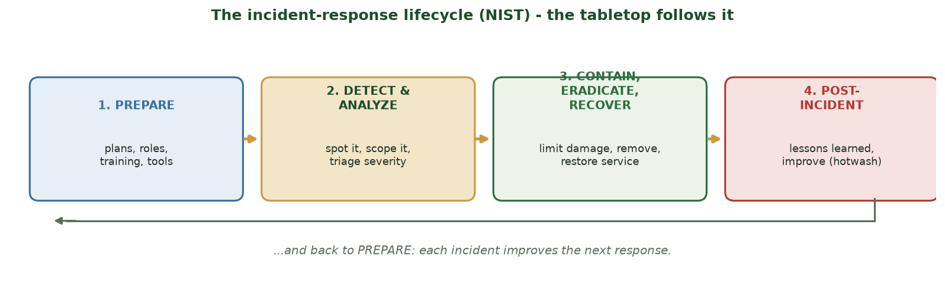
THE TABLETOP FOLLOWS THESE PHASES
The Incident-Response Lifecycle
Prepare -> detect & analyze -> contain/eradicate/recover -> post-incident, then back to prepare.
CIS 350: AI for Cybersecurity · Wednesday
8
Notes:
Walk the lifecycle figure. Tell students each tabletop round maps to a phase: Round 1 = detect & analyze, Round 2 = contain/decide, Round 3 = recover & communicate, then debrief = post-incident. This gives them a mental map for the exercise. ~4 min.

Slide 9
AI MAKES IT HARDER
What's Different About an AI/ML Incident?
The 'bug' may be in the DATA or MODEL, not just code - harder to see.
Failures can be silent: quiet accuracy decay (drift) or a hidden backdoor (Week 10).
Explaining what happened is hard if the model isn't explainable (Monday).
Fixes may mean retraining or rolling back a model - not just a patch.
Human judgment is essential: AI can flag, but people decide under uncertainty.
AI incidents hide in data/model; response needs explainability + humans.
CIS 350: AI for Cybersecurity · Wednesday
9
Notes:
Connect incident response to the whole unit. AI incidents are trickier: the fault may be in data/model, failures can be silent, and you need explainability (Monday) to understand them. Reinforce the course theme: keep a human in the loop - AI assists, humans decide. This frames the debrief. ~5 min.

Slide 10
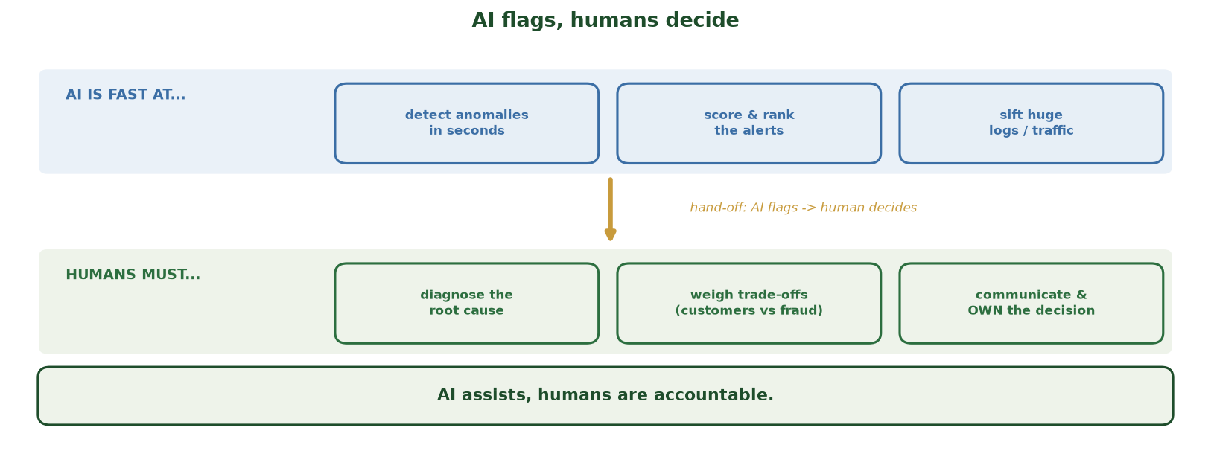
WHAT AI DOES FAST VS. WHAT HUMANS MUST OWN
AI Flags, Humans Decide
AI is fast at detecting anomalies, ranking alerts, and sifting logs; humans must diagnose the root cause, weigh trade-offs, and communicate and OWN the decision - AI assists, humans are accountable.
CIS 350: AI for Cybersecurity · Wednesday
10
Notes:
Anchor the day's central theme before the exercise. TOP lane - what AI is fast at (detect anomalies in seconds, score/rank alerts, sift huge logs) - is real speed. BOTTOM lane - what only HUMANS can do (diagnose the root cause, weigh customers-vs-fraud trade-offs, communicate and OWN the decision). The gold hand-off arrow is the whole point: AI FLAGS, humans DECIDE. Tell students to hold this in mind during the tabletop - every round, notice where the AI helped and where a human had to judge. Ties straight to Monday's accountability pillar. ~2 min.

Slide 11
PART 2 · THE TABLETOP EXERCISE · ~30 MIN
Three Rounds, Decisions Under Pressure
Notes:
Transition: 'Now we run it. Form teams and assign roles.' ~33 minutes of active exercise.

Slide 12
SETUP & RULES
Scenario Setup & Ground Rules
Scenario (CISA-based): an AI-powered fraud detector starts behaving strangely during a busy sales day.
Form teams of 4-6; each team is the incident-response group for a mid-size company.
Rules: discuss and decide together; justify choices; there are no trick questions.
A facilitator (instructor) will reveal 'injects' - new information mid-crisis.
Record decisions and reasoning on the Lab 12 worksheet as you go.
Teams of 4-6; CISA scenario; discuss, decide, justify; log it.
CIS 350: AI for Cybersecurity · Wednesday
12
Notes:
Set up the exercise crisply so time isn't lost. Use a concrete AI-relevant scenario (adapt a CISA CTEP package). Form teams, hand out the Lab 12 worksheet, and explain injects. Keep energy up and circulate during rounds. ~5 min.

Slide 13
ROLES & INJECTS
Roles & the Inject Process
Assign roles: Incident Lead, Comms, Tech/Analyst, Legal/Compliance, Scribe.
Each round: read the situation, discuss, decide, and note WHO does WHAT.
The facilitator drops an 'inject' (a twist) to test your plan.
Rotate speaking so everyone contributes (peer learning).
Stay in role - it mirrors a real incident bridge call.
Assign 5 roles; decide per round; injects test the plan.
CIS 350: AI for Cybersecurity · Wednesday
13
Notes:
Assign clear roles so teams function (map to accountability from Monday). Explain the inject rhythm. Encourage quieter students via the Scribe/role rotation. Model one quick example inject so they get the format. ~5 min.

Slide 14
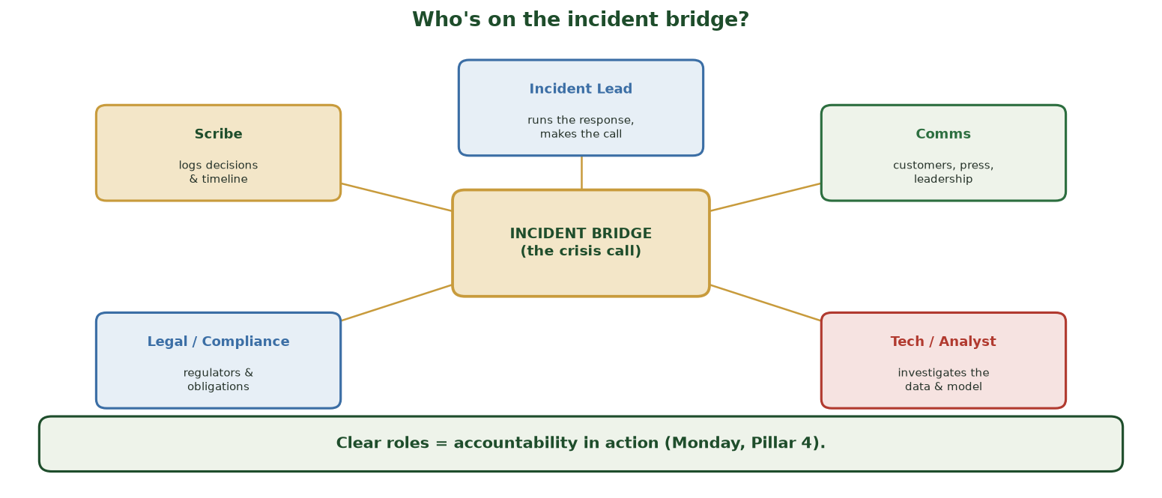
THE FIVE ROLES AROUND THE CRISIS CALL
Who's on the Incident Bridge?
Five roles around the incident bridge: Incident Lead (runs it), Comms (customers/press/leadership), Tech/Analyst (data & model), Legal/Compliance (regulators), Scribe (logs every decision).
CIS 350: AI for Cybersecurity · Wednesday
14
Notes:
Use this hub-and-spoke to lock in roles before Round 1 - assign one per person on each team. Point to each: the INCIDENT LEAD makes the call; COMMS handles customers, press, and leadership; TECH/ANALYST investigates the data and model; LEGAL/COMPLIANCE tracks regulators and obligations; the SCRIBE logs every decision and the timeline (this is your Lab 12 worksheet). Land the banner: clear roles ARE accountability in action - Monday's Pillar 4 made operational. Stay in role during the rounds. ~2 min.

Slide 15
🎲 ROUND 1 · 8 MIN
Detect & Analyze (inject #1)
The fraud model's block rate jumped 20x this morning. As a team:
Is this an attack, a bug, data drift, or a false alarm? How would you tell?
What's the severity, and who do you notify first?
What do you NOT do yet, and why?
CIS 350: AI for Cybersecurity · Wednesday
15
Notes:
Run Round 1 = detect & analyze. Circulate and prompt teams to consider drift/poisoning/attack vs. a benign cause. Good thinking: gather evidence before acting; classify severity; notify the incident lead + business owner; don't blindly disable the model (fraud could spike) or accuse anyone yet. Scribes log decisions on the worksheet. ~8 min.

Slide 16
🎲 ROUND 2 · 8 MIN
Contain & Decide (inject #2)
Inject: logs show the model was retrained last night on new data. Real fraud is now slipping through. As a team:
Contain it: roll back the model, add human review, or something else?
What are the trade-offs of each option (customers vs. fraud losses)?
Who approves a high-impact action like a rollback?
CIS 350: AI for Cybersecurity · Wednesday
16
Notes:
Run Round 2 = contain/decide. The inject points to a data-poisoning/bad-retrain root cause (Week 10). Push teams to weigh trade-offs (block real customers vs. let fraud through) and to require human APPROVAL for the rollback (accountability). There's no single right answer - reward justified decisions. ~8 min.

Slide 17
🎲 ROUND 3 · 7 MIN
Recover & Communicate (inject #3)
Inject: a reporter and several customers are asking what happened. As a team:
What's your recovery plan to safely restore normal service?
What do you tell customers, leadership, and regulators (and when)?
What do you preserve for the post-incident review?
CIS 350: AI for Cybersecurity · Wednesday
17
Notes:
Run Round 3 = recover & communicate. Emphasize honest, timely communication (transparency from Monday), a safe restore (verify the model before re-enabling), and preserving logs/evidence for the hotwash and any audit. Connect to governance/accountability. ~7 min.

Slide 18
PART 3 · DEBRIEF · ~7 MIN
The Hotwash: AI + Human Judgment
Notes:
Transition: 'The most valuable part of any exercise is the debrief.' ~8 minutes.

Slide 19
THE DEBRIEF
Hotwash: What Did We Learn?
What went well? What was confusing or slow?
Where did AI HELP (fast detection) and where did HUMANS have to decide?
Which trustworthy-AI pillar would have prevented or eased this? (usually robustness or accountability)
What one change to the PREPARE phase would help next time?
Capture it - a real hotwash produces an action list, not just talk.
Hotwash: what worked, AI vs human roles, and one improvement.
CIS 350: AI for Cybersecurity · Wednesday
19
Notes:
Facilitate the debrief across teams - this is where the learning consolidates. Draw out the AI-plus-human theme: AI flagged the anomaly fast, but humans had to diagnose, weigh trade-offs, and communicate. Tie failures back to Monday's pillars. Capture concrete improvements. ~5 min.

Slide 20
🔎 DEBRIEF · 3 MIN
Your one improvement
As a team, agree on ONE line for the worksheet:
The single most important thing you'd change about your preparation or response.
Which trustworthy-AI pillar it strengthens.
CIS 350: AI for Cybersecurity · Wednesday
20
Notes:
End the exercise with a concrete commitment per team, mapped to a pillar. This makes the tabletop actionable and ties it to Monday. Collect a few aloud. ~3 min.

Slide 21
🔎 IN-CLASS TASK · 12 MIN
Draft Your Crisis Communications Kit
Same incident: the AI fraud model was retrained overnight on bad data, wrongly blocked thousands of real customers, and let some fraud through; a reporter and customers are now asking questions. In your team (Comms + Legal lead, everyone contributes), produce the three first-hour messages (~7 min).
CUSTOMER notice (3-4 sentences): what happened in plain language, what you're doing, what they should do - honest, no blame, no jargon, no unconfirmed numbers.
REGULATOR line (1 sentence): the incident, rough scope, and that a full report follows on schedule.
INTERNAL status (1 line): severity, current action, and who owns the incident.
Under each, tag the pillar it upholds (transparency / accountability) and note ONE thing you did NOT say yet and why.
CIS 350: AI for Cybersecurity · Wednesday
21
Notes:
The session's written artifact - turns the tabletop into real deliverables. A good CUSTOMER note acknowledges some customers were wrongly blocked by an automated system, says service is being restored, apologizes, and gives a contact - with NO premature root-cause claim, no names, no PII, no unconfirmed counts. The REGULATOR line is concise, factual, and commits to a follow-up on schedule. INTERNAL status e.g. 'Sev-1: fraud model rolled back, human review live, Incident Lead = Dana, next update in 30 min.' What you HOLD BACK - unverified cause, names, unconfirmed numbers - because retractions destroy trust and premature blame creates legal exposure. This makes Monday concrete: timely honest disclosure = transparency; a named owner + committed follow-up = accountability; and it shows AI flagged the anomaly but humans judged what/when/how to communicate. Have 2 teams read their customer note. ~12 min.

Slide 22
USE THESE SLIDES AS YOUR STUDY GUIDE
How Today Connects to Lab 12 & Quiz 11
🧪 In Lab 12 (Tabletop) you will...
📝 For Quiz 11, master...
Complete the Lab 12 worksheet: decisions, roles, and reasoning per round.
Write your hotwash: what worked, AI vs. human roles, one improvement.
Map the incident to a trustworthy-AI pillar.
Submit the worksheet in Canvas.
The IR lifecycle: prepare, detect & analyze, contain/eradicate/recover, post-incident.
Why AI incidents are harder (data/model faults, silent failures).
How the four pillars relate to incident response.
AI assists, humans decide - the role of human judgment.
CIS 350: AI for Cybersecurity · Wednesday
22
Notes:
Tie Wednesday to Lab 12 (the worksheet write-up) and Quiz 11. Left = Lab 12 submission tasks; right = Quiz 11 concepts. Remind students Quiz 11 is now, and the Lab 12 worksheet is due (see Canvas). ~2 min.

Slide 23
Key Takeaways
✓
A tabletop is a safe, talk-through rehearsal; the IR lifecycle is prepare -> detect/analyze -> contain/eradicate/recover -> post-incident.
✓
AI incidents are harder: faults hide in data/models and failures can be silent - explainability and monitoring help.
✓
Under pressure, AI assists (fast detection) but humans decide, communicate, and are accountable.
✓
The most valuable step is the hotwash - turn every incident into a concrete improvement.
Notes:
Recap the essentials. Cold-call: 'Name the four IR phases.' Reinforce AI-plus-human. Then administer Quiz 11. ~2 min.

Slide 24
WHAT'S NEXT
Looking Ahead: Lab 12, Quiz 11 & Week 15
📝 Quiz 11 is administered now (trustworthy AI + incident response).
🧪 Finish the Lab 12 worksheet and submit in Canvas (due next week).
📖 Review Handout 12: Trustworthy AI and Responsible AI.
🔜 Week 15: advanced topics, emerging threats, and the course wrap-up.
🧭 Exam 4 (final, Weeks 10-16) is in Week 17 - keep your notes.
Quiz 11 now; finish Lab 12; Week 15 = advanced topics & wrap-up.
CIS 350: AI for Cybersecurity · Wednesday
24
Notes:
Administer Quiz 11 at the end of class. Assign the Lab 12 write-up (due Week 15) and Handout 12. Preview Week 15. Remind that Exam 4 covers Weeks 10-16. ~2 min.

Slide 25
🎯 EXIT TICKET · 2 MIN
Before Quiz 11
Quick check (then we start Quiz 11):
Name the four phases of the IR lifecycle.
One way AI made this incident harder than a normal one.
One concept you want reviewed before the quiz.
CIS 350: AI for Cybersecurity · Wednesday
25
Notes:
Use as a pre-quiz warm-up and last-chance clarification, then open Quiz 11. Q1 checks the lifecycle; Q2 checks the AI-specific angle. ~2 min.

Slide 26
SOURCES & FURTHER READING
References & Further Reading
  CISA Tabletop Exercise Packages (CTEP) - free, professionally designed scenarios.
  NIST SP 800-61r2, Computer Security Incident Handling Guide.
  NIST SP 800-84, Guide to Test, Training, and Exercise Programs.
  SANS Incident Handler's Handbook; CISA Incident Response playbooks.
  NIST AI RMF 1.0 (2023) - govern & manage functions for AI incidents.
CIS 350: AI for Cybersecurity · Wednesday
26
Notes:
Appendix slide: references and further reading. Post to Canvas or leave visible during the exit ticket - it is not part of the timed session. The NIST AI RMF is the anchor reference for trustworthy AI; CISA CTEP is the source for the tabletop.

