Slide 1

WEEK 14 · MONDAY · 75 MINUTES
Trustworthy AI & Responsible AI in Practice
Transparency · Explainability · Robustness · Accountability
CIS 350: AI for Cybersecurity — Smart Defense for the Digital Business
Ramadan Abdunabi, Ph.D. · Computer Information Systems
Notes:
Open by pulling the course together: 'We've studied attacks, fairness, and privacy. Today they roll up into one business question - can people TRUST this AI?' Frame trust as a competitive advantage and a regulatory requirement. Note Lab 12 (a tabletop incident-response exercise) releases today and runs Wednesday; Quiz 11 is Wednesday. This is Exam-4 material (Weeks 10-16). Reach Part 1 by ~minute 8. ~1 min.

Slide 2

🔁 WARM-UP · 5 MIN
Would you trust it?
With a neighbor, one sentence each:
Name an AI system you'd hesitate to trust with an important decision. Why?
What would the company have to SHOW you to earn your trust?
Who should be responsible if that AI is wrong?
CIS 350: AI for Cybersecurity · Monday
2
Notes:
Surface intuitions about trust before naming the framework. Pairs 2 min, cold-call 2-3. Expected: medical/loan/hiring AI; 'show me how it works, that it's accurate and fair, that a human checks it'; 'the company/its leaders.' Those three map exactly to transparency/explainability, robustness, and accountability - today's pillars. ~5 min.

Slide 3
MONDAY · 75 MINUTES
Today's Plan
🔁
Warm-up & why trust matters
Trust = a business requirement
8 min
🏛️
What is Trustworthy AI?
The four pillars, overview
14 min
🔍
The four pillars in depth
Transparency, explainability, robustness, accountability
25 min
🏗️
Building responsible AI + cases
Trust by design; real examples
11 min
🧩
In-class task
Read the explanation, write the letter
12 min
🎯
Wrap & exit
Takeaways; Lab 12 & Quiz 11
5 min
CIS 350: AI for Cybersecurity · Monday
3
Notes:
Walk the plan; the row minutes add up to exactly 75. Today: define trustworthy AI, go deep on the four pillars (with a real explainability demo), then how organizations build it. ~1 min.

Slide 4
TRUSTWORTHY & RESPONSIBLE AI
Today's Objectives
1
Explain the four pillars of trustworthy AI: transparency, explainability, robustness, accountability.
2
Tell transparency and explainability apart, and read a real model explanation.
3
Describe how organizations build and deploy responsible AI ('trust by design').
4
Connect governance, transparency, and business decision-making.
CIS 350: AI for Cybersecurity · Monday
4
Notes:
State the four goals. Note this synthesizes Weeks 10-13 (attacks->robustness, fairness/privacy/governance->accountability & transparency) and sets up Wednesday's incident-response tabletop. All Exam-4 relevant. ~1 min.

Slide 5
PART 1 · WHAT IS TRUSTWORTHY AI? · ~14 MIN
Why Trust Matters, and the Four Pillars
Notes:
Transition: 'Trust isn't a feeling - it's built from concrete properties we can design and check.' ~16 minutes with a figure and an activity.

Slide 6
WHY IT MATTERS
Why Trust Is a Business Requirement
AI now makes or shapes real decisions - loans, hiring, security alerts, medical triage.
Users, leaders, and REGULATORS won't adopt AI they can't trust.
Distrust is expensive: abandoned projects, lawsuits, fines, lost reputation.
Trust is a competitive advantage - and increasingly the law (EU AI Act, Week 12).
Trustworthy AI turns 'cool demo' into 'deployable in a real business.'
No trust, no adoption - trust is a business & legal requirement.
CIS 350: AI for Cybersecurity · Monday
6
Notes:
Make the business case first (the 'why' before the 'how'). Beginners may think trust is soft/optional; reframe it as the gate to adoption and a legal requirement. Concrete: a brilliant model nobody trusts never ships. Tie to Week 12's regulation. ~4 min.

Slide 7
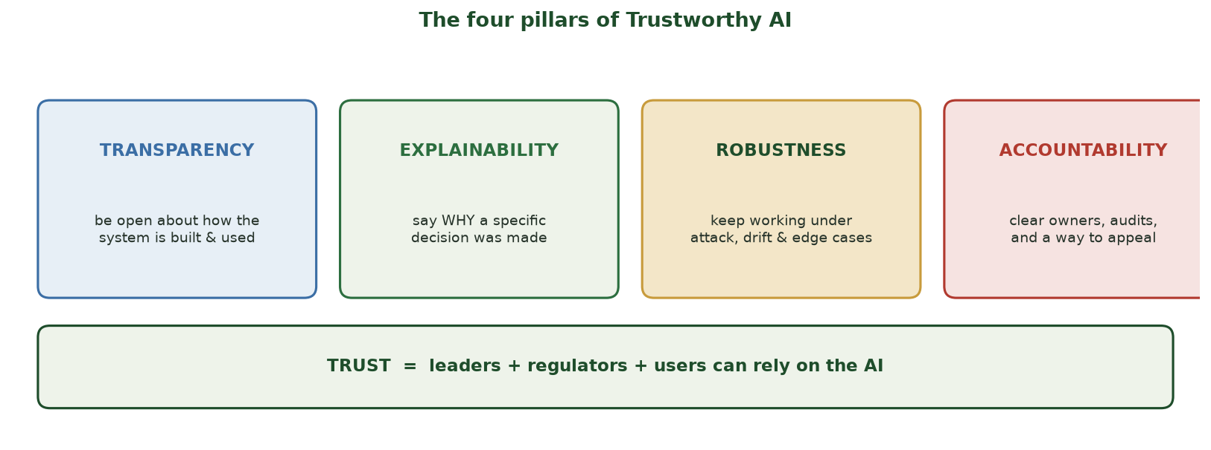
WHAT TRUST IS BUILT FROM
The Four Pillars of Trustworthy AI
Transparency, explainability, robustness, and accountability together let leaders, regulators, and users rely on the AI.
CIS 350: AI for Cybersecurity · Monday
7
Notes:
Introduce the framework with the pillars figure. Give the one-line meaning of each: transparency = open about the system; explainability = why THIS decision; robustness = holds up in the real world; accountability = clear owners and appeals. Note these come straight from the NIST AI RMF. We go deep on each in Part 2. ~4 min.

Slide 8
THE FRAMEWORK
The Four Pillars, in One Breath
TRANSPARENCY - be open about what data, what model, where it's used, and its limits.
EXPLAINABILITY - be able to say WHY a specific decision was made.
ROBUSTNESS - keep working under attack, data drift, and edge cases.
ACCOUNTABILITY - clear owners, audits, human override, and a way to appeal.
They reinforce each other - weak in one undermines the whole.
Four pillars: transparency, explainability, robustness, accountability.
CIS 350: AI for Cybersecurity · Monday
8
Notes:
Give the crisp definitions students should memorize. Stress they interlock: a robust but unexplainable model still isn't trustworthy; an explainable but unaccountable one isn't either. This slide is the study anchor for Quiz 11. ~4 min.

Slide 9
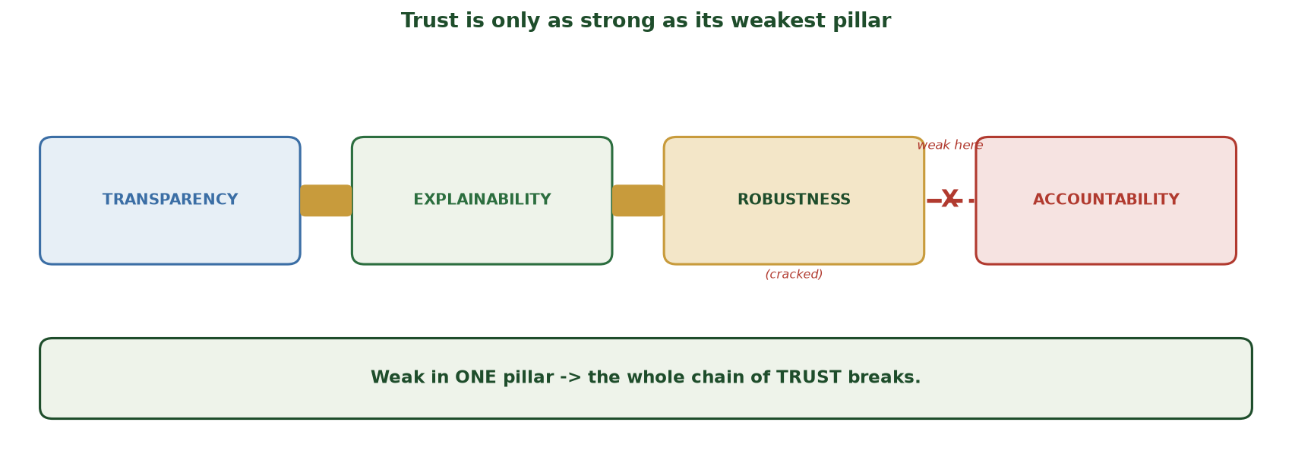
ONE BROKEN LINK SNAPS THE CHAIN
Trust Is Only as Strong as Its Weakest Pillar
The four pillars form a chain of trust; if one is weak (here, robustness fails), the whole chain breaks - a system can't be trustworthy while any single pillar is missing.
CIS 350: AI for Cybersecurity · Monday
9
Notes:
Reinforce the 'they interlock' point with the chain image. Each pillar is a link; the connectors hold them together. Show the BROKEN link between robustness and accountability: if the model isn't robust (it collapses under attack or drift), it doesn't matter how transparent or explainable it is - trust still snaps. Land the banner: weak in ONE pillar breaks the whole chain. This is exactly the diagnostic the next activity drills (find the missing pillar). ~2 min.

Slide 10
🧩 ACTIVITY · 4 MIN
Match the concern to the pillar
Which pillar addresses each worry (transparency / explainability / robustness / accountability)?
'I don't know why the AI denied my loan.'
'The vendor won't say what data it was trained on.'
'It broke the moment attackers changed their inputs.'
'No one will take responsibility when it's wrong.'
CIS 350: AI for Cybersecurity · Monday
10
Notes:
Check the framework. Answers: explainability; transparency; robustness; accountability. Quick pairs, then cold-call. This diagnostic habit (name the missing pillar) is exactly what Exam-4 scenarios reward. ~4 min.

Slide 11
PART 2 · THE FOUR PILLARS IN DEPTH · ~25 MIN
Transparency, Explainability, Robustness, Accountability
Notes:
Transition: 'Now one pillar at a time, with a real explanation demo.' ~30 minutes with figures and an activity.

Slide 12
PILLAR 1
Pillar 1 - Transparency
Being OPEN about how the system is built and used.
Document: what data, what model, intended use, and known LIMITS.
Tool: a MODEL CARD (Week 12) - a short 'nutrition label' for the model.
Also: tell people when they're interacting with AI (an EU AI Act rule).
Transparency doesn't mean leaking secrets - it means honest disclosure.
Transparency = honest disclosure of how the system works & its limits.
CIS 350: AI for Cybersecurity · Monday
12
Notes:
Define transparency and make it concrete with the model card (callback to Week 12). Head off a misconception: transparency isn't about exposing proprietary code or security-sensitive details; it's honest disclosure of purpose, data, performance, and limits. ~4 min.

Slide 13
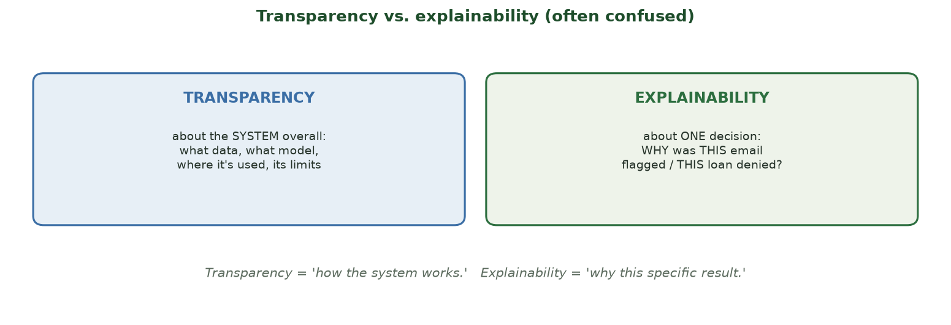
TWO DIFFERENT THINGS
Transparency vs. Explainability
Transparency = how the SYSTEM works overall; explainability = WHY this ONE decision was made.
CIS 350: AI for Cybersecurity · Monday
13
Notes:
Draw the distinction students most often confuse. Transparency is system-level ('here's how it was built'); explainability is decision-level ('here's why YOUR email was flagged'). Both are needed. Ask: 'Which does a rejected loan applicant most want?' (Explainability - the specific reason.) ~4 min.

Slide 14
PILLAR 2
Pillar 2 - Explainability
Being able to say WHY the model made a specific decision.
Simple approach: which FEATURES pushed the decision, and how much.
Enables appeals ('here's why') and debugging ('that reason is wrong').
Legally relevant: GDPR supports a 'right to explanation' (Week 12).
Next slide: a REAL explanation from a phishing classifier.
Explainability = the WHY behind one decision (which features mattered).
CIS 350: AI for Cybersecurity · Monday
14
Notes:
Define explainability and preview the real demo. Keep it intuitive: the simplest explanation is 'which inputs moved the decision and in which direction.' Stress its dual value: fairness/appeals AND debugging. Set up the figure. ~4 min.

Slide 15
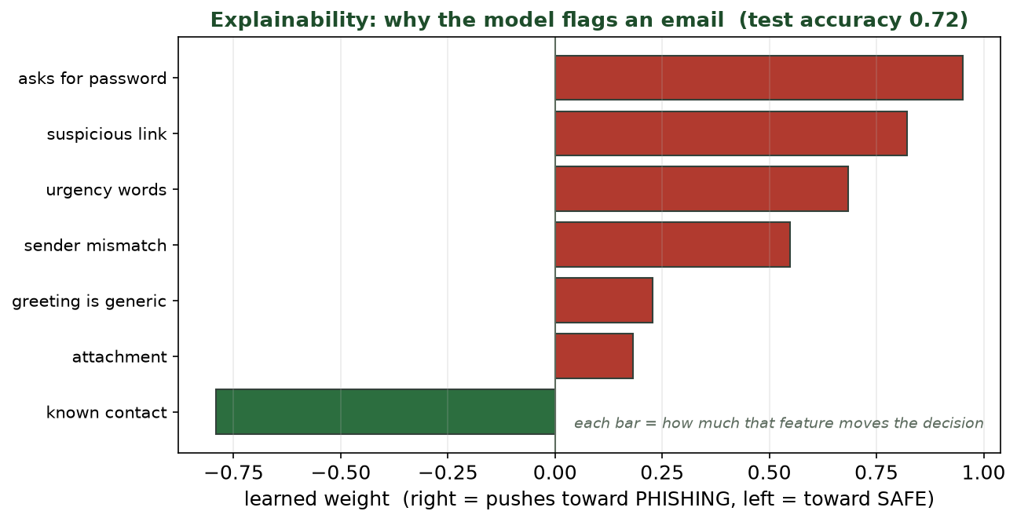
FEATURE WEIGHTS FROM A TRAINED CLASSIFIER
A Real Explanation: Why the Model Flags an Email
The model learned that 'asks for password' (+0.95), 'suspicious link' (+0.82) and 'urgency words' push toward phishing; 'known contact' (-0.79) pushes toward safe.
CIS 350: AI for Cybersecurity · Monday
15
Notes:
Walk the real explainability figure (test accuracy ~0.72 on this toy set). Each bar = how much a feature moves the decision. Red = toward phishing, green = toward safe. Point out it matches human intuition (asking for a password is the strongest phishing signal; a known contact is protective) - that ALIGNMENT is what makes it trustworthy and debuggable. If a nonsense feature had the biggest weight, you'd catch a problem. ~5 min.

Slide 16
PILLAR 3
Pillar 3 - Robustness
Does the model keep working in the messy real world?
Threats: adversarial inputs (Week 10), DATA DRIFT (the world changes), edge cases, failures.
Data drift: yesterday's 'normal' isn't tomorrow's - accuracy silently decays.
Build it: test on hard cases, monitor performance, retrain, fail safely.
Robustness is ongoing - not a one-time test before launch.
Robustness = holds up under attack, drift, and edge cases - monitored over time.
CIS 350: AI for Cybersecurity · Monday
16
Notes:
Define robustness and connect to Week 10 (adversarial) and the privacy/monitoring themes. Emphasize DATA DRIFT as the quiet killer beginners miss: a model can be accurate at launch and decay as behavior changes, so you must MONITOR, not just test once. Cybersecurity example: attackers deliberately shift tactics to induce drift. ~4 min.

Slide 17
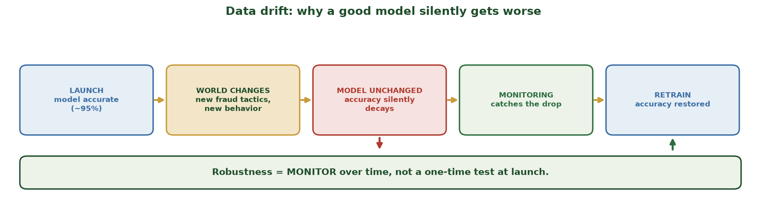
ACCURACY DECAYS UNLESS YOU MONITOR
Data Drift: Why a Good Model Silently Gets Worse
A model accurate at launch decays as the world changes (new tactics, new behavior); the drop is silent until monitoring catches it and a retrain restores accuracy - robustness is ongoing, not one-time.
CIS 350: AI for Cybersecurity · Monday
17
Notes:
Make data drift concrete with the timeline. Walk it left to right: the model launches accurate (~95%); the WORLD changes (new fraud tactics); the unchanged model's accuracy SILENTLY decays (nobody gets an error message - that's the danger); MONITORING catches the drop; a RETRAIN restores it. The takeaway: robustness is a monitor-over-time discipline, not a one-time launch test - which is exactly why accountability (owners who watch and retrain) matters. ~2 min.

Slide 18
PILLAR 4
Pillar 4 - Accountability
When AI affects people, humans must be ACCOUNTABLE - not 'the algorithm did it.'
Clear OWNER of the model; a governance board that AUDITS it (Week 12).
A human who can OVERRIDE high-impact decisions (human in the loop).
A documented way for affected people to APPEAL.
Keep an audit trail: who approved, trained, changed, and monitored it.
Accountability = named owners, audits, human override, and appeals - documented.
CIS 350: AI for Cybersecurity · Monday
18
Notes:
Define accountability - the pillar that assigns human responsibility. Kill the 'the algorithm decided' excuse: someone owns it. Tie to Week 12 governance and the recurring 'human in the loop' theme. The audit trail is what regulators and incident responders (Wednesday) will ask for. ~4 min.

Slide 19
🔍 ACTIVITY · 5 MIN
Audit a chatbot for trust
A bank launches an AI loan-decision chatbot. With a neighbor, name ONE concrete step for each pillar:
Transparency: what would you publish?
Explainability: what must a denied applicant receive?
Robustness: what would you monitor after launch?
Accountability: who owns it and how do people appeal?
CIS 350: AI for Cybersecurity · Monday
19
Notes:
Synthesize all four pillars on one realistic system. Good answers: publish a model card + disclose it's AI; give the applicant the top reasons for denial; monitor accuracy/fairness drift; a named owner + a documented appeal path with human review. This is exactly the applied reasoning Exam 4 rewards. Pairs 3, discuss 2. ~5 min.

Slide 20
PART 3 · BUILDING RESPONSIBLE AI · ~11 MIN
Trust by Design, with Real Case Studies
Notes:
Transition: 'How do organizations actually deliver on the four pillars? They build trust in from the start.' ~13 minutes with a figure and an activity.

Slide 21
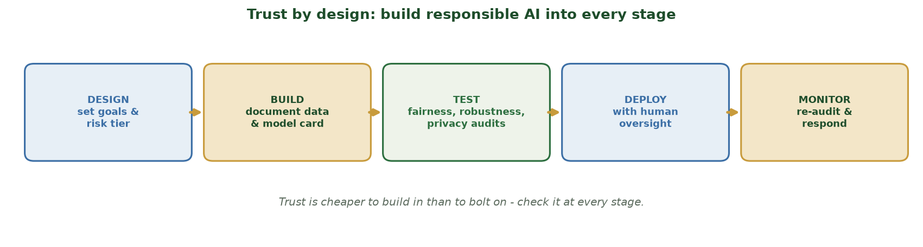
BUILD RESPONSIBLE AI INTO EVERY STAGE
Trust by Design
Design -> build (document) -> test (fairness/robustness/privacy) -> deploy (with oversight) -> monitor & re-audit.
CIS 350: AI for Cybersecurity · Monday
21
Notes:
Walk the delivery pipeline. Key message: trust is cheaper to build IN than to bolt ON. Each stage has a trust checkpoint - set the risk tier at design, document at build, audit at test, add oversight at deploy, and monitor after. This operationalizes Weeks 12-14. ~4 min.

Slide 22
LEARN FROM REAL CASES
Real Case Studies: Trust Won and Lost
WON: model cards & disclosure - some AI vendors publish limits and intended use.
WON: differential privacy in the U.S. Census (Week 13) - protect people, keep utility.
LOST: a biased hiring tool scrapped after it disadvantaged women (no fairness audit).
LOST: a chatbot that gave harmful advice - no robustness testing or human oversight.
Lesson: the failures skipped a pillar; the wins designed trust in.
Wins built trust in; failures skipped a pillar.
CIS 350: AI for Cybersecurity · Monday
22
Notes:
Ground the framework in real, well-known (paraphrased, non-defamatory) case types. For each failure, have students name the MISSING pillar - reinforcing the diagnostic. Keep it factual and constructive. This motivates the incident-response tabletop: even good systems fail, so you plan for it. ~5 min.

Slide 23
🏗️ ACTIVITY · 4 MIN
Trust win or trust fail?
For each, say whether trust was built or broken, and WHICH pillar:
A vendor publishes a model card with known limitations.
A model is deployed with no plan for when it fails.
A company can't explain why it denied thousands of claims.
CIS 350: AI for Cybersecurity · Monday
23
Notes:
Quick consolidation. Answers: built (transparency); broken (robustness/accountability - no incident plan); broken (explainability + accountability). Bridge to Wednesday: 'when trust fails in a crisis, you need an incident-response plan - which we'll practice.' Pairs 2, discuss 2. ~4 min.

Slide 24
🔍 IN-CLASS TASK · 12 MIN
Read the Explanation, Write the Applicant's Letter
A bank's loan model DENIED an applicant. You get its explanation as feature weights (push toward DENY when positive): high_existing_debt +1.4, applicant_zip_code +1.2, many_recent_inquiries +1.1, missed_payment +0.9, short_credit_history +0.8, stable_income -1.0, long_tenure -0.7. Regulation gives the applicant a right to a real explanation. In pairs (~7 min), turn the chart into an action.
Rank the features by how strongly each pushed toward DENY; pick the top 3 REAL reasons.
Write the 3-sentence plain-language denial letter (top reasons in everyday words, no jargon, no math).
Circle the ONE weight that looks unfair/nonsensical and write one line on why it's a red flag.
Tag which pillar your letter serves and which pillar your red-flag catch protects.
CIS 350: AI for Cybersecurity · Monday
24
Notes:
The session's hands-on task - students turn an explanation into a real-world artifact. Hand out the feature-weight chart. Model answer: top DENY drivers are high existing debt, many recent inquiries, and a missed payment; the letter states these plainly ('Your application was declined mainly because of a high level of existing debt, several recent credit applications, and a recent missed payment') - no jargon. The PLANTED red flag is applicant_zip_code (+1.2): location is a proxy for protected attributes, so a high positive weight signals a fairness/robustness problem - and you could only catch it BECAUSE the model was explainable. The letter serves EXPLAINABILITY (and enables appeals -> accountability); catching the bad feature serves ROBUSTNESS/fairness. This mirrors the core point: when reasons align with human intuition the model is trustworthy and debuggable; when a nonsense feature dominates, explainability lets you find the bug. Have 2 pairs read their letter. ~12 min.

Slide 25
USE THESE SLIDES AS YOUR STUDY GUIDE
How Today Connects to Lab 12 & Quiz 11
🧪 In Lab 12 (Tabletop) you will...
📝 For Quiz 11, master...
Run a tabletop incident-response exercise (CISA scenario).
Make decisions under pressure as a team, across the IR lifecycle.
See how governance, comms & tech intersect in a crisis.
Debrief and write up lessons learned.
Define the four pillars (transparency, explainability, robustness, accountability).
Tell transparency and explainability apart; read a model explanation.
Explain 'trust by design' and data drift.
Connect accountability to incident response and human oversight.
CIS 350: AI for Cybersecurity · Monday
25
Notes:
Tie the lecture to Lab 12 (Wednesday's tabletop) and Quiz 11. Left = Lab 12 tabletop tasks; right = Quiz 11 concepts. Note the tabletop puts the accountability/robustness pillars into practice under pressure. ~2 min.

Slide 26
Key Takeaways
✓
Trustworthy AI rests on four pillars: transparency, explainability, robustness, and accountability - and they interlock.
✓
Transparency = how the system works; explainability = why THIS decision (which features mattered).
✓
Robustness must be monitored over time (data drift), not just tested once at launch.
✓
Accountability means named owners, audits, human override, and appeals - build trust in by design.
Notes:
Recap one point per pillar. Cold-call: 'What's the difference between transparency and explainability?' Preview Wednesday: a hands-on incident-response tabletop where these ideas get tested under pressure. ~2 min.

Slide 27
WHAT'S NEXT
Looking Ahead: Lab 12, Quiz 11 & Wednesday
🧪 Wednesday IS Lab 12: a CISA tabletop incident-response exercise - come ready to participate.
📝 Quiz 11 is Wednesday (the four pillars + responsible AI).
📖 Read Handout 12: Trustworthy AI and Responsible AI.
🧭 Bring the four pillars - the tabletop will test accountability and robustness live.
🔜 Week 15: advanced topics, emerging threats, and course wrap-up.
Wed = tabletop (Lab 12) + Quiz 11; read Handout 12.
CIS 350: AI for Cybersecurity · Monday
27
Notes:
Assign and preview. Emphasize Wednesday is participatory (the tabletop) - students should skim the handout and come ready. Quiz 11 is Wednesday. ~2 min.

Slide 28
🎯 EXIT TICKET · 2 MIN
One minute before you go
On the Canvas exit-ticket quiz or a card:
Name the four pillars of trustworthy AI.
In one sentence, how do transparency and explainability differ?
One thing you'd like clarified before Quiz 11.
CIS 350: AI for Cybersecurity · Monday
28
Notes:
Close with the exit ticket. The pillars list and the transparency/explainability distinction are the two highest-yield checks. Use clarifications to open Wednesday. ~2 min.

Slide 29
SOURCES & FURTHER READING
References & Further Reading
  NIST AI Risk Management Framework (AI RMF 1.0), 2023 - trustworthy-AI characteristics.
  OECD AI Principles (2019); the EU AI Act (2024) requirements for high-risk AI.
  M. Mitchell et al., 'Model Cards for Model Reporting,' 2019.
  C. Molnar, 'Interpretable Machine Learning' (free online) - explainability methods.
  CISA, Secure by Design; NIST SP 800-53 (accountability & audit controls).
CIS 350: AI for Cybersecurity · Monday
29
Notes:
Appendix slide: references and further reading. Post to Canvas or leave visible during the exit ticket - it is not part of the timed session. The NIST AI RMF is the anchor reference for trustworthy AI; CISA CTEP is the source for the tabletop.

