Slide 1

WEEK 13 · MONDAY · 75 MINUTES
Privacy-Preserving ML & Trade-Offs
Differential Privacy · Federated Learning · Security vs. Privacy
CIS 350: AI for Cybersecurity — Smart Defense for the Digital Business
Ramadan Abdunabi, Ph.D. · Computer Information Systems
Notes:
Open with the tension at the heart of the week: 'We spend all semester using DATA to defend systems - but that data is about PEOPLE. How do we learn from it without exposing them?' Connect to Week 10 (models can leak training data) and Week 12 (responsible AI). Note this is the last content week before Exam 3 (Weeks 10-13). Lab 11 (differential privacy) releases today. Reach Part 1 by ~minute 8. ~1 min.

Slide 2

🔁 WARM-UP · 5 MIN
Would you share your data?
With a neighbor, one sentence each:
Name data a security team might collect about you (logins, location, emails...).
What could go wrong if that data leaked - or was misused?
Could a company still learn useful patterns WITHOUT seeing your personal details?
CIS 350: AI for Cybersecurity · Monday
2
Notes:
Make privacy personal. Everyone gives up data daily. Pairs 2 min, cold-call 2-3. Expected: logins, browsing, location, email content; risks = breach, surveillance, identity theft; the third question is the hook - YES, and that's exactly what privacy-preserving ML does. Bridge: 'Today we learn HOW.' ~5 min.

Slide 3
MONDAY · 75 MINUTES
Today's Plan
🔁
Warm-up & why privacy matters
Data is about people
8 min
🔒
Why privacy matters in ML
PII, how models leak data
13 min
🛡️
Privacy-preserving techniques
DP, federated learning, encryption
24 min
⚖️
Security vs. privacy trade-offs
The tension & real dilemmas
13 min
🧩
In-class task
Privacy plan for a bank consortium
12 min
🎯
Wrap & exit
Takeaways; Lab 11 & Quiz 10
5 min
CIS 350: AI for Cybersecurity · Monday
3
Notes:
Walk the plan; the row minutes add up to exactly 75. Today: why privacy matters, the three main techniques (with a real trade-off experiment), and the security-vs-privacy tension. ~1 min.

Slide 4
PRIVACY-PRESERVING ML & TRADE-OFFS
Today's Objectives
1
Explain why data privacy matters in ML and how models can leak data.
2
Describe differential privacy, federated learning, and encrypted computation.
3
Interpret the privacy vs. accuracy trade-off from a real experiment.
4
Discuss the tension between security and privacy with real examples.
CIS 350: AI for Cybersecurity · Monday
4
Notes:
State the four goals. Note this is Exam-3 material and powers Lab 11 (you'll reproduce the trade-off curve). Objective 3 is the hands-on heart; Objective 4 is the judgment students need as future business leaders. ~1 min.

Slide 5
PART 1 · WHY PRIVACY MATTERS IN ML · ~13 MIN
Personal Data, and How Models Leak It
Notes:
Transition: 'Before the techniques, let's be clear on what we're protecting and what the threat is.' ~15 minutes with a figure and an activity.

Slide 6
WHAT WE PROTECT
Data Privacy and PII
Privacy = people's right to control information about themselves.
PII = Personally Identifiable Information (name, email, SSN, location, device IDs).
ML is hungry for data - and security data is especially personal.
Laws (GDPR, HIPAA - recall Week 12) require protecting it.
A breach or misuse harms real people and the business (fines, trust).
Privacy = control over personal data (PII).
CIS 350: AI for Cybersecurity · Monday
6
Notes:
Define privacy and PII in plain terms. Tie back to Week 12's governance (GDPR/HIPAA) - the law already requires this. Emphasize security data (logins, locations, email content) is unusually sensitive, so privacy is not optional. Set stakes: harm to people AND to the business. ~4 min.

Slide 7
THE THREAT
How ML Models Can Leak Data
Recall Week 10: models can memorize and leak their training data.
Membership inference: was THIS person in the training set?
Model inversion: reconstruct a training record (e.g., a face).
Even 'anonymized' data can be re-identified by combining fields.
So 'we removed names' is NOT enough - we need real techniques.
Models can leak training data; anonymization alone is weak.
CIS 350: AI for Cybersecurity · Monday
7
Notes:
Connect directly to Week 10's privacy attacks - this is the motivation. Key misconception to kill: removing names ('anonymization') is weak, because quasi-identifiers (zip + birthdate + gender) can re-identify people, and models can leak memorized records. This is why we need the principled techniques in Part 2. ~4 min.

Slide 8
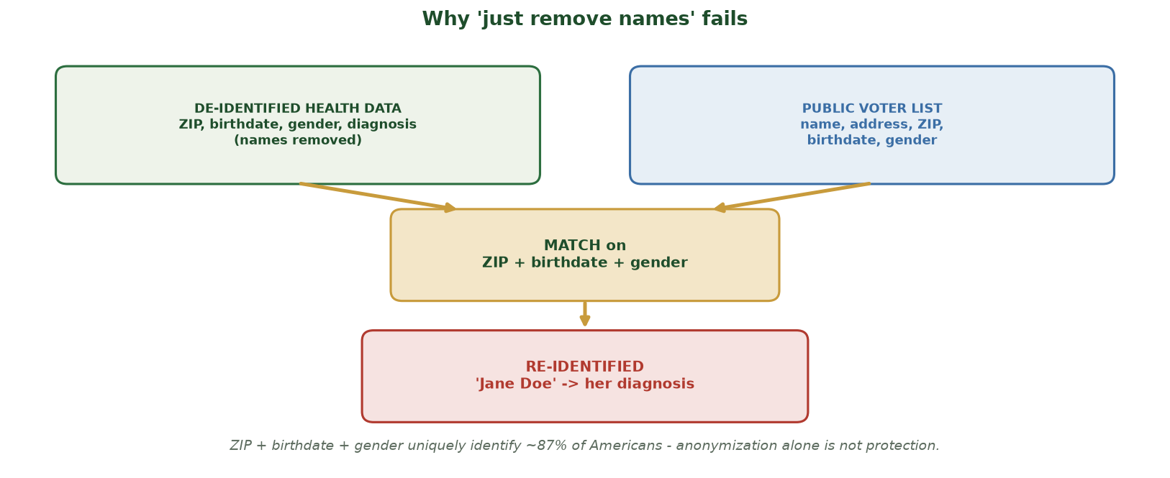
QUASI-IDENTIFIERS RE-IDENTIFY PEOPLE
Why 'Just Remove Names' Fails
De-identified health data (ZIP, birthdate, gender, diagnosis) can be matched to a public voter list on ZIP + birthdate + gender to re-identify 'Jane Doe' and her diagnosis - names removed is not protection.
CIS 350: AI for Cybersecurity · Monday
8
Notes:
Make the anonymization-fails point concrete and memorable. Even after deleting names, the health table still carries QUASI-identifiers - ZIP, birthdate, gender. Trace the join: those three fields also live in a public voter list, so matching on them links the 'anonymous' record back to a named person and exposes her diagnosis. Land the number: ZIP + birthdate + gender uniquely identify ~87% of Americans (the classic Sweeney result). So 'we removed names' is a false comfort - which is exactly why we need the principled techniques (DP, federated, encryption) in Part 2. ~2 min.

Slide 9
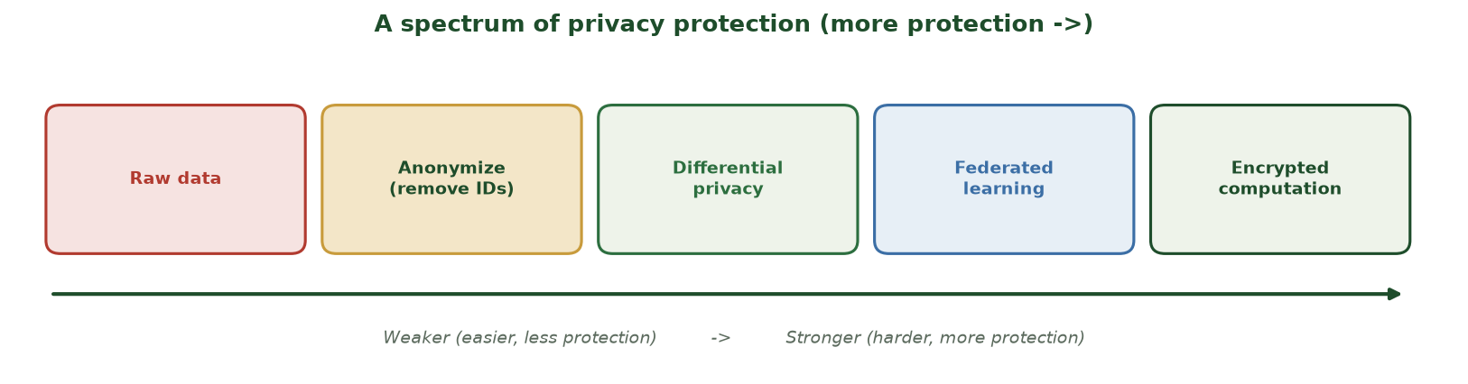
FROM RAW DATA TO STRONG PROTECTION
A Spectrum of Privacy Protection
Raw data -> anonymize -> differential privacy -> federated learning -> encrypted computation (increasing protection).
CIS 350: AI for Cybersecurity · Monday
9
Notes:
Use the spectrum to preview Part 2 and set expectations: protection increases left to right, but so does cost/complexity. Anonymization is the weak end; DP, federated learning, and encrypted computation are the principled tools we'll cover. There's no free lunch - stronger protection usually costs accuracy, speed, or effort. ~3 min.

Slide 10
🔎 ACTIVITY · 4 MIN
Spot the privacy risk
For each, is 'just remove names' enough? Why or why not?
A dataset of logins with zip code, birth date, and device model.
A model that answers 'was user X in the breach training data?'
Sharing a face-recognition model trained on employee photos.
CIS 350: AI for Cybersecurity · Monday
10
Notes:
Build intuition that anonymization is weak. Answers: no - zip+birthdate+device re-identifies people; no - that's membership inference, a leak; no - model inversion could reconstruct faces. Each maps to a technique we'll fix in Part 2. Pairs 2, discuss 2. ~4 min.

Slide 11
PART 2 · PRIVACY-PRESERVING TECHNIQUES · ~24 MIN
Differential Privacy, Federated Learning & Encryption
Notes:
Transition: 'Now the toolkit - three principled ways to learn from data without exposing individuals.' ~28 minutes with figures, a real experiment, and an activity.

Slide 12
TECHNIQUE 1: DP
Differential Privacy: Add Calibrated Noise
Idea: add carefully-tuned random NOISE so no single person changes the answer much.
You get useful AGGREGATE patterns; individuals stay hidden.
The privacy budget epsilon controls it: small epsilon = more noise = more privacy.
It comes with a mathematical guarantee (unlike 'just remove names').
Used in the real world: Apple, Google, and the U.S. 2020 Census.
DP adds calibrated noise; epsilon tunes privacy vs. utility.
CIS 350: AI for Cybersecurity · Monday
12
Notes:
Introduce differential privacy as the gold standard. Core intuition (no math): add just enough random noise that any one person's presence barely changes the output, so you can't reverse-engineer individuals - but averages/patterns survive. Emphasize epsilon: SMALL = more noise = more privacy. Ground it: Apple/Google/Census use it. The figures make it concrete. ~5 min.

Slide 13
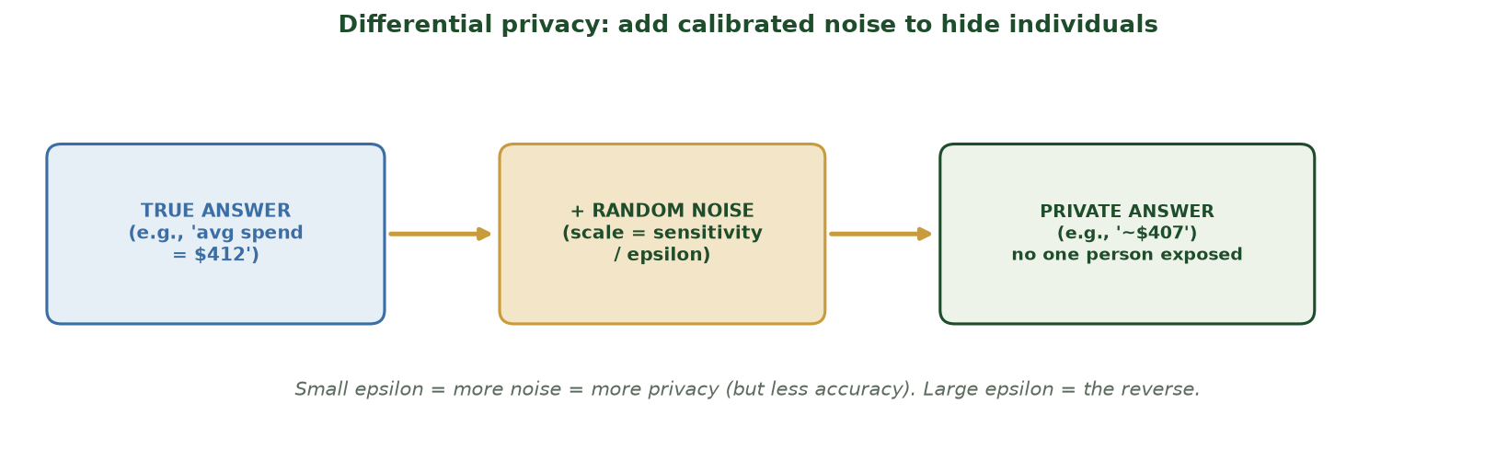
TRUE ANSWER + CALIBRATED NOISE
How Differential Privacy Works
Add random noise (scale = sensitivity / epsilon) to the true answer; the released value protects any individual.
CIS 350: AI for Cybersecurity · Monday
13
Notes:
Walk the mechanism figure. True aggregate -> add noise scaled by sensitivity/epsilon -> private released value. Stress the knob: smaller epsilon means bigger noise (more privacy, less accuracy). Ask: 'If I set epsilon tiny, what happens to the answer's usefulness?' (It gets noisy/less accurate - the trade-off we measure next.) ~4 min.

Slide 14
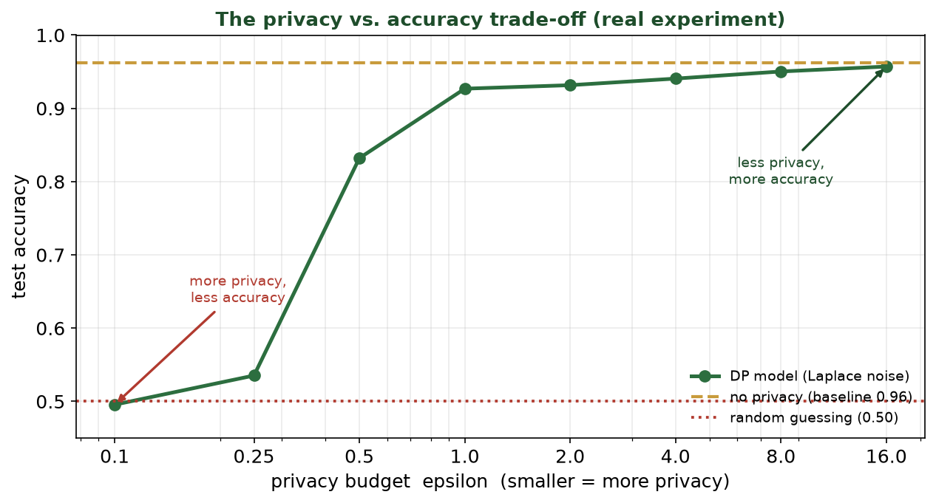
LAB 11'S EXPERIMENT
The Privacy vs. Accuracy Trade-off (Real)
Adding Laplace noise at each epsilon: tiny epsilon (0.1) collapses to ~0.50 (guessing); epsilon=1 already reaches ~0.93 vs the 0.96 baseline.
CIS 350: AI for Cybersecurity · Monday
14
Notes:
This is the money slide and it's REAL (you'll reproduce it in Lab 11). Walk the curve: at epsilon=0.1 accuracy is ~0.50 (chance) - too much noise; as epsilon grows, accuracy climbs toward the no-privacy baseline (0.96). The key insight: at epsilon=1 we already get ~0.93 - strong privacy for a small accuracy cost. The trade-off is real but often very affordable. ~5 min.

Slide 15
TECHNIQUE 2: FEDERATED
Federated Learning: Bring the Model to the Data
Instead of collecting everyone's data centrally, keep data ON the device.
Each device trains locally; only model UPDATES (not raw data) are sent.
A server combines the updates into a shared model.
Your phone's keyboard suggestions are trained this way.
Great for hospitals/banks that legally cannot pool raw data.
Data stays home; only model updates travel.
CIS 350: AI for Cybersecurity · Monday
15
Notes:
Introduce federated learning. The flip: don't move the data to the model, move the model to the data. Raw data never leaves the device; only learned updates are shared and combined. Real examples: phone keyboards (Gboard), and hospitals/banks that can't legally share raw records. Note it reduces exposure but isn't perfect (updates can leak a little - often combined with DP). ~4 min.

Slide 16
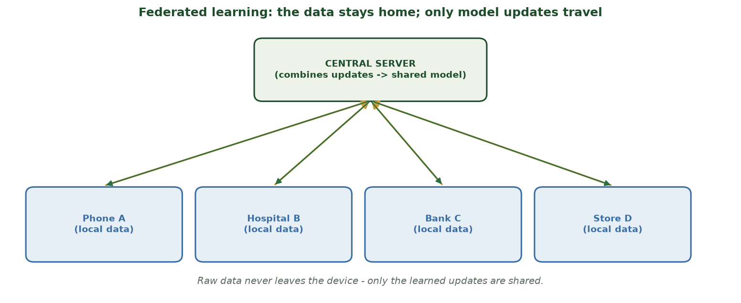
THE DATA STAYS HOME
Federated Learning
Devices train locally and send only model updates to a central server, which combines them into a shared model.
CIS 350: AI for Cybersecurity · Monday
16
Notes:
Walk the federated diagram. Point out the two flows: updates go UP to the server, the improved shared model comes back DOWN - and raw data never moves. Emphasize the business relevance: organizations that cannot pool data (privacy law, competition) can still collaborate on a shared model. ~4 min.

Slide 17
TECHNIQUE 3: ENCRYPTION
Encrypted Computation (a Peek)
Idea: compute on data while it stays ENCRYPTED - never decrypt it.
Homomorphic encryption: math on ciphertext; only the owner decrypts the result.
Secure multiparty computation: several parties compute a joint result, each hiding its input.
Extremely strong privacy - but currently slow and complex.
Best for narrow, high-value tasks today; improving fast.
Compute on encrypted data; strong but slow.
CIS 350: AI for Cybersecurity · Monday
17
Notes:
Give a light, intuition-level peek (don't go deep). The wow idea: you can compute on data without ever seeing it. Homomorphic encryption and secure multiparty computation. Be honest about the trade-off: very strong privacy but slow/complex, so it's used for narrow high-value tasks today. Students only need the concept and when it's worth it. ~3 min.

Slide 18
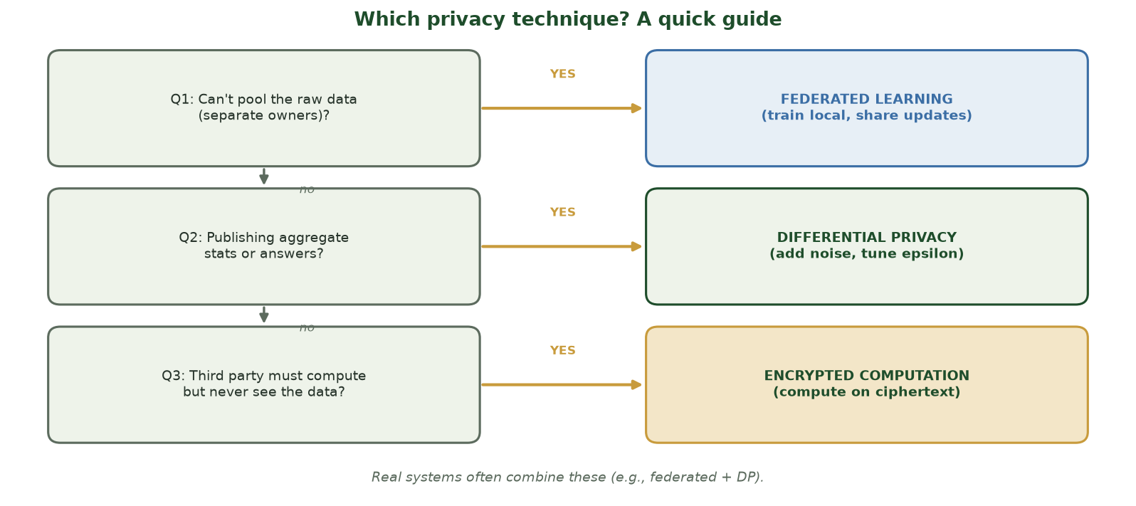
THREE QUESTIONS PICK THE TOOL
Which Privacy Technique? A Quick Guide
Can't pool the raw data? -> federated learning. Publishing aggregate stats? -> differential privacy. A third party must compute but never see the data? -> encrypted computation. Real systems combine them.
CIS 350: AI for Cybersecurity · Monday
18
Notes:
Give students a reusable decision guide before the matching activity. Walk the three yes/no questions top to bottom: (1) if separate owners CAN'T pool raw data, use FEDERATED LEARNING (train local, share updates); (2) if you're PUBLISHING aggregate stats/answers, use DIFFERENTIAL PRIVACY (add noise, tune epsilon); (3) if a third party must COMPUTE but never SEE the data, use ENCRYPTED COMPUTATION. Emphasize the bottom note: real systems often COMBINE these (e.g., federated + DP). This guide is exactly the reasoning the next activity and the in-class task ask for. ~2 min.

Slide 19
🧩 ACTIVITY · 3 MIN
Match the technique
Which privacy technique fits each situation - DP, federated learning, or encrypted computation?
Publish crime statistics without exposing any single victim.
Ten hospitals want a shared model but cannot share raw patient records.
A cloud service must analyze data it is never allowed to see in the clear.
CIS 350: AI for Cybersecurity · Monday
19
Notes:
Consolidate Part 2. Answers: differential privacy (noisy published stats); federated learning (local training, share updates); encrypted computation (compute without decrypting). Note real systems often COMBINE these (e.g., federated + DP). Pairs 2, discuss 1. ~3 min.

Slide 20
PART 3 · SECURITY VS. PRIVACY · ~13 MIN
The Tension, and Real SecOps Dilemmas
Notes:
Transition: 'Privacy tools are great - but privacy and security sometimes PULL against each other.' ~16 minutes with a figure and an activity.

Slide 21
THE CORE TENSION
The Tension: Encryption vs. Detection
More privacy can mean LESS visibility for defenders.
Strong encryption hides data from attackers - and from inspection tools.
Collecting more data helps detection - but erodes privacy.
Neither 'maximize privacy' nor 'maximize surveillance' is right.
The goal is a deliberate, justified BALANCE.
Privacy and detection can pull against each other - balance them.
CIS 350: AI for Cybersecurity · Monday
21
Notes:
State the tension clearly. Example: encrypted traffic (HTTPS, VPNs) protects users but also hides malware command-and-control and data exfiltration from defenders. Conversely, deep monitoring catches attacks but is surveillance. The mature stance (recall defense-in-depth and governance): balance deliberately, don't maximize one blindly. ~4 min.

Slide 22
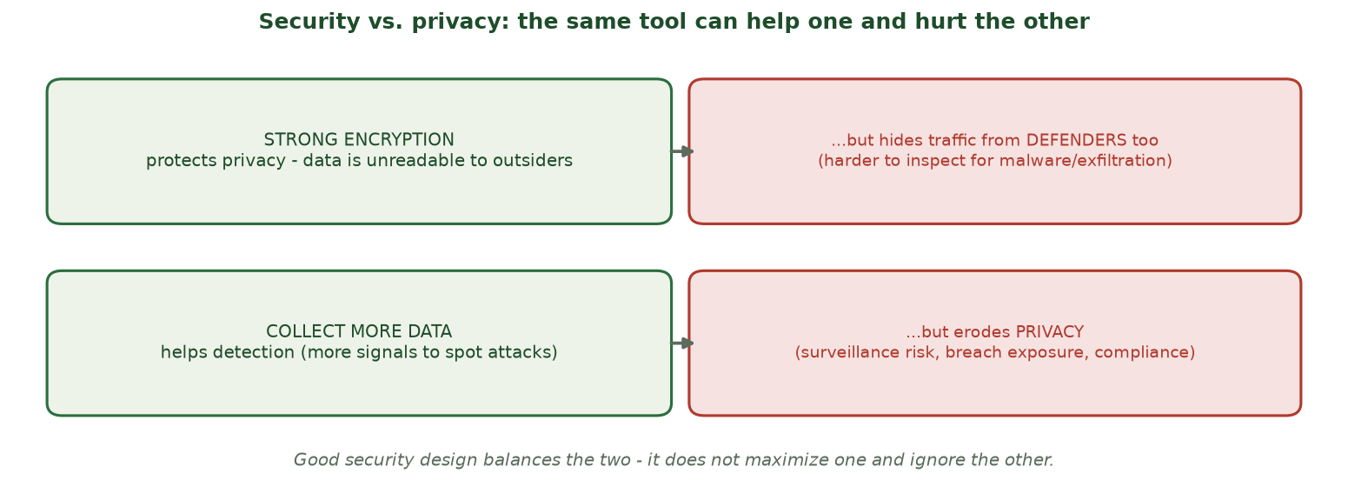
BALANCE, DON'T MAXIMIZE
Security vs. Privacy: the Same Tool Cuts Both Ways
Strong encryption and more data collection each help one goal while hurting the other - design for balance.
CIS 350: AI for Cybersecurity · Monday
22
Notes:
Walk the four-quadrant figure. Left = the benefit, right = the cost, for two common choices (encryption; more data collection). The lesson: every privacy/security lever has a cost on the other side. Good design names the trade-off and justifies where it lands - it doesn't pretend there's a free win. ~4 min.

Slide 23
SECOPS DILEMMAS
Real Dilemmas in Security Operations
Inspecting encrypted traffic: decrypt to catch malware, or preserve user privacy?
Logging everything: better forensics, but a huge sensitive-data honeypot.
Sharing threat data across companies: helps everyone, risks exposing customers.
Employee monitoring: catches insider threats, but erodes trust and may break law.
There's rarely a 'correct' answer - there's a documented, defensible decision.
Real trade-offs: inspection, logging, sharing, monitoring.
CIS 350: AI for Cybersecurity · Monday
23
Notes:
Ground the tension in concrete SecOps decisions students could face as managers. For each, name both sides. Reinforce the Week-12 governance theme: the right move is a DOCUMENTED, justified decision (with legal input and data-minimization), not a reflex. This is exactly the applied judgment Exam 3 scenarios reward. ~4 min.

Slide 24
⚖️ ACTIVITY · 4 MIN
Resolve the dilemma
Your SOC wants to decrypt all employee web traffic to catch malware. With a neighbor:
Name one security benefit and one privacy cost.
Suggest a middle-ground that gets most of the benefit with less privacy cost.
Who should decide, and what should be documented?
CIS 350: AI for Cybersecurity · Monday
24
Notes:
Practice the balanced reasoning. Good answers: benefit = catch hidden malware/exfiltration; cost = reading employees' personal browsing (trust, legal). Middle ground: inspect only work systems, exclude banking/health domains, minimize retention, notify employees. Decide: security + legal + HR together, documented policy. Pairs 2, discuss 2. ~4 min.

Slide 25
🧩 IN-CLASS TASK · 12 MIN
Design a Privacy Plan for a Bank Fraud-Detection Consortium
Ten regional banks want ONE shared phishing/fraud model but face three constraints: (1) law forbids sharing raw customer transactions across banks; (2) they must publish a quarterly PUBLIC fraud-rate dashboard by region; (3) a third-party cloud vendor runs the heavy analytics but must never see customer data in the clear. In pairs, pick the right tool for each need (~7 min).
List the three needs; for each, name the technique - federated learning, differential privacy, or encrypted computation.
For each choice, write one sentence justifying it and one naming its trade-off (accuracy/speed/effort).
For the PUBLIC dashboard, choose a small or large epsilon and justify it (aim near epsilon ~ 1).
Add one security-vs-privacy safeguard (e.g., drop account numbers, minimize retention) and name who signs off.
CIS 350: AI for Cybersecurity · Monday
25
Notes:
The session's capstone - students map each need to the right tool, the exact reasoning Lab 11 and Quiz 10 reward. Model answer: NEED 1 (can't pool raw data) -> FEDERATED LEARNING (train local, share only updates); trade-off = updates can leak a little (often paired with DP) and coordination is slower. NEED 2 (public regional stats) -> DIFFERENTIAL PRIVACY with epsilon ~ 1 (Monday's curve showed ~0.93 vs the 0.96 baseline - strong privacy at small cost); trade-off = slight accuracy loss. NEED 3 (vendor never sees cleartext) -> ENCRYPTED COMPUTATION (homomorphic / secure multiparty); trade-off = very strong but slow/complex, so keep it narrow. SAFEGUARD: minimize retained fields, exclude account numbers, document with legal/compliance sign-off. Key point: real systems COMBINE techniques (federated + DP), and 'remove names' is never the answer. Have 2 pairs share. ~12 min.

Slide 26
USE THESE SLIDES AS YOUR STUDY GUIDE
How Today Connects to Lab 11 & Quiz 10
🧪 In Lab 11 you will...
📝 For Quiz 10, master...
Add Laplace noise to training data at several epsilons.
Plot the privacy vs. accuracy trade-off curve.
Find an epsilon that balances privacy and accuracy.
Reflect on when the trade-off is worth it.
Explain differential privacy, federated learning, encrypted computation.
Read the privacy vs. accuracy trade-off (epsilon).
Explain why anonymization alone is weak.
Discuss a security-vs-privacy dilemma and a balanced answer.
CIS 350: AI for Cybersecurity · Monday
26
Notes:
Tie the lecture to Lab 11 and Quiz 10. Left = Lab 11 tasks (reproduce today's trade-off curve); right = Quiz 10 concepts. Note Lab 11 releases today; Quiz 10 and Exam 3 are this week. ~2 min.

Slide 27
Key Takeaways
✓
Models can leak personal data, and 'just remove names' is not real protection.
✓
Differential privacy adds calibrated noise (epsilon knob); federated learning keeps data on-device; encrypted computation works on ciphertext.
✓
The privacy vs. accuracy trade-off is real but often affordable - epsilon=1 reached ~0.93 vs a 0.96 baseline.
✓
Security and privacy can pull against each other - design for a deliberate, documented balance.
Notes:
Recap one point per objective. Cold-call: 'What does epsilon control in differential privacy?' Reinforce that privacy protection is principled and measurable. Preview Wednesday: an active Exam-3 review, logistics, and a Week 14 preview. ~2 min.

Slide 28
WHAT'S NEXT
Looking Ahead: Lab 11, Quiz 10 & Exam 3
🧪 Lab 11 (Differential Privacy) releases today - reproduce today's trade-off curve.
📝 Quiz 10 this week (privacy-preserving ML, DP, federated learning, trade-offs).
📖 Read Handout 11: Privacy-Preserving ML and Trade-Offs.
🧭 Exam 3 (online, 90 min, 100 pts) covers Weeks 10-13 - see the Study Guide & Practice Exam.
📊 Wednesday: guided Exam-3 review, exam logistics, and a Week 14 preview.
Lab 11 today; Quiz 10 & Exam 3 this week; Wed = review + logistics.
CIS 350: AI for Cybersecurity · Monday
28
Notes:
Assign and preview. Lab 11 reproduces today's curve. Point students to the Exam 3 Study Guide and Practice Exam (posted in Canvas). Wednesday is a full active review + logistics. ~2 min.

Slide 29
🎯 EXIT TICKET · 2 MIN
One minute before you go
On the Canvas exit-ticket quiz or a card:
In one sentence, what does differential privacy do?
Why isn't removing names enough to protect privacy?
One thing from today you'd like clarified before Exam 3.
CIS 350: AI for Cybersecurity · Monday
29
Notes:
Close with the exit ticket. Q1 checks Objective 2; Q2 checks the anonymization misconception. Use clarifications to shape Wednesday's review. ~2 min.

Slide 30
SOURCES & FURTHER READING
References & Further Reading
  C. Dwork & A. Roth, 'The Algorithmic Foundations of Differential Privacy,' 2014.
  NIST SP 800-226 (2023), Guidelines for Evaluating Differential Privacy Guarantees.
  H. B. McMahan et al., 'Communication-Efficient Learning' (federated learning), 2017.
  NIST Privacy Framework 1.0; NIST AI RMF 1.0 (2023).
  U.S. Census Bureau - differential privacy in the 2020 Census (case study).
CIS 350: AI for Cybersecurity · Monday
30
Notes:
Appendix slide: references and study resources. Post to Canvas or leave visible during the exit ticket - it is not part of the timed session.

