Slide 1

WEEK 12 · WEDNESDAY · 75 MINUTES
Fairness Definitions, Regulation & Responsible AI
Trade-offs · GDPR & the EU AI Act · Governance in Practice
CIS 350: AI for Cybersecurity — Smart Defense for the Digital Business
Ramadan Abdunabi, Ph.D. · Computer Information Systems
Notes:
Connect to Monday: 'We SAW bias in the risk flagger. Today: how to define fairness precisely (harder than it sounds), what the law requires, and how organizations actually do responsible AI.' Remind students Quiz 9 is today in class. Reach Part 1 by ~minute 8. ~1 min.

Slide 2

🔁 WARM-UP · 5 MIN
Define 'fair' in one sentence
With a neighbor, one sentence each:
Write your own definition of a 'fair' risk flagger.
Compare with your partner - do they match?
Could two reasonable people disagree about what's fair here?
CIS 350: AI for Cybersecurity · Wednesday
2
Notes:
Surface the key tension before naming it. Pairs write definitions; most will differ (equal flag rates? equal accuracy? equal false positives?). Cold-call 2-3 and note the disagreement on the board. Bridge: 'You've just discovered that 'fair' has multiple, competing definitions - that's today's Part 1.' ~5 min.

Slide 3
WEDNESDAY · 75 MINUTES
Today's Plan
🔁
Warm-up & recap
'Fair' means many things
8 min
⚖️
Fairness definitions & trade-offs
Parity, opportunity, odds + mitigation
20 min
📜
The regulatory landscape
GDPR, EU AI Act, US & sector rules
18 min
🏛️
Responsible AI in practice
Boards, model cards, audits, oversight
10 min
🧩
In-class task
Draft the model card fairness section
13 min
🎯
Wrap & exit
Takeaways; Quiz 9; Week 13
6 min
CIS 350: AI for Cybersecurity · Wednesday
3
Notes:
Walk the plan; the row minutes add up to exactly 75. Definitions and trade-offs first, then the law, then organizational practice. Quiz 9 is administered at the end of class. ~1 min.

Slide 4
DEFINITIONS, REGULATION & RESPONSIBLE AI
Today's Objectives
1
Compare fairness definitions: demographic parity, equal opportunity, equalized odds.
2
Explain why fairness definitions can conflict (you must choose).
3
Summarize GDPR, the EU AI Act, and US/sector regulation.
4
Describe how organizations operationalize responsible AI.
CIS 350: AI for Cybersecurity · Wednesday
4
Notes:
State the goals. Objective 2 (definitions conflict) is the intellectual core; Objectives 3-4 make it actionable. All are Exam-3 relevant. ~1 min.

Slide 5
PART 1 · FAIRNESS DEFINITIONS & TRADE-OFFS · ~20 MIN
Three Definitions - and Why They Conflict
Notes:
Transition: 'Let's make 'fair' precise. There are several definitions, and here's the catch - you usually can't have them all.' ~24 minutes with two figures and an activity.

Slide 6
THREE DEFINITIONS
Three Ways to Define Fairness
Demographic parity: each group is flagged at the SAME rate.
Equal opportunity: each group's TRUE risky cases are caught at the same rate (equal TPR).
Equalized odds: equal TPR AND equal false-positive rate across groups.
Each encodes a different notion of what 'fair' should mean.
None is 'the' right one - it depends on the harm you care about.
Parity, equal opportunity, equalized odds - different notions.
CIS 350: AI for Cybersecurity · Wednesday
6
Notes:
Introduce the three most common group-fairness definitions in plain language (no formulas). Tie each to Monday's metrics: parity = equal selection rate; equal opportunity = equal TPR; equalized odds = equal TPR AND FPR. Emphasize each is a value judgment about which harm matters. The figure visualizes them. ~4 min.

Slide 7
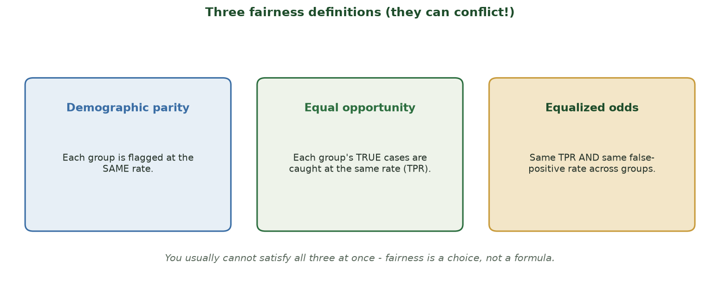
THEY CAN CONFLICT
Three Fairness Definitions
Demographic parity, equal opportunity, and equalized odds - you usually cannot satisfy all at once.
CIS 350: AI for Cybersecurity · Wednesday
7
Notes:
Walk the three cards. Give a security example for each: parity (flag both groups equally often), equal opportunity (catch real threats equally well in both groups), equalized odds (also wrongly flag innocents equally rarely). Set up the punchline: these pull in different directions. ~4 min.

Slide 8
IMPOSSIBILITY
The Catch: Definitions Conflict
If two groups truly differ in base rates, you often CAN'T satisfy all definitions.
Enforcing equal flag rates can change who gets wrongly flagged.
Researchers proved several fairness definitions are mathematically incompatible.
So 'make it fair' is under-specified - you must CHOOSE a definition.
That choice is an ethical & business decision, not a purely technical one.
You must choose a definition - they can't all hold at once.
CIS 350: AI for Cybersecurity · Wednesday
8
Notes:
Deliver the key intellectual result at an intuitive level: when base rates differ, common fairness definitions can't all be satisfied simultaneously (the Kleinberg/Chouldechova impossibility results). Don't do the math - the point is that fairness requires an explicit CHOICE, made by humans with stakeholders, not hidden in code. This reframes fairness as governance. ~4 min.

Slide 9
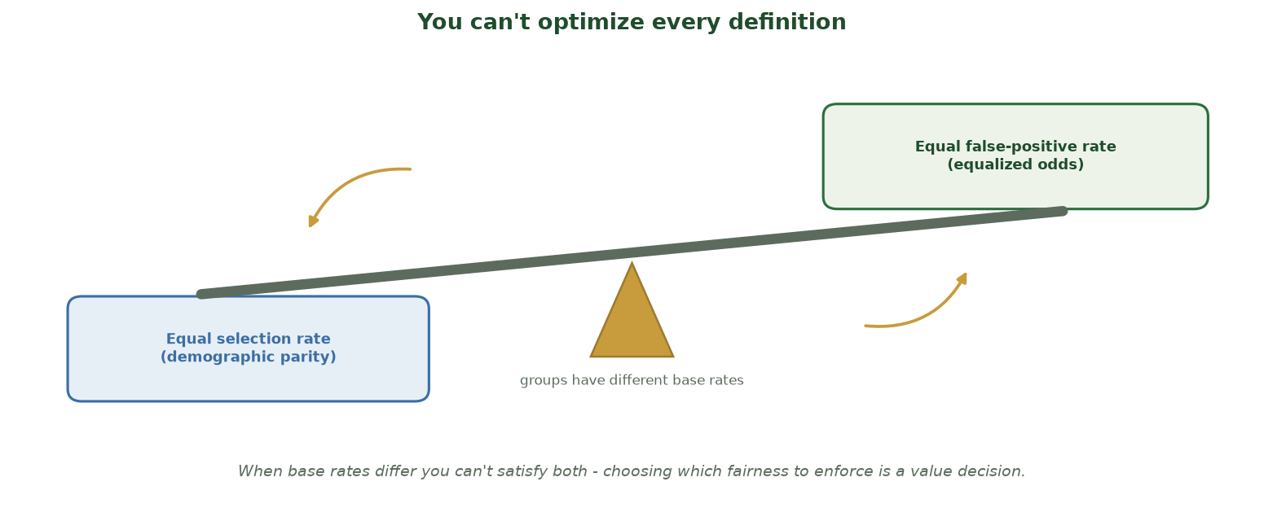
TIGHTEN ONE FAIRNESS METRIC, ANOTHER LOOSENS
You Can't Optimize Every Definition
When two groups have different base rates, pushing down toward equal selection rates raises the false-positive-rate gap (and vice versa) - so you must choose which fairness to enforce.
CIS 350: AI for Cybersecurity · Wednesday
9
Notes:
Use the seesaw to make the impossibility result intuitive - no math. The beam can't be level: when the groups' base rates differ, enforcing equal SELECTION rates (left, demographic parity) tips the balance so equal FALSE-POSITIVE rates (right, equalized odds) can't also hold - push one down and the other rises. The fulcrum label reminds them WHY: different base rates. The takeaway: choosing which fairness definition to enforce is a value decision tied to the harm you care about, not a formula the computer picks. This sets up the deliberate mitigation choice next. ~2 min.

Slide 10
MITIGATION TOOLKIT
Mitigation: What We Can Actually Do
Fix the DATA: correct biased labels, remove proxy features (e.g., zip code).
Adjust the MODEL: reweight groups, set group-aware thresholds, add fairness constraints.
Audit BEFORE and AFTER deployment - and keep monitoring.
Keep a human in the loop for high-stakes flags (appeals).
Trade-off: fairness fixes can cost some accuracy - decide deliberately.
Fix data, adjust model, audit, keep humans in the loop.
CIS 350: AI for Cybersecurity · Wednesday
10
Notes:
Give the practical toolkit, mapped to Monday's pipeline. Pre-processing (fix data), in-processing (constraints), post-processing (thresholds). Stress auditing and human oversight. Set up the figure: our simplest fix - drop the proxy and train on fair labels. Note the usual accuracy trade-off (though in our case it actually improved). ~4 min.

Slide 11
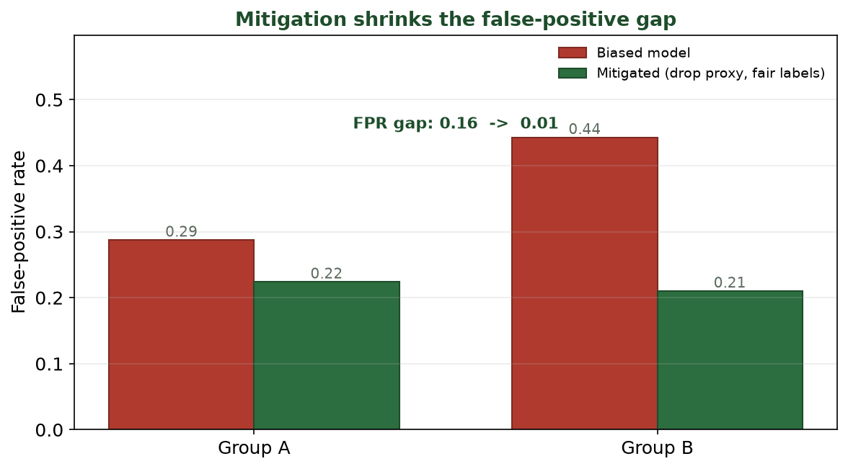
SAME MODEL FAMILY, FAIRER OUTCOME
Mitigation Shrinks the Gap
Dropping the proxy and training on fair labels cut the false-positive gap from 0.16 to 0.01 - and accuracy rose to 0.75.
CIS 350: AI for Cybersecurity · Wednesday
11
Notes:
Show the payoff figure (Lab 10's mitigation step). The FPR gap collapses from 0.16 to 0.01. Highlight the pleasant surprise: accuracy went UP (0.71 -> 0.75) because the biased labels were noise. Caveat honestly: fairness fixes don't always improve accuracy - here they did, but sometimes there's a real trade-off you must weigh. ~4 min.

Slide 12
⚖️ ACTIVITY · 4 MIN
Pick a fairness goal
For the risk flagger, with a neighbor:
Which definition would you enforce - parity, equal opportunity, or equalized odds? Why?
Who should make that call (engineers, legal, affected users)?
Name one mitigation you'd try first.
CIS 350: AI for Cybersecurity · Wednesday
12
Notes:
Force the choice the lecture set up. There's no single right answer - reward justification. Many will pick equalized odds or equal FPR given the wrongful-investigation harm. Emphasize the decision belongs to a cross-functional group, not just engineers. Pairs 2, discuss 2. ~4 min.

Slide 13
PART 2 · THE REGULATORY LANDSCAPE · ~18 MIN
GDPR, the EU AI Act, and US/Sector Rules
Notes:
Transition: 'You don't get to ignore fairness - increasingly, the law requires it. Here's the landscape.' ~22 minutes with an activity.

Slide 14
THE WHY
Why Regulation Exists
AI now makes high-stakes decisions about people at scale.
Voluntary 'we'll be careful' hasn't been enough - real harms occurred.
Regulation sets a floor: what you MUST do, and what you can't.
It also creates accountability - someone is responsible when it goes wrong.
For a business, compliance is now a core requirement, not optional.
Law sets a floor and assigns accountability for AI harms.
CIS 350: AI for Cybersecurity · Wednesday
14
Notes:
Motivate regulation before listing laws. Point to real harms (biased hiring tools, COMPAS recidivism scores). The business framing matters for CIS students: non-compliance means fines, lawsuits, and reputational damage - fairness is now a business requirement. ~4 min.

Slide 15
GDPR (EU, 2018)
GDPR: Data Protection & a Right to Explanation
EU law (2018), but it affects any company handling EU residents' data.
Requires a lawful basis to process personal data, and data-minimization.
Gives people rights: access, correction, deletion.
Includes protections around solely-automated decisions - a 'right to explanation.'
Relevant to our flagger: people may be entitled to know why they were flagged.
Data-protection rights + limits on automated decisions.
CIS 350: AI for Cybersecurity · Wednesday
15
Notes:
Cover GDPR at a business-literate level. Two things to remember: (1) it's extraterritorial - US companies with EU users must comply; (2) it constrains solely-automated decisions and supports explanation, which ties directly to Monday's explainability. Don't get lost in legal detail. ~5 min.

Slide 16
EU AI ACT (2024)
The EU AI Act: Risk-Tiered Rules
First comprehensive AI law (2024); regulates by RISK level.
Unacceptable risk (e.g., social scoring): banned.
High risk (e.g., hiring, credit, some security screening): strict duties.
High-risk duties: risk management, data quality, documentation, human oversight, audits.
Limited/minimal risk (e.g., chatbots): mostly transparency ('you're talking to AI').
Risk tiers: banned / high-risk duties / transparency.
CIS 350: AI for Cybersecurity · Wednesday
16
Notes:
Explain the EU AI Act's central idea: obligations scale with risk. Our account-risk flagger would likely be HIGH-risk (it screens people), triggering documentation, human oversight, and audit duties - exactly the governance we discuss in Part 3. This is the model other jurisdictions are following. ~5 min.

Slide 17
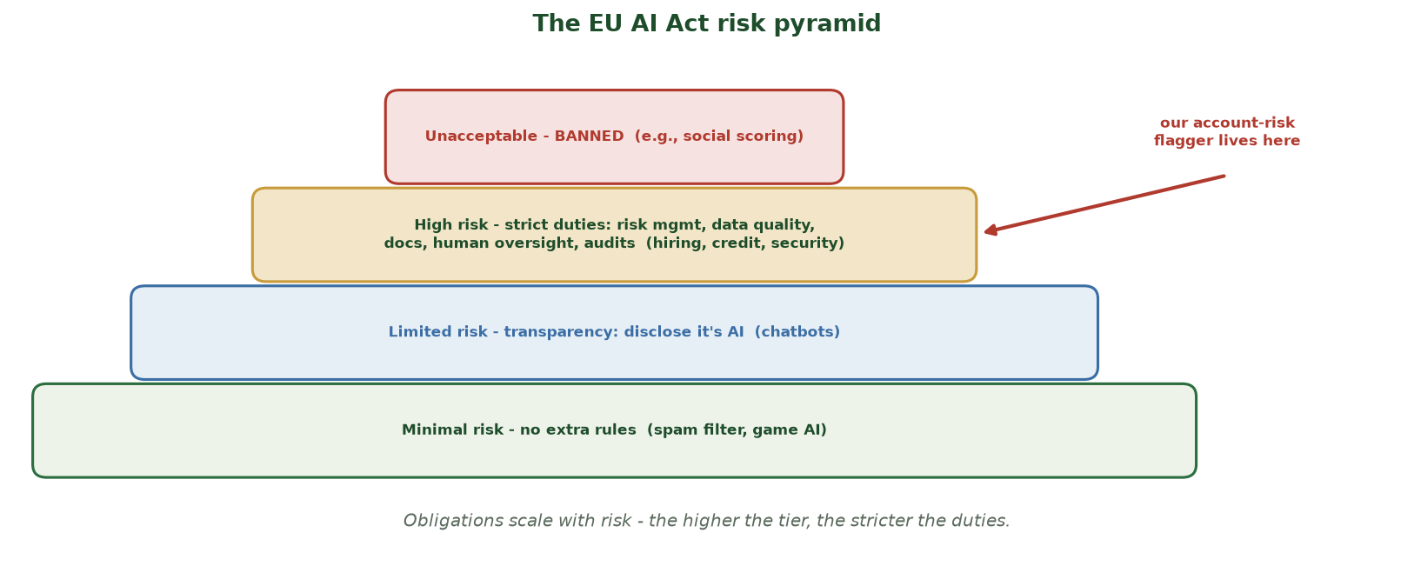
OBLIGATIONS SCALE WITH RISK
The EU AI Act Risk Pyramid
Four tiers: unacceptable (banned) -> high-risk (strict duties: risk mgmt, data quality, docs, human oversight, audits) -> limited (transparency) -> minimal (no extra rules). Our account-risk flagger is high-risk.
CIS 350: AI for Cybersecurity · Wednesday
17
Notes:
Anchor the EU AI Act with the pyramid. The core idea is that duties scale with risk. Point to the narrow RED top - a few uses are outright BANNED (social scoring). The GOLD high-risk tier is the one that matters for us: anything that screens people (hiring, credit, security) must do risk management, data-quality checks, documentation, human oversight, and audits. Land the red callout: our account-risk flagger lives in the high-risk tier - which is exactly why Part 3's governance (model cards, audits, oversight) is not optional. Limited/minimal tiers get lighter or no rules. ~2 min.

Slide 18
US & SECTORS
United States & Sector-Specific Rules
No single US federal AI law yet - a patchwork instead.
Executive orders push 'safe, secure, trustworthy' AI; NIST AI RMF is voluntary guidance.
Sector rules bite: finance (ECOA/fair lending), hiring (EEOC), health (HIPAA).
Some states/cities add their own (e.g., NYC's hiring-AI audit law).
Takeaway: which rules apply depends on your industry and location.
A patchwork: NIST guidance + sector & state rules.
CIS 350: AI for Cybersecurity · Wednesday
18
Notes:
Contrast the US patchwork with the EU's comprehensive approach. Key point for business students: even without one big AI law, sector regulators (banking, employment, health) already police biased algorithms under existing law, and states are adding rules. You must know which apply to YOUR context. ~4 min.

Slide 19
📜 ACTIVITY · 4 MIN
Which rules apply?
For each deployment, name a rule/framework that likely applies:
A US bank's AI that approves or denies loans.
A hiring tool screening applicants in New York City.
A chatbot serving EU customers.
A hospital's AI triaging patients.
CIS 350: AI for Cybersecurity · Wednesday
19
Notes:
Apply the landscape. Answers: fair-lending (ECOA) + would be high-risk under the EU AI Act if EU; NYC automated-employment-decision audit law + EEOC; GDPR transparency (disclose it's AI) + EU AI Act limited-risk; HIPAA + high-risk medical AI. Reward naming the right domain. Pairs 2, discuss 2. ~4 min.

Slide 20
PART 3 · RESPONSIBLE AI IN PRACTICE · ~10 MIN
How Organizations Actually Do It
Notes:
Transition: 'How does a company turn all this into daily practice? A repeatable process.' ~13 minutes with a figure and an activity.

Slide 21
A REPEATABLE LOOP
Responsible AI Is a Process, Not a Checkbox
It's an ongoing loop, owned by people - not a one-time sign-off.
Governance board: sets policy and approves high-risk models.
Documentation: data sheets and MODEL CARDS (what it does, limits, fairness results).
Bias & fairness AUDITS before launch and on a schedule after.
Transparency, human oversight, appeals - then monitor and re-audit.
Board, documentation, audits, oversight, monitoring - repeat.
CIS 350: AI for Cybersecurity · Wednesday
21
Notes:
Frame responsible AI as an operational process. Define model cards (a short 'nutrition label' for a model: purpose, data, performance, fairness metrics, limitations). Emphasize the cycle continues after launch - models drift, populations change. The figure shows the loop. ~3 min.

Slide 22
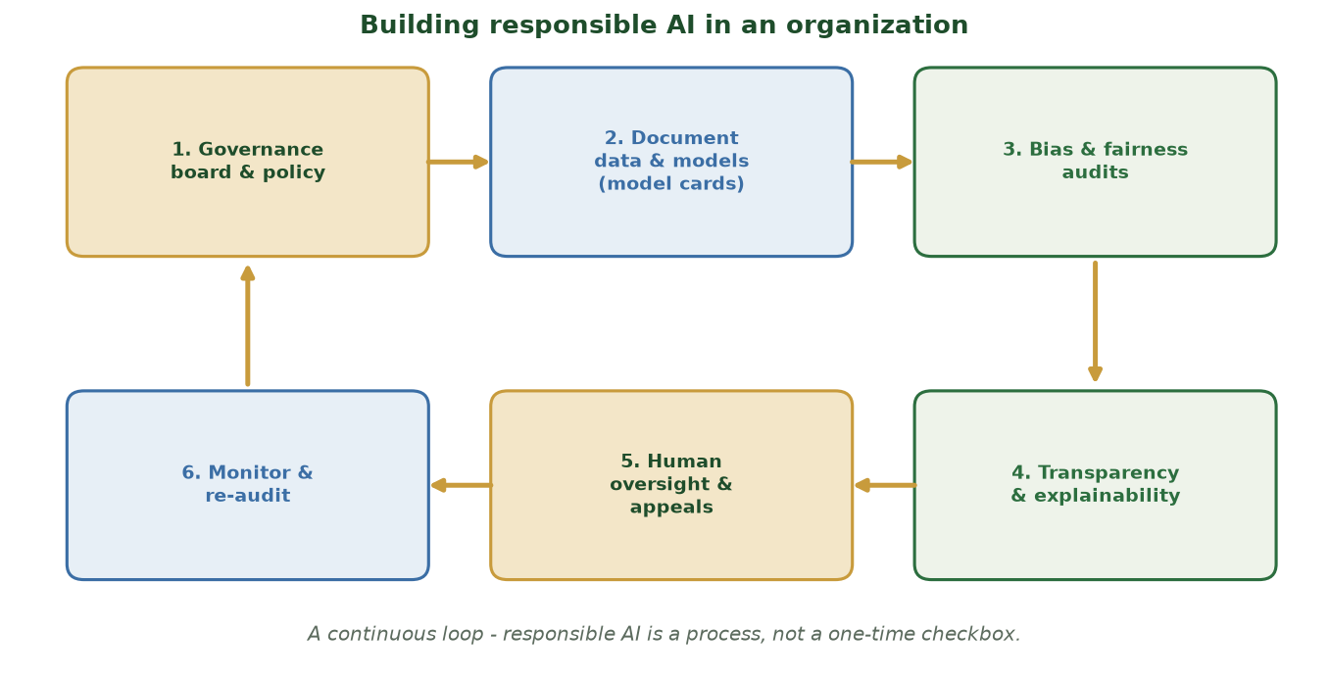
A CONTINUOUS LOOP
Building Responsible AI in an Organization
Governance board -> documentation -> audits -> transparency -> human oversight -> monitoring -> repeat.
CIS 350: AI for Cybersecurity · Wednesday
22
Notes:
Walk the six-step loop. Point out each step maps to something concrete from the week: audits produce Monday's per-group metrics; documentation is the model card; oversight is the human appeal path; monitoring catches drift and feedback loops. This is what compliance with the EU AI Act looks like in practice. ~4 min.

Slide 23
THE ARTIFACTS
Model Cards, Audits & Human Oversight
Model card: purpose, training data, performance, PER-GROUP fairness, and known limits.
Fairness audit: compute per-group metrics (like Lab 10) and report the gaps.
Human oversight: a person can review, override, and be accountable for flags.
Appeals: affected people can contest an automated decision.
Document decisions - including which fairness definition you chose and why.
Model cards + audits + oversight + appeals, all documented.
CIS 350: AI for Cybersecurity · Wednesday
23
Notes:
Make the artifacts concrete. A fairness audit is literally what students do in Lab 10 - computing and reporting per-group metrics. Tie back to Part 1: the chosen fairness definition should be documented in the model card with its justification. This is where technical work meets accountability. ~3 min.

Slide 24
🏛️ ACTIVITY · 3 MIN
Design a governance step
Your team is about to deploy the risk flagger. With a neighbor, pick ONE:
Write two lines that must appear on its model card.
Design one question the fairness audit must answer.
Define who can override a flag, and how a user appeals.
CIS 350: AI for Cybersecurity · Wednesday
24
Notes:
Consolidate into practice. Good answers: model card must state per-group FPR and the chosen fairness definition; audit must answer 'what's the FPR gap across groups?'; overrides by a trained analyst with a logged reason, appeals via a documented channel. Ties the whole week together. Pairs 2, discuss 1. ~3 min.

Slide 25
⚖️ IN-CLASS TASK · 13 MIN
Draft the Model Card Fairness Section
Your fintech is about to launch the account-risk flagger to EU + US customers; the governance board requires a one-page Model Card fairness section. This week's numbers - BIASED: acc 0.71, Group A sel 0.47/FPR 0.29/TPR 0.74, Group B sel 0.64/FPR 0.44/TPR 0.89; MITIGATED: acc 0.75, FPR gap 0.16 -> 0.01. Main harm: an innocent customer is investigated / account frozen. In pairs, draft the card (~8 min), then present.
Header: the model's purpose, who it decides about, and the two groups compared.
Enter per-group FPR/TPR and the FPR gap BEFORE and AFTER mitigation.
Choose ONE fairness definition to enforce (parity / equal opportunity / equalized odds) and justify it in two sentences tied to the wrongful-investigation harm.
Name the regulation(s) that apply (EU AI Act tier + GDPR) with one control each, and state who overrides a flag + how a user appeals.
CIS 350: AI for Cybersecurity · Wednesday
25
Notes:
The week's capstone - students produce the governance artifact Lab 10 formalizes. Model answer: HEADER - purpose = flag risky accounts for review; decides about account holders; groups A vs B. METRICS - FPR gap 0.16 (0.29 vs 0.44) before, ~0.01 after; TPR ~0.74/0.89; accuracy 0.71 -> 0.75. DEFINITION - equalized odds / equal-FPR is the strongest defensible pick because the dominant harm is innocent people wrongly investigated (equal opportunity alone ignores false positives; parity ignores who is actually risky) - reward any choice justified against the harm. REGULATION - EU AI Act = HIGH-RISK (screens people) -> documentation, human oversight, audits; GDPR -> lawful basis + meaningful explanation for solely-automated decisions. OVERSIGHT - a trained analyst overrides with a logged reason; users appeal via a documented, time-bound channel. This is exactly the fairness audit + documentation students produce in Lab 10. Have 2 pairs present. ~13 min.

Slide 26
USE THESE SLIDES AS YOUR STUDY GUIDE
How Today Connects to Lab 10 & Quiz 9
🧪 In Lab 10 you will...
📝 For Quiz 9, master...
Compute per-group metrics on the biased flagger.
Apply a mitigation and re-measure the FPR gap.
Write a short fairness finding (like an audit).
Submit the completed notebook in Canvas.
Compare parity, equal opportunity, and equalized odds.
Explain why fairness definitions conflict (you must choose).
Summarize GDPR, the EU AI Act, and US/sector rules.
Describe model cards, audits, and human oversight.
CIS 350: AI for Cybersecurity · Wednesday
26
Notes:
Tie Wednesday to Lab 10 and Quiz 9. Left = Lab 10 tasks; right = Quiz 9 concepts. Remind students Quiz 9 is administered now, and Lab 10 is due next week. ~2 min.

Slide 27
Key Takeaways
✓
There are multiple fairness definitions (parity, equal opportunity, equalized odds) and they can conflict - you must choose.
✓
Regulation is real and rising: GDPR, the EU AI Act (risk tiers), and US/sector rules - compliance is a business requirement.
✓
Mitigation works: fixing data and dropping proxies cut our FPR gap from 0.16 to 0.01 (accuracy even rose to 0.75).
✓
Responsible AI is a continuous process: governance boards, model cards, audits, oversight, and monitoring.
Notes:
Recap one point per objective. Cold-call: 'Why can't a model satisfy every fairness definition at once?' Reinforce that fairness is a documented human choice. Preview Week 13: privacy, security-vs-privacy trade-offs, and Exam 3. ~2 min.

Slide 28
WHAT'S NEXT
Looking Ahead: Quiz 9, Lab 10 & Week 13
📝 Quiz 9 is administered now (fairness, bias, governance, regulation).
🧪 Finish Lab 10 (Bias Detection) and submit in Canvas by the due date.
📖 Review Handout 10: AI Ethics, Bias, and Fairness.
🔜 Week 13: privacy-preserving ML, security-vs-privacy trade-offs, and Exam 3.
🧭 Exam 3 covers Weeks 10-13 (attacks on AI, LLM security, ethics, privacy).
Quiz 9 now; finish Lab 10; Week 13 = privacy + Exam 3.
CIS 350: AI for Cybersecurity · Wednesday
28
Notes:
Administer Quiz 9 at the end of class. Assign the rest of Lab 10 and Handout 10. Preview Week 13 (privacy) and flag that Exam 3 covers Weeks 10-13. ~2 min.

Slide 29
🎯 EXIT TICKET · 2 MIN
Before Quiz 9
Quick check (then we start Quiz 9):
Name two fairness definitions and how they differ.
Name one law/framework that governs AI decisions about people.
One concept you want reviewed before the quiz.
CIS 350: AI for Cybersecurity · Wednesday
29
Notes:
Use as a pre-quiz warm-up and last-chance clarification. Then hand out/open Quiz 9. Q1 checks definitions; Q2 checks regulation. ~2 min.

Slide 30
SOURCES & FURTHER READING
References & Further Reading
  EU Artificial Intelligence Act (2024) - risk-tiered regulation of AI.
  S. Barocas, M. Hardt, A. Narayanan, 'Fairness and Machine Learning' (fairmlbook.org).
  Hardt, Price, Srebro, 'Equality of Opportunity in Supervised Learning,' 2016.
  NIST AI RMF 1.0 (2023); U.S. Executive Order 14110 on AI (2023).
  Microsoft Fairlearn and the Aequitas bias-audit toolkit (open source).
CIS 350: AI for Cybersecurity · Wednesday
30
Notes:
Appendix slide: references and further reading for students. Post to Canvas or leave visible during the exit ticket - it is not part of the timed lecture. 'Fairness and Machine Learning' (free online) and the NIST AI RMF are the best starting points.

