Slide 1

WEEK 12 · MONDAY · 75 MINUTES
AI Ethics, Bias, Fairness & Governance
What Fairness Means · Where Bias Comes From · A Real Case
CIS 350: AI for Cybersecurity — Smart Defense for the Digital Business
Ramadan Abdunabi, Ph.D. · Computer Information Systems
Notes:
Open with the pivot: 'For weeks we asked can AI work and can it be attacked. Now we ask SHOULD it, and is it fair?' Frame: these systems make decisions about people - loans, hiring, who gets flagged as risky. When they're biased, real people are harmed. Note we return to a quiz this week (Quiz 9, Wednesday) and Lab 10 (bias detection) releases today. Reach Part 1 by ~minute 8. ~1 min.

Slide 2

🔁 WARM-UP · 5 MIN
When has a system judged you?
With a neighbor, one sentence each:
Name an automated decision that has affected you (credit, ads, a spam filter, a score).
Did it feel fair? How would you even know?
If an AI flagged you as 'risky' by mistake, what would you want?
CIS 350: AI for Cybersecurity · Monday
2
Notes:
Make it personal and concrete. Everyone has been scored by an algorithm. Pairs 2 min, cold-call 2-3. Expected: credit scores, ad targeting, spam filters, exam proctoring. The 'how would you know it's fair?' question is the hook - fairness is hard to see, which is exactly why we measure it today. Bridge: 'Today we make fairness measurable.' ~5 min.

Slide 3
MONDAY · 75 MINUTES
Today's Plan
🔁
Warm-up & why ethics now
Systems that judge people
8 min
⚖️
Fairness & where bias comes from
Definitions + the bias pipeline
14 min
🔎
Seeing bias in a real model
A biased account-risk flagger
22 min
🏛️
Governance & transparency
Who sets the rules; explainability
14 min
🧩
In-class task
Bias audit card
12 min
🎯
Wrap & exit
Takeaways; Lab 10 & Quiz 9
5 min
CIS 350: AI for Cybersecurity · Monday
3
Notes:
Walk the plan; the row minutes add up to exactly 75. Today: define fairness, see bias in a real model, and meet the governance landscape. Wednesday: fairness trade-offs, regulation, and responsible AI. ~1 min.

Slide 4
ETHICS, BIAS & FAIRNESS
Today's Objectives
1
Define fairness in machine learning (and why it's hard to pin down).
2
Identify where bias enters: data, model design, and deployment.
3
Read per-group metrics to SEE bias in a real model.
4
Explain why governance, transparency, and explainability matter.
CIS 350: AI for Cybersecurity · Monday
4
Notes:
State the four goals. Note this is Exam-3 material (Weeks 10-13) and directly powers Lab 10 (you'll compute these exact metrics) and Quiz 9. Objective 3 is the heart - we make bias visible with numbers. ~1 min.

Slide 5
PART 1 · FAIRNESS & BIAS · ~14 MIN
What We Mean, and Where Bias Comes From
Notes:
Transition: 'Before we measure fairness, let's agree what it is - and where unfairness sneaks in.' ~16 minutes with a figure and an activity.

Slide 6
DEFINITIONS
What Do We Mean by 'Fairness'?
Fairness = the model doesn't systematically disadvantage a group of people.
A 'group' is defined by a SENSITIVE attribute: race, gender, age, zip code...
Bias = a systematic error that favors or harms a group.
Key idea: a model can be accurate OVERALL and still be unfair to a group.
Fairness is measurable - but there's no single 'fair' number (Wednesday).
Accurate overall can still be unfair to a group.
CIS 350: AI for Cybersecurity · Monday
6
Notes:
Define fairness and bias in plain terms. The crucial, counterintuitive point for beginners: high overall accuracy can hide serious per-group harm - a model can be 95% accurate and still wrong far more often for one group. That's why we break metrics down BY GROUP (Part 2). Preview that 'fair' isn't one formula (Wednesday). ~4 min.

Slide 7
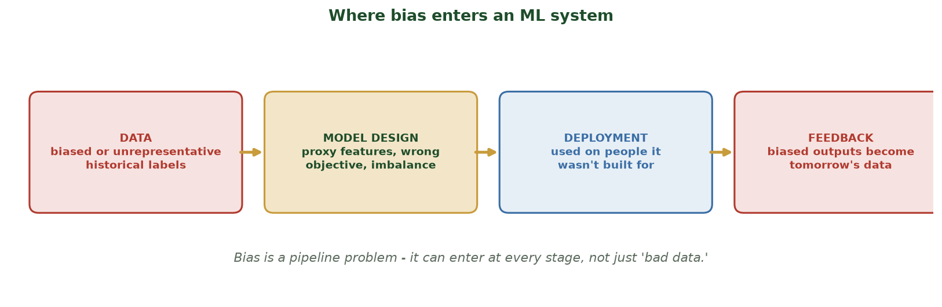
IT'S A PIPELINE PROBLEM
Where Bias Enters an ML System
Bias can enter at data, model design, deployment, and the feedback loop - not just from 'bad data.'
CIS 350: AI for Cybersecurity · Monday
7
Notes:
Walk the pipeline figure. Bias is not only 'bad data.' DATA: historical labels reflect past human bias (e.g., who was flagged before). MODEL: proxy features (zip code standing in for race), wrong objective, class imbalance. DEPLOYMENT: using a model on people it wasn't built for. FEEDBACK: biased outputs become tomorrow's training data (a doom loop). This frames today's case. ~4 min.

Slide 8
OUR RUNNING CASE
A Cybersecurity Example: the 'Risk Flagger'
Many security tools SCORE people: risky login, insider-threat, fraud, account takeover.
Imagine a model that flags accounts as 'risky' for review.
It learns from HISTORICAL analyst decisions - which may have been biased.
If one group was over-flagged before, the model learns to over-flag them now.
The harm: innocent people from that group get wrongly investigated.
A model that flags 'risky' accounts - learned from biased history.
CIS 350: AI for Cybersecurity · Monday
8
Notes:
Ground fairness in a security context (not just loans/hiring). Security systems constantly score people, and they train on historical human decisions. Set up the running example we'll measure in Part 2: a risk-flagging model trained on biased history over-flags one group. The harm is concrete: wrongful investigation, locked accounts, stress. ~4 min.

Slide 9
🕵️ ACTIVITY · 4 MIN
Spot the bias source
For each, name the stage (data / model design / deployment / feedback):
The training labels came from analysts who over-flagged one neighborhood.
The model uses zip code, which closely tracks a protected group.
A tool built for corporate email is deployed on a student population.
Flagged users get more scrutiny, generating more 'evidence' against them.
CIS 350: AI for Cybersecurity · Monday
9
Notes:
Apply the pipeline. Answers: data (biased historical labels); model design (proxy feature); deployment (wrong population); feedback loop (self-reinforcing). This builds the diagnostic habit - name WHERE bias enters before fixing it. Pairs 2, discuss 2. ~4 min.

Slide 10
PART 2 · SEEING BIAS IN A REAL MODEL · ~22 MIN
Per-Group Metrics on the Risk Flagger
Notes:
Transition: 'Enough theory - let's measure. These are the exact numbers you'll compute in Lab 10.' ~26 minutes with two real figures and an activity.

Slide 11
THE SETUP
Meet the Account-Risk Model
We trained a real classifier to flag 'risky' accounts (this is Lab 10's model).
Two groups, A and B. TRUE risk depends only on account activity - not the group.
But the training labels were biased (Group B over-flagged in the past).
And it has a PROXY feature that leaks group membership.
Overall accuracy looks fine (~71%) - so where's the problem?
Fair ground truth, biased labels, a proxy feature - 71% accurate overall.
CIS 350: AI for Cybersecurity · Monday
11
Notes:
Introduce the model students will build in Lab 10. Emphasize the fair ground truth vs. biased training labels distinction - this is the crux. Overall accuracy (~71%) looks acceptable, which is the trap: aggregate numbers hide the bias. Set the question: 'break it down by group.' ~4 min.

Slide 12
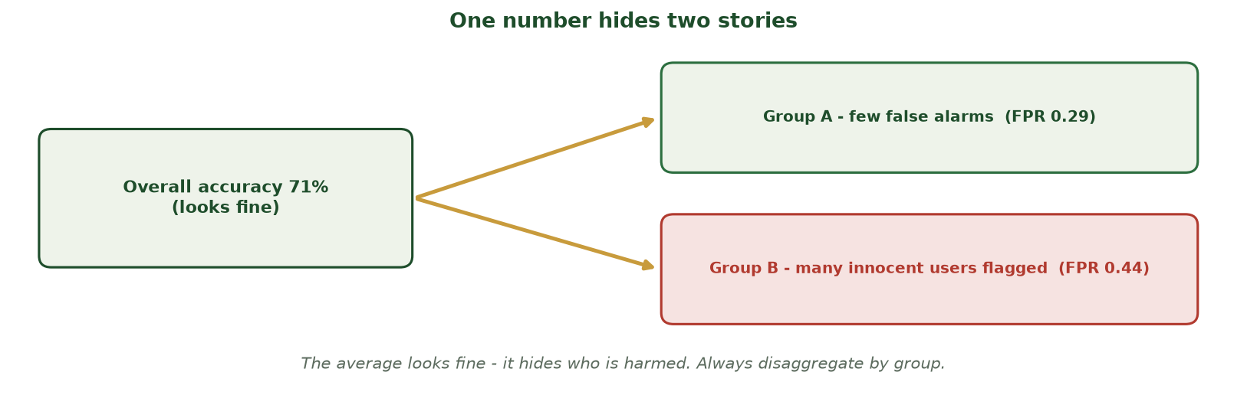
WHY OVERALL ACCURACY IS A TRAP
One Number Hides Two Stories
A single 71% overall-accuracy number averages a fairly-treated Group A (FPR 0.29) together with an over-flagged Group B (FPR 0.44) - the average conceals who is harmed.
CIS 350: AI for Cybersecurity · Monday
12
Notes:
Use this before the real bars to make the trap unforgettable. ONE headline number - 71% accuracy - looks fine, but it is the AVERAGE of two very different experiences: Group A is treated fairly (few false alarms) while Group B's innocent users are flagged far more often. The average literally hides the harm. The fix is one habit: always DISAGGREGATE metrics by group. The next figure shows the real per-group bars for exactly this model. ~2 min.

Slide 13
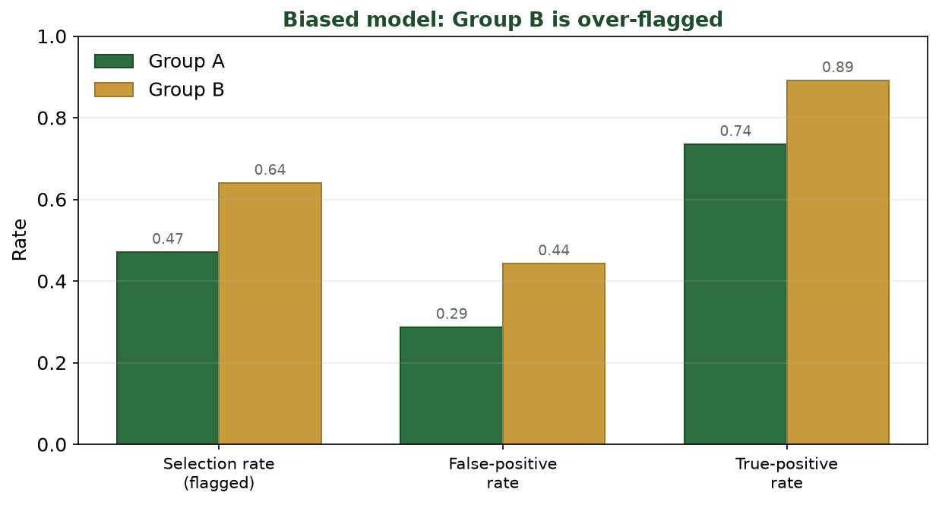
GROUP B IS OVER-FLAGGED
Break the Metrics Down by Group
Selection rate 0.47 vs 0.64, false-positive rate 0.29 vs 0.44, TPR 0.74 vs 0.89 - all higher for Group B.
CIS 350: AI for Cybersecurity · Monday
13
Notes:
This is the money slide. Walk each pair of bars. SELECTION RATE: B flagged far more (0.64 vs 0.47) - a demographic-parity gap of 0.17. FALSE-POSITIVE RATE: B's innocent users wrongly flagged much more (0.44 vs 0.29) - THIS is the harm. TPR is also higher for B, but the model achieves that by flagging almost everyone in B. Same model, very different experience by group. ~5 min.

Slide 14
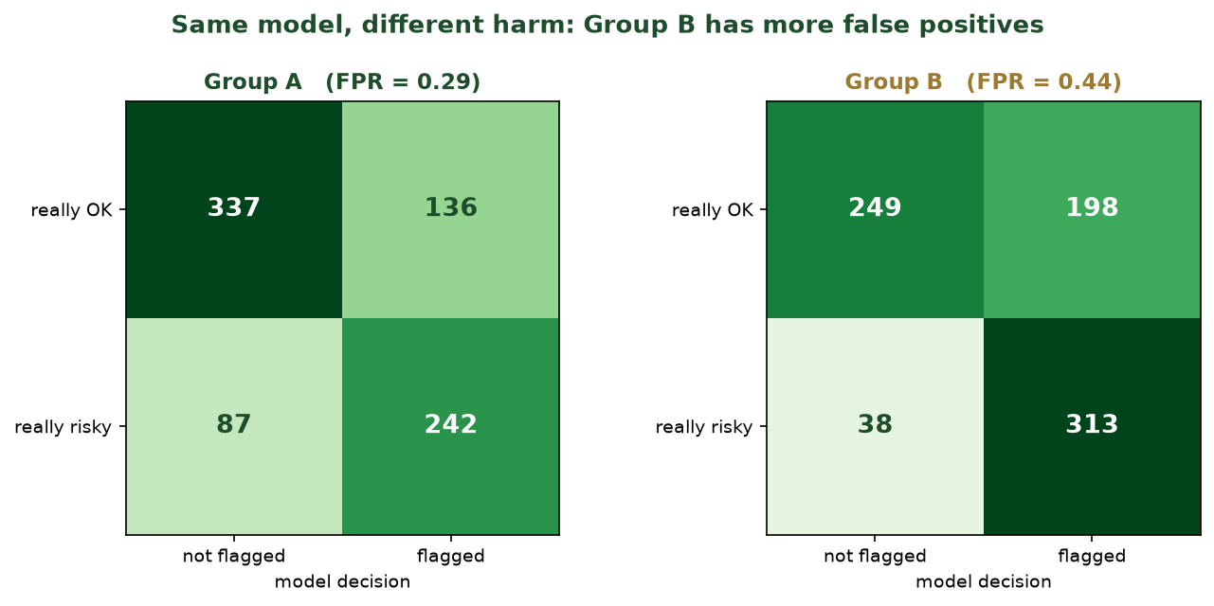
CONFUSION MATRICES PER GROUP
The Same Model, Different Harm
Group B has many more false positives (innocent accounts flagged), even though the model's 'accuracy' looks OK.
CIS 350: AI for Cybersecurity · Monday
14
Notes:
Reinforce with the per-group confusion matrices - the raw counts behind the rates. Point at the false-positive cell (really OK -> flagged): far larger for Group B. Tell students: 'Each number in that cell is a real person wrongly investigated.' Connect back: overall accuracy averaged this harm away. This is why fairness needs per-group analysis. ~5 min.

Slide 15
INTERPRETATION
Reading the Harm: Which Metric Matters?
Different errors hurt differently - match the metric to the harm.
False positives here = innocent people investigated (a real cost).
Selection-rate gap = one group flagged far more often overall.
'Overall accuracy' hid all of this - it averaged the groups together.
Rule: always disaggregate metrics by group before you trust a model.
Pick the metric that matches who gets hurt; always disaggregate.
CIS 350: AI for Cybersecurity · Monday
15
Notes:
Teach metric selection, not just computation. In this security context the false-positive rate is the key harm (wrongful investigation), so the FPR gap matters most. In a different context (e.g., missing real fraud) you'd weigh false negatives. The universal rule: disaggregate by group. This is the reasoning Quiz 9 and Lab 10 reward. ~4 min.

Slide 16
⚖️ ACTIVITY · 4 MIN
Who is harmed, and how?
Using the figures, with a neighbor:
Which group is worse off, and by which metric (give a number)?
Describe the real-world harm to a person in that group.
Is high overall accuracy a good defense here? Why or why not?
CIS 350: AI for Cybersecurity · Monday
16
Notes:
Check interpretation of real numbers. Answers: Group B; FPR 0.44 vs 0.29 (or selection 0.64 vs 0.47); harm = innocent people wrongly flagged/investigated; NO - overall accuracy hides per-group harm. Have them cite a number - Lab 10 requires exactly this. Pairs 2, discuss 2. ~4 min.

Slide 17
ROOT CAUSE
Why Did This Happen?
The labels were biased: the model faithfully learned past over-flagging.
The proxy feature let it identify (and target) Group B.
'Garbage in, garbage out' - but the model looked accurate, so no alarm.
The model isn't 'evil' - it optimized exactly what we gave it.
Fixing it means fixing DATA and DESIGN, not just the algorithm (Wednesday).
It learned our biased history through biased labels + a proxy.
CIS 350: AI for Cybersecurity · Monday
17
Notes:
Tie the harm back to the Part 1 pipeline: biased labels (data) + proxy feature (design) produced the disparity, and good overall accuracy masked it. Emphasize the model did exactly what we asked - the responsibility is human. This sets up Wednesday's mitigation (fix labels, drop proxies) and governance (audits catch this). ~4 min.

Slide 18
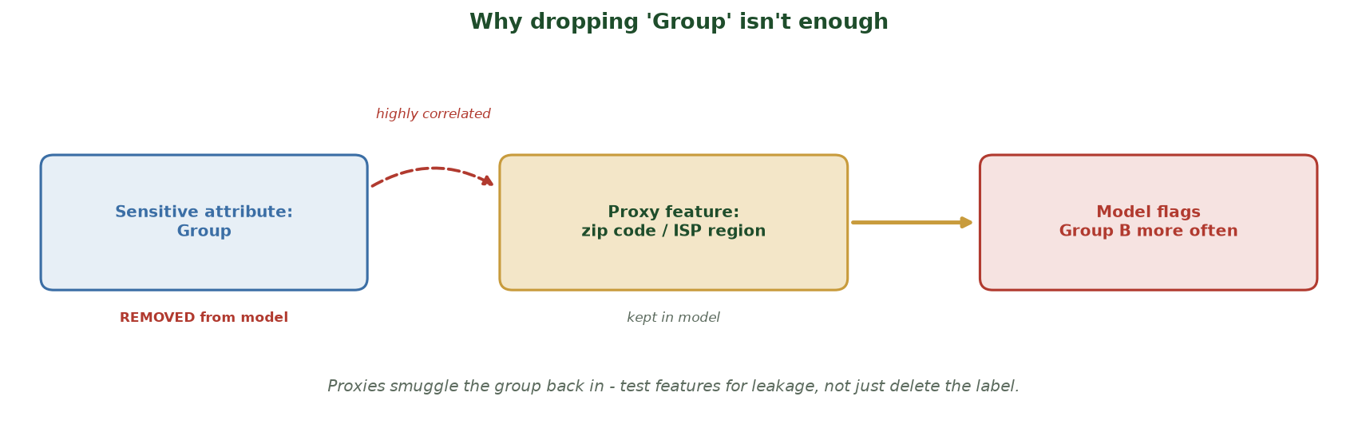
PROXY FEATURES SMUGGLE THE GROUP BACK IN
Why Dropping 'Group' Isn't Enough
Even after the sensitive attribute (Group) is removed, a correlated proxy (zip code / ISP region) stays in the model - so it still targets Group B. Test features for leakage, don't just delete the label.
CIS 350: AI for Cybersecurity · Monday
18
Notes:
Pre-empt the #1 beginner 'fix': 'just remove the group column.' Walk it: we DELETE the sensitive attribute (left), but a PROXY feature - zip code / ISP region - is highly correlated with group and stays in the model, so the model re-derives group membership and still over-flags Group B. The lesson: fairness-by-blindness fails; you must TEST remaining features for leakage (and correct the labels), not just drop the label. This is exactly why Wednesday's mitigation drops the proxy AND fixes the labels. ~2 min.

Slide 19
PART 3 · GOVERNANCE & TRANSPARENCY · ~14 MIN
Who Sets the Rules, and Explaining Decisions
Notes:
Transition: 'If a model can be quietly unfair, who's responsible - and how do we catch it?' ~17 minutes with a figure and an activity.

Slide 20
WHY GOVERNANCE
From Metrics to Governance
Measuring bias is step one; someone must be accountable to ACT on it.
Governance = the rules, roles, and processes that keep AI responsible.
It answers: who approved this model? who audits it? who can appeal a decision?
Laws increasingly REQUIRE this for high-stakes decisions about people.
Governance turns 'we should be fair' into 'here's how we ensure it.'
Rules, roles & processes that make AI accountable.
CIS 350: AI for Cybersecurity · Monday
20
Notes:
Bridge from measurement to accountability. A fairness metric is useless if no one owns the response. Define governance simply: rules + roles + processes. Preview that this is increasingly a legal requirement (next slide) and an organizational practice (Wednesday). ~4 min.

Slide 21
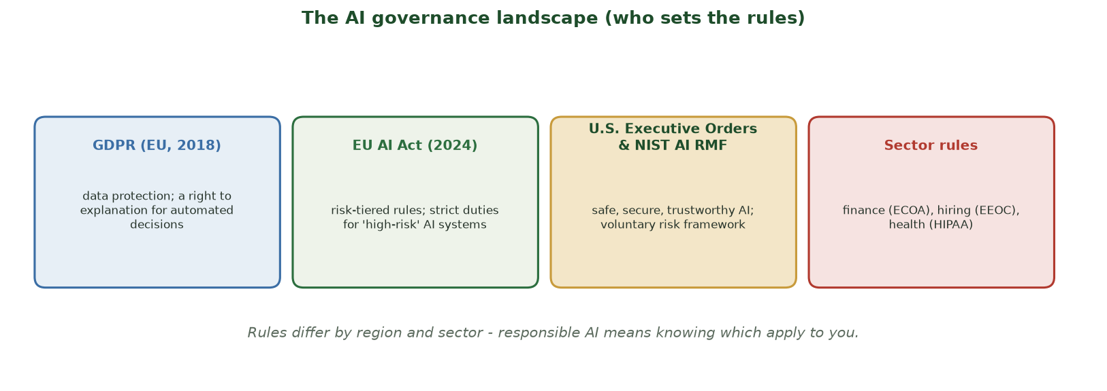
THE AI GOVERNANCE LANDSCAPE
Who Sets the Rules?
GDPR, the EU AI Act, U.S. executive orders and NIST, plus sector rules (finance, hiring, health).
CIS 350: AI for Cybersecurity · Monday
21
Notes:
Give a map-level tour (deep dive Wednesday). GDPR: EU data-protection law with a 'right to explanation' for automated decisions. EU AI Act (2024): risk-tiered - high-risk AI (like our risk flagger) faces strict duties. US: executive orders + the voluntary NIST AI RMF. Sector rules: finance (ECOA), hiring (EEOC), health (HIPAA). Takeaway: which rules apply depends on where and what. ~4 min.

Slide 22
TRUST & THE RIGHT TO KNOW
Transparency & Explainability
Transparency = being open about how a model was built and how it's used.
Explainability = being able to say WHY the model made a specific decision.
Both are hard for complex models - but essential for trust and appeals.
'Why was I flagged?' deserves an answer a human can understand.
Simple tools: which features mattered most; a plain-language reason.
Transparency = how it works; explainability = why THIS decision.
CIS 350: AI for Cybersecurity · Monday
22
Notes:
Define the two terms clearly (students conflate them). Transparency is about the system overall; explainability is about an individual decision. Tie to the running case: a wrongly-flagged user deserves an understandable reason and a way to appeal. Note explainability is legally relevant (GDPR). Mention simple approaches: feature importance, plain-language reasons. ~5 min.

Slide 23
🏛️ ACTIVITY · 4 MIN
Explain the decision
Your risk flagger flagged a user. With a neighbor:
Write a one-sentence explanation a non-technical user could understand.
What information would you NOT reveal (and why)?
Should a human be able to override the flag? Who?
CIS 350: AI for Cybersecurity · Monday
23
Notes:
Make explainability concrete. Good answers: 'You were flagged because your login pattern was unusual for your account' (plain, specific); don't reveal exact thresholds attackers could game; yes - a human analyst should be able to override, with an appeal path. Connects transparency, security, and human oversight. Pairs 2, discuss 2. ~4 min.

Slide 24
🕵️ IN-CLASS TASK · 12 MIN
Bias Audit Card: The Login-Risk Flagger
SecureBank's login-risk model flags accounts for extra identity checks. Trained on 3 years of analyst 'suspicious login' tickets; features = login time, device, home ISP region; rolled out bank-wide including a new campus branch of young/new customers. Audit: overall accuracy 88%; Group A (long-time) sel 0.20 / FPR 0.10 / TPR 0.80; Group B (new campus) sel 0.55 / FPR 0.38 / TPR 0.85. In pairs, fill a one-page Bias Audit Card (~7 min).
Name the harmed group and the single metric + numbers that prove it (compute the gap).
Tag which pipeline stage(s) let bias in - data / model design / deployment / feedback - with one line of evidence each.
Describe in one sentence the real-world harm to a person in the harmed group.
Write a plain-language sentence explaining why they were flagged, and name who may override the flag.
CIS 350: AI for Cybersecurity · Monday
24
Notes:
The session's hands-on task - a mini bias audit, exactly what Lab 10 formalizes. Hand out the scenario + per-group table. Model answer: harmed group = B, by FPR 0.38 vs 0.10 (gap 0.28) - selection 0.55 vs 0.20 also valid; the 88% overall accuracy hides it. Stages: DATA (analyst tickets encode past over-scrutiny of newer users); MODEL DESIGN (home ISP region is a proxy for the campus population); DEPLOYMENT (built on established customers, applied to a new population it wasn't tuned for); FEEDBACK optional (flagged users generate more tickets). Harm: legitimate new customers repeatedly locked out / forced through extra verification, eroding trust. Explanation example: 'Your login was flagged because it came from a network and device pattern our system rarely sees for accounts like yours' - a trained fraud analyst can override, with the reason logged. Reinforce: name WHERE bias entered before proposing a fix. ~12 min.

Slide 25
USE THESE SLIDES AS YOUR STUDY GUIDE
How Today Connects to Lab 10 & Quiz 9
🧪 In Lab 10 you will...
📝 For Quiz 9, master...
Train the biased account-risk model in Colab.
Compute per-group selection rate, FPR, and TPR.
Visualize the disparity and name who is harmed.
Try a mitigation and re-measure the gap.
Define fairness and bias; overall accuracy can hide per-group harm.
Name where bias enters (data, design, deployment, feedback).
Read per-group metrics and pick the metric that matches the harm.
Explain governance, transparency, and explainability.
CIS 350: AI for Cybersecurity · Monday
25
Notes:
Tie the lecture to Lab 10 and Quiz 9. Left = Lab 10 tasks (compute the exact metrics from today); right = concepts for Quiz 9. Note Lab 10 releases today; Quiz 9 is Wednesday in class. ~2 min.

Slide 26
Key Takeaways
✓
A model can be accurate overall and still be unfair - always break metrics down BY GROUP.
✓
Bias enters across a pipeline: biased data/labels, proxy features & design, deployment, and feedback loops.
✓
In our security case, the biased flagger's false-positive rate was far higher for Group B (0.44 vs 0.29).
✓
Governance, transparency, and explainability turn 'be fair' into accountable, auditable practice.
Notes:
Recap one point per objective. Cold-call: 'Why isn't high overall accuracy enough?' Reinforce disaggregation. Preview Wednesday: competing fairness definitions, the regulatory deep-dive, and how organizations operationalize responsible AI. ~2 min.

Slide 27
WHAT'S NEXT
Looking Ahead: Lab 10, Quiz 9 & Wednesday
🧪 Lab 10 (Bias Detection) releases today - start early; it uses today's model.
📝 Quiz 9 is Wednesday in class (fairness, bias sources, governance).
📖 Read Handout 10: AI Ethics, Bias, and Fairness.
📊 Wednesday: fairness definitions & trade-offs, regulation, and responsible AI.
⚖️ Remember: fairness is a design choice, not an afterthought.
Lab 10 out today; Quiz 9 Wednesday; Wed = definitions, regulation, responsible AI.
CIS 350: AI for Cybersecurity · Monday
27
Notes:
Assign and preview. Lab 10 uses today's exact model, so starting early pays off. Quiz 9 is Wednesday. Assign Handout 10. Preview Wednesday's deeper treatment. ~2 min.

Slide 28
🎯 EXIT TICKET · 2 MIN
One minute before you go
On the Canvas exit-ticket quiz or a card:
Why can a model be accurate overall but still unfair?
Name one place bias can enter an ML system.
One thing from today you'd like clarified.
CIS 350: AI for Cybersecurity · Monday
28
Notes:
Close with the exit ticket. Q1 checks the core misconception; Q2 checks the pipeline. Use clarifications to open Wednesday. ~2 min.

Slide 29
SOURCES & FURTHER READING
References & Further Reading
  S. Barocas, M. Hardt, A. Narayanan, 'Fairness and Machine Learning' (fairmlbook.org).
  NIST AI RMF 1.0 (2023) and NIST AI 600-1 (Generative AI Profile).
  J. Angwin et al., 'Machine Bias' (COMPAS), ProPublica, 2016.
  M. Mitchell et al., 'Model Cards for Model Reporting,' 2019.
  EU General Data Protection Regulation (GDPR), 2018.
CIS 350: AI for Cybersecurity · Monday
29
Notes:
Appendix slide: references and further reading for students. Post to Canvas or leave visible during the exit ticket - it is not part of the timed lecture. 'Fairness and Machine Learning' (free online) and the NIST AI RMF are the best starting points.

