Slide 1

WEEK 10 · WEDNESDAY · 75 MINUTES
Privacy Attacks & Defending AI
Model Inversion & Membership Inference · Robustness, Provenance & Privacy Defenses
CIS 350: AI for Cybersecurity — Smart Defense for the Digital Business
Ramadan Abdunabi, Ph.D. · Computer Information Systems
Notes:
Connect to Monday: 'We saw attacks that make models give wrong answers. Today: attacks that make models LEAK their secrets - and then the full defensive toolkit.' Keep the defensive frame. This is the constructive payoff of the week. Remind students Quiz 8 is today and Lab 8 is due. Reach Part 1 by ~minute 8. ~1 min.

Slide 2

🔁 WARM-UP · 5 MIN
Recap the attacks
With a neighbor, one sentence each:
What is an adversarial example?
How is data poisoning different from evasion?
Could a model accidentally reveal something about its training data?
CIS 350: AI for Cybersecurity · Wednesday
2
Notes:
Reactivate Monday and tee up privacy. Pairs 2, cold-call 2-3. Expected: a tiny crafted input that fools the model; poisoning corrupts training data (train time) vs evasion fools the finished model (test time); yes - models can memorize and leak training data (today's topic). ~5 min.

Slide 3
WEDNESDAY · 75 MINUTES
Today's Plan
🔁
Warm-up & recap
From wrong answers to leaked secrets
8 min
🕵️
Privacy attacks on models
Model inversion, membership, theft
20 min
🛡️
Defending AI systems
Robustness, provenance, privacy
20 min
🧭
Robustness & the big picture
No perfect defense; governance
10 min
🧩
In-class task
AI security review matrix
13 min
🎯
Wrap & exit
Takeaways; Lab 8 & Week 11
4 min
CIS 350: AI for Cybersecurity · Wednesday
3
Notes:
Walk the plan; the row minutes add up to exactly 75. Today: the third attack family (privacy), then the defenses for ALL of this week's attacks, then the realistic big picture. ~1 min.

Slide 4
PRIVACY ATTACKS & DEFENSES
Today's Objectives
1
Explain model inversion and membership-inference (privacy) attacks.
2
Describe how a model can leak its training data.
3
Identify defenses for evasion, poisoning, and privacy attacks.
4
Explain why there is no perfect defense - and what to do about it.
CIS 350: AI for Cybersecurity · Wednesday
4
Notes:
State the goals: privacy attacks (objectives 1-2) then the defensive toolkit (3) and a realistic arms-race view (4). All appear on Quiz 8. Emphasize this is where the week turns constructive. ~1 min.

Slide 5
PART 1 · PRIVACY ATTACKS ON MODELS · ~20 MIN
When the Model Leaks Its Secrets
Notes:
Transition: 'A model trained on private data can accidentally reveal it. Attackers exploit that.' ~22 minutes with a figure and an activity.

Slide 6
THE PRIVACY RISK
Models Remember Their Training Data
To learn, models absorb patterns from their training data.
Sometimes they MEMORIZE specific, sensitive examples.
Attackers can probe a model to pull that information back out.
This threatens CONFIDENTIALITY - the data, not the prediction.
Big deal for models trained on medical, financial, or personal data.
Models can memorize - and then leak - training data.
CIS 350: AI for Cybersecurity · Wednesday
6
Notes:
Set up privacy attacks: the danger is the model as a leaky container of its training data. Contrast with Monday (which attacked the OUTPUT); here the target is the confidential DATA. Give the stakes - health/finance/LLMs trained on personal data. This is the third box in Monday's taxonomy. ~3 min.

Slide 7
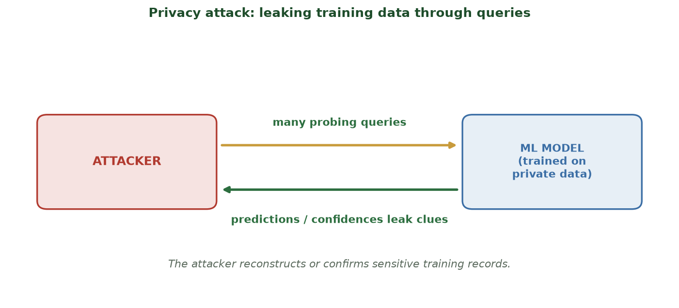
PROBE THE MODEL, RECONSTRUCT THE SECRETS
Leaking Data Through Queries
An attacker sends many queries and uses the predictions/confidences to reconstruct or confirm private records.
CIS 350: AI for Cybersecurity · Wednesday
7
Notes:
Walk the model-inversion diagram. The attacker never sees the training data directly - they infer it from many queries and the model's confident responses. Analogy: guessing a secret by asking many yes/no questions and watching reactions. This is why exposing detailed confidences/probabilities is risky. ~4 min.

Slide 8
INVERSION VS. MEMBERSHIP
Two Privacy Attacks to Know
MODEL INVERSION: reconstruct features of the training data (e.g., a face).
MEMBERSHIP INFERENCE: find out IF a specific person was in the training set.
Membership alone can be sensitive (e.g., 'in a disease-study dataset').
Both rely on the model behaving differently on data it memorized.
More queries + more model detail leaked = easier attacks.
Inversion = rebuild data; membership = was it used?
CIS 350: AI for Cybersecurity · Wednesday
8
Notes:
Define the two canonical privacy attacks. Membership inference is subtle but important - just KNOWING someone was in a sensitive dataset is a privacy harm. Both work because models are often more confident on data they trained on. This motivates differential privacy in Part 2. ~4 min.

Slide 9
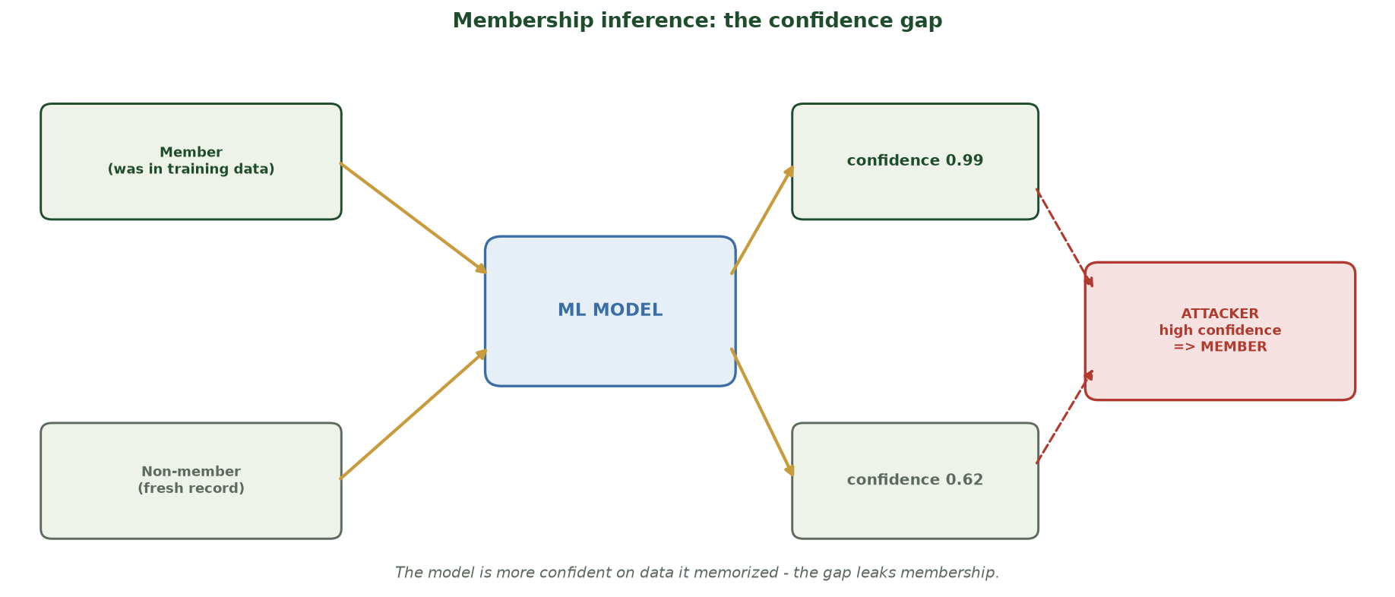
THE MODEL IS SURER ON DATA IT MEMORIZED
Membership Inference: the Confidence Gap
A model returns higher confidence on a record it was trained on (0.99) than on a fresh one (0.62); an attacker reads that gap to confirm someone was in the training set.
CIS 350: AI for Cybersecurity · Wednesday
9
Notes:
Make membership inference concrete. Feed the SAME model two records: a MEMBER (it trained on) and a NON-MEMBER (fresh). The model is systematically more confident on the member (0.99 vs 0.62) because it partly memorized it. The attacker never sees the training data - they just watch the confidence and infer membership from the gap. Stress why this is a real harm: just KNOWING someone was in, say, a disease-study dataset is sensitive. This is exactly why exposing raw confidences is risky and why differential privacy (Part 2) closes the gap. ~2 min.

Slide 10
STEALING THE MODEL
Model Theft (Extraction)
Attackers query a model a lot to build a copy that behaves the same.
Steals intellectual property and the effort that went into it.
The stolen copy also makes crafting evasion attacks easier.
Common against paid prediction APIs.
Defense: throttle/limit queries, watermarking, abuse monitoring.
Query a lot -> clone the model's behavior.
CIS 350: AI for Cybersecurity · Wednesday
10
Notes:
Cover model extraction/theft briefly - a business/IP angle students relate to. Note the compounding risk: a stolen local copy lets attackers develop evasion attacks offline. Name the defenses (rate limiting, monitoring) so it connects forward. ~3 min.

Slide 11
WHY IT MATTERS
Real-World Privacy Failures
Large language models have repeated memorized secrets from training text.
Medical/image models have leaked recognizable patient information.
Regulations (GDPR, HIPAA) make this a legal and ethical problem, not just technical.
'The model is trained, so the data is safe' is FALSE.
Privacy must be designed in - it is not automatic.
Trained != safe; privacy must be designed in.
CIS 350: AI for Cybersecurity · Wednesday
11
Notes:
Ground privacy attacks in real, recent failures (LLM memorization; medical model leakage) and the legal stakes (GDPR/HIPAA). Kill the misconception that training 'anonymizes' data. This sets up differential privacy as a designed-in defense. Previews Weeks 12-13 (ethics, privacy-preserving ML). ~4 min.

Slide 12
🕵️ ACTIVITY · 4 MIN
Name that privacy attack
For each, name the attack (inversion, membership inference, or model theft).
Repeatedly querying a model to rebuild a training face image. -> ?
Determining whether a specific patient was in the training data. -> ?
Cloning a paid prediction API by querying it heavily. -> ?
CIS 350: AI for Cybersecurity · Wednesday
12
Notes:
Consolidate Part 1. Answers: model inversion; membership inference; model theft/extraction. The tell: rebuild data? confirm presence? copy the model? Pairs 2, discuss 2. ~4 min.

Slide 13
PART 2 · DEFENDING AI SYSTEMS · ~20 MIN
Robustness, Provenance & Privacy
Notes:
Transition: 'Now the payoff: how do we defend against everything we've seen this week?' ~24 minutes with an activity - map each attack to its defense.

Slide 14
HOW TO DEFEND
The Defensive Mindset
No single trick stops all attacks - defend in depth (recall Week 8).
Match the defense to the attack's timing and target.
Assume attackers will probe - monitor, detect, and respond.
Balance robustness with accuracy and cost (there are trade-offs).
People and process matter as much as the model.
Match defense to attack; defend in depth.
CIS 350: AI for Cybersecurity · Wednesday
14
Notes:
Frame defense strategically before the specifics. The organizing idea: each attack family has tailored defenses, layered together. Set expectations that defenses cost something (accuracy, latency, effort) - there's no free lunch, which is honest and exam-worthy. ~3 min.

Slide 15
DEFENSE: EVASION
Defending Against Adversarial Examples
Adversarial training: include adversarial examples during training so the model learns to resist.
Input checks/preprocessing: smooth, compress, or validate inputs.
Detection: flag suspicious or LOW-CONFIDENCE predictions for review.
Recall Lab 8: the adversarial '2' dropped to ~56% confidence - a usable signal.
No method is perfect - combine several.
Adversarial training + input checks + detection.
CIS 350: AI for Cybersecurity · Wednesday
15
Notes:
Give concrete evasion defenses, tying to Lab 8: the adversarial example sat near the boundary (low confidence), so flagging low-confidence predictions catches many attacks. Adversarial training is the strongest single tool (train on the attacks). Stress layering. ~4 min.

Slide 16
FLAG LOW-CONFIDENCE PREDICTIONS FOR REVIEW
A Simple Detection Defense (from Lab 8)
Python · Google Colab
proba = clf.predict_proba([x_adv])[0]
top = proba.max()
if top < 0.90:
print('FLAG for human review - low confidence:', round(top, 2))
# clean '2' -> 0.99 (passes); adversarial -> 0.56 (flagged)
Detection is one cheap layer: adversarial inputs often sit near the boundary (low confidence).
CIS 350: AI for Cybersecurity · Wednesday
16
Notes:
Show a defensive code snippet students can run: threshold the model's confidence. On the Lab 8 example the clean digit is 0.99 (passes) but the adversarial one is 0.56 (flagged). Caveat honestly: a determined attacker can push past the boundary, so this is ONE layer, not a cure. ~4 min.

Slide 17
DEFENSE: POISONING & PRIVACY
Defending Against Poisoning & Privacy Attacks
Poisoning -> vet and clean training data; track DATA PROVENANCE (where it came from).
Poisoning -> anomaly-check the training set; test for backdoor triggers.
Privacy -> DIFFERENTIAL PRIVACY: add calibrated noise so no single record stands out.
Privacy -> limit exposed detail (coarse outputs), rate-limit queries.
Model theft -> throttle queries, watermark, monitor for abuse.
Vet data + provenance; DP + limit queries.
CIS 350: AI for Cybersecurity · Wednesday
17
Notes:
Cover the training-time and privacy defenses. Data provenance (knowing and controlling your training sources) is the key poisoning defense; anomaly detection (Week 6!) helps screen training data. For privacy, introduce differential privacy in one line - add noise so individuals don't stand out - which Weeks 12-13 revisit. Connect back to earlier course tools. ~4 min.

Slide 18
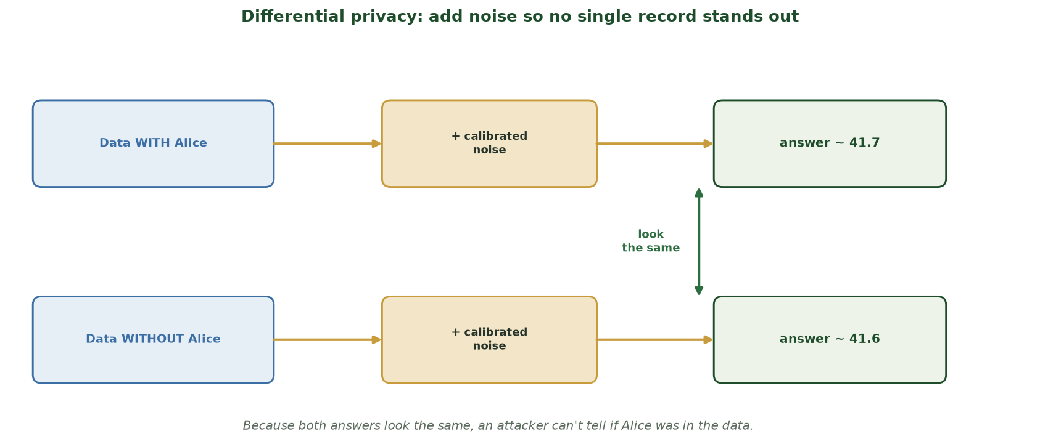
ADD NOISE SO NO RECORD STANDS OUT
Differential Privacy: Hide the Individual, Keep the Pattern
Two datasets differing only by whether Alice is included produce nearly identical noised answers (~41.7 vs ~41.6) - so an attacker can't tell whether Alice's data was used.
CIS 350: AI for Cybersecurity · Wednesday
18
Notes:
Explain differential privacy with the Alice example. Run the same query on two datasets that differ ONLY by whether Alice is in them; add calibrated noise to each answer. The two results come out indistinguishable (~41.7 vs ~41.6), so no attacker can decide from the output whether Alice was included - that is the guarantee. Emphasize the trade-off: more noise = more privacy but less precise answers, so we tune the privacy budget. This directly defeats the membership-inference gap from Part 1 and returns in Weeks 12-13. ~2 min.

Slide 19
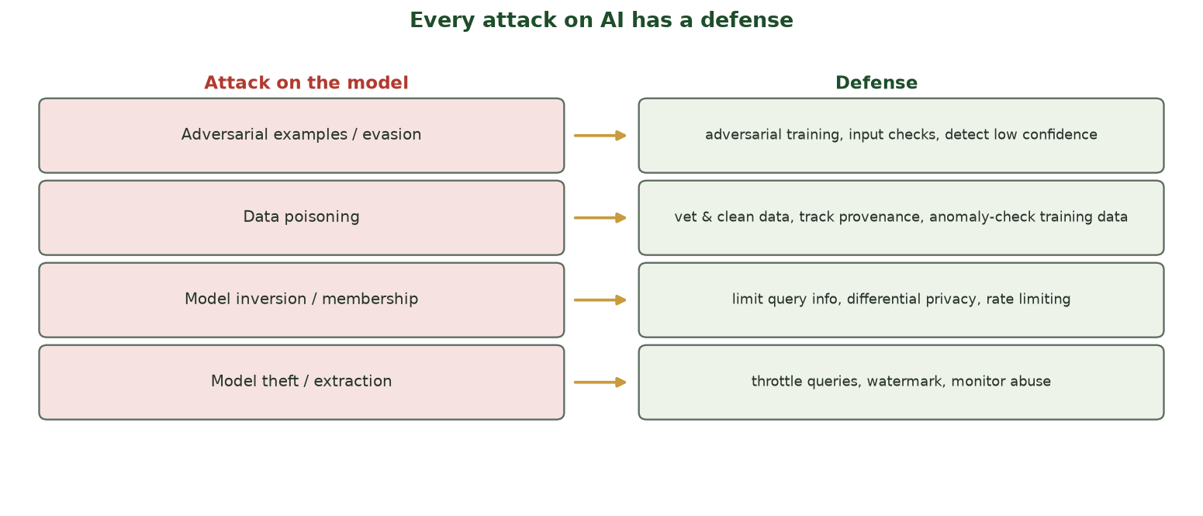
ATTACK -> DEFENSE MAP
Every Attack on AI Has a Defense
Evasion, poisoning, privacy, and model theft each map to concrete, layered countermeasures.
CIS 350: AI for Cybersecurity · Wednesday
19
Notes:
Use the defense map to synthesize Part 2. Walk each row and name the timing (train vs test vs post-deploy). The empowering message: students now know the attacks AND the defenses across the whole model life cycle. This is the slide to photograph. ~4 min.

Slide 20
🛡️ ACTIVITY · 5 MIN
Match attack to defense
Name the best defense for each attack.
Adversarial examples fooling a deployed classifier. -> ?
Mislabeled data slipped into the training set. -> ?
Membership inference on a medical model. -> ?
CIS 350: AI for Cybersecurity · Wednesday
20
Notes:
Consolidate the defenses. Answers: adversarial training + input checks + low-confidence detection; data vetting/provenance + anomaly-checking the training set; differential privacy + limiting exposed detail/queries. Reinforce: understanding the attack tells you the defense. Pairs 3, discuss 2. ~5 min.

Slide 21
PART 3 · THE BIG PICTURE · ~10 MIN
Robustness, Trade-offs & Governance
Notes:
Transition: 'Let's step back: how secure can AI really be, and whose job is it?' ~13 minutes.

Slide 22
A REALISTIC VIEW
There Is No Perfect Defense
Security of AI is an arms race - attacks and defenses co-evolve.
Stronger robustness often costs some accuracy or speed.
Goal is not 'unbreakable' but 'hard enough + detect + recover.'
Test your own models the way an attacker would (red-teaming).
Assume breach: monitor, log, and have a response plan.
Not unbreakable - hard enough + detect + recover.
CIS 350: AI for Cybersecurity · Wednesday
22
Notes:
Give the honest, professional view: perfect robustness is unattainable, and defenses have costs. The mature goal is raising the attacker's cost, detecting attempts, and recovering - not a mythical unbreakable model. Introduce red-teaming (test your own models like an attacker). Ties to Week 1's assume-breach mindset. ~5 min.

Slide 23
GOVERNANCE & STANDARDS
Whose Job Is AI Security? (Governance)
It spans data, model, deployment, and monitoring - many hands.
Standards help: NIST AI 100-2 (attacks) and the NIST AI RMF (risk).
MITRE ATLAS catalogs real attacker techniques against AI.
Document data sources, test for attacks, and plan incident response.
Governance turns 'we should be secure' into repeatable practice.
NIST AI RMF / AI 100-2, MITRE ATLAS - make it repeatable.
CIS 350: AI for Cybersecurity · Wednesday
23
Notes:
Elevate to governance: AI security is an organizational responsibility guided by standards. Name-drop NIST AI 100-2 and the AI RMF and MITRE ATLAS as the go-to references. Preview Week 12 (ethics & governance). Keep it practical: document, test, plan. ~4 min.

Slide 24
🧭 ACTIVITY · 3 MIN
Red-team your own model
Your team deployed an ML fraud model. With a neighbor:
Name one attack you'd test it against (from this week).
Name one defense you'd add first, and why.
What would you monitor after deployment?
CIS 350: AI for Cybersecurity · Wednesday
24
Notes:
Apply the big-picture mindset. Good answers: test evasion (craft borderline transactions) or poisoning (vet data); add adversarial training or data-provenance checks first; monitor confidence distributions, query rates, and drift. Reinforce proactive, layered defense. Pairs 2, discuss 1. ~4 min.

Slide 25
🧭 IN-CLASS TASK · 13 MIN
AI Security Review: Build the Threat-and-Defense Matrix
A hospital built an ML model that predicts patient readmission risk, exposed via an internal API that returns a score + confidence. In pairs, complete a one-page security review before go-live (~8 min), then present.
Draw a 4-row matrix: ATTACK | HOW IT COULD HIT THIS SYSTEM | PRIMARY DEFENSE | LIFE-CYCLE STAGE (train / deploy / monitor). Rows: evasion, poisoning, privacy, model theft.
For each attack, write one concrete way it could target THIS readmission system.
Fill in the primary defense and the life-cycle stage for each.
Circle the single highest-priority risk for a hospital (justify in one line) + add one thing to monitor after deployment.
CIS 350: AI for Cybersecurity · Wednesday
25
Notes:
The week's capstone task - students map every attack to a real system and its defense. Hand out the matrix worksheet. Model rows: EVASION - craft borderline records to dodge a high-risk flag -> adversarial training + input checks + low-confidence flagging (test/deploy). POISONING - inject mislabeled records via the retraining feed -> vet data + provenance + anomaly-check the training set (train). PRIVACY/MEMBERSHIP - query the API's confidences to confirm a patient was in training, or reconstruct fields -> differential privacy + coarse outputs + rate-limit queries (deploy/monitor). MODEL THEFT - scrape the API to clone the model -> throttle + watermark + abuse monitoring (deploy/monitor). Highest priority = PRIVACY (HIPAA, direct patient harm). Monitoring: confidence distributions, per-user query rates, and data drift. Reinforce: knowing the attack tells you the defense, and defenses span the whole life cycle - ties directly to the defenses_map figure. Have 2 pairs present. ~13 min.

Slide 26
USE THESE SLIDES AS YOUR STUDY GUIDE
How Today Connects to Lab 8 & Quiz 8
💻 In Lab 8 you will...
📝 Quiz 8 will ask you to...
Craft and visualize an adversarial example (sandbox).
Observe the confidence drop (a detection signal).
Try the low-confidence detection defense.
Reflect on defenses across the model life cycle.
Explain model inversion and membership inference.
Match evasion / poisoning / privacy attacks to defenses.
Explain why there's no perfect defense.
Describe adversarial training and differential privacy at a high level.
CIS 350: AI for Cybersecurity · Wednesday
26
Notes:
Tie Wednesday to the assessments. Left = Lab 8 (includes the detection defense you just saw); right = Quiz 8 question types. Tell students these slides ARE the study guide. ~2 min.

Slide 27
Key Takeaways
✓
Privacy attacks make a model leak its training data: model inversion, membership inference, model theft.
✓
Defenses match the attack: adversarial training/detection (evasion), provenance/vetting (poisoning), differential privacy (privacy).
✓
Defend in depth across the model life cycle - training, deployment, and monitoring.
✓
There is no perfect defense: raise attacker cost, detect attempts, and plan to recover.
Notes:
Recap one point per objective. Cold-call: 'Name a privacy attack and its defense' and 'Why is there no perfect defense?' This is prime Quiz-8 material and ties the week together. ~2 min.

Slide 28
WHAT'S NEXT
Looking Ahead: Lab 8 & Week 11
💻 Finish Lab 8 (Adversarial Example Explorer) - sandboxed, defensive.
📝 Complete Quiz 8 on Canvas; 📖 review Handout 8.
🔜 Week 11: LLM security - prompt injection and how to defend chatbots/assistants.
Plus Lab 9 (a beginner Capture-the-Flag challenge) is released next week.
The attacks-on-AI theme continues into the world of large language models.
Finish Lab 8 & Quiz 8; Week 11 = prompt injection & LLM security.
CIS 350: AI for Cybersecurity · Wednesday
28
Notes:
Assign and preview. Week 11 applies the attack/defend mindset to LLMs (prompt injection) and includes a beginner CTF (Lab 9). Assign Lab 8, Quiz 8, Handout 8. Note the through-line: attacks on AI now extend to the LLMs everyone is deploying. ~2 min.

Slide 29
🎯 EXIT TICKET · 2 MIN
One minute before you go
On the Canvas exit-ticket quiz or a card:
In one sentence, what is a model-inversion (privacy) attack?
Name one defense and the attack it counters.
One topic from this week you want reviewed before Quiz 8.
CIS 350: AI for Cybersecurity · Wednesday
29
Notes:
Close with the exit ticket. The privacy-attack definition checks Objective 1; the defense pairing checks Objective 3. Use the review requests to shape a quick pre-quiz Canvas note. ~2 min.

Slide 30
SOURCES & FURTHER READING
References & Further Reading
  NIST AI 100-2 (2023) and NIST AI Risk Management Framework (AI RMF 1.0), 2023.
  R. Shokri et al., 'Membership Inference Attacks Against ML Models,' 2017.
  M. Fredrikson et al., 'Model Inversion Attacks,' 2015.
  C. Dwork & A. Roth, 'The Algorithmic Foundations of Differential Privacy.'
  CISA/NCSC, Guidelines for Secure AI System Development, 2023.
CIS 350: AI for Cybersecurity · Wednesday
30
Notes:
Appendix slide: references and further reading for students. Post to Canvas or leave visible during the exit ticket - it is not part of the timed lecture. NIST AI 100-2 and MITRE ATLAS are the best starting points for the defensive view of attacks on AI.

