Slide 1

WEEK 10 · MONDAY · 75 MINUTES
How AI Systems Are Attacked
Adversarial Examples & Evasion · Data Poisoning
CIS 350: AI for Cybersecurity — Smart Defense for the Digital Business
Ramadan Abdunabi, Ph.D. · Computer Information Systems
Notes:
Flip the perspective one more time: 'Weeks 3-7 we built AI defenses; Week 8 was attackers USING AI. Now: attacks ON the AI itself.' Frame defensively - we study these to protect our models. Reassure: no heavy math; today's lab crafts a tiny perturbation on a toy digit classifier in a sandbox to SEE why models are fragile. Note we're back from break (Exam 2 covered Weeks 5-8). Reach Part 1 by ~minute 8. ~1 min.

Slide 2

🔁 WARM-UP · 5 MIN
Could you fool a model?
With a neighbor, one sentence each:
Name an ML model we built or used this term (spam filter, image classifier...).
How might someone TRICK it into a wrong answer?
Where do models get their 'knowledge' (that an attacker could corrupt)?
CIS 350: AI for Cybersecurity · Monday
2
Notes:
Prime the two attack surfaces. Pairs 2 min, cold-call 2-3. Expected: spam/phishing/digit classifiers; trick by crafting a sneaky input; knowledge comes from TRAINING DATA (which an attacker could poison). Those two ideas - fooling the input (test time) and corrupting the data (training time) - are today's two attacks. ~5 min.

Slide 3
MONDAY · 75 MINUTES
Today's Plan
🔁
Warm-up & the new target
Attacking the model itself
8 min
🎯
A new target: the model
Why models are fragile
10 min
👁️
Adversarial examples & evasion
Fool the input at test time
22 min
☠️
Data poisoning
Corrupt the training data
18 min
🧩
In-class task
Poison the spam filter
12 min
🎯
Wrap & exit
Takeaways; Lab 8 & Wednesday
5 min
CIS 350: AI for Cybersecurity · Monday
3
Notes:
Walk the plan; the row minutes add up to exactly 75. Two attack surfaces today: TEST-TIME (adversarial examples / evasion) and TRAINING-TIME (data poisoning). Wednesday adds privacy attacks and defenses. ~1 min.

Slide 4
ATTACKS ON THE MODEL (TO DEFEND IT)
Today's Objectives
1
Explain adversarial examples and how they fool ML models.
2
Describe data poisoning and its impact on model training.
3
Distinguish test-time (evasion) from training-time (poisoning) attacks.
4
Recognize why understanding these attacks is the first step to defending.
CIS 350: AI for Cybersecurity · Monday
4
Notes:
State the four goals. Stress the defensive purpose (objective 4) and that this is Exam-related. The test-time vs training-time distinction (objective 3) is the mental model that organizes the whole week. ~1 min.

Slide 5
PART 1 · A NEW TARGET: THE MODEL · ~10 MIN
Why Models Are Fragile
Notes:
Transition: 'So far attacks targeted people and systems. Now the AI model is the target.' ~12 minutes with an activity.

Slide 6
A NEW ATTACK SURFACE
The Model Itself Can Be Attacked
An ML model is software that LEARNED its rules from data.
That creates two new weak points attackers can hit:
  The INPUT it sees at test time (fool it into a wrong answer).
  The DATA it learns from during training (corrupt what it learns).
Plus privacy: a model can LEAK the data it was trained on (Wednesday).
Same defensive goal as always: protect confidentiality, integrity, availability.
Attack the input, the training data, or leak the data.
CIS 350: AI for Cybersecurity · Monday
6
Notes:
Establish the new attack surface. Unlike a bug in code, these attacks exploit HOW models learn from data. Name the three families now (evasion, poisoning, privacy) so students have a map. Tie back to Week 1's CIA triad - integrity of predictions, integrity of training data, confidentiality of training data. ~3 min.

Slide 7
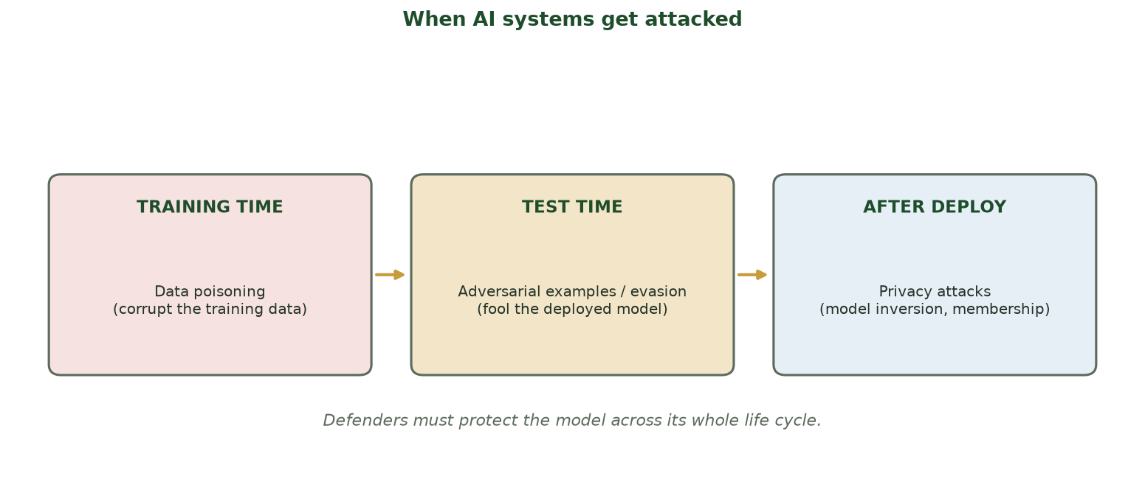
TRAINING TIME VS. TEST TIME VS. AFTER DEPLOYMENT
When AI Systems Get Attacked
Poisoning hits training; adversarial examples/evasion hit test time; privacy attacks probe a deployed model.
CIS 350: AI for Cybersecurity · Monday
7
Notes:
Use the taxonomy to give the big picture up front. Three phases of a model's life, three attack types. Today: poisoning (left) and evasion (middle); Wednesday: privacy (right). Tell students to keep this map in mind - every attack this week fits one box, and each box has defenses. ~3 min.

Slide 8
THE ROOT CAUSE
Why Are Models So Fragile?
Models learn statistical patterns, not human understanding.
They can be very confident and still be easily fooled.
Tiny input changes a human ignores can cross a decision boundary.
And a model blindly trusts whatever data it was trained on.
Attackers exploit both facts - so defenders must anticipate them.
Models learn patterns, not meaning - so they're brittle.
CIS 350: AI for Cybersecurity · Monday
8
Notes:
Explain the root cause without math: models match learned patterns rather than understanding meaning, so they can be confidently wrong. This is why an imperceptible change can flip a prediction, and why bad training data quietly corrupts a model. Set up the boundary intuition in Part 2. ~3 min.

Slide 9
🎯 ACTIVITY · 3 MIN
Guess the weak point
For each, is the attacker targeting the INPUT (test time) or the TRAINING DATA?
Adding invisible noise to a photo so it's misread. -> ?
Sneaking mislabeled examples into a training set. -> ?
Slightly reworent a spam email so the filter passes it. -> ?
CIS 350: AI for Cybersecurity · Monday
9
Notes:
Check the test-time vs training-time distinction early. Answers: input/test time; training data; input/test time (evasion). This primes the two parts. (Typo intentional in item 3? No - read as 'rewording' a spam email.) Pairs 2, discuss 1. ~3 min.

Slide 10
PART 2 · ADVERSARIAL EXAMPLES & EVASION · ~22 MIN
Fooling the Input at Test Time
Notes:
Transition: 'The most famous attack on AI: a tiny, crafted change to an input that flips the prediction.' ~26 minutes with figures, code, and an activity.

Slide 11
DEFINITION
What Is an Adversarial Example?
An input changed by a small, CRAFTED amount to fool the model.
The change is often invisible (or meaningless) to a human.
But it pushes the input just across the model's decision boundary.
Result: high-confidence WRONG prediction.
Classic demo: a panda photo + tiny noise -> classified as a 'gibbon.'
Small crafted change -> confident wrong answer.
CIS 350: AI for Cybersecurity · Monday
11
Notes:
Define adversarial examples with the iconic panda->gibbon example (Goodfellow 2015). Emphasize CRAFTED (not random) and SMALL. The scary part: the model is confidently wrong and a human sees nothing amiss. The next figure shows WHY with a decision boundary. ~5 min.

Slide 12
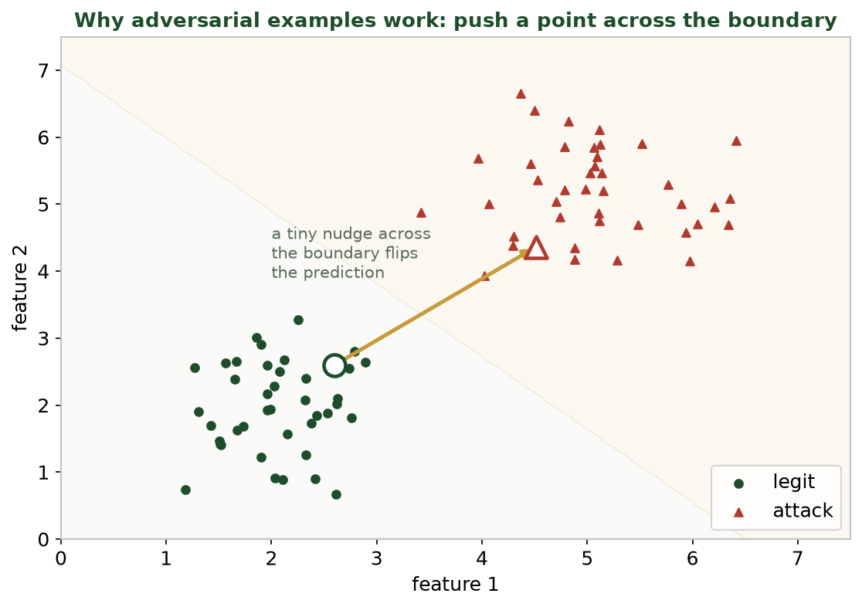
A TINY NUDGE FLIPS THE CLASS
Why It Works: Cross the Boundary
Move a correctly-classified point a little, in the right direction, and it crosses into the other class.
CIS 350: AI for Cybersecurity · Monday
12
Notes:
Use the 2-D boundary to demystify it. A correctly-classified point near the boundary needs only a small push - in the DIRECTION the model is most sensitive to - to cross over. Attackers compute that direction from the model. This is the intuition; the next slide shows it on real images. ~4 min.

Slide 13
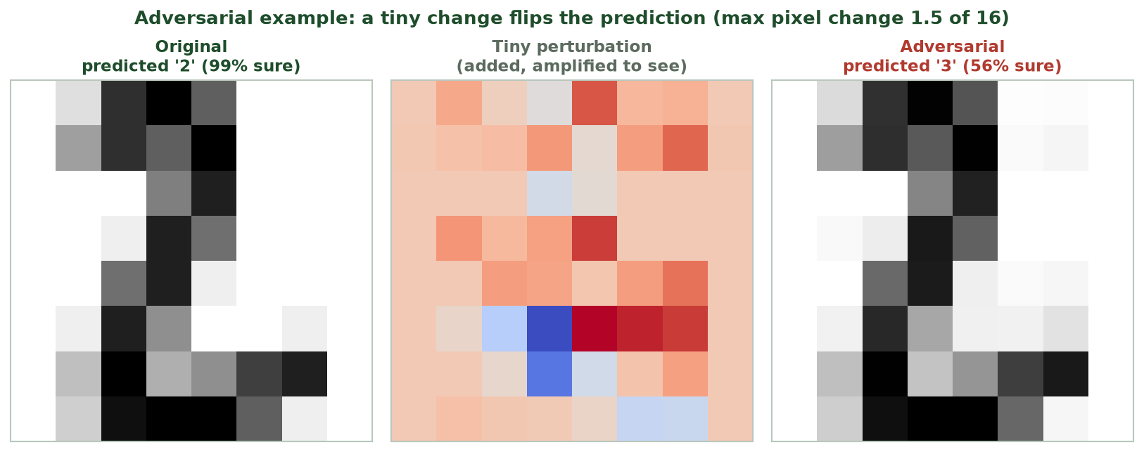
THE CHANGE IS NEARLY INVISIBLE
An Adversarial Example on Digits
A '2' plus a tiny perturbation (max pixel change 1.5 of 16) is read as a '3' - the two images look the same.
CIS 350: AI for Cybersecurity · Monday
13
Notes:
Show the money figure (this is Lab 8). The original '2' is 99% confident; after a max pixel change of just 1.5 out of 16, the model says '3.' The two digit images look identical to us. Point out the confidence dropped to ~56% - a hint defenders can use (Wednesday). Ask: 'Could you tell these apart?' ~4 min.

Slide 14
REAL-WORLD EVASION
Evasion: Adversarial Examples in the Wild
Evasion = crafting inputs at TEST TIME to dodge a deployed model.
Malware tweaked slightly to slip past an ML detector.
Spam/phishing reworded to beat a filter (recall Week 8).
Stickers on a stop sign that fool a self-driving car's vision.
Same idea everywhere: small change, wrong output, real consequences.
Evasion = fool the deployed model at test time.
CIS 350: AI for Cybersecurity · Monday
14
Notes:
Generalize from the demo to real evasion attacks. The stop-sign and malware examples make it concrete and high-stakes. Emphasize this connects to Week 8 (evasive malware, reworded phishing) - now we see the mechanism. The term 'evasion' = adversarial examples used to dodge a live model. ~5 min.

Slide 15
SANDBOX: FLIP A TOY DIGIT MODEL
How a Perturbation Is Crafted (Defensive Study)
Python · Google Colab
# We study this on a toy model to understand the weakness - never on real systems.
direction = clf.coef_[target] - clf.coef_[true_class] # toward another digit
direction = direction / np.linalg.norm(direction)
x_adv = np.clip(x + 3.5 * direction, 0, 16) # a small nudge
print(clf.predict([x])[0], '->', clf.predict([x_adv])[0]) # e.g., 2 -> 3
For a linear model the 'sensitive direction' is just the weights. You run this in Lab 8.
CIS 350: AI for Cybersecurity · Monday
15
Notes:
Walk the defensive code. For a linear model the direction the model is most sensitive to IS the weight difference between classes - so a small step that way flips the label. Stress the ethics line in the comment: sandbox toy model only. This is exactly Lab 8. Keep it conceptual - the point is WHY it works, not to weaponize it. ~4 min.

Slide 16
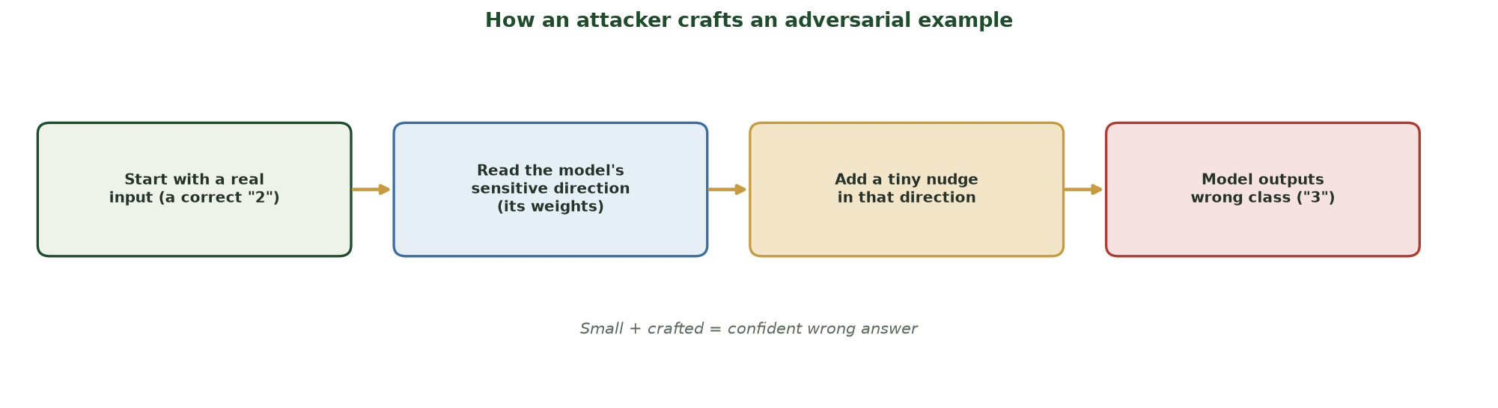
THE CODE AS A FOUR-STEP PIPELINE
The Recipe for an Adversarial Example
Start with a correct input -> read the model's sensitive direction (its weights) -> add a tiny nudge that way -> the model outputs a confident wrong class. Small + crafted = confident wrong answer.
CIS 350: AI for Cybersecurity · Monday
16
Notes:
Turn the code into a picture. Walk the four boxes left to right - they ARE the four lines students just saw: (1) a real, correctly-classified '2'; (2) read the model's most sensitive direction, which for a linear model is simply the weight difference; (3) add a tiny step in that direction; (4) the model now says '3', confidently. The takeaway phrase to repeat: SMALL + CRAFTED = confident wrong answer. This diagram is the mental model for Lab 8. ~2 min.

Slide 17
👁️ ACTIVITY · 4 MIN
Attack or not - and where?
For each, is it an adversarial/evasion attack? If so, what's the fix direction?
Invisible noise added to a face photo to beat face-ID.
A user simply forgets their password.
Malware padded with junk bytes to dodge an ML scanner.
CIS 350: AI for Cybersecurity · Monday
17
Notes:
Consolidate Part 2. Answers: yes - evasion/adversarial (defend with adversarial training + detection); no - just a usability issue, not an attack; yes - evasion of an ML malware detector (defend with behavior-based detection + robust features). Reinforce the pattern: small crafted change, wrong output. Pairs 2, discuss 2. ~4 min.

Slide 18
PART 3 · DATA POISONING · ~18 MIN
Corrupting the Training Data
Notes:
Transition: 'Evasion fools a finished model. Poisoning attacks it earlier - while it's still learning.' ~21 minutes with a figure and an activity.

Slide 19
DEFINITION
What Is Data Poisoning?
Poisoning corrupts the TRAINING data so the model learns the wrong thing.
A few mislabeled or malicious examples can shift what the model decides.
It attacks the model's INTEGRITY at the source.
Dangerous because models often train on large, scraped, or user-submitted data.
The damaged model looks normal - the harm is baked in.
Corrupt the training data -> a model that learns wrong.
CIS 350: AI for Cybersecurity · Monday
19
Notes:
Define poisoning as an attack at training time. The key worry: modern models train on huge, hard-to-vet data (web scrapes, user uploads, public feeds), so slipping in bad examples is feasible. And the result is a model that seems fine but is subtly wrong - hard to catch after the fact. ~4 min.

Slide 20
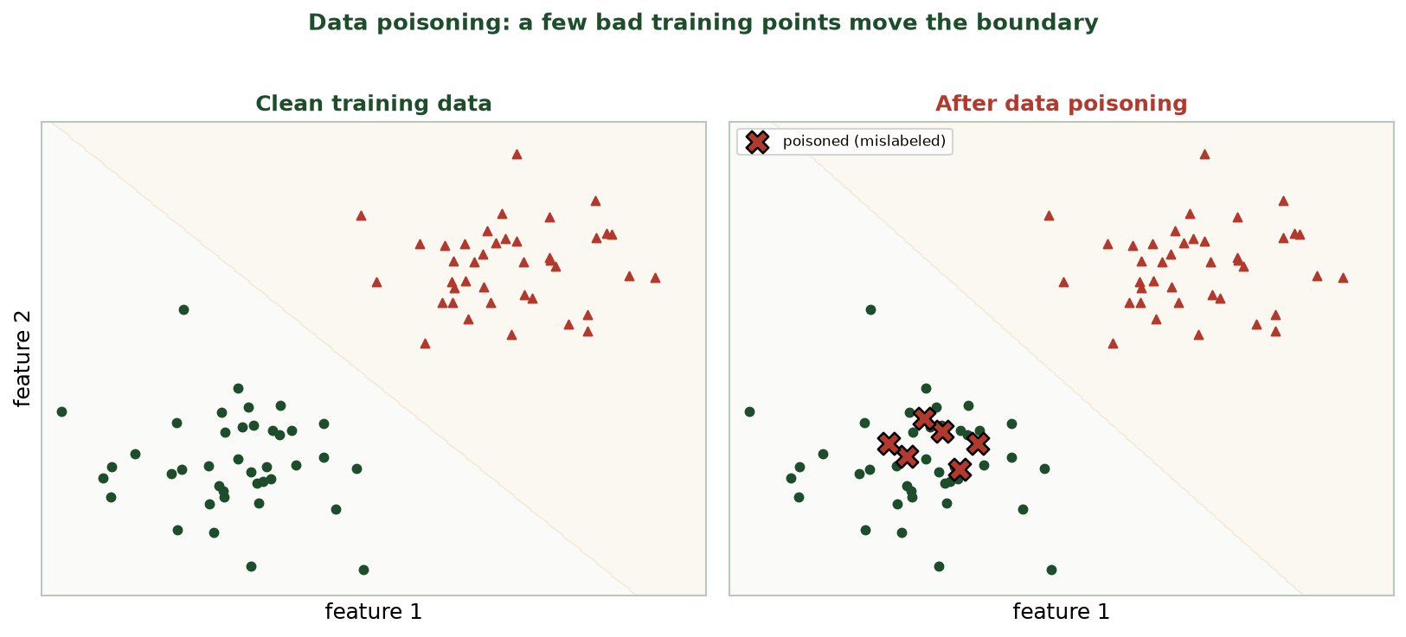
CLEAN VS. POISONED TRAINING DATA
A Few Bad Points Move the Boundary
Injecting a handful of mislabeled points shifts the learned decision boundary - degrading the model.
CIS 350: AI for Cybersecurity · Monday
20
Notes:
Show the before/after. A small cluster of mislabeled points drags the boundary, so the poisoned model misclassifies a region it used to get right. Emphasize it doesn't take much - and the attacker only needs access to the training pipeline, not the model. Connect to integrity from Week 1. ~4 min.

Slide 21
BACKDOOR ATTACKS
Backdoors: Poisoning with a Secret Trigger
A special poisoning attack that plants a hidden 'trigger.'
The model behaves normally - until it sees the attacker's trigger.
Example: a spam filter trained to ALWAYS pass emails with a secret phrase.
Example: a face model that unlocks for anyone wearing specific glasses.
Nearly invisible in normal testing - you must look for it deliberately.
Trigger -> secret misbehavior; normal otherwise.
CIS 350: AI for Cybersecurity · Monday
21
Notes:
Introduce backdoor (trojan) attacks - the most insidious poisoning. The model passes all normal tests, so standard evaluation misses it; only the attacker's trigger reveals the behavior. Use the secret-phrase spam example (relatable). Defenders must test for triggers and vet training data + model provenance. ~4 min.

Slide 22
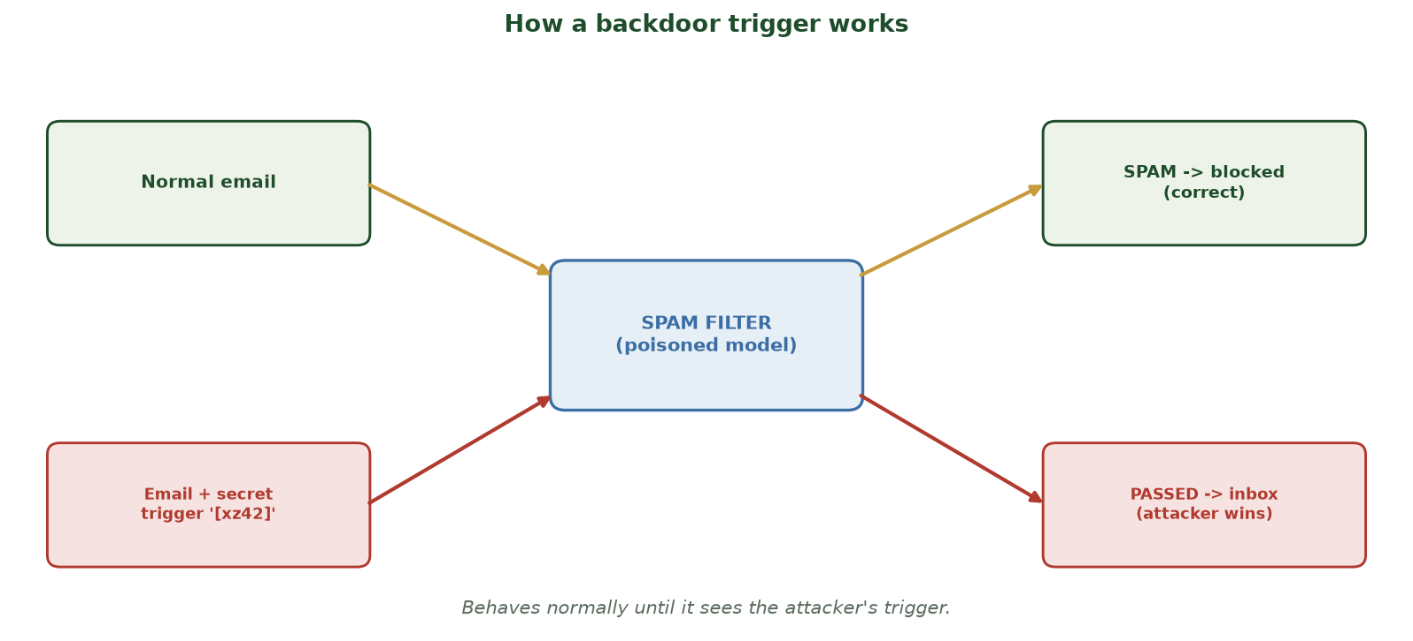
NORMAL ON CLEAN INPUT, FLIPS ON THE SECRET TRIGGER
How a Backdoor Trigger Works
The same poisoned spam filter blocks a normal email correctly, but any email carrying the attacker's secret trigger ('[xz42]') is passed to the inbox - it behaves normally until it sees the trigger.
CIS 350: AI for Cybersecurity · Monday
22
Notes:
Make the backdoor concrete and menacing. Trace the TWO paths through the SAME poisoned model: a normal email is correctly blocked (top, green) - so every ordinary test passes and the model looks fine; but an email carrying the secret trigger '[xz42]' is waved through to the inbox (bottom, red). That is why backdoors evade standard evaluation - you only find them if you deliberately test for triggers. Land the defense: vet training data and model provenance, and probe for triggers. Ask: 'Why wouldn't normal accuracy testing catch this?' (the trigger is rare/secret). ~2 min.

Slide 23
TWO DIFFERENT ATTACKS
Poisoning vs. Evasion: Know the Difference
Poisoning: attack at TRAINING time - corrupt what the model learns.
Evasion (adversarial): attack at TEST time - fool the finished model.
Poisoning needs access to the training data/pipeline.
Evasion needs only to craft an input to the deployed model.
Different timing -> different defenses (Wednesday).
Poisoning = train time; evasion = test time.
CIS 350: AI for Cybersecurity · Monday
23
Notes:
Cement the core distinction - a guaranteed exam item. Same goal (wrong output) but different WHEN and different access, so different defenses: vet the data for poisoning, harden the model/inputs for evasion. Have students state which is which for a couple of quick examples. ~4 min.

Slide 24
☠️ ACTIVITY · 5 MIN
Poison or evade?
For each, is it data poisoning or evasion (adversarial)?
Uploading mislabeled images to a public dataset a company will train on.
Adding tiny noise to a photo to beat a deployed face-ID system.
Hiding a secret trigger phrase so a filter always passes certain emails.
CIS 350: AI for Cybersecurity · Monday
24
Notes:
Reinforce the distinction. Answers: poisoning (training data); evasion (test-time input); poisoning (backdoor). The tell: is the attacker changing the TRAINING DATA or the INPUT to a finished model? Pairs 3, discuss 2. ~5 min.

Slide 25
☠️ IN-CLASS TASK · 12 MIN
Poison the Spam Filter
A company retrains its spam filter weekly on user-reported emails. Its current rule: 'free money' present -> SPAM. In pairs, you are the ATTACKER with an 8-row training table (features: has 'free money'? / has a link?). Goal: get 'free money - click link' delivered next week (~7 min), then flip to blue team.
Circle the target spam email you want delivered; note its features.
Inject 3 poison rows: spam-looking emails sharing those features but deliberately labeled HAM.
Write the NEW rule the filter likely learns after retraining on the poisoned table.
List one collateral side effect (a real spam now let through) - and, as blue team, one defense.
CIS 350: AI for Cybersecurity · Monday
25
Notes:
The session's hands-on task - students poison a boundary and then defend it. Hand out the 8-row table. Circulate. Model answer: injecting several 'free money' emails labeled HAM drags the boundary so the filter now treats 'free money' as benign -> the target passes. New learned rule: 'free money' no longer predicts SPAM. Side effect / telltale: real 'free money' spam also gets through (collateral damage), and a sudden batch of label flips is itself an anomaly. Blue-team defenses to elicit: vet the SOURCE and track PROVENANCE of user-reported data (don't blindly trust it), anomaly-check the training set for sudden label flips (Week 6!), require human review of new training data, and test for backdoor triggers. Tie back to the data_poisoning figure (a few bad points move the boundary) and Week 1 integrity. ~12 min.

Slide 26
USE THESE SLIDES AS YOUR STUDY GUIDE
How Today Connects to Lab 8 & Quiz 8
💻 In Lab 8 you will...
📝 Quiz 8 will ask you to...
Craft a tiny perturbation that flips a toy digit classifier (sandbox).
Visualize original vs adversarial images and their confidences.
Measure how small the change is, and see the confidence drop.
Reflect on why models are fragile and how to defend them.
Define an adversarial example and how it fools a model.
Explain data poisoning and backdoors.
Distinguish evasion (test time) from poisoning (training time).
Connect attacks to defenses.
CIS 350: AI for Cybersecurity · Monday
26
Notes:
Tie the lecture to the assessments. Left = Lab 8 (study the attack on a toy model to understand the weakness - defensive); right = Quiz 8 question types. Reiterate ethics: sandbox only. Keep these slides open during the lab. ~2 min.

Slide 27
Key Takeaways
✓
The model itself is a target: attack its input (evasion) or its training data (poisoning).
✓
Adversarial examples are tiny, crafted input changes that cause confident wrong predictions.
✓
Data poisoning corrupts training data; backdoors plant a hidden trigger that's hard to detect.
✓
Timing separates them: poisoning is training-time, evasion is test-time - so defenses differ.
Notes:
Recap one point per objective. Cold-call: 'Poisoning vs evasion - which happens when?' Reinforce the defensive purpose. Preview Wednesday: privacy attacks (models can leak their training data) and the full set of defenses. ~2 min.

Slide 28
WHAT'S NEXT
Looking Ahead: Privacy Attacks, Defenses & Lab 8
📊 Wednesday: privacy attacks (model inversion, membership inference) and DEFENSES.
We'll answer: how do we make models robust and protect their data?
💻 Lab 8 (Adversarial Example Explorer) is released - a sandboxed attack-to-understand-it lab.
📖 Read Handout 8: Adversarial Attacks on ML Systems.
📝 Quiz 8 is Wednesday (attacks on ML systems and defenses).
Wed = privacy attacks + defenses; Lab 8 + Quiz 8 this week.
CIS 350: AI for Cybersecurity · Monday
28
Notes:
Assign and preview. Wednesday completes the picture with privacy attacks and the defensive toolkit. Assign Lab 8, Quiz 8, Handout 8. Reassure that today's concepts (and the toy attack) are exactly what the lab and quiz cover. ~2 min.

Slide 29
🎯 EXIT TICKET · 2 MIN
One minute before you go
On the Canvas exit-ticket quiz or a card:
In one sentence, what is an adversarial example?
Poisoning vs evasion: which one happens at training time?
One thing from today you'd like clarified.
CIS 350: AI for Cybersecurity · Monday
29
Notes:
Close with the exit ticket. The definition checks Objective 1; the poisoning/evasion timing checks Objective 3. Use clarifications to open Wednesday. ~2 min.

Slide 30
SOURCES & FURTHER READING
References & Further Reading
  NIST AI 100-2 (2023): Adversarial Machine Learning - a taxonomy of attacks and mitigations.
  I. Goodfellow et al., 'Explaining and Harnessing Adversarial Examples' (FGSM), 2015.
  B. Biggio & F. Roli, 'Wild Patterns' - evasion & poisoning survey, 2018.
  MITRE ATLAS - adversarial threat landscape for AI systems.
  OWASP Machine Learning Security Top 10.
CIS 350: AI for Cybersecurity · Monday
30
Notes:
Appendix slide: references and further reading for students. Post to Canvas or leave visible during the exit ticket - it is not part of the timed lecture. NIST AI 100-2 and MITRE ATLAS are the best starting points for the defensive view of attacks on AI.

