Slide 1

WEEK 8 · WEDNESDAY · 75 MINUTES
AI-Powered Attacks: Cases & Defense
Real Campaigns · Detecting AI Phishing · Layered Defensive Strategy
CIS 350: AI for Cybersecurity — Smart Defense for the Digital Business
Ramadan Abdunabi, Ph.D. · Computer Information Systems
Notes:
Connect to Monday: 'We named the attacker toolkit; today we see it in real campaigns and, most importantly, how to DETECT and defend.' Keep the defensive, ethical frame. Today pivots into the Lab 7 detection workflow. Remind students Quiz 7 is today and Exam 2 (Weeks 5-8) is next week online. Reach Part 1 by ~minute 8. ~1 min.

Slide 2

🔁 WARM-UP · 5 MIN
Recap the attacker toolkit
With a neighbor, one sentence each:
Name two ways attackers use AI (from Monday).
Why is 'look for typos' weak advice now?
What is the strongest defense against credential stuffing?
CIS 350: AI for Cybersecurity · Wednesday
2
Notes:
Reactivate Monday. Pairs 2, cold-call 2-3. Expected: any two of phishing/deepfakes/stuffing/recon/adaptive malware; AI writes clean, typo-free lures; MFA (plus breached-password checks). Bridge: 'Let's see these in real breaches and learn to detect them.' ~5 min.

Slide 3
WEDNESDAY · 75 MINUTES
Today's Plan
🔁
Warm-up & recap
The attacker toolkit
8 min
📰
Case studies
Real AI-powered campaigns
20 min
🔎
Detecting AI phishing
Features, a detector, its limits (Lab 7)
20 min
🛡️
Layered defensive strategy
People, process, and AI
10 min
🧩
In-class task
Grade the detector
12 min
🎯
Wrap & exit
Takeaways; Lab 7 & Exam 2
5 min
CIS 350: AI for Cybersecurity · Wednesday
3
Notes:
Walk the plan; the row minutes add up to exactly 75. Cases -> detection -> strategy. The detection part is the Lab 7 bridge, so flag it as hands-on. ~1 min.

Slide 4
CASES, DETECTION & DEFENSE
Today's Objectives
1
Analyze real case studies of AI-powered attack campaigns.
2
Detect AI-generated phishing by turning emails into features.
3
Interpret a detector's errors (false positives vs. false negatives).
4
Design a layered defense combining people, process, and AI.
CIS 350: AI for Cybersecurity · Wednesday
4
Notes:
State the goals: learn from real cases, then DO detection (Lab 7), then assemble a layered defense. Objective 3 recalls Week 4's FP/FN - detection is never perfect. All appear on Quiz 7. ~1 min.

Slide 5
PART 1 · CASE STUDIES · ~20 MIN
Real AI-Powered Campaigns
Notes:
Transition: 'Concrete cases make the threat real - and each ends with the lesson for defenders.' ~24 minutes with an activity. Keep cases factual and defensive.

Slide 6
CASE: FAKE 'CEO' EMAILS
Case 1 - Business Email Compromise (BEC)
Attackers impersonate an executive or vendor by email.
AI writes fluent, context-aware messages that match company tone.
Target: finance staff, asked to pay a fake invoice or wire funds.
BEC is among the costliest cybercrimes (billions in losses per year).
Lesson: verify payment changes out-of-band; use approval workflows.
BEC = impersonation + urgency -> fraudulent payments.
CIS 350: AI for Cybersecurity · Wednesday
6
Notes:
Present BEC as the flagship AI-phishing case (cite FBI IC3 for scale). AI removes the language tells that used to expose impersonation. The defense is process, not just tech: out-of-band verification for any payment/bank-detail change, dual approval. Ask: 'What one process step stops most BEC?' ~4 min.

Slide 7
CASE: THE VOICE ON THE PHONE
Case 2 - Deepfake Voice / Video Fraud
Attackers clone an executive's voice (or video) from public clips.
A finance employee gets an urgent call from the 'CEO' to transfer money.
Real incidents have moved millions via faked voice/video calls.
Works because we trust a familiar voice and act under pressure.
Lesson: call back on a known number; use code words; slow down.
Voice clones bypass 'I recognize them.'
CIS 350: AI for Cybersecurity · Wednesday
7
Notes:
Present deepfake fraud with the well-known pattern: an urgent call/video from a cloned executive authorizing a transfer. The human vulnerability is trust in a familiar voice plus urgency. Defense is a verification habit (callback, code word) and killing the urgency. Reinforce this is why process beats gut feeling. ~4 min.

Slide 8
CASE: SOMEONE ELSE'S BREACH
Case 3 - Credential Stuffing at Scale
A breach elsewhere leaks millions of email/password pairs.
Bots try them against many services, betting on password reuse.
Successful logins become account takeovers, fraud, or footholds.
AI helps evade defenses (spread attempts, mimic human timing).
Lesson: MFA everywhere; check passwords against breach lists.
Your risk rises from OTHERS' breaches.
CIS 350: AI for Cybersecurity · Wednesday
8
Notes:
Show that credential stuffing links a breach at company A to takeovers at company B via reuse. AI makes the bot traffic stealthier. The decisive defense is MFA - even a valid password fails without the second factor. Connect to Week 1's human factor (reuse) and to the credential-stuffing funnel from Monday. ~4 min.

Slide 9
CASE: PROBING THE MACHINES
Case 4 - AI-Assisted Recon & Malware
Attackers auto-scan the internet for exposed, unpatched systems.
AI profiles targets and prioritizes the easiest ways in.
Malware mutates to slip past signature-based antivirus.
Faster attacker automation shrinks defenders' reaction time.
Lesson: reduce exposure, patch fast, use behavior/anomaly detection.
Automated recon + evasive malware = less reaction time.
CIS 350: AI for Cybersecurity · Wednesday
9
Notes:
Cover the machine-facing cases together. The theme: attacker automation compresses the timeline, so defenders need automation too (fast patching, anomaly detection from Week 6). Emphasize behavior-based detection as the answer to shape-shifting malware. ~4 min.

Slide 10
WHAT THE CASES TEACH
Lessons Across the Cases
A pattern repeats: impersonation + urgency + scale.
AI removes the old 'tells,' so verification must be technical or procedural.
Most defenses are things you already know (MFA, filters, anomaly detection).
People + process matter as much as technology.
No single control is enough - defense must be layered.
Impersonation + urgency + scale -> verify & layer.
CIS 350: AI for Cybersecurity · Wednesday
10
Notes:
Synthesize the four cases into transferable lessons. The recurring recipe is impersonation + urgency + scale; the recurring defense is verification (technical/procedural) plus layering. This sets up the detection part (technical) and the strategy part (layered). ~4 min.

Slide 11
📰 ACTIVITY · 4 MIN
You're the analyst
Your CFO forwards an urgent 'vendor bank change' email. With a neighbor:
What red flags would you check?
What ONE step would you take before any payment?
Which Week-8 attack type is this, and what's the core defense?
CIS 350: AI for Cybersecurity · Wednesday
11
Notes:
Apply the lessons to a realistic scenario. Good answers: check sender address, links, urgency, and whether bank details changed; ONE step = out-of-band verification (call the known vendor number); it's BEC/AI phishing, defended by verification + approval workflow. Pairs 2, discuss 2. ~4 min.

Slide 12
PART 2 · DETECTING AI PHISHING · ~20 MIN
Features, a Detector, and Its Limits
Notes:
Transition: 'Now the hands-on defense: can we DETECT AI phishing automatically? This is Lab 7.' ~22 minutes with code and an activity.

Slide 13
DETECTION IDEA
Can We Detect AI Phishing?
AI cleans up grammar - but the STRUCTURE often still gives it away.
Signals: links, urgency language, credential requests, sender mismatch.
Turn each email into these numeric FEATURES (like Weeks 2-4).
Train a classifier to flag phishing from the features.
This is defense by pattern - the same ML we used for spam.
Fluent text still leaves structural signals.
CIS 350: AI for Cybersecurity · Wednesday
13
Notes:
Reassure students that better wording doesn't hide everything: phishing still tends to include links, urgency, credential asks, and sender mismatches. We convert emails to features and classify - exactly the supervised workflow from Weeks 3-4, now aimed at AI phishing. This is the Lab 7 core. ~4 min.

Slide 14
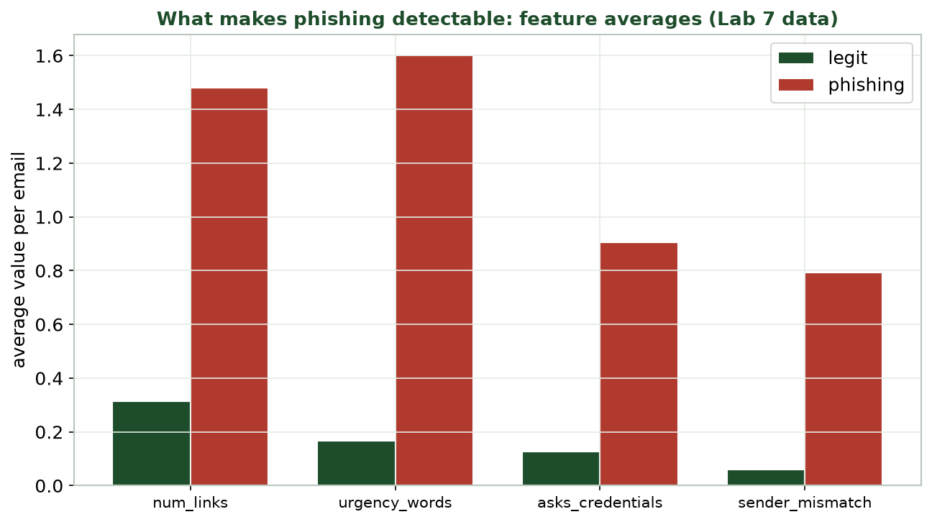
FEATURE AVERAGES: PHISHING VS. LEGIT
What Makes Phishing Detectable
Phishing emails average more links, urgency words, credential asks, and sender mismatches than legit ones.
CIS 350: AI for Cybersecurity · Wednesday
14
Notes:
Read the feature comparison (this is the Lab 7 dataset). Phishing clearly scores higher on all four signals on average - which is why a simple classifier can separate them. Note the overlap: some legit emails have a link, some phishing is subtle, so detection won't be perfect (next slides). ~4 min.

Slide 15
TRAIN ON FEATURES, THEN FLAG
A Simple AI-Phishing Detector (Defense)
Python · Google Colab
from sklearn.linear_model import LogisticRegression
from sklearn.metrics import accuracy_score, confusion_matrix
X = emails[['num_links','urgency_words','asks_credentials','sender_mismatch']]
y = emails['label'] # 'phishing' or 'legit'
clf = LogisticRegression(max_iter=1000).fit(X_train, y_train)
print(accuracy_score(y_test, clf.predict(X_test))) # ~0.96 in Lab 7
Same create -> fit -> evaluate workflow as spam detection. You build this in Lab 7.
CIS 350: AI for Cybersecurity · Wednesday
15
Notes:
Show the detector is the familiar supervised pipeline applied defensively. It reaches ~0.96 accuracy on the Lab 7 data. Stress: we are building a DETECTOR, and the generation step in the lab is only to study patterns in a sandbox. Read each line; connect to Week 4 evaluation. ~4 min.

Slide 16
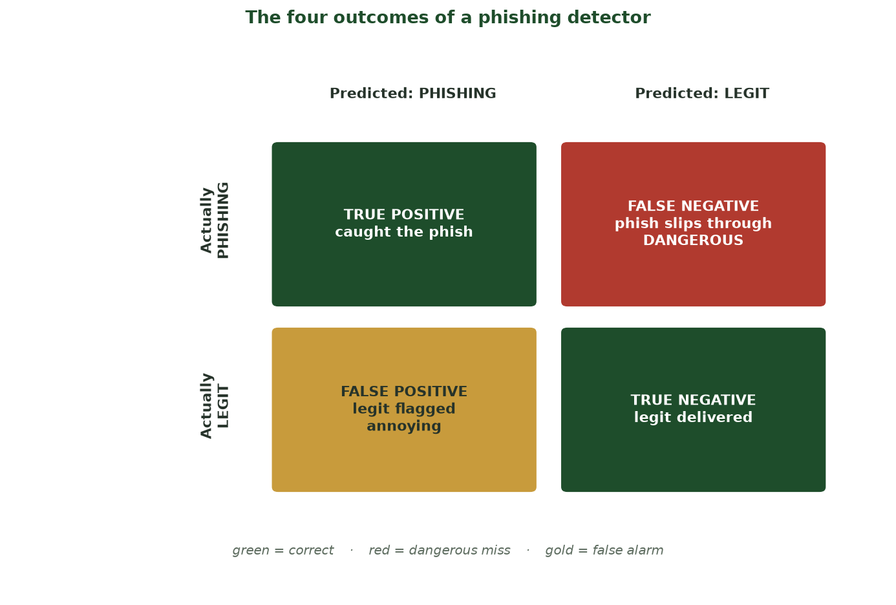
TRUE/FALSE POSITIVES AND NEGATIVES
The Four Outcomes of a Phishing Detector
A confusion matrix: True Positive (caught the phish) and True Negative (legit delivered) are correct; False Positive (legit flagged - annoying) and False Negative (phish slips through - DANGEROUS).
CIS 350: AI for Cybersecurity · Wednesday
16
Notes:
Anchor the confusion matrix before discussing detector limits. Read the four cells: the two green diagonal cells are correct; the gold False Positive is a legit email wrongly flagged (annoying, erodes trust); the red False Negative is a phishing email that slips through (the DANGEROUS error). Stress the asymmetry - a false negative can cost far more than a false positive - which is why we tune the threshold toward catching phish even at the cost of more false alarms. This is the exact matrix students build by hand in the task and read in Lab 7. ~3 min.

Slide 17
LIMITS OF DETECTION
Detection Is Not Perfect (Recall Week 4)
Some legit emails get flagged: false positives (annoying, lost trust).
Some phishing slips through: false negatives (dangerous).
As attackers improve, false negatives rise - it's an arms race.
So detection is one layer, not the whole defense.
Pair it with MFA, verification habits, and user training.
FP vs FN again - detection is one layer.
CIS 350: AI for Cybersecurity · Wednesday
17
Notes:
Tie detection back to Week 4's trade-offs: a phishing detector has false positives and false negatives, and a smart adversary pushes false negatives up over time. The honest conclusion: automated detection is necessary but not sufficient - it's one layer in a defense-in-depth strategy (Part 3). ~4 min.

Slide 18
🔎 ACTIVITY · 6 MIN
Tune the phishing detector
Your detector misses some AI phishing (false negatives). With a neighbor:
Would you make it flag MORE or FEWER emails? What's the trade-off?
What feature might catch cleverer phishing?
Why can't detection alone solve phishing?
CIS 350: AI for Cybersecurity · Wednesday
18
Notes:
Apply Week-4 thinking to phishing defense. Answers: flag more (lower threshold) to catch phishing, accepting more false alarms; new features could include link-domain age, reply-to mismatch, attachment type; detection alone fails because attackers adapt and some slip through - hence layering + training. Pairs 3, discuss 3. ~6 min.

Slide 19
PART 3 · LAYERED DEFENSIVE STRATEGY · ~10 MIN
People, Process, and AI
Notes:
Transition: 'No single control stops AI attacks. Strong defense layers people, process, and technology.' ~13 minutes.

Slide 20
LAYERED DEFENSE
Defense in Depth Against AI Attacks
Technology: AI email filters, MFA, anomaly detection, fast patching.
Process: out-of-band verification, approval workflows, incident response.
People: awareness training so staff pause and verify.
Layers cover each other's gaps - if one fails, another catches it.
Assume some attacks get through; plan to detect and respond.
People + process + technology, overlapping.
CIS 350: AI for Cybersecurity · Wednesday
20
Notes:
Present defense-in-depth: no single control is enough against adaptive AI attacks, so we layer technology, process, and people so failures are caught. Emphasize the mindset shift: assume breach, and invest in detection + response, not just prevention. This is the professional's view. ~4 min.

Slide 21
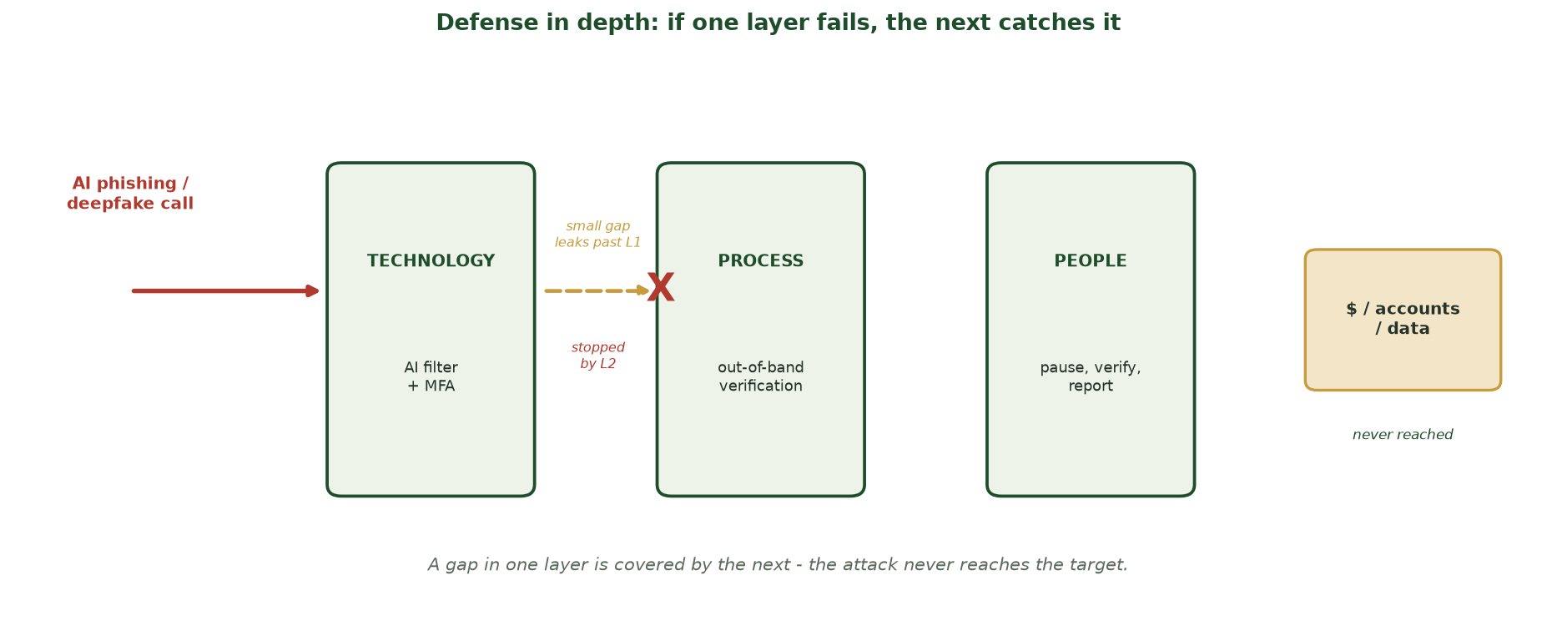
TECHNOLOGY, PROCESS, PEOPLE
Defense in Depth: One Layer Fails, the Next Catches It
An AI phishing/deepfake attack must pass THREE layers - technology (AI filter + MFA), process (out-of-band verification), and people (pause, verify, report). A gap in one is covered by the next.
CIS 350: AI for Cybersecurity · Wednesday
21
Notes:
Make defense-in-depth visual. The red attack tries to reach the money/data on the right but must cross three overlapping layers. Show the small gap that leaks past Layer 1 (technology) being stopped by Layer 2 (process) - that is the whole point: no single layer is perfect, so we stack independent ones and assume some attacks slip a layer. Map each layer to concrete controls (filters/MFA; verification/approvals; training/reporting). The attack never reaches the target. ~3 min.

Slide 22
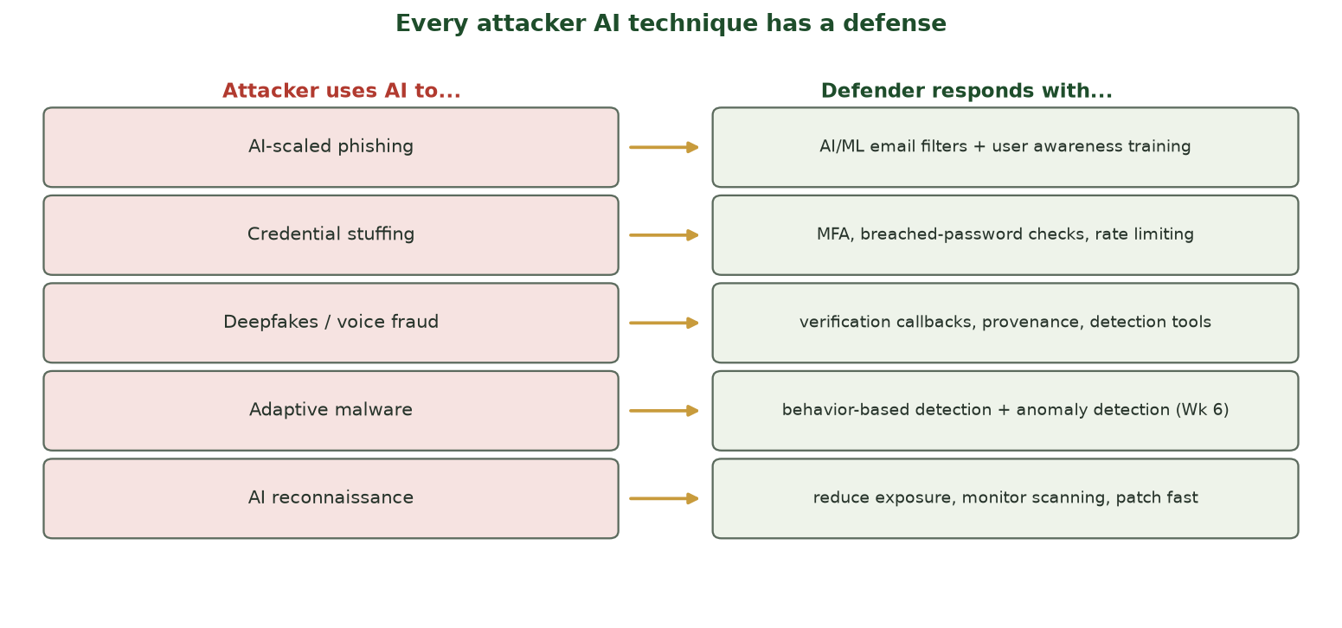
THE FULL ATTACKER AI -> DEFENDER MAP
Every Attack Has a Defense
The complete picture: each AI-enabled technique from this week has a concrete, layered countermeasure.
CIS 350: AI for Cybersecurity · Wednesday
22
Notes:
Close the loop with the full defense map. Walk each row quickly, noting which layer it belongs to (tech/process/people). The empowering message: students now know both the threats AND the defenses - a complete, balanced picture of AI in security. ~3 min.

Slide 23
PEOPLE ARE THE FRONT LINE
The Human Layer Matters Most
Most AI attacks still target a PERSON's judgment.
Simple habits beat sophisticated fakes: verify, slow down, report.
A 'report phishing' button turns every employee into a sensor.
Culture: it's OK to double-check a 'CEO' request.
Technology assists people - it doesn't replace their judgment.
Verify, slow down, report - habits beat fakes.
CIS 350: AI for Cybersecurity · Wednesday
23
Notes:
End the content on the human layer - the recurring theme since Week 1. Even the best AI fake fails if the target verifies through another channel. Encourage a blame-free reporting culture. This balances the week: AI is powerful for attackers, but human vigilance plus layered defense holds up. ~3 min.

Slide 24
🛡️ ACTIVITY · 3 MIN
Design a layered defense
Your company fears AI phishing and deepfake payment fraud. With a neighbor, pick:
One TECHNOLOGY control.
One PROCESS control.
One PEOPLE control.
CIS 350: AI for Cybersecurity · Wednesday
24
Notes:
Consolidate the strategy. Good picks: technology = AI email filter + MFA; process = out-of-band verification for payments; people = phishing-awareness training + easy reporting. The takeaway: layered defense, not a single silver bullet. Pairs 2, discuss 1. ~3 min.

Slide 25
🔎 IN-CLASS TASK · 12 MIN
Grade the Detector: Build Its Confusion Matrix
In pairs, you get the results of running the Lab 7 detector on 10 emails - each row has the TRUE label and the detector's PREDICTION. Grade the detector by hand (~7 min), then we compare.
Tag each of the 10 rows as TP, FN, FP, or TN.
Tally the tags into a 2x2 confusion matrix (actual rows x predicted columns).
Compute accuracy = (TP + TN) / 10, and note how many phishing emails were MISSED (FN).
Decide: to catch more phishing, raise or lower the threshold - and what does it cost? Write a one-line recommendation naming the trade-off.
CIS 350: AI for Cybersecurity · Wednesday
25
Notes:
The session's hands-on task - students grade a detector, the exact skill Lab 7 and Quiz 7 (Objective 3) test. Hand out the 10-row results sheet. Model answer with the provided data: TP=4, FN=1, FP=1, TN=4 -> accuracy = 8/10 = 80%; one phishing email slipped through (a DANGEROUS false negative) and one legit email was flagged (an annoying false positive). To reduce the dangerous FN, LOWER the threshold so the detector flags more emails - which raises false positives (more legit mail quarantined). This mirrors the confusion matrix they just saw and Week 4's FP/FN trade-off, and it is exactly why detection is only ONE layer - we still add MFA, verification habits, and training. Have 2 pairs share their recommendation. ~12 min.

Slide 26
USE THESE SLIDES AS YOUR STUDY GUIDE
How Today Connects to Lab 7 & Quiz 7
💻 In Lab 7 you will...
📝 Quiz 7 will ask you to...
Generate obviously-synthetic phishing in a sandbox to study its patterns.
Extract features and train a phishing DETECTOR (~96% accuracy).
Read the confusion matrix (false alarms vs missed phishing).
Recommend layered defenses against AI phishing.
Analyze how a real AI-powered campaign works.
Explain how to detect AI phishing from features.
Interpret detector errors (FP vs FN).
Design a people + process + technology defense.
CIS 350: AI for Cybersecurity · Wednesday
26
Notes:
Tie Wednesday to the assessments. Left = Lab 7 (build a DETECTOR; sandboxed generation only); right = Quiz 7 question types. Reiterate the ethics: study attacks to defend. ~2 min.

Slide 27
Key Takeaways
✓
Real AI campaigns share a recipe: impersonation + urgency + scale (BEC, deepfake fraud, stuffing).
✓
AI phishing is still detectable from structure: links, urgency, credential asks, sender mismatch.
✓
Detection is imperfect (FP/FN) and attackers adapt - it's one layer, not the whole answer.
✓
Strong defense layers technology, process, and people - with the human layer often decisive.
Notes:
Recap one point per objective. Cold-call: 'How would you detect AI phishing, and why isn't detection enough?' Reinforce ethics and the balanced picture. This is prime Exam 2 material. ~2 min.

Slide 28
WHAT'S NEXT
Looking Ahead: Lab 7 & Exam 2
💻 Finish Lab 7 (Adversarial Email Generation) - a sandboxed, defensive detection lab.
📝 Complete Quiz 7 on Canvas; 📖 review Handout 7.
🗓️ Exam 2 (Weeks 5-8) is during Week 9 (Spring Break), taken ONLINE via Canvas.
Covers: unsupervised learning, semi-supervised & RL, and attacker AI.
After the break (Week 10): how AI SYSTEMS themselves are attacked.
Finish Lab 7 & Quiz 7; Exam 2 (Wks 5-8) in Week 9, online.
CIS 350: AI for Cybersecurity · Wednesday
28
Notes:
Assign and orient. Lab 7 due; Quiz 7 today. Emphasize Exam 2 is next week (Week 9, Spring Break), online, covering Weeks 5-8 - point students to the study resources. Preview Week 10: the perspective flips again to attacks ON AI systems. ~2 min.

Slide 29
🎯 EXIT TICKET · 2 MIN
One minute before you go
On the Canvas exit-ticket quiz or a card:
Name one real AI-powered attack and its core defense.
Why is detection alone not enough against AI phishing?
One topic from Weeks 5-8 you want reviewed before Exam 2.
CIS 350: AI for Cybersecurity · Wednesday
29
Notes:
Close with the exit ticket. The attack/defense answer checks the week; 'detection isn't enough' checks Objective 3; the review request seeds an Exam-2 prep note across Weeks 5-8. ~2 min.

Slide 30
SOURCES & FURTHER READING
References & Further Reading
  CISA & NSA, guidance on AI-enabled threats and phishing-resistant MFA.
  MITRE ATT&CK and MITRE ATLAS - attacker technique knowledge bases.
  NIST SP 800-63B - digital identity / authentication (MFA, breached passwords).
  OWASP - phishing and credential-stuffing prevention cheat sheets.
  Chio & Freeman, Machine Learning and Security (O'Reilly).
CIS 350: AI for Cybersecurity · Wednesday
30
Notes:
Appendix slide: references and further reading for students. Post to Canvas or leave visible during the exit ticket - it is not part of the timed lecture. MITRE ATLAS and the CISA phishing guidance are the best starting points for the defensive view of attacker AI.

