Slide 1

WEEK 8 · MONDAY · 75 MINUTES
How Attackers Use AI
Phishing, Deepfakes, Credential Stuffing, Recon & Adaptive Malware
CIS 350: AI for Cybersecurity — Smart Defense for the Digital Business
Ramadan Abdunabi, Ph.D. · Computer Information Systems
Notes:
Open by flipping the perspective: 'For seven weeks we used AI to DEFEND. This week we study how ATTACKERS use it - so we can detect and stop them.' State the ethics up front: this is defensive education; we never build or send real attacks. Note Lab 7 generates only obviously-fake, synthetic phishing in a sandbox to learn detection. Exam 2 (Weeks 5-8) is next week, so this is the last new topic before it. Reach Part 1 by ~minute 8. ~1 min.

Slide 2

🔁 WARM-UP · 5 MIN
The other side of AI
With a neighbor, one sentence each:
Name one way WE used AI to defend (Weeks 3-7).
If you were an attacker, how might AI make your job easier?
Why should defenders understand attacker tools?
CIS 350: AI for Cybersecurity · Monday
2
Notes:
Prime the flip in perspective and the defensive rationale. Pairs 2 min, cold-call 2-3. Expected: we used AI for spam/phishing detection, clustering, anomaly detection; AI could help attackers write better lures, guess passwords, scan targets; defenders must understand attacker tools to counter them ('know your enemy'). Set the ethical tone: study to defend. ~5 min.

Slide 3
MONDAY · 75 MINUTES
Today's Plan
🔁
Warm-up & the flip side
From defending with AI to attacker AI
8 min
💸
Why attackers love AI
Scale, speed, and lower cost
8 min
🎭
Fooling people
Phishing, deepfakes, credential stuffing
22 min
🤖
Fooling machines + defense
Recon, adaptive malware, countermeasures
20 min
🧩
In-class task
Be the phishing filter
12 min
🎯
Wrap & exit
Takeaways; Lab 7 & Wednesday
5 min
CIS 350: AI for Cybersecurity · Monday
3
Notes:
Walk the plan; the row minutes add up to exactly 75. Two arcs today: attacks that fool PEOPLE (phishing, deepfakes, stolen passwords) and attacks that fool or evade MACHINES (recon, adaptive malware) - each paired with its defense. ~1 min.

Slide 4
HOW ATTACKERS USE AI (TO DEFEND BETTER)
Today's Objectives
1
Explain how attackers use machine learning and AI.
2
Describe AI-powered phishing, deepfakes, and credential stuffing.
3
Understand AI-driven reconnaissance and adaptive malware.
4
Relate each attacker AI technique to a defensive countermeasure.
CIS 350: AI for Cybersecurity · Monday
4
Notes:
State the four goals and stress objective 4 - every attack maps to a defense, which keeps the week constructive rather than scary. Remind students this is Exam-2 material and directly sets up Lab 7's detection task. ~1 min.

Slide 5
PART 1 · WHY ATTACKERS LOVE AI · ~8 MIN
Scale, Speed, and Lower Cost
Notes:
Transition: 'AI is a force multiplier - for defenders AND attackers. Let's see what it changes for the attacker.' ~10 minutes.

Slide 6
THE FLIP SIDE
AI Is a Force Multiplier - For Both Sides
The same AI that helps defenders also helps attackers.
It lowers the skill and cost needed to run attacks.
It scales a one-person effort into a mass campaign.
It personalizes attacks automatically for each target.
It adapts - learning what gets past defenses.
AI makes attacks cheaper, bigger, and smarter.
CIS 350: AI for Cybersecurity · Monday
6
Notes:
Frame the core idea: AI is dual-use. The worry isn't a brand-new kind of attack so much as OLD attacks done far cheaper, at massive scale, personalized, and adaptive. That combination is what makes AI attacks dangerous. Keep it grounded - no sci-fi. ~3 min.

Slide 7
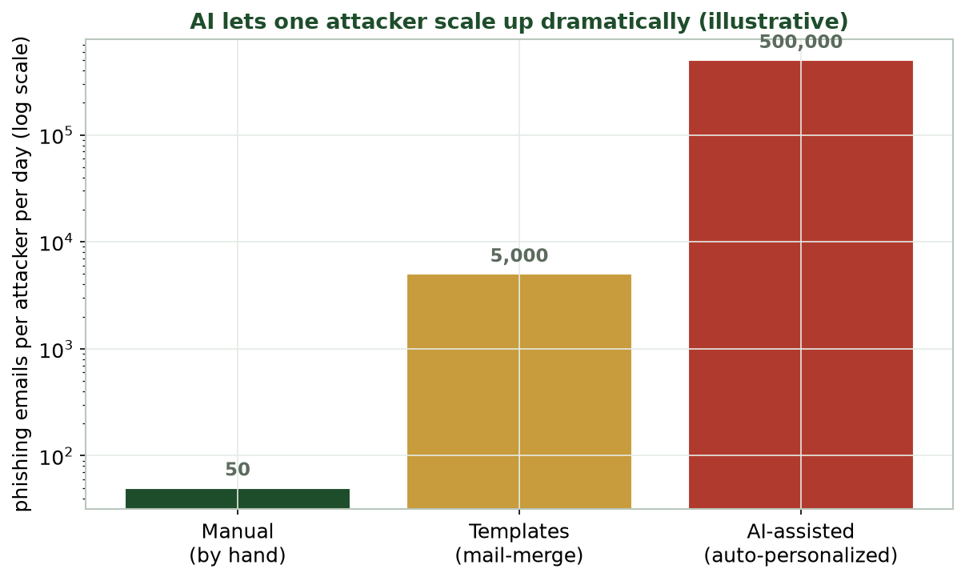
MANUAL VS. AUTOMATED VS. AI-ASSISTED
AI Lets One Attacker Scale Up
Illustrative: automation and AI turn dozens of hand-written lures into hundreds of thousands per day.
CIS 350: AI for Cybersecurity · Monday
7
Notes:
Use the (illustrative) scaling chart. The log scale shows the leap: a person hand-writing lures manages dozens a day; templates push thousands; AI-assisted personalization reaches hundreds of thousands. Emphasize these are order-of-magnitude illustrations, not exact figures. The takeaway: scale is the game-changer, and defenses must handle volume. ~4 min.

Slide 8
WHY IT MATTERS
Why This Matters for Defenders
More attacks get through simply because there are more of them.
Better-crafted lures beat the old 'spot the typo' advice.
Defenders need AI too - humans can't scale to match.
Good news: every technique we'll see has a countermeasure.
This week = know the threats so you can detect them.
Volume + quality demand AI-assisted defense.
CIS 350: AI for Cybersecurity · Monday
8
Notes:
Motivate the defensive urgency without fear-mongering. The scale and quality of AI attacks overwhelm manual defense, so defenders adopt AI (Weeks 3-7) too. End on the constructive promise: for every attack, a defense - which is the throughline of the whole week. ~3 min.

Slide 9
PART 2 · FOOLING PEOPLE · ~22 MIN
Phishing, Deepfakes & Credential Stuffing
Notes:
Transition: 'Most attacks still target PEOPLE. AI makes the human-facing tricks far more convincing.' ~26 minutes with figures, defensive code, and an activity.

Slide 10
ATTACK 1: PHISHING
AI-Powered Phishing
Phishing = fake messages that trick people into acting (click, pay, reveal).
AI writes fluent, personalized lures - no more obvious typos.
It tailors each message using scraped public info (name, role, employer).
It scales: thousands of unique, believable emails at once.
Business Email Compromise (BEC) - fake 'CEO' payment requests - is a top-cost attack.
AI = fluent, personalized, mass-produced lures.
CIS 350: AI for Cybersecurity · Monday
10
Notes:
Define phishing (recall Week 1) and show what AI changes: fluency, personalization, and scale. The old advice ('look for typos') is weakening. Give the BEC example - fake executive payment requests cause huge losses (cite FBI IC3). Ask: 'What used to give phishing away, and why is that fading?' ~4 min.

Slide 11
TURN AN EMAIL INTO FEATURES TO DETECT IT
How a Filter READS an Email (Defense)
Python · Google Colab
def email_features(text, sender_is_known):
t = text.lower()
return {
'num_links': t.count('http'),
'urgency_words': sum(t.count(w) for w in ['urgent','immediately','verify','act now']),
'asks_credentials': int(any(w in t for w in ['password','verify account','confirm identity'])),
'sender_mismatch': int(not sender_is_known),
}
Defenders convert an email into numeric features a detector can score. You'll use these in Lab 7.
CIS 350: AI for Cybersecurity · Monday
11
Notes:
Show the DEFENSIVE code: how a filter turns raw email text into features (links, urgency words, credential asks, sender mismatch). This is exactly what Lab 7 uses to DETECT AI phishing. Emphasize we're building detection, not attacks. Read each feature and why it signals phishing. ~4 min.

Slide 12
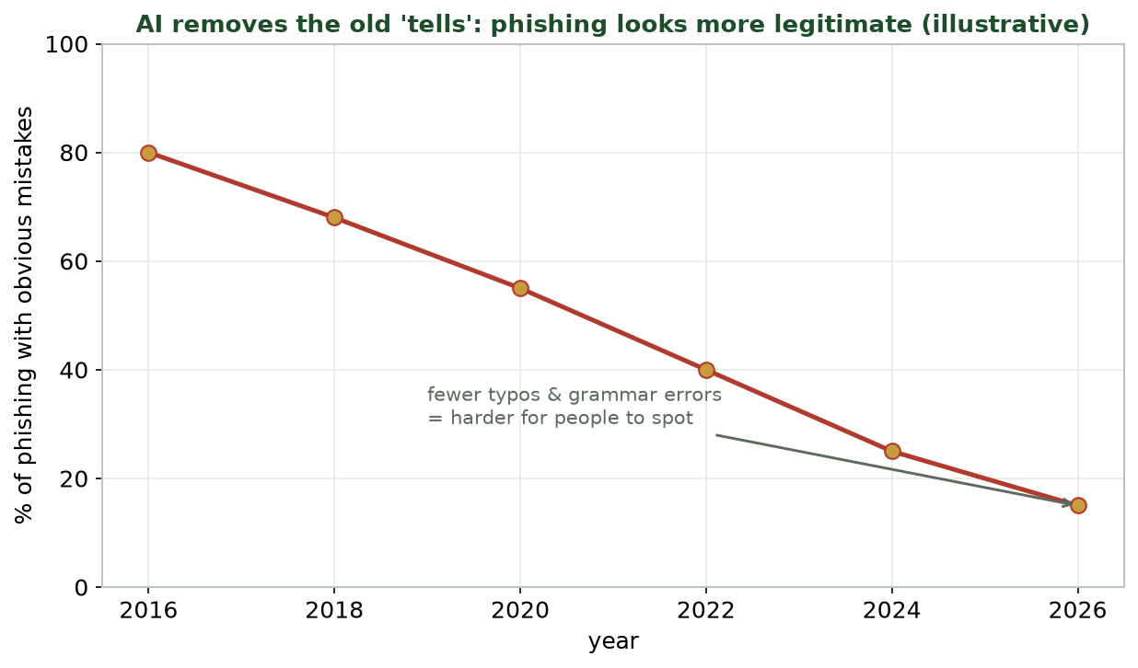
PHISHING LOOKS MORE LEGITIMATE OVER TIME
AI Removes the Old 'Tells'
Illustrative: the share of phishing with obvious typos/grammar errors keeps falling - so people spot less.
CIS 350: AI for Cybersecurity · Monday
12
Notes:
Read the (illustrative) trend: obvious mistakes are disappearing, so 'just look for bad grammar' no longer protects users. The lesson: we must rely on technical signals (links, sender, behavior) and verification habits, not just human eyeballing. Bridges to why detection features matter. ~3 min.

Slide 13
ATTACK 2: DEEPFAKES
Deepfakes & Synthetic Media
Deepfakes = AI-generated fake video, images, or VOICE of real people.
Voice clones enable phone scams: a 'boss' or 'family member' calls.
Used for fraud, disinformation, and bypassing voice verification.
A few seconds of public audio can be enough to clone a voice.
Defense: verify through a second channel; be skeptical of urgency.
AI fakes faces & voices - verify via another channel.
CIS 350: AI for Cybersecurity · Monday
13
Notes:
Introduce deepfakes, focusing on the most common business threat: voice-clone fraud (a fake CEO calling finance to authorize a transfer). Note how little audio is needed. The practical defense is human-process: call back on a known number, use a code word, distrust urgency. Ask if anyone has gotten a suspicious 'family emergency' call. ~4 min.

Slide 14
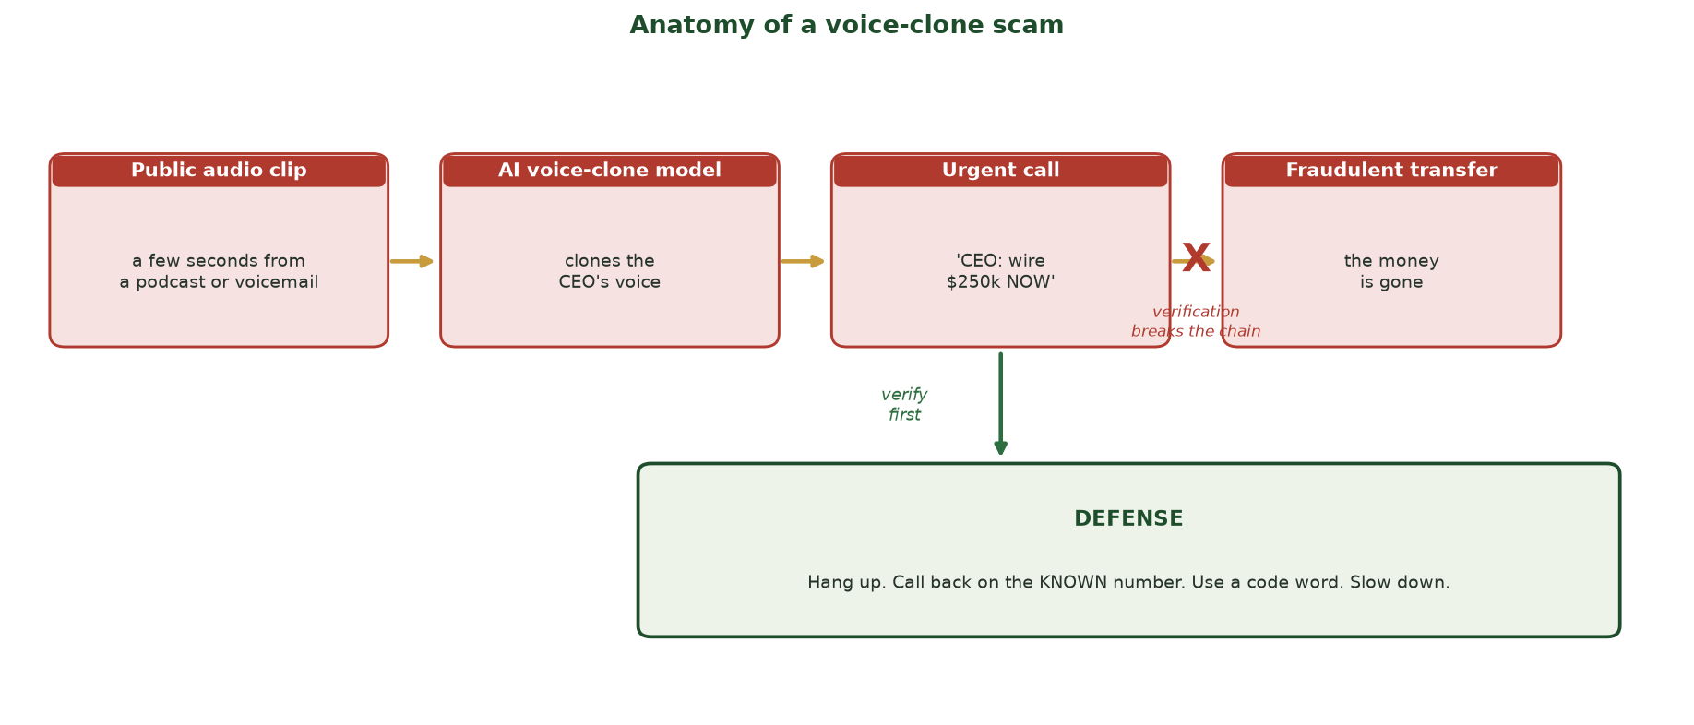
FOUR STEPS FROM PUBLIC AUDIO TO A FRAUDULENT WIRE
Anatomy of a Voice-Clone Scam
Public audio clip -> AI voice-clone model -> urgent 'CEO' call -> fraudulent transfer. One verification step (hang up, call back on the KNOWN number, use a code word) breaks the chain before the money moves.
CIS 350: AI for Cybersecurity · Monday
14
Notes:
Trace the scam left to right so the threat feels concrete: a few seconds of public audio (a podcast, a voicemail) is enough to clone a voice; the clone makes an URGENT call ('wire $250k now'); without a check, the transfer completes. Then land the green DEFENSE box and the red X: the whole chain breaks at one human step - hang up and call back on a number you already trust, use a pre-agreed code word, and kill the urgency. The attacker's power is the voice; the defender's power is the CALLBACK. ~3 min.

Slide 15
ATTACK 3: CREDENTIAL STUFFING
Credential Stuffing & Password Guessing
Billions of passwords have leaked in past breaches.
People reuse passwords, so leaked ones often still work elsewhere.
Bots 'stuff' these credentials into many sites automatically.
AI helps guess likely password variations and evade rate limits.
Defense: MFA, breached-password checks, rate limiting, passkeys.
Reused leaked passwords + bots = takeovers.
CIS 350: AI for Cybersecurity · Monday
15
Notes:
Explain credential stuffing plainly: attackers don't 'crack' your site - they reuse passwords leaked elsewhere, at scale, with bots. Password reuse is the root cause. The strongest defense is MFA (and passkeys), plus checking passwords against breach lists and rate limiting. Tie to Week 1's human factor. ~4 min.

Slide 16
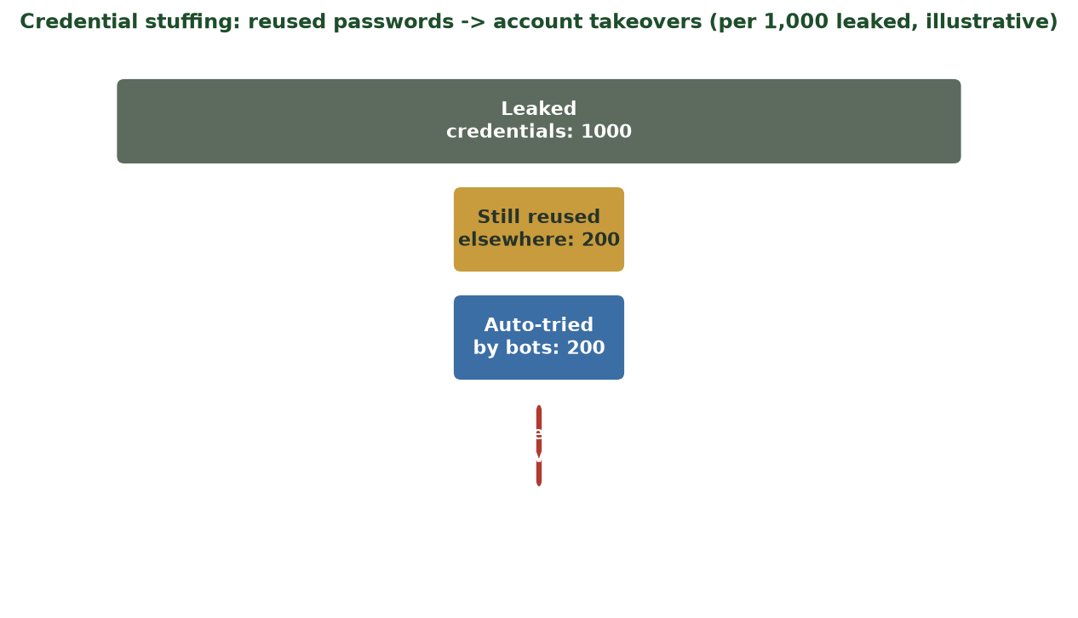
REUSED PASSWORDS BECOME TAKEOVERS
Credential Stuffing, Step by Step
Illustrative: of leaked credentials, many are reused; bots try them all; a small fraction succeed - but at scale that's a lot.
CIS 350: AI for Cybersecurity · Monday
16
Notes:
Walk the funnel. Even if only a small percentage of reused credentials work, the sheer volume of leaked passwords makes the absolute number of takeovers large. This is why MFA matters so much - it breaks the 'password alone = access' assumption. Numbers are illustrative. ~3 min.

Slide 17
🎭 ACTIVITY · 4 MIN
Spot the AI-enabled attack
For each, name the attack and one defense.
A flawless email 'from IT' asking you to verify your password now.
A voicemail in your manager's voice requesting an urgent wire transfer.
Login attempts on your account using an old password from a breach.
CIS 350: AI for Cybersecurity · Monday
17
Notes:
Consolidate Part 2. Answers: AI phishing -> report it, don't click, verify via IT; voice deepfake -> call back on a known number, use a verification step; credential stuffing -> MFA + change reused passwords. Reinforce that each attack has a concrete defense. Pairs 2, discuss 2. ~4 min.

Slide 18
PART 3 · FOOLING MACHINES + DEFENSE · ~20 MIN
Recon, Adaptive Malware & Countermeasures
Notes:
Transition: 'AI also helps attackers probe systems and evade our tools - but defenders adapt too.' ~23 minutes with figures and an activity.

Slide 19
ATTACK 4: RECONNAISSANCE
AI-Driven Reconnaissance
Recon = gathering information about a target before attacking.
AI automates scanning for exposed systems and known weaknesses.
It mines public data (sites, social media) to profile targets fast.
It helps prioritize which vulnerabilities to exploit first.
Defense: reduce your exposure, monitor for scanning, patch quickly.
AI auto-scans & profiles targets at scale.
CIS 350: AI for Cybersecurity · Monday
19
Notes:
Explain reconnaissance as the attacker's homework, now automated. AI speeds up finding exposed systems and building target profiles from public info. Defensive response: shrink the attack surface (close exposed services), watch for scanning, and patch fast so found weaknesses close quickly. ~4 min.

Slide 20
ATTACK 5: ADAPTIVE MALWARE
Adaptive / AI-Assisted Malware
Malware that changes its code to slip past signature scanners.
It can probe the environment and behave differently to avoid detection.
AI helps generate many variants and find evasive tricks.
Signature-only antivirus struggles against constant change.
Defense: behavior-based detection + anomaly detection (Week 6).
Shape-shifting malware beats signatures.
CIS 350: AI for Cybersecurity · Monday
20
Notes:
Describe adaptive malware: it mutates to dodge signature detection (which looks for known patterns). The defensive answer connects to Week 6: watch BEHAVIOR and flag ANOMALIES rather than relying on signatures alone. This ties the whole course together - anomaly detection defends against novel/adaptive threats. ~5 min.

Slide 21
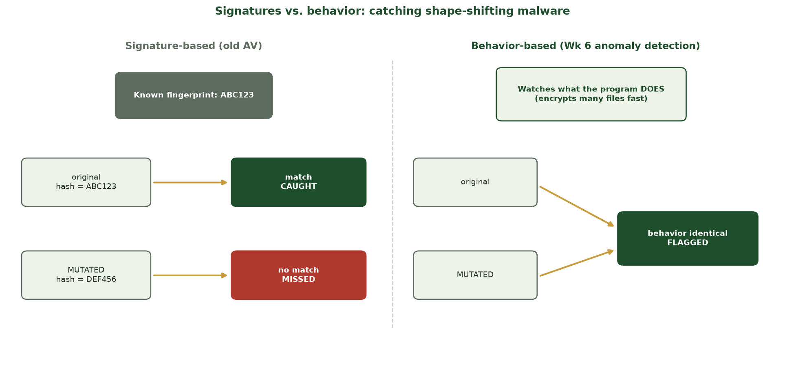
WHY MUTATION BEATS OLD AV BUT NOT BEHAVIOR DETECTION
Signatures vs. Behavior
Signature scanners match a fixed fingerprint, so a MUTATED variant (new hash) slips through; behavior-based detection watches what the program DOES, so both the original and the mutant get flagged.
CIS 350: AI for Cybersecurity · Monday
21
Notes:
Use this side-by-side to show exactly WHY adaptive malware defeats old antivirus. LEFT (signature-based): the original file matches the known hash and is CAUGHT, but the mutated variant has a new hash, no match, and is MISSED - the attacker only had to change the code, not the behavior. RIGHT (behavior-based, our Week 6 anomaly detection): both variants ENCRYPT many files fast - identical behavior - so both are FLAGGED. The lesson: to catch shape-shifting malware, watch behavior, not fingerprints. This is why Week 6 mattered. ~3 min.

Slide 22
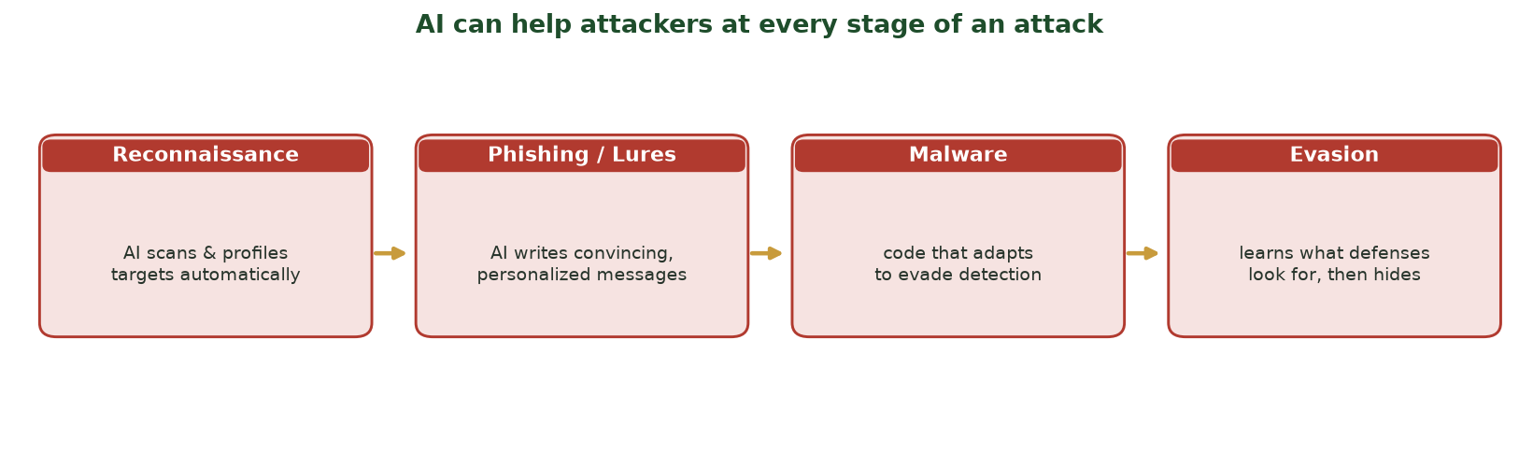
ATTACKERS CAN USE AI AT EVERY STAGE
AI Across the Attack Lifecycle
From reconnaissance to phishing to malware to evasion - AI can assist each step of an attack.
CIS 350: AI for Cybersecurity · Monday
22
Notes:
Use the lifecycle figure to synthesize Parts 2-3: AI can assist recon, lure creation, malware, and evasion. Point out defenders don't need to win every stage - breaking any link disrupts the attack. This sets up the defense-mapping slide. ~4 min.

Slide 23
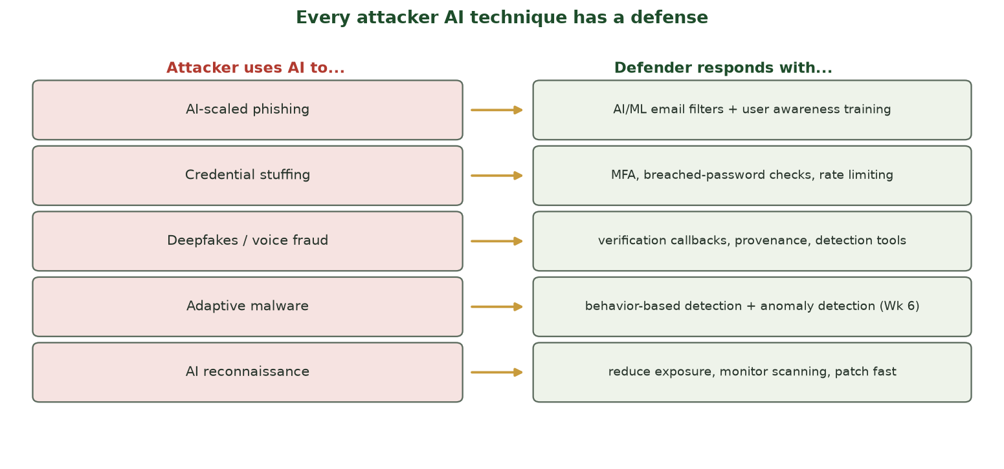
ATTACKER AI -> DEFENDER RESPONSE
Every Attack Has a Defense
Each AI-enabled technique maps to a concrete countermeasure - many of which you already learned.
CIS 350: AI for Cybersecurity · Monday
23
Notes:
This is the reassuring payoff slide. Walk the mapping: AI phishing -> ML filters + training; credential stuffing -> MFA; deepfakes -> verification; adaptive malware -> behavior/anomaly detection; recon -> reduce exposure. Emphasize students already learned most of these defenses - this week just names the threats they answer. ~4 min.

Slide 24
🤖 ACTIVITY · 4 MIN
Match attack to defense
Name the best defense for each AI-enabled attack.
Adaptive malware that changes to dodge signature antivirus. -> ?
AI mass-personalized phishing. -> ?
Bots stuffing leaked passwords into your login page. -> ?
CIS 350: AI for Cybersecurity · Monday
24
Notes:
Reinforce the attack->defense mapping. Answers: behavior/anomaly-based detection (not signatures); AI email filtering + user training; MFA + breached-password checks + rate limiting. The point students should leave with: understanding the attack tells you the defense. Pairs 3, discuss 3. ~6 min.

Slide 25
🎭 IN-CLASS TASK · 12 MIN
Be the Phishing Filter: Score the Inbox
In pairs, you get 5 short email snippets (a mix of phishing and legit). BE the email_features() function from earlier - score each email by hand on the four signals (~7 min), then we reveal the truth.
Count num_links (web links) and urgency_words (urgent / immediately / verify / act now).
Mark asks_credentials = 1 if it wants a password/account confirmation; sender_mismatch = 1 if the display name and address disagree.
Add the four numbers = the email's risk score.
Label 'phishing' if score >= 3, else 'legit'; circle the ONE email you were least sure about.
CIS 350: AI for Cybersecurity · Monday
25
Notes:
The session's hands-on task - students physically run the detector's feature logic before Lab 7 automates it. Hand each pair the 5 snippets. Circulate. Reveal the true labels: the obvious phishing scores high on all four signals; the clean legit mail scores 0-1. The PLANTED borderline case - e.g., a real password-reset the user requested (asks_credentials=1 but sender matches, one link) or a well-written phish whose only tell is sender_mismatch - lands right at the cutoff, showing why any single threshold produces false positives AND false negatives (Week 4 callback). This is exactly what email_features() computes and what the Lab 7 classifier learns; because detection is imperfect, we still layer MFA and out-of-band verification on top. ~12 min.

Slide 26
USE THESE SLIDES AS YOUR STUDY GUIDE
How Today Connects to Lab 7 & Quiz 7
💻 In Lab 7 you will...
📝 Quiz 7 will ask you to...
Generate obviously-synthetic phishing (in a sandbox) to study its patterns.
Turn emails into features and DETECT phishing with a classifier.
Read a confusion matrix of the detector (false alarms vs misses).
Reflect on defenses against AI-scaled phishing.
Explain how attackers use AI (phishing, deepfakes, stuffing, recon).
Match each attacker AI technique to a defense.
Describe why AI scales and personalizes attacks.
Reason about detecting AI-generated phishing.
CIS 350: AI for Cybersecurity · Monday
26
Notes:
Tie the lecture to the assessments. Left = Lab 7 (study attacker patterns to build a DETECTOR - defensive); right = Quiz 7 question types. Stress Lab 7 is sandboxed and educational: no real phishing, no real targets. Keep these slides open for the lab. ~2 min.

Slide 27
Key Takeaways
✓
AI is dual-use: it makes attacks cheaper, bigger, more personalized, and adaptive.
✓
Human-facing attacks: AI phishing, deepfakes/voice fraud, and credential stuffing.
✓
Machine-facing attacks: automated reconnaissance and adaptive, evasive malware.
✓
Every attacker AI technique maps to a defense - many you already know (MFA, filters, anomaly detection).
Notes:
Recap one point per objective. Cold-call: 'Name an AI attack and its defense.' Reinforce the constructive message and the ethics: we study attacks to defend, never to carry them out. Prime Exam 2 (Weeks 5-8). ~2 min.

Slide 28
WHAT'S NEXT
Looking Ahead: Lab 7, Wednesday & Exam 2
📊 Wednesday: real case studies of AI-powered campaigns and how to DETECT them.
💻 Lab 7 (Adversarial Email Generation) is released - a sandboxed, defensive detection lab.
📖 Read Handout 7: AI-Powered Attacks.
📝 Quiz 7 is Wednesday (attacker use of AI).
🗓️ Exam 2 (Weeks 5-8) is during Week 9 (Spring Break), taken online.
Wed = case studies + detection; Exam 2 (Wks 5-8) in Week 9.
CIS 350: AI for Cybersecurity · Monday
28
Notes:
Assign and preview. Wednesday grounds today in real cases and pivots hard to DETECTION (the Lab 7 bridge). Assign Lab 7, Quiz 7, Handout 7. Flag Exam 2 during Week 9 (online) covering Weeks 5-8, so this is the final new content before it. ~2 min.

Slide 29
🎯 EXIT TICKET · 2 MIN
One minute before you go
On the Canvas exit-ticket quiz or a card:
In one sentence, how does AI make phishing more dangerous?
Name one AI-enabled attack and its defense.
One thing from today you'd like clarified.
CIS 350: AI for Cybersecurity · Monday
29
Notes:
Close with the exit ticket. The phishing answer checks Objective 2; the attack/defense pairing checks Objective 4. Use clarifications to open Wednesday. ~2 min.

Slide 30
SOURCES & FURTHER READING
References & Further Reading
  CISA, Phishing Guidance: Stopping the Attack Cycle at Phase One, 2023.
  MITRE ATLAS - Adversarial Threat Landscape for AI Systems (attacker techniques).
  NIST, Artificial Intelligence Risk Management Framework (AI RMF 1.0), 2023.
  Verizon, Data Breach Investigations Report (DBIR), annual (phishing & credential stats).
  FBI IC3, Internet Crime Report (business email compromise, deepfake fraud).
CIS 350: AI for Cybersecurity · Monday
30
Notes:
Appendix slide: references and further reading for students. Post to Canvas or leave visible during the exit ticket - it is not part of the timed lecture. MITRE ATLAS and the CISA phishing guidance are the best starting points for the defensive view of attacker AI.

