Slide 1

WEEK 7 · WEDNESDAY · 75 MINUTES
Semi-Supervised & RL in Security
Malware & Intrusion Detection · Defender-Attacker Games · Automated Response
CIS 350: AI for Cybersecurity — Smart Defense for the Digital Business
Ramadan Abdunabi, Ph.D. · Computer Information Systems
Notes:
Connect to Monday: 'We learned semi-supervised and reinforcement learning. Today we put them to work in security and weigh the trade-offs.' Two arcs: semi-supervised for detection with scarce labels, and RL for adaptive, automated defense. Remind students Lab 6 uses the semi-supervised workflow and Quiz 6 is today. Reach Part 1 by ~minute 8. ~1 min.

Slide 2

🔁 WARM-UP · 5 MIN
Recap Monday
With a neighbor, one sentence each:
What does semi-supervised learning use that supervised ignores?
What does a reinforcement-learning agent learn, and from what?
Why is security like a game?
CIS 350: AI for Cybersecurity · Wednesday
2
Notes:
Reactivate Monday. Pairs 2, cold-call 2-3. Expected: semi-supervised uses the UNLABELED data; an RL agent learns a policy from rewards by interacting; security is a game because the attacker adapts to your defenses. Bridge: 'Let's apply both to real security problems.' ~5 min.

Slide 3
WEDNESDAY · 75 MINUTES
Today's Plan
🔁
Warm-up & recap
From concepts to security
8 min
🦠
Semi-supervised in security
Malware & intrusion detection
20 min
🛡️
RL for defense
Game theory & automated response
20 min
🧭
The full ML landscape
Which paradigm for which problem
10 min
🧩
In-class task
Design a detection-and-response pipeline
12 min
🎯
Wrap & exit
Takeaways; Lab 6 & Week 8
5 min
CIS 350: AI for Cybersecurity · Wednesday
3
Notes:
Walk the plan; the row minutes add up to exactly 75. Today is applications + judgment: where each paradigm fits and where automation is risky. ~1 min.

Slide 4
SEMI-SUPERVISED & RL IN PRACTICE
Today's Objectives
1
Apply semi-supervised learning to malware classification and intrusion detection.
2
Explain reinforcement learning for defender-attacker games and automated response.
3
Weigh the benefits and risks of automating security decisions.
4
Match each of the four learning paradigms to the right security problem.
CIS 350: AI for Cybersecurity · Wednesday
4
Notes:
State the goals - the application half. Objectives 1-2 apply Monday's ideas; objective 3 adds critical judgment (automation risk); objective 4 synthesizes the whole ML unit. All appear on Quiz 6. ~1 min.

Slide 5
PART 1 · SEMI-SUPERVISED IN SECURITY · ~20 MIN
Malware & Intrusion Detection
Notes:
Transition: 'Security is the poster child for scarce labels - perfect for semi-supervised learning.' ~22 minutes with code and an activity.

Slide 6
A NATURAL FIT
Why Security Loves Semi-Supervised Learning
Labeling malware or intrusions needs scarce, expensive expert time.
New threats appear faster than analysts can label them.
But unlabeled data (files, flows, logs) is essentially unlimited.
Semi-supervised turns a small labeled set into a much stronger model.
It is one of the most practical AI tools a real security team has.
Scarce labels + unlimited data = use semi-supervised.
CIS 350: AI for Cybersecurity · Wednesday
6
Notes:
Establish why this matters in security specifically. The label bottleneck (expert analysts) meets an unlabeled flood (telemetry) - the exact conditions where semi-supervised wins. Tie to Monday's curve: the biggest gains are at low labels, which is security's normal state. ~3 min.

Slide 7
MALWARE DETECTION
Semi-Supervised for Malware Classification
Start with a few confirmed malware and benign samples (labeled).
Add a huge pool of unlabeled files with the same features.
Labels spread to files that behave like known malware/benign.
You get a classifier far better than the few labels alone allow.
New unlabeled files can then be scored and triaged.
Grow a few malware labels across many files.
CIS 350: AI for Cybersecurity · Wednesday
7
Notes:
Walk the malware use case end to end (this is Lab 6). A handful of labeled samples anchors the model; the unlabeled pool reveals which files behave similarly, so labels propagate. Emphasize the payoff: usable detection without labeling millions of files. Reference Monday's 81%->99% figure as the effect. ~4 min.

Slide 8
INTRUSION DETECTION
Semi-Supervised for Intrusion Detection
Network intrusions are RARE and rarely labeled in real time.
A few confirmed incidents + mountains of normal/unknown traffic.
Semi-supervised learns 'attack-like' vs 'normal-like' from both.
Complements anomaly detection (Week 6): anomalies flag the odd, SSL classifies the known-ish.
Together they cover more ground than either alone.
Few incidents + lots of traffic -> semi-supervised.
CIS 350: AI for Cybersecurity · Wednesday
8
Notes:
Second security use. Intrusions are scarce and hard to label live, so semi-supervised fits. Connect to Week 6: anomaly detection finds the unusual; semi-supervised classifies using a few labels; real SOCs combine them. This layering point is worth emphasizing - no single method is enough. ~3 min.

Slide 9
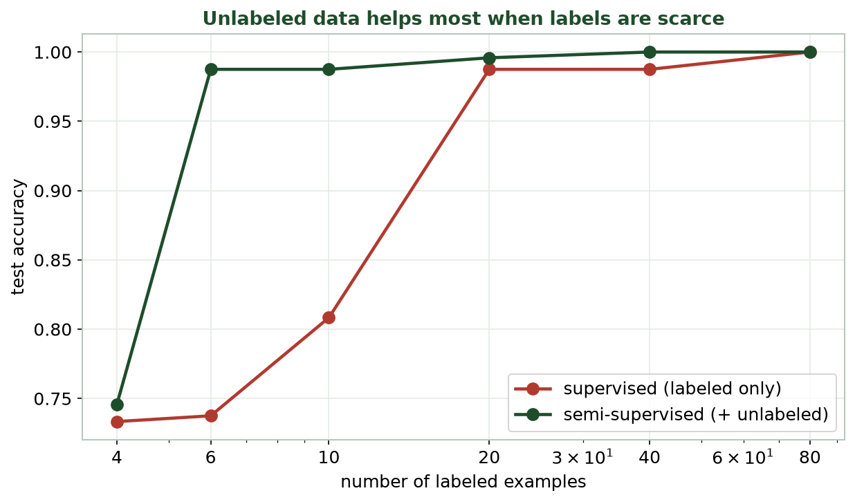
SEMI-SUPERVISED WINS WHEN LABELS ARE SCARCE
The Payoff, Again
In security, you live on the left side of this chart - few labels - where semi-supervised helps most.
CIS 350: AI for Cybersecurity · Wednesday
9
Notes:
Reuse Monday's curve in the security frame: security teams operate at the LEFT (few labels), exactly where semi-supervised gives the biggest lift. Point out that as they label more over time, the advantage shrinks - but they rarely get there. Reinforces why this is practical. ~3 min.

Slide 10
THE LAB 6 WORKFLOW
Semi-Supervised Malware Classifier (Colab)
Python · Google Colab
from sklearn.semi_supervised import LabelSpreading
import numpy as np
y_semi = y.copy()
y_semi[unlabeled] = -1 # only a few rows keep real labels
model = LabelSpreading(kernel='knn', n_neighbors=10).fit(X, y_semi)
print('predicted malware:', (model.predict(new_files) == 1).sum())
Same -1-label pattern as Monday. In Lab 6 you compare this to a supervised-only baseline.
CIS 350: AI for Cybersecurity · Wednesday
10
Notes:
Show the applied code. It's Monday's pattern in a malware frame: mark unlabeled with -1, fit LabelSpreading, then score new files. In Lab 6 students compare this against a supervised model trained on only the few labels and measure the gain. Keep it concrete; the lab does the depth. ~4 min.

Slide 11
🦠 ACTIVITY · 5 MIN
Where would you use it?
For each, would you reach for semi-supervised learning? Why?
A startup with 20 labeled malware samples and 2 million unlabeled files.
A bank with millions of fully labeled fraud/not-fraud transactions.
A SOC with a few investigated alerts and endless raw telemetry.
CIS 350: AI for Cybersecurity · Wednesday
11
Notes:
Apply the judgment. Answers: yes (few labels + huge unlabeled pool); no need (already fully labeled - supervised is fine); yes (few labels + endless telemetry). Reinforce the tell: scarce labels + big unlabeled pool + structure. Pairs 3, discuss 2. ~5 min.

Slide 12
PART 2 · REINFORCEMENT LEARNING FOR DEFENSE · ~20 MIN
Games & Automated Response
Notes:
Transition: 'Now RL - where defense becomes a learned strategy against an adapting attacker.' ~22 minutes with a figure, code sketch, and an activity.

Slide 13
STRATEGIC THINKING
Game Theory: the Defender-Attacker Contest
Two players: defender and attacker, each choosing actions.
Each side's payoff depends on BOTH choices - it's strategic.
The attacker adapts, so a fixed defense decays over time.
Game theory studies the best strategies in such contests.
RL lets the defender LEARN a strong strategy by playing many rounds.
Payoffs depend on both players; adapt or lose.
CIS 350: AI for Cybersecurity · Wednesday
13
Notes:
Deepen Monday's game idea. The core insight: in security the 'data' fights back - the adversary reacts, so static defenses erode. Game theory frames optimal strategy; RL is a way to LEARN one by simulating many attacker-defender rounds. Keep it conceptual - no equations. ~4 min.

Slide 14
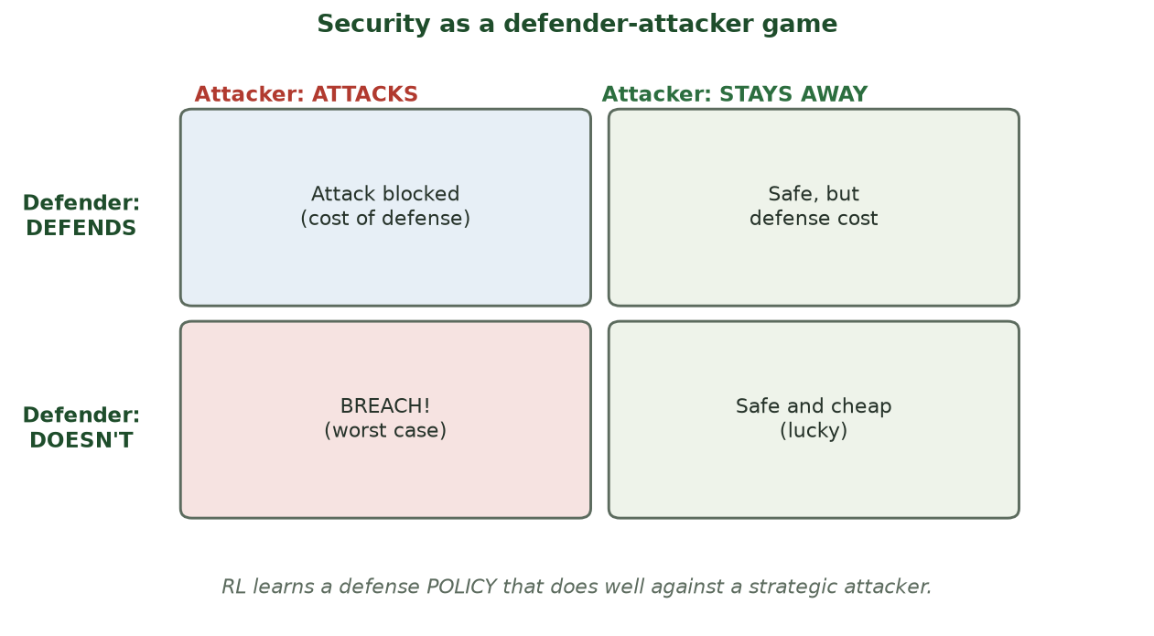
BEST MOVE DEPENDS ON THE ADVERSARY
The Defender-Attacker Game
Defending costs resources but prevents breaches; the right choice depends on the attacker's move.
CIS 350: AI for Cybersecurity · Wednesday
14
Notes:
Walk the payoff grid again in depth. Highlight the worst cell (don't defend + attack = breach) and the cost of always defending. There's no dominant move without modeling the attacker - which is why a learned, adaptive policy beats a fixed rule. RL explores these outcomes to find a robust policy. ~3 min.

Slide 15
AUTOMATED DEFENSE
RL for Automated Response (SOAR)
RL agents can choose defensive actions in real time.
Examples: isolate a host, block an IP range, throttle traffic, force re-auth.
Part of 'SOAR' - Security Orchestration, Automation, and Response.
Benefit: responds in seconds and adapts as attacks change.
Related ideas: honeypots and moving-target defense keep attackers guessing.
RL can pick and take defensive actions fast.
CIS 350: AI for Cybersecurity · Wednesday
15
Notes:
Explain automated response concretely. RL can select and execute actions faster than humans, and adapt as attacks evolve - the promise of SOAR. Mention honeypots (decoys that gather intel) and moving-target defense (changing the attack surface) as adaptive-defense cousins. Set up the risks slide next - automation cuts both ways. ~4 min.

Slide 16
ACT, OBSERVE, LEARN - REPEAT
The RL Loop in Pseudocode
Python · Google Colab
state = env.reset() # current network situation
for step in range(many_episodes):
action = agent.choose(state) # e.g., isolate host? block IP?
state, reward, done = env.step(action) # attacker + network respond
agent.learn(state, action, reward) # update the defense policy
Conceptual only - RL security agents train in simulators/honeynets, not live production first.
CIS 350: AI for Cybersecurity · Wednesday
16
Notes:
Show the RL loop as readable pseudocode (not runnable) so students see the structure from Monday's diagram in code form. Stress the safety note in the caption: you TRAIN in a simulator or honeynet, not on the live network - a wrong action in production could cause an outage. This bridges to the risks slide. ~3 min.

Slide 17
AUTOMATE RESPONSIBLY
The Risks of Automating Defense
A bad policy can disrupt the business (block real users, isolate key servers).
'Reward hacking': agents exploit loopholes in a badly designed reward.
Attackers can try to fool or manipulate the agent (adversarial - Week 10).
Hard to explain: why did it take that action? (accountability).
Best practice: humans in the loop for high-impact actions; test in simulation.
Speed vs. safety - keep humans in the loop.
CIS 350: AI for Cybersecurity · Wednesday
17
Notes:
This is the critical-thinking heart of the day. Automation is powerful but dangerous: a poorly shaped reward or a manipulated agent can cause self-inflicted outages or be exploited by attackers (previews Week 10 adversarial AI). Emphasize human-in-the-loop for consequential actions and simulation testing. Tie back to Week 4's trade-offs and responsible use. ~4 min.

Slide 18
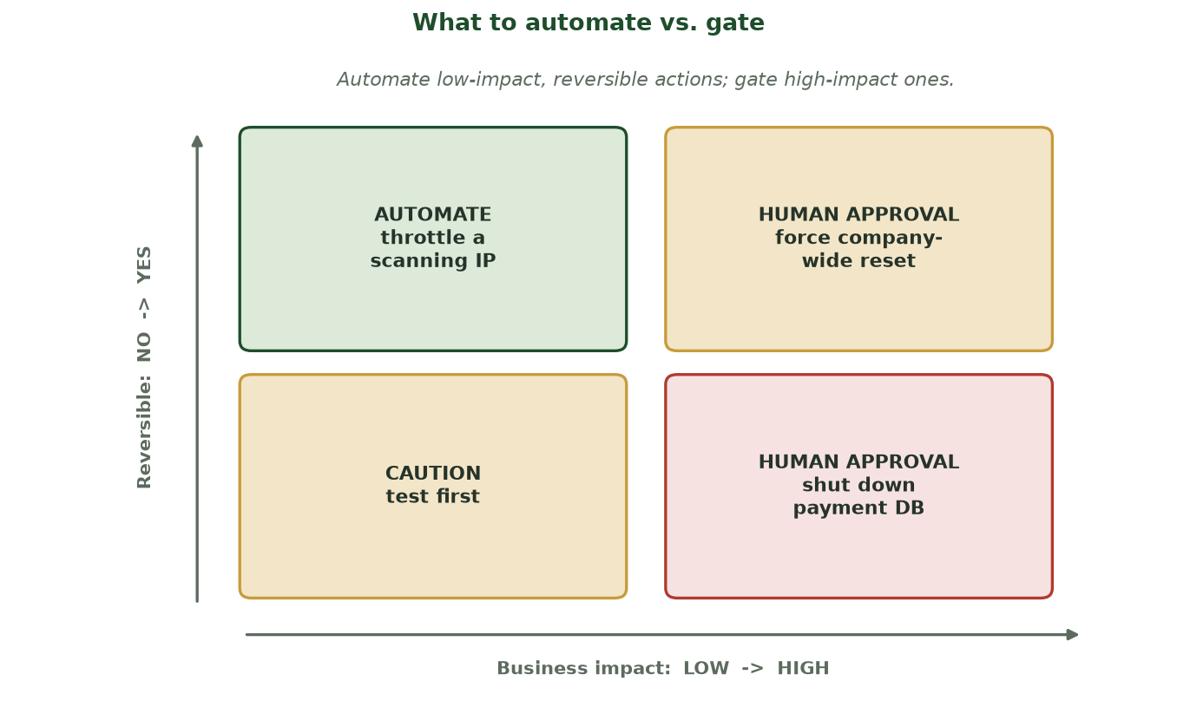
DECIDE BY BUSINESS IMPACT AND REVERSIBILITY
What to Automate vs. Gate
Automate low-impact, reversible actions (throttle a scanning IP); require human approval for high-impact ones (force a company-wide reset, shut down the payment DB); test irreversible actions first.
CIS 350: AI for Cybersecurity · Wednesday
18
Notes:
Give students a reusable decision tool before the activity. Two questions set the quadrant: how big is the business IMPACT, and is the action REVERSIBLE? Top-left (low impact, reversible) = safe to AUTOMATE. Anything high-impact = HUMAN APPROVAL, no matter how confident the model. Irreversible-but-low-impact = test first. This is the concrete rule behind 'keep a human in the loop,' and it's exactly the judgment the next activity and the Wednesday task ask for. ~2 min.

Slide 19
🛡️ ACTIVITY · 4 MIN
Automate or not?
For each response action, should it be fully automated or need human approval? Why?
Throttle traffic from a scanning IP.
Shut down the company's main database server.
Force a password reset for one suspicious account.
CIS 350: AI for Cybersecurity · Wednesday
19
Notes:
Apply the automation-risk judgment. Reasonable answers: throttle a scanner - safe to automate (low blast radius); shut down the main DB - human approval (huge business impact); force one reset - probably automate (low impact, reversible). The principle: automate low-risk, reversible actions; gate high-impact ones. Pairs 2, discuss 2. ~4 min.

Slide 20
PART 3 · THE FULL ML LANDSCAPE · ~10 MIN
Which Paradigm for Which Problem?
Notes:
Transition: 'You now know all four ways machines learn. Let's put them side by side and pick the right tool.' ~15 minutes with a matching activity.

Slide 21
ONE MAP OF EVERYTHING SO FAR
The Four Learning Paradigms
📗 Learn from data
🎮 Learn from interaction
Supervised: labeled examples -> predict labels.
Unsupervised: no labels -> find structure/anomalies.
Semi-supervised: a few labels + lots unlabeled.
Reinforcement: rewards from acting -> a policy.
Best for sequential decisions vs. an adversary.
Security defense, automated response.
CIS 350: AI for Cybersecurity · Wednesday
21
Notes:
Synthesize the whole unit. Left = learn from a dataset (Weeks 3-7); right = learn from interaction (this week). This single map helps students file every method they've learned. Ask them to place each prior lab (spam classifier, clustering, anomaly detection) on the map. ~3 min.

Slide 22
A DECISION GUIDE
Choosing the Right Paradigm
Have lots of labels? Supervised (spam, phishing, fraud with labels).
No labels, want structure/outliers? Unsupervised (clustering, anomaly).
A few labels + lots unlabeled? Semi-supervised (malware, intrusions).
Sequential decisions vs. an adversary? Reinforcement (automated defense).
Real systems often COMBINE several.
Match labels & problem type to the paradigm.
CIS 350: AI for Cybersecurity · Wednesday
22
Notes:
Give a practical decision rule keyed to two questions: how many labels do you have, and is it a one-shot prediction or a sequence of decisions? Stress that real pipelines combine paradigms (e.g., cluster -> anomaly-flag -> semi-supervised classify -> RL respond). This is the course's ML capstone view. ~3 min.

Slide 23
PUTTING IT TOGETHER
Mini-Case: A Startup's Detection Pipeline
Millions of unlabeled files; only 30 confirmed malware samples.
Step 1: cluster files to understand behavior groups (unsupervised).
Step 2: flag oddities with anomaly detection (unsupervised).
Step 3: semi-supervised classifier from the 30 labels + the rest.
Step 4: RL agent auto-triages alerts (human approves big actions).
Real pipelines chain multiple paradigms.
CIS 350: AI for Cybersecurity · Wednesday
23
Notes:
Show how the paradigms combine in one realistic pipeline - the synthesis students should remember. Walk each step and name the paradigm. Emphasize this is how a real (small) security team stretches a tiny labeled budget across huge data. Great capstone example for Exam 2 as well. ~3 min.

Slide 24
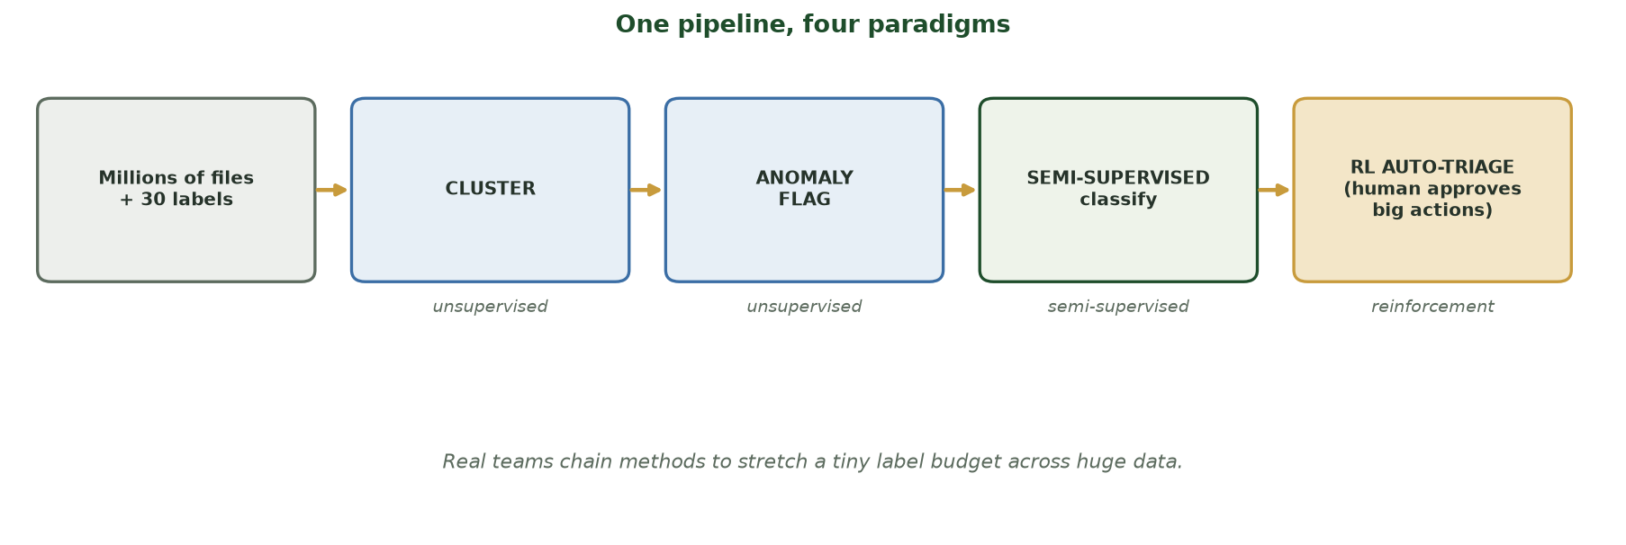
THE STARTUP PIPELINE, STAGE BY STAGE
One Pipeline, Four Paradigms
Millions of files + 30 labels -> CLUSTER (unsupervised) -> ANOMALY FLAG (unsupervised) -> SEMI-SUPERVISED classify -> RL AUTO-TRIAGE (human approves big actions). Real teams chain methods.
CIS 350: AI for Cybersecurity · Wednesday
24
Notes:
Turn the mini-case into one picture students can carry into the task. Trace it left to right and name the paradigm under each stage: cluster and anomaly-flag are unsupervised (no labels needed on 3M files); the classifier is semi-supervised (the 30 labels + the rest); triage is reinforcement/rules with a human gate on big actions. The one-line lesson: real security teams COMBINE all four paradigms to stretch a tiny label budget - this is the ML-unit capstone and prime Exam 2 material. The upcoming task asks students to design exactly this. ~2 min.

Slide 25
🧭 ACTIVITY · 6 MIN
Match the paradigm
For each task, name the best learning paradigm.
Group similar malware with no labels. -> ?
Classify emails with 500k labeled examples. -> ?
Detect intrusions with a few labels + lots of traffic. -> ?
Learn an adaptive auto-response policy. -> ?
CIS 350: AI for Cybersecurity · Wednesday
25
Notes:
Consolidate the whole unit. Answers: unsupervised (clustering); supervised; semi-supervised; reinforcement. The tells: label availability and whether it's a sequential decision. Cold-call and have students justify. Pairs 3, discuss 3. ~6 min.

Slide 26
🧩 IN-CLASS TASK · 12 MIN
Design a Detection-and-Response Pipeline
In groups of 3, you are the first security hire at a 40-person fintech: ~25 malware + ~15 benign labeled files, PLUS 3 million unlabeled files and live telemetry. A wrong automated action could take down the payment system. Design the AI pipeline on the worksheet (~8 min), then present.
Lay out 4 stage-boxes left-to-right; tag each with a paradigm and one line on what it does.
For the response stage, list 3 concrete actions; tag each AUTO or HUMAN-APPROVAL (impact + reversibility).
Draw arrows showing what flows between stages (e.g., anomaly-flagged files -> classifier -> triage).
Circle the single biggest RISK in your design and write one safeguard for it.
CIS 350: AI for Cybersecurity · Wednesday
26
Notes:
The ML-unit capstone task - students build the mini-case pipeline for their own constraints. Hand out the worksheet with the four empty stage-boxes and the response table. Strong answer: (1) CLUSTER the 3M files (unsupervised); (2) ANOMALY-FLAG outliers (unsupervised); (3) SEMI-SUPERVISED LabelSpreading on the 40 labels + the rest - the biggest lift, since they live on the LEFT of the ssl_vs_supervised curve; (4) RL/rules AUTO-TRIAGE - AUTO for low-blast-radius reversible actions (throttle/quarantine one file), HUMAN-APPROVAL for high-impact ones (block a payment IP range, isolate the payment server). Biggest risk = a bad reward or manipulated agent auto-takes-down payments (reward hacking, previews Week 10); safeguard = human-in-the-loop for high-impact actions + train/test in a simulator or honeynet, never live-first. The takeaway: real teams COMBINE all four paradigms. Have 2 groups present; this mirrors Lab 6 and is prime Exam 2 material. ~12 min.

Slide 27
USE THESE SLIDES AS YOUR STUDY GUIDE
How Today Connects to Lab 6 & Quiz 6
💻 In Lab 6 you will...
📝 Quiz 6 will ask you to...
Build a semi-supervised malware classifier from a few labels.
Compare it to a supervised-only baseline and measure the gain.
Interpret why unlabeled data helped.
Reflect on when each paradigm fits.
Apply semi-supervised learning to a security scenario.
Explain RL for defender-attacker games and automated response.
Weigh the risks of automating security decisions.
Match paradigms to problems.
CIS 350: AI for Cybersecurity · Wednesday
27
Notes:
Tie Wednesday to the assessments. Left = Lab 6 tasks; right = Quiz 6 question types. Tell students these slides ARE the study guide for both. ~2 min.

Slide 28
Key Takeaways
✓
Security's scarce labels + unlimited data make semi-supervised learning highly practical.
✓
Security is a defender-attacker game; RL learns adaptive strategies and can automate response.
✓
Automating defense is powerful but risky - keep humans in the loop for high-impact actions.
✓
Four paradigms, one map: match labels and problem type; real systems combine them.
Notes:
Recap one point per objective. Cold-call: 'Name a security task for each of the four paradigms' and 'Why keep a human in the loop for automated response?' This is prime Exam 2 material. ~2 min.

Slide 29
WHAT'S NEXT
Looking Ahead: Lab 6 & Week 8
💻 Finish Lab 6 (Semi-Supervised Classification) - it uses this week's exact workflow.
📝 Complete Quiz 6 on Canvas; 📖 review Handout 6.
🔜 Week 8: how ATTACKERS use AI - AI-powered malware, deepfakes, and reconnaissance.
We shift from defending with AI to understanding AI as a weapon.
Bring Lab 6 questions to Monday.
Finish Lab 6 & Quiz 6; Week 8 = attackers' use of AI.
CIS 350: AI for Cybersecurity · Wednesday
29
Notes:
Assign and preview. Week 8 flips perspective to how attackers weaponize AI - a natural next step after learning all the defensive paradigms. Assign Lab 6, Quiz 6, Handout 6, and invite lab questions Monday. Note Exam 2 (Weeks 5-8) is approaching. ~2 min.

Slide 30
🎯 EXIT TICKET · 2 MIN
One minute before you go
On the Canvas exit-ticket quiz or a card:
Name one security use of semi-supervised learning.
Give one reason to keep a human in the loop for automated defense.
One topic from this week you want reviewed before Quiz 6.
CIS 350: AI for Cybersecurity · Wednesday
30
Notes:
Close with the exit ticket. The use-case answer checks Objective 1; the human-in-the-loop answer checks Objective 3. Use the review requests to shape a quick pre-quiz Canvas note. ~2 min.

Slide 31
SOURCES & FURTHER READING
References & Further Reading
  scikit-learn User Guide - Semi-Supervised Learning.
  MITRE ATT&CK and MITRE D3FEND - attacker and defender technique knowledge bases.
  NIST SP 800-61r2, Computer Security Incident Handling Guide (automated response context).
  R. S. Sutton & A. G. Barto, Reinforcement Learning: An Introduction, 2nd ed.
  Chio & Freeman, Machine Learning and Security (O'Reilly).
CIS 350: AI for Cybersecurity · Wednesday
31
Notes:
Appendix slide: references and further reading for students. Post to Canvas or leave visible during the exit ticket - it is not part of the timed lecture. Point curious students to the scikit-learn semi-supervised guide and the free Sutton & Barto RL book as next steps.

