Slide 1

WEEK 7 · MONDAY · 75 MINUTES
Two More Ways to Learn
Semi-Supervised Learning · Reinforcement Learning · Security Games
CIS 350: AI for Cybersecurity — Smart Defense for the Digital Business
Ramadan Abdunabi, Ph.D. · Computer Information Systems
Notes:
Frame the week as completing the map of machine learning. 'You've met supervised (labels) and unsupervised (no labels). Today: the two in between and beyond - semi-supervised (a FEW labels) and reinforcement learning (learn from rewards).' Keep it intuition-first, no math. Preview the security hook: RL turns defense into a game against an attacker. Lab 6 (semi-supervised malware) is released this week. Reach Part 1 by ~minute 8. ~1 min.

Slide 2

🔁 WARM-UP · 5 MIN
The four ways to learn
With a neighbor, one sentence each:
Supervised learning: what does it need?
Unsupervised learning: what does it need?
Where might you have only a FEW labels and lots of unlabeled data?
CIS 350: AI for Cybersecurity · Monday
2
Notes:
Activate prior weeks and set up today. Pairs 2 min, cold-call 2-3. Expected: supervised needs labeled examples; unsupervised needs none (finds structure); few-labels situations: a handful of confirmed malware among millions of files, a few investigated alerts among thousands. That gap is exactly what semi-supervised learning fills. ~5 min.

Slide 3
MONDAY · 75 MINUTES
Today's Plan
🔁
Warm-up & the four paradigms
Where today fits
8 min
🏷️
Semi-supervised learning
A few labels + lots of unlabeled data
20 min
🧩
In-class task
Spread the labels by hand
12 min
🎮
Reinforcement learning
Learning from rewards and penalties
20 min
♟️
Security as a game
Defender vs. attacker
9 min
🎯
Wrap & exit
Takeaways; Lab 6 & Wednesday
6 min
CIS 350: AI for Cybersecurity · Monday
3
Notes:
Walk the plan; the row minutes add up to exactly 75. Two big ideas today (semi-supervised, RL) plus a short security-game teaser that Wednesday expands. ~1 min.

Slide 4
SEMI-SUPERVISED & REINFORCEMENT LEARNING
Today's Objectives
1
Explain semi-supervised learning as learning from a few labels plus lots of unlabeled data.
2
Describe reinforcement learning as learning from rewards and penalties.
3
Identify where each fits among the four learning paradigms.
4
Relate reinforcement learning to a defender-attacker security game.
CIS 350: AI for Cybersecurity · Monday
4
Notes:
State the four goals. Note this week completes the 'four styles of machine learning' from the course overview. Objective 4 (defender-attacker game) is the security bridge that Wednesday deepens. ~1 min.

Slide 5
PART 1 · SEMI-SUPERVISED LEARNING · ~20 MIN
A Few Labels + Lots of Unlabeled Data
Notes:
Transition: 'In the real world you rarely have all labels or none - usually a FEW. That's where semi-supervised learning shines.' ~24 minutes with a demo figure and an activity.

Slide 6
WHY SEMI-SUPERVISED
The Label Problem
Supervised learning needs LABELED data - but labels are expensive.
Labeling malware, fraud, or intrusions needs scarce expert time.
Meanwhile UNLABELED data is everywhere and cheap (logs, files, traffic).
Typical reality: a few hundred labeled items, millions unlabeled.
Throwing away the unlabeled data wastes most of what you have.
Few labels, tons of unlabeled data - use both.
CIS 350: AI for Cybersecurity · Monday
6
Notes:
Motivate the whole topic. Labeling requires expert analysts (expensive, slow), while raw data piles up for free. So the common situation is a tiny labeled set plus a huge unlabeled set. Supervised learning ignores the unlabeled data; semi-supervised learning uses BOTH. Ask: 'Why might only a few malware samples be labeled?' (each needs manual analysis). ~3 min.

Slide 7
THE IDEA
Semi-Supervised Learning: the Idea
Use the FEW labels to get started, and the MANY unlabeled points to see structure.
Key assumption: nearby / similar points probably share a label.
So labels can 'spread' from labeled points to similar unlabeled ones.
Result: a better model than the few labels alone could give.
Best when the data has clear structure (groups, manifolds).
Let labels spread to similar unlabeled points.
CIS 350: AI for Cybersecurity · Monday
7
Notes:
Explain the core intuition: the unlabeled data reveals the shape of the classes, and labels propagate to nearby points (the 'smoothness/cluster assumption'). Emphasize this only works if similar points really do share labels - which is usually true for behavior data. The next figure makes it vivid. ~3 min.

Slide 8
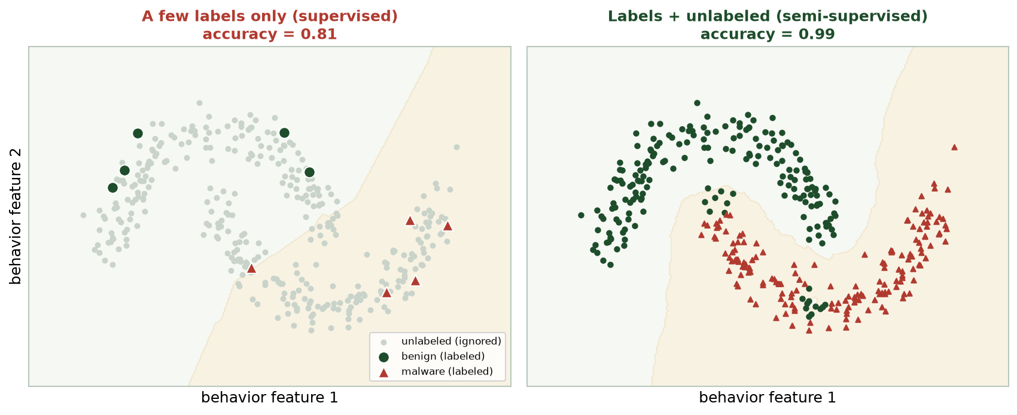
SEMI-SUPERVISED USES THE WHOLE PICTURE
A Few Labels vs. Labels + Unlabeled
Left: 10 labels only - the boundary is wrong (81%). Right: adding unlabeled data recovers the two groups (99%).
CIS 350: AI for Cybersecurity · Monday
8
Notes:
This is the money slide. Left: with only 10 labeled points, a supervised model draws a bad diagonal boundary (81%). Right: semi-supervised uses the 350 unlabeled points to see the two interleaving groups and gets 99%. Same 10 labels - the difference is USING the unlabeled data. Ask: 'How did the right panel know the shape without more labels?' (nearby points share labels). ~4 min.

Slide 9
TWO APPROACHES
How It Works (No Math)
Self-training: train on the few labels, predict the unlabeled, add the most confident as new labels, repeat.
Label propagation/spreading: labels flow along a graph of similar points.
Both grow the labeled set using the model's own confident guesses.
Caution: a wrong early guess can spread errors - confidence matters.
You still choose features and check results (a human stays in the loop).
Self-training or label spreading - grow labels from structure.
CIS 350: AI for Cybersecurity · Monday
9
Notes:
Give the two main mechanisms without math. Self-training = the model bootstraps its own labels, adding only high-confidence predictions each round. Label spreading = labels flow through a similarity graph. Flag the key risk: confidently-wrong early guesses propagate errors, so semi-supervised isn't magic - it relies on the structure assumption holding. ~4 min.

Slide 10
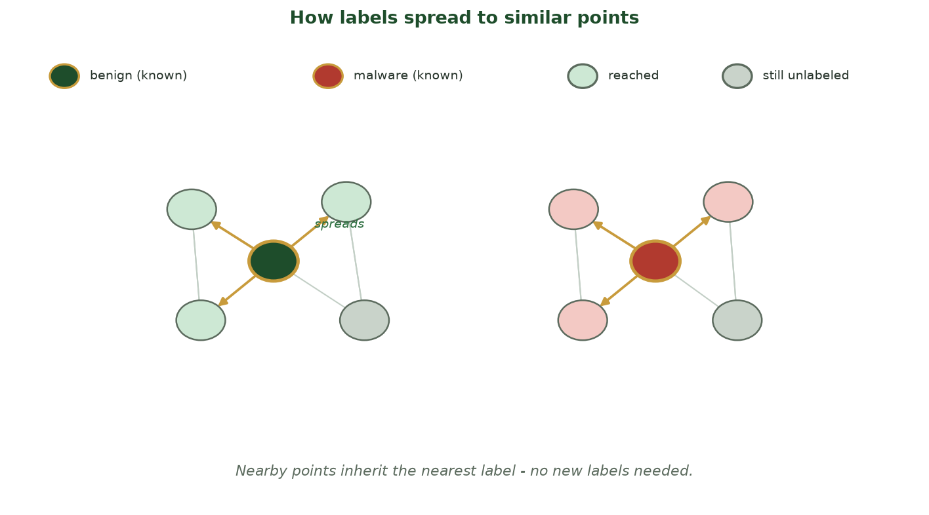
LABEL PROPAGATION ON A SIMILARITY GRAPH
How Labels Spread to Similar Points
Two known points (gold-ringed) pass their labels along graph edges to their nearest neighbors; the labels spread outward one ring at a time until every point is colored.
CIS 350: AI for Cybersecurity · Monday
10
Notes:
Make label spreading concrete with this graph. Each point is connected to its nearest neighbors (the gray edges = the similarity graph). Only two points start labeled - one benign (green), one malware (red), both gold-ringed. Along the gold arrows, each unlabeled neighbor INHERITS the nearest label ('reached', light-tinted); the two far points are 'still unlabeled' and get colored on the next round. This is exactly what LabelSpreading(kernel='knn') does - and it sets up the hands-on task next. Flag the risk again: if a STARTING label were wrong, the error would spread along these same edges. ~3 min.

Slide 11
MARK UNLABELED ROWS WITH -1
Semi-Supervised in a Few Lines (Colab)
Python · Google Colab
from sklearn.semi_supervised import LabelSpreading
import numpy as np
y_semi = y_train.copy()
y_semi[unlabeled_index] = -1 # -1 marks 'no label' for these rows
model = LabelSpreading(kernel='knn', n_neighbors=10).fit(X_train, y_semi)
preds = model.predict(X_test) # now labels every point
The -1 convention tells scikit-learn which rows are unlabeled. You'll run this in Lab 6.
CIS 350: AI for Cybersecurity · Monday
11
Notes:
Show it's only a few lines. The one new idea: mark unlabeled rows with -1 so scikit-learn knows to learn their labels from structure. LabelSpreading then labels everything. This is exactly the Lab 6 workflow. Don't dwell on kernel details - 'knn' means 'connect each point to its 10 nearest.' ~3 min.

Slide 12
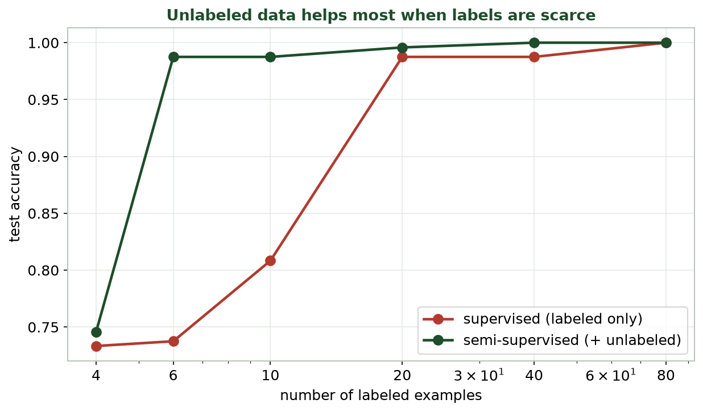
ACCURACY VS. NUMBER OF LABELS
Unlabeled Data Helps Most When Labels Are Scarce
With very few labels, semi-supervised (green) far outperforms supervised (red); the gap shrinks as labels grow.
CIS 350: AI for Cybersecurity · Monday
12
Notes:
Read the curve: at 4-10 labels, semi-supervised is far above supervised; by 40-80 labels they converge. The lesson: unlabeled data is most valuable when labels are SCARCE - exactly the security situation. Once you have plenty of labels, plain supervised is fine. This directly frames Lab 6. ~3 min.

Slide 13
🏷️ ACTIVITY · 4 MIN
Would semi-supervised help?
For each situation, decide: would adding unlabeled data likely help?
10 labeled malware samples, 1 million unlabeled files. -> ?
500,000 fully labeled emails. -> ?
A few investigated alerts, millions of raw log lines. -> ?
CIS 350: AI for Cybersecurity · Monday
13
Notes:
Check the 'when does it help' judgment. Answers: yes (few labels, lots of unlabeled - ideal); not much (already fully labeled, supervised is fine); yes (few labels, huge unlabeled pool). The tell: is there a big unlabeled pool AND too few labels? Pairs 2, discuss 2. ~4 min.

Slide 14
🧩 IN-CLASS TASK · 12 MIN
Spread the Labels by Hand
In pairs, you get a printed scatter of 15 files plotted by two behavior features. Only 2 are labeled (1 benign = green, 1 malware = red); the other 13 are blank. BE the algorithm - let labels flow to the nearest points (~7 min), then check the key.
Round 1: color each blank point whose NEAREST neighbor is already labeled - copy that color in.
Rounds 2-3: repeat, each time using the nearest ALREADY-colored point, until all 15 are colored.
Draw ONE boundary line separating your green region from your red region.
Flip to the key: circle any points you colored wrong - notice where they sit.
Write one sentence: what happens if the FIRST labeled point had been WRONG?
CIS 350: AI for Cybersecurity · Monday
14
Notes:
The session's hands-on task - students physically run label spreading. Hand each pair the 15-point sheet (the same two interleaving groups as semi_supervised.png / Lab 6) with exactly 2 seeds labeled. Circulate. Expected: nearest-neighbor propagation recovers the two groups almost perfectly from just 2 labels - which is what LabelSpreading(kernel='knn', n_neighbors=10) does automatically. Most 'wrong' points sit on the boundary where the groups nearly touch (the same place the supervised-only model failed on the money slide). The last question surfaces the key risk from 'How It Works': one confidently-wrong early label spreads to its neighbors - so label quality matters, semi-supervised is not magic. This is precisely the Lab 6 workflow, where rows marked -1 get labeled by this same neighbor structure. ~12 min.

Slide 15
PART 2 · REINFORCEMENT LEARNING · ~20 MIN
Learning from Rewards and Penalties
Notes:
Transition: 'Our last paradigm learns very differently - not from a dataset, but from EXPERIENCE and feedback.' ~24 minutes with two figures and an activity.

Slide 16
AGENT, ACTION, REWARD
Reinforcement Learning: the Setup
An AGENT takes ACTIONS in an ENVIRONMENT.
Each action changes the state and returns a REWARD (or penalty).
The agent's goal: earn the most reward over time.
No labeled dataset - it learns by TRYING and getting feedback.
Over many attempts it discovers what works.
Act -> get reward -> learn what works.
CIS 350: AI for Cybersecurity · Monday
16
Notes:
Introduce RL's vocabulary: agent, environment, action, state, reward. The big shift from earlier weeks: there's no fixed dataset - the agent generates its own experience by acting and observing rewards. Analogy preview: how you learned to ride a bike (try, wobble, adjust). The next figure shows the loop. ~4 min.

Slide 17
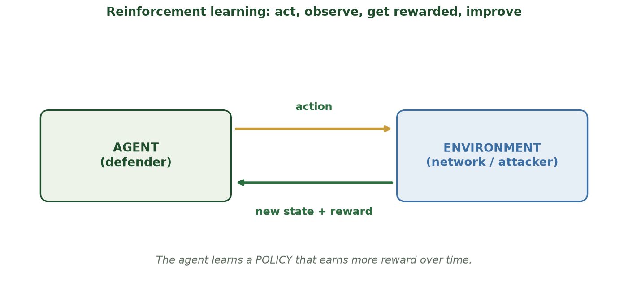
ACT, OBSERVE, GET REWARDED, IMPROVE
The Reinforcement Learning Loop
The agent takes an action; the environment returns a new state and a reward; the agent updates its policy.
CIS 350: AI for Cybersecurity · Monday
17
Notes:
Walk the loop with the figure. Agent (say, a defender) takes an action; the environment (network + attacker) responds with a new state and a reward; the agent updates its POLICY - its strategy for choosing actions. Repeat thousands of times and the policy gets good. Emphasize the cycle; it's the heart of RL. ~3 min.

Slide 18
THE MOVING PARTS
Key Ideas: Policy, Reward, Exploration
Policy = the agent's strategy: what action to take in each situation.
Reward shaping: good outcomes get + points, bad ones get - points.
Exploration vs. exploitation: try new things vs. use what works.
Too little exploration -> stuck in a rut; too much -> never settles.
Delayed reward: a good move now may only pay off later.
Policy + rewards + explore/exploit.
CIS 350: AI for Cybersecurity · Monday
18
Notes:
Unpack the parts students most need. The policy is what the agent learns. Rewards encode what we WANT (designing them well is an art). Exploration vs exploitation is the classic tension - a favorite exam idea; use the 'new restaurant vs favorite restaurant' analogy. Mention delayed reward: chess-like moves that only pay off later. ~4 min.

Slide 19
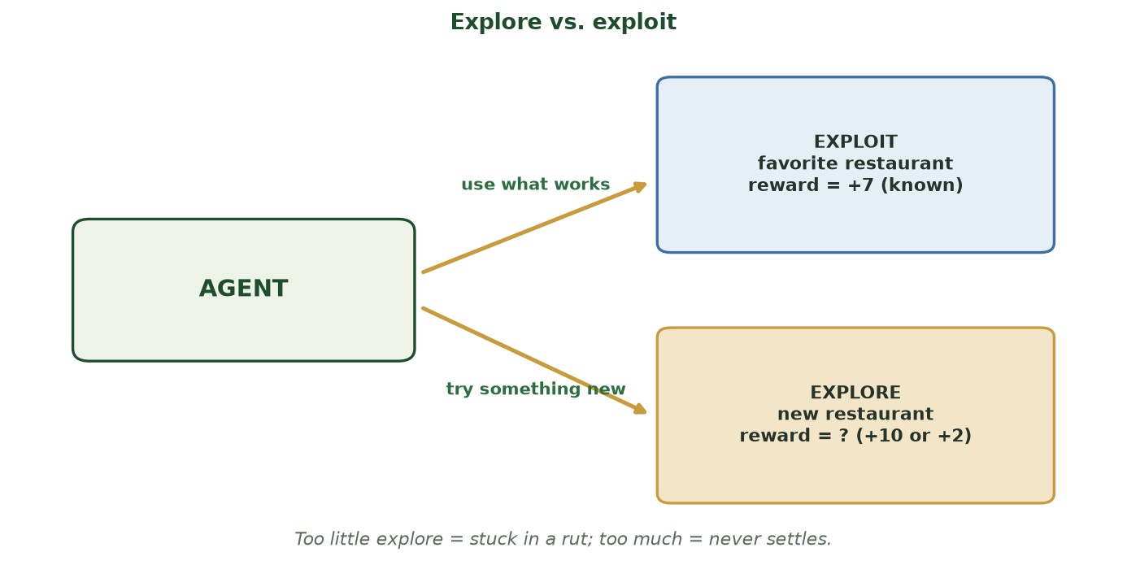
USE WHAT WORKS, OR GAMBLE ON SOMETHING BETTER?
Explore vs. Exploit: the RL Trade-off
EXPLOIT the known-good option (your favorite restaurant, reward +7) or EXPLORE an uncertain one (a new restaurant, reward +10 or +2). Too little explore = stuck in a rut; too much = never settles.
CIS 350: AI for Cybersecurity · Monday
19
Notes:
Make the explore/exploit tension concrete with the restaurant analogy. EXPLOIT = take the action you know pays off (+7 for certain). EXPLORE = try the unknown, which might be better (+10) or worse (+2). An agent that only exploits never discovers a better strategy; one that only explores never cashes in what it learned. The balance is the whole game - and it maps straight onto a defender: keep using a proven response, or try a new one that might handle a novel attack better? A favorite exam idea. ~3 min.

Slide 20
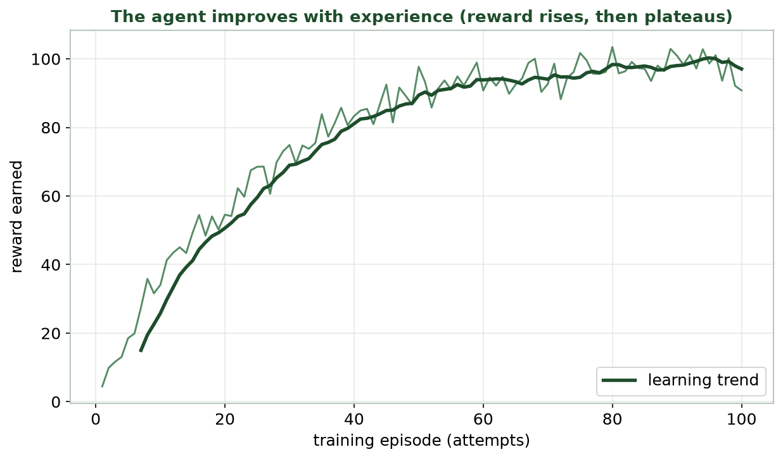
REWARD RISES, THEN PLATEAUS
The Agent Improves with Experience
Early on the agent is bad and earns little; with more episodes it learns a good policy and reward climbs.
CIS 350: AI for Cybersecurity · Monday
20
Notes:
Read the learning curve. Early episodes: low, noisy reward (the agent is basically guessing). As it learns, reward climbs and then plateaus near the best achievable. This 'learning curve' shape is the signature of RL training. Note it takes MANY attempts - RL is data/experience hungry. ~3 min.

Slide 21
EVERYDAY ANALOGY
Everyday Analogies for RL
Training a dog: treats for good behavior, none for bad - it learns over time.
A video game: your score is the reward; you improve by playing.
Learning to ride a bike: wobble, adjust, eventually balance.
A thermostat that learns your comfort from your adjustments.
In each: act, get feedback, adjust - no answer key needed.
Dog treats, game score, riding a bike.
CIS 350: AI for Cybersecurity · Monday
21
Notes:
Ground RL in familiar experience - this makes it click. The dog-training and video-game analogies are the strongest: reward-driven improvement with no labeled 'correct answers,' just feedback. Ask students for their own example of learning by trial and reward. ~3 min.

Slide 22
WHERE RL FITS
RL vs. the Other Paradigms
Supervised: learn from labeled examples (an answer key).
Unsupervised: find structure with no labels.
Semi-supervised: a few labels + lots of unlabeled data.
Reinforcement: learn from rewards by interacting - no dataset needed.
RL fits SEQUENTIAL decisions where actions change the situation.
RL = learn by acting, for sequential decisions.
CIS 350: AI for Cybersecurity · Monday
22
Notes:
Contrast all four paradigms so students place RL correctly. The distinguishing feature: RL learns from INTERACTION and handles sequential decisions where each action changes what comes next (defense, trading, robotics, games). The others learn from a fixed dataset. This recap also previews Wednesday's full-landscape slide. ~3 min.

Slide 23
🎮 ACTIVITY · 4 MIN
Design the reward
You want an RL agent to defend a network. With a neighbor:
What action might the agent take? (e.g., block an IP, isolate a host)
What should earn POSITIVE reward? What should earn a PENALTY?
What could go wrong if the reward is designed badly?
CIS 350: AI for Cybersecurity · Monday
23
Notes:
Get students thinking like RL designers. Good answers: actions = block/isolate/alert; +reward for stopping attacks with minimal disruption; -penalty for breaches AND for blocking legitimate users; bad rewards cause bad behavior (e.g., block everything to avoid breaches = denial of service). This 'reward hacking' point previews Wednesday's risks. Pairs 2, discuss 2. ~4 min.

Slide 24
PART 3 · SECURITY AS A GAME · ~9 MIN
Defender vs. Attacker
Notes:
Transition: 'Security is a contest between a defender and an adversary who reacts - a natural fit for RL and game theory.' ~11 minutes.

Slide 25
A STRATEGIC CONTEST
Security Is a Two-Player Game
Defender and attacker each choose actions; each side's payoff depends on the other.
The attacker adapts to your defenses; a fixed rulebook goes stale.
Game theory studies these strategic, adaptive interactions.
RL lets a defender LEARN a strong policy against an adapting attacker.
The goal: a strategy that holds up even as the adversary changes.
Both sides adapt - defense must too.
CIS 350: AI for Cybersecurity · Monday
25
Notes:
Frame security as a game: unlike a static dataset, the attacker is an adversary who reacts to your moves, so yesterday's defense may fail tomorrow. Game theory + RL model this adaptive contest. This is why 'set it and forget it' security fails. Wednesday goes deeper on defender-attacker dynamics. ~3 min.

Slide 26
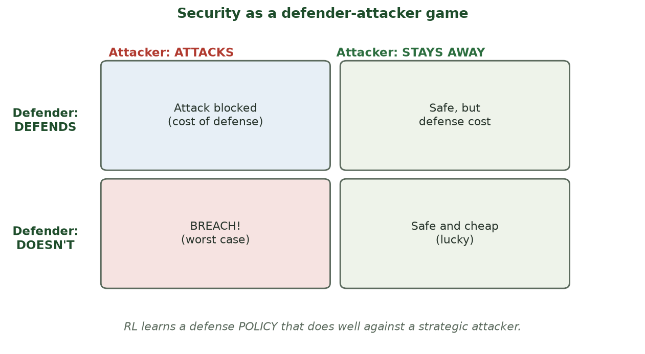
EACH SIDE'S OUTCOME DEPENDS ON THE OTHER'S CHOICE
The Defender-Attacker Game
A simple game grid: the best outcome for the defender depends on what the attacker does - so strategy matters.
CIS 350: AI for Cybersecurity · Monday
26
Notes:
Walk the game grid. Each cell is an outcome depending on BOTH players' choices - defending costs resources but prevents breaches; not defending is cheap but risky if attacked. There's no single best move without considering the adversary. RL learns a policy that does well across the attacker's likely choices. ~3 min.

Slide 27
LOOKING AHEAD
RL for Automated Defense (Preview)
An RL agent can learn to respond to attacks automatically.
Examples: auto-isolate an infected host, throttle suspicious traffic.
It adapts as attacker behavior changes - no rule rewrite needed.
Big benefit: speed - respond in seconds, not hours.
Big risk: a bad policy could disrupt the business (Wednesday).
RL can automate response - powerful but risky.
CIS 350: AI for Cybersecurity · Monday
27
Notes:
Preview Wednesday's application. RL can power automated response (a piece of what the industry calls SOAR). Emphasize the double edge: speed and adaptivity vs. the danger of an automated agent taking a harmful action. This tension (and keeping humans in the loop) is Wednesday's theme. ~3 min.

Slide 28
♟️ ACTIVITY · 2 MIN
Adapt or lose
Quick think-pair-share:
Name one defense that attackers have learned to bypass over time.
Why is a fixed rule weaker than a policy that adapts?
CIS 350: AI for Cybersecurity · Monday
28
Notes:
Fast discussion connecting to the adaptive-adversary idea. Good answers: signature antivirus (malware mutates), simple spam keywords (spammers reword), CAPTCHAs (bots improve); fixed rules can't keep up with an adapting adversary, while a learning policy can. Pairs 1, discuss 1. ~2 min.

Slide 29
USE THESE SLIDES AS YOUR STUDY GUIDE
How Today Connects to Lab 6 & Quiz 6
💻 In Lab 6 you will...
📝 Quiz 6 will ask you to...
Classify malware with only a FEW labels using semi-supervised learning.
Compare supervised vs. semi-supervised accuracy as labels grow.
See how unlabeled data reveals class structure.
Reflect on when each paradigm fits a security problem.
Define semi-supervised and reinforcement learning.
Match each of the four paradigms to a scenario.
Explain the RL loop (agent, action, reward, policy).
Relate RL to a defender-attacker game.
CIS 350: AI for Cybersecurity · Monday
29
Notes:
Tie the lecture to the assessments. Left = Lab 6 steps (semi-supervised malware, shown today); right = Quiz 6 question types. Tell students to keep these slides open during the lab and re-read before the quiz. ~2 min.

Slide 30
Key Takeaways
✓
Semi-supervised learning uses a FEW labels plus lots of unlabeled data - ideal when labels are scarce.
✓
It works by letting labels spread to similar unlabeled points (structure assumption).
✓
Reinforcement learning learns a POLICY from rewards by interacting - no labeled dataset.
✓
Security is a defender-attacker game; RL can learn adaptive defenses (powerful but risky).
Notes:
Recap one point per objective. Cold-call: 'When does semi-supervised beat supervised?' (few labels + structure) and 'What does an RL agent learn?' (a policy that maximizes reward). ~2 min.

Slide 31
WHAT'S NEXT
Looking Ahead: Applications & Lab 6
📊 Wednesday: semi-supervised for malware & intrusion detection; RL for automated defense.
We'll go deeper on game theory and the risks of automated response.
💻 Lab 6 (Semi-Supervised Classification) is released - it uses today's -1-label workflow.
📖 Read Handout 6: Semi-Supervised and Reinforcement Learning.
📝 Quiz 6 is Wednesday (semi-supervised; RL; paradigms; security games).
Wed = applications; Lab 6 + Quiz 6 this week.
CIS 350: AI for Cybersecurity · Monday
31
Notes:
Assign and preview. Wednesday applies both paradigms to real security and weighs the risks of automation. Assign Lab 6, Quiz 6, and Handout 6. Reassure that today's concepts are exactly what the lab and quiz test. ~2 min.

Slide 32
🎯 EXIT TICKET · 2 MIN
One minute before you go
On the Canvas exit-ticket quiz or a card:
In one sentence, what is semi-supervised learning?
In one sentence, what does a reinforcement-learning agent learn?
One thing from today you'd like clarified.
CIS 350: AI for Cybersecurity · Monday
32
Notes:
Close with the exit ticket. The two definitions confirm Objectives 1-2 landed; use the clarifications to open Wednesday if needed. ~2 min.

Slide 33
SOURCES & FURTHER READING
References & Further Reading
  scikit-learn User Guide - Semi-Supervised Learning (LabelSpreading, SelfTrainingClassifier).
  R. S. Sutton & A. G. Barto, Reinforcement Learning: An Introduction, 2nd ed. (free online).
  Google, Machine Learning Crash Course (developers.google.com/machine-learning).
  NIST, Artificial Intelligence Risk Management Framework (AI RMF 1.0), 2023.
  Chio & Freeman, Machine Learning and Security (O'Reilly).
CIS 350: AI for Cybersecurity · Monday
33
Notes:
Appendix slide: references and further reading for students. Post to Canvas or leave visible during the exit ticket - it is not part of the timed lecture. Point curious students to the scikit-learn semi-supervised guide and the free Sutton & Barto RL book as next steps.

