Slide 1

WEEK 6 · WEDNESDAY · 75 MINUTES
Anomaly Detection
Finding What Doesn't Fit · Isolation Forests & Local Outlier Factor
CIS 350: AI for Cybersecurity — Smart Defense for the Digital Business
Ramadan Abdunabi, Ph.D. · Computer Information Systems
Notes:
Open by connecting to Monday: 'We grouped normal behavior. Today we hunt what DOESN'T fit - the anomalies that often signal attacks.' This is one of the most useful unsupervised ideas in security: catching NEW threats with no labels. Hands-on again with Colab. Remind them Lab 5 uses today's anomaly tools and Quiz 5 is today. Reach Part 1 by ~minute 8. ~1 min.

Slide 2

🔁 WARM-UP · 5 MIN
Recap clustering; predict anomalies
With a neighbor:
What did scaling and the elbow method help us do Monday?
If clusters describe NORMAL behavior, what is an anomaly?
Give one security example of an anomaly.
CIS 350: AI for Cybersecurity · Wednesday
2
Notes:
Bridge from Monday. Pairs 2, cold-call 2-3. Expected: scaling + elbow helped us cluster well; an anomaly is a record that fits no normal group; examples: a 3 a.m. login, a huge data transfer, a port scan. Land it: 'Today we detect those automatically, without labels.' ~5 min.

Slide 3
WEDNESDAY · 75 MINUTES
Today's Plan
🔁
Warm-up & recap
From normal groups to outliers
8 min
🚨
What is an anomaly?
Outliers, and why they matter
12 min
🌲
Isolation Forests
How they work; scoring; Colab code
18 min
📍
Local Outlier Factor
A second method; when to use each
13 min
🔐
Real case: unusual logins
The full detection workflow
8 min
🧩
In-class task
Triage the anomaly queue
12 min
CIS 350: AI for Cybersecurity · Wednesday
3
🎯
Wrap & exit
Takeaways; Lab 5 & Week 7
4 min
Notes:
Walk the plan; the row minutes add up to exactly 75. Emphasize this is the payoff of the unit: unsupervised methods that catch threats nobody labeled. ~1 min.

Slide 4
ANOMALY DETECTION
Today's Objectives
1
Explain what an anomaly is and why anomalies matter in security.
2
Describe how an Isolation Forest flags outliers (no math).
3
Compare Isolation Forest with Local Outlier Factor (LOF).
4
Apply anomaly detection to detect unusual login patterns.
CIS 350: AI for Cybersecurity · Wednesday
4
Notes:
State today's goals - the anomaly-detection toolkit. Note these are unsupervised (no labels), which is exactly why they can catch novel attacks. All four appear in Lab 5. ~1 min.

Slide 5
PART 1 · WHAT IS AN ANOMALY? · ~12 MIN
Outliers, and Why They Matter
Notes:
Transition: 'Before the tools, let's be clear on what we're hunting.' ~14 minutes with an activity.

Slide 6
DEFINITION
Anomaly = A Point That Doesn't Fit
An anomaly (outlier) is a record unlike the normal majority.
Not a separate cluster - just a rare point that stands apart.
Anomaly detection LEARNS 'normal,' then flags the rest.
It needs NO labels - perfect for never-seen attacks.
Clustering asks 'what groups exist?'; anomaly asks 'what doesn't fit?'
Anomaly = a rare point unlike normal; no labels needed.
CIS 350: AI for Cybersecurity · Wednesday
6
Notes:
Define anomaly clearly and contrast with clustering. Key idea: the method models what NORMAL looks like and flags deviations - so it can catch brand-new attacks that a labeled classifier never saw. Misconception to flag: an anomaly isn't necessarily its own cluster; it's a rare point that doesn't fit any normal group. ~4 min.

Slide 7
SECURITY PAYOFF
Why Anomalies Matter in Security
Intrusions: a login or process unlike anything normal.
Data exfiltration: an unusually large outbound transfer.
Fraud: a purchase pattern that breaks the user's habits.
Insider threat: an employee suddenly acting out of character.
Zero-days: attacks with no signature - but they still look ODD.
Catch the novel: intrusions, exfiltration, fraud, insiders.
CIS 350: AI for Cybersecurity · Wednesday
7
Notes:
Motivate with high-stakes examples. The through-line: attacks are rare and DIFFERENT, so 'unusual' is a powerful signal even without a labeled example. Emphasize zero-days - signature-based tools miss them, but anomaly detection can catch the odd behavior they produce. Connect to Week 4: this is how AI helps human analysts focus. ~4 min.

Slide 8
EVERYDAY ANALOGY
Everyday Analogy: The Odd One Out
A bank notices a charge in another country at 3 a.m. - unlike your habits.
A teacher spots the one essay written in a totally different style.
A doctor flags a lab value far outside the normal range.
None needed a labeled 'fraud/plagiarism/disease' example - just 'unusual.'
Anomaly detection automates that 'this doesn't fit' instinct.
You already flag 'this doesn't fit' every day.
CIS 350: AI for Cybersecurity · Wednesday
8
Notes:
Ground anomaly detection in familiar experience - fraud alerts, a mismatched essay, an abnormal lab result. Each flags 'unusual' without a labeled example. This makes the upcoming methods feel intuitive: they're automating a judgment students already make. Ask for a personal 'odd one out' example. ~3 min.

Slide 9
🚨 ACTIVITY · 3 MIN
Normal or anomaly?
For each, decide: normal behavior or a likely anomaly worth review?
A nightly backup transferring gigabytes at 2 a.m. -> ?
One workstation suddenly scanning hundreds of internal ports. -> ?
A user logging in from their usual laptop at 9 a.m. -> ?
An account downloading the entire customer database at once. -> ?
CIS 350: AI for Cybersecurity · Wednesday
9
Notes:
Sharpen intuition and the 'context matters' point. Answers: normal (scheduled backup - a known pattern); anomaly (port scan); normal; anomaly (mass download / exfiltration). Note the backup shows why context and features matter - big transfers aren't always bad. Pairs 2, discuss 1. ~3 min.

Slide 10
PART 2 · ISOLATION FORESTS · ~18 MIN
The Go-To Anomaly Detector
Notes:
Transition: 'The most popular anomaly detector is the Isolation Forest - and its idea is beautifully simple.' ~22 minutes with scoring and code.

Slide 11
THE INTUITION
The Big Idea: Anomalies Are Easy to Isolate
Imagine splitting the data with random yes/no cuts, again and again.
Normal points sit in crowds - it takes MANY cuts to isolate one.
Anomalies sit alone - a FEW cuts isolate them.
'Easy to isolate' = likely an anomaly. That's the whole idea.
An Isolation Forest averages many random split-trees for a stable score.
Few cuts to isolate -> anomaly.
CIS 350: AI for Cybersecurity · Wednesday
11
Notes:
Explain the Isolation Forest intuition - no math needed. Analogy: playing 20 questions - a very unusual item is pinned down in a couple of questions, while a typical one takes many. Points that get isolated quickly (few random cuts) are anomalies. A 'forest' of many random trees averages out luck for a reliable score. This is the key concept to nail. ~3 min.

Slide 12
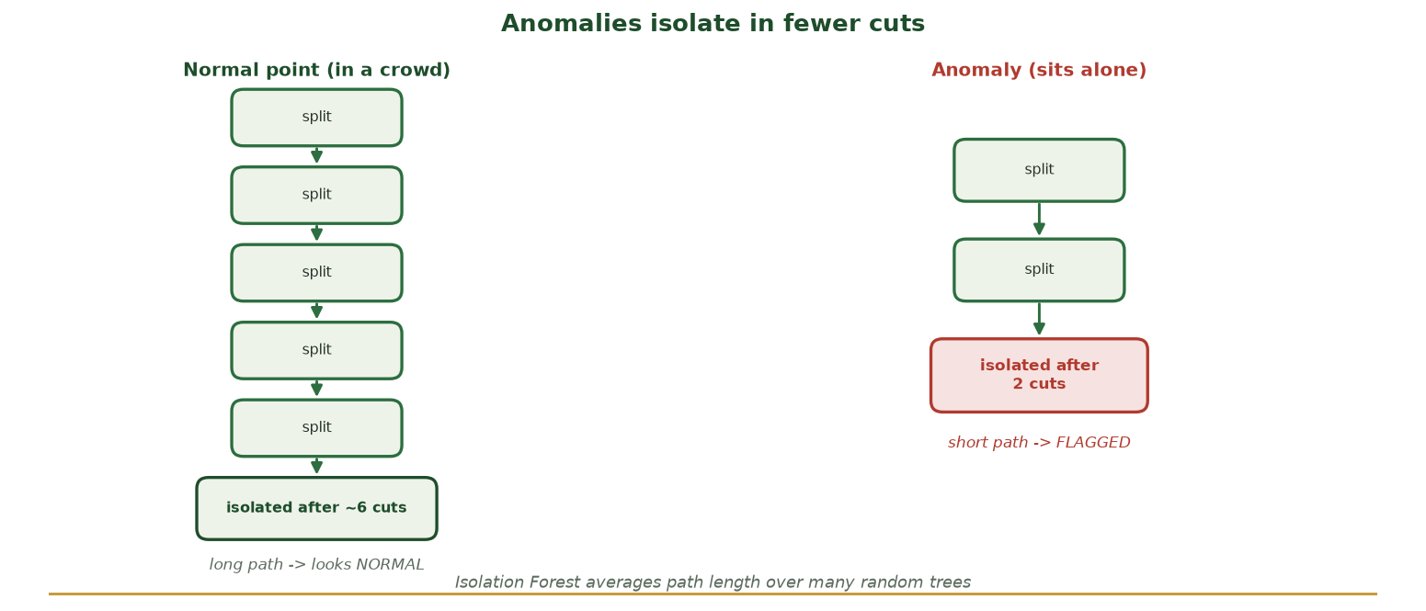
NORMAL VS. ANOMALY: CUTS TO ISOLATE
Why 'Easy to Isolate' Means Anomalous
A normal point sits in a crowd and needs many random cuts to isolate (long path); an anomaly sits alone and falls out in just a couple of cuts (short path) - so short path = anomalous.
CIS 350: AI for Cybersecurity · Wednesday
12
Notes:
Anchor the whole Isolation Forest idea with this side-by-side. LEFT: a normal point is surrounded, so random yes/no cuts keep hitting neighbors - it takes ~6 cuts (a LONG path) to isolate it. RIGHT: an anomaly sits alone, so 2 cuts isolate it (a SHORT path). The forest averages path length over many random trees; a consistently short path = anomalous. Ask: 'Which point would YOU find faster in 20 questions - a typical one or a weird one?' That intuition IS the algorithm. ~3 min.

Slide 13
THE RECIPE
How It Works (No Math)
Build many trees, each making random splits on random features.
For each point, measure how FEW splits it took to isolate it.
Average across all trees -> an anomaly score per point.
Points isolated quickly (short paths) get the most anomalous scores.
You set 'contamination' - roughly what fraction you expect to be anomalies.
Random split-trees; short path = anomalous.
CIS 350: AI for Cybersecurity · Wednesday
13
Notes:
Give the step-by-step at a conceptual level. Emphasize randomness + averaging (like a random forest). Introduce 'contamination' as the expected anomaly fraction you provide - it sets how many points get flagged. Foreshadow that choosing contamination is a judgment call (like k). Keep it intuitive. ~4 min.

Slide 14
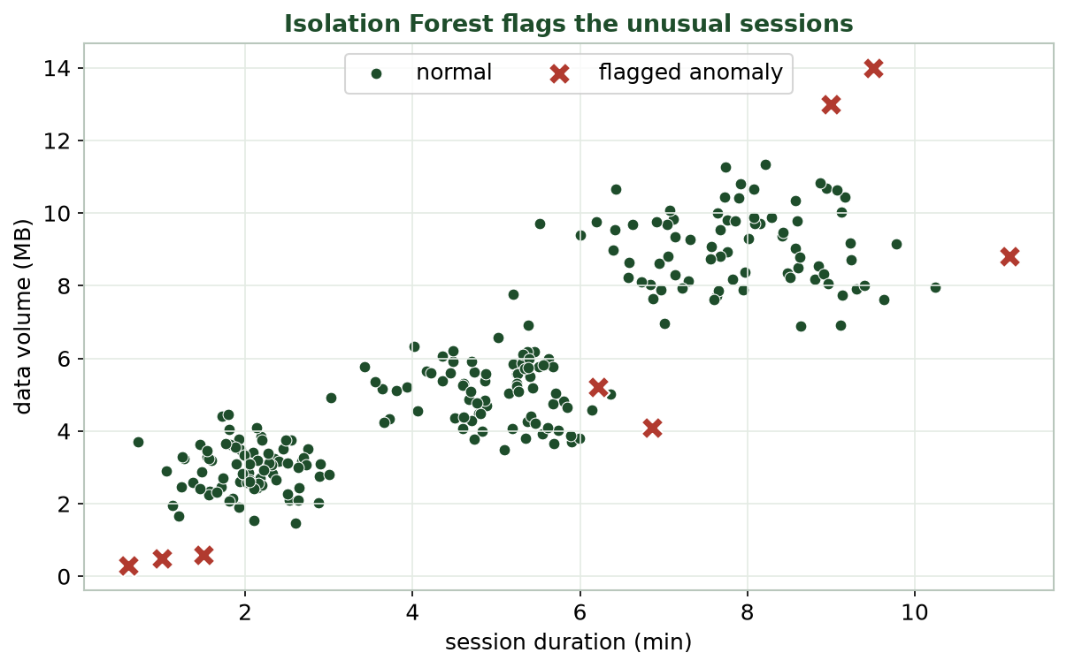
IT FLAGS THE SESSIONS THAT DON'T FIT
Isolation Forest on Network Traffic
Green = normal sessions; red X = flagged anomalies (port scans at bottom-left, exfiltration at top-right).
CIS 350: AI for Cybersecurity · Wednesday
14
Notes:
Show it working. The green cloud is normal traffic; the red X's are flagged anomalies - the tiny low-volume port scans and the huge exfiltration transfers. Note that a couple of flagged points look normal in THIS 2-D view but are odd across the full feature set (e.g., many failed connections) - a reminder that 2-D plots hide dimensions. ~3 min.

Slide 15
SCORES, NOT JUST LABELS
Anomaly Scores & Choosing a Threshold
The model gives every point a normality score (lower = more anomalous).
Most points score 'normal'; a few tail off as suspicious.
You choose where to cut - like the alert threshold from Week 4.
Lower the cut -> catch more, but more false alarms (alert fatigue).
Same trade-off as before: tune it to the cost of each error.
Score each point; choose the cutoff.
CIS 350: AI for Cybersecurity · Wednesday
15
Notes:
Connect anomaly detection back to Week 4's threshold trade-off - a powerful callback. Instead of a hard yes/no, the model scores every point; you choose the cutoff based on how many alerts your team can handle. Too aggressive -> alert fatigue; too lax -> missed attacks. The next figure shows the score distribution. ~4 min.

Slide 16
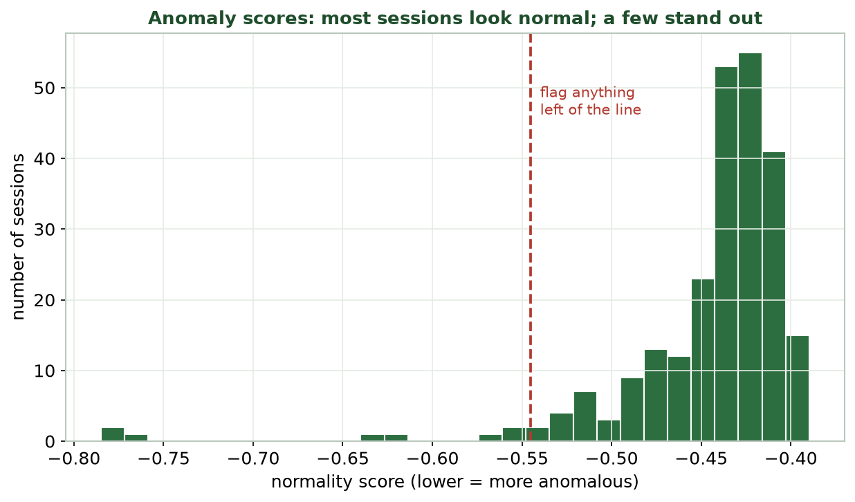
MOST NORMAL, A FEW STAND OUT
Anomaly Scores Distribution
Most sessions cluster as 'normal'; the left tail past the red line is where we flag anomalies for review.
CIS 350: AI for Cybersecurity · Wednesday
16
Notes:
Read the score histogram. The bulk of sessions score as normal; a thin left tail is clearly separated - those past the red threshold line get flagged. Point out that a clean gap makes the choice easy, while a smooth tail forces a judgment call. This is exactly what students tune in Lab 5. ~3 min.

Slide 17
FIT, FLAG, AND SCORE
Isolation Forest (Colab)
Python · Google Colab
from sklearn.ensemble import IsolationForest
from sklearn.preprocessing import StandardScaler
Xs = StandardScaler().fit_transform(X) # scale first (again!)
iso = IsolationForest(contamination=0.03, random_state=0).fit(Xs)
df['anomaly'] = iso.predict(Xs) # -1 = anomaly, 1 = normal
df['score'] = iso.score_samples(Xs) # lower = more anomalous
Same scaled features as clustering. contamination = expected anomaly fraction.
CIS 350: AI for Cybersecurity · Wednesday
17
Notes:
Walk the code: scale (same rule as clustering), fit the Isolation Forest with a contamination estimate, then predict (-1 = anomaly) and score_samples for a ranked score. Stress reusing scaling and that contamination is your estimate of the anomaly rate. This is the core of Lab 5's anomaly section. ~4 min.

Slide 18
PART 3 · LOCAL OUTLIER FACTOR · ~13 MIN
A Second Opinion
Notes:
Transition: 'Isolation Forests look globally. Sometimes 'unusual' is LOCAL - that's where LOF shines.' ~15 minutes with a comparison and activity.

Slide 19
THINK LOCAL
Local Outlier Factor (LOF): Unusual vs. Your Neighbors
LOF compares a point's crowding to that of its nearest neighbors.
In a dense area but you're in a sparse pocket? You're a local outlier.
It catches anomalies that are odd RELATIVE to their neighborhood.
Isolation Forest is more global; LOF is more local.
You set the neighborhood size (n_neighbors) and contamination.
LOF: sparse compared to your neighbors = outlier.
CIS 350: AI for Cybersecurity · Wednesday
19
Notes:
Explain LOF's distinct angle: it's about LOCAL density. A point can look fine globally but be odd for its immediate neighborhood - LOF catches that. Analogy: a quiet person is unremarkable in a library but stands out at a loud party. Contrast: Isolation Forest is global, LOF is local; using both gives a fuller picture. ~4 min.

Slide 20
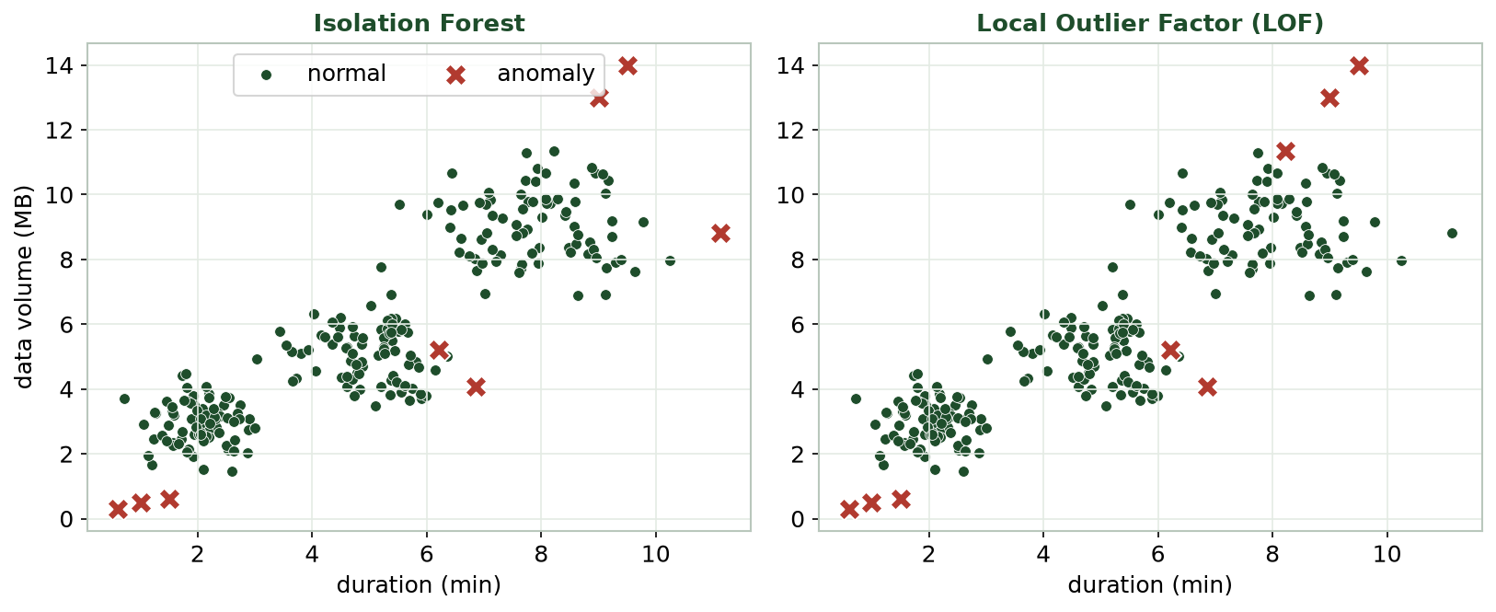
ISOLATION FOREST VS. LOF
Two Detectors, Compared
Both flag the clear outliers; they can disagree on borderline points - using two methods adds confidence.
CIS 350: AI for Cybersecurity · Wednesday
20
Notes:
Compare the two detectors on the same data. Both catch the obvious anomalies; they may differ on borderline cases. The teaching point: no detector is perfect, so agreement between methods raises confidence and disagreement flags cases for a human to review. This mirrors ensemble thinking. ~3 min.

Slide 21
CHOOSING A TOOL
Which Detector, When?
Isolation Forest: fast, scales to big data, great general default.
LOF: catches local outliers in varying-density data.
Both are unsupervised and need scaled features.
Both need a contamination estimate - a judgment call.
In practice: try both; investigate what either flags.
Isolation Forest = default; LOF = local density.
CIS 350: AI for Cybersecurity · Wednesday
21
Notes:
Give a practical selection guide. Isolation Forest is the workhorse default (fast, scalable); LOF is the tool when density varies and 'unusual' is local. Both need scaling and a contamination estimate. Real teams often run both. Keep it decision-oriented. ~3 min.

Slide 22
A SECOND DETECTOR IN TWO LINES
Local Outlier Factor (Colab)
Python · Google Colab
from sklearn.neighbors import LocalOutlierFactor
lof = LocalOutlierFactor(n_neighbors=20, contamination=0.03)
df['lof_flag'] = lof.fit_predict(Xs) # -1 = anomaly, 1 = normal
n_neighbors sets the 'neighborhood' size. Compare lof_flag with the Isolation Forest flags.
CIS 350: AI for Cybersecurity · Wednesday
22
Notes:
Show LOF is just as easy to run. n_neighbors sets the neighborhood size for the local comparison. Students will compare LOF's flags to the Isolation Forest's in Lab 5 and note agreements/disagreements. ~2 min.

Slide 23
📍 ACTIVITY · 3 MIN
Isolation Forest or LOF?
For each situation, which detector fits better - and why?
A huge, uniform stream of network sessions; flag the rare weird ones.
Traffic with dense and sparse regions; some outliers are only locally odd.
Two methods disagree on a session. What should you do?
CIS 350: AI for Cybersecurity · Wednesday
23
Notes:
Apply the selection logic. Answers: Isolation Forest (large, uniform, general); LOF (varying density, local oddness); on disagreement, send it to a human to review (don't auto-block). Reinforce that detectors assist judgment, not replace it. Pairs 2, discuss 1. ~3 min.

Slide 24
PART 4 · REAL CASE · ~8 MIN
Detecting Unusual Login Patterns
Notes:
Transition: 'Let's run the full workflow on logins - the classic security use.' ~10 minutes.

Slide 25
THE WORKFLOW
The Case: Spotting a Compromised Account
Data: login records (hour, location distance, device age, failed tries, volume).
No labels - we don't know which logins are attacks.
Step 1: SCALE the features (same rule as always).
Step 2: run an Isolation Forest to score every login.
Step 3: review the top-scored anomalies as possible compromises.
Scale -> score -> review the top anomalies.
CIS 350: AI for Cybersecurity · Wednesday
25
Notes:
Set up the canonical security use. With no labels, we score logins and surface the most anomalous for review. Walk the three steps and note they're identical to the code students just saw. Emphasize this is exactly the kind of task a Security Operations Center (SOC) automates. ~3 min.

Slide 26
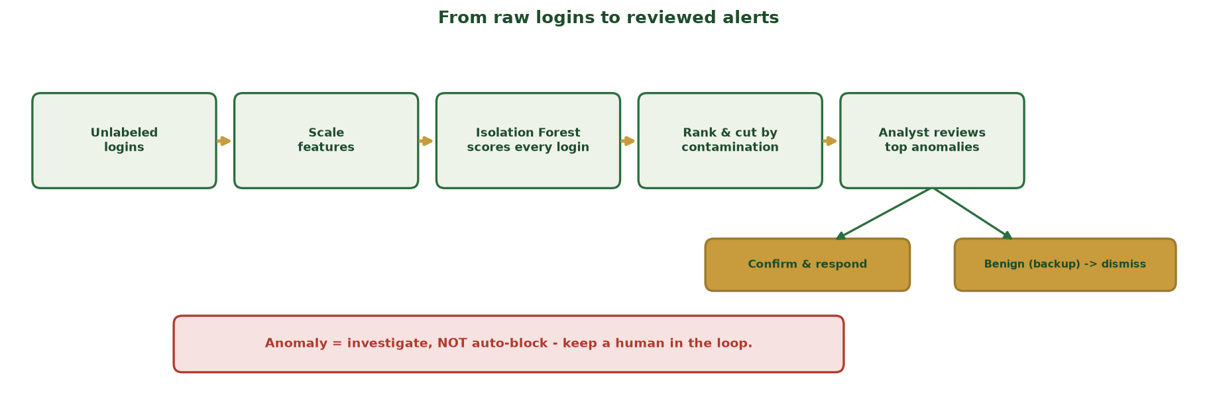
FROM RAW LOGINS TO A REVIEWED ALERT
The End-to-End Detection Workflow
Unlabeled logins -> scale -> Isolation Forest scores every login -> rank & cut by contamination -> an analyst reviews the top anomalies and either confirms & responds or dismisses. A human makes the call.
CIS 350: AI for Cybersecurity · Wednesday
26
Notes:
Walk the pipeline left to right so students see where each piece they learned fits: scale (Monday), Isolation Forest scoring (Part 2), the contamination cut (the threshold idea), then - critically - a HUMAN reviews the top anomalies and branches to confirm-and-respond or dismiss. Land the red banner: an anomaly means INVESTIGATE, not auto-block. This diagram is the template for the in-class task next and for Lab 5's anomaly section. ~2 min.

Slide 27
THE ANOMALIES RISE TO THE TOP
Flagged Logins for Review
The flagged logins - odd hours, new devices, many failures, or huge transfers - are queued for an analyst.
CIS 350: AI for Cybersecurity · Wednesday
27
Notes:
Reuse the anomaly figure in the login framing: the flagged points are the logins an analyst should check first - odd hours, new devices, many failed attempts, or big transfers. The payoff: from thousands of unlabeled logins, the model surfaces the handful worth human attention. That's the value proposition of anomaly detection. ~3 min.

Slide 28
RESPONSIBLE USE
Acting on Anomalies (Responsibly)
Anomaly != attack - it means 'unusual, worth a look.'
Review before acting; add context (user, location, history).
Tune contamination to what your analysts can handle (alert fatigue).
Combine with clustering baselines and rules for stronger detection.
Keep a human in the loop for high-impact actions (don't auto-block blindly).
Anomaly = investigate, not auto-punish.
CIS 350: AI for Cybersecurity · Wednesday
28
Notes:
End with responsible-use guidance - a favorite of security managers. Stress that an anomaly is a signal to INVESTIGATE, not proof of an attack; false positives have real costs (a locked-out CEO). Tune the alert volume to the team's capacity and keep humans in the loop. This ties ethics + Week 4's trade-offs together. ~3 min.

Slide 29
🧩 IN-CLASS TASK · 12 MIN
Triage the Anomaly Queue
In pairs, you get 6 flagged logins ranked by anomaly score (lowest score = most anomalous), each with a few features. Triage every row (~7 min), then we compare calls.
For each login decide: INVESTIGATE NOW, investigate later, or DISMISS - and why.
Use context, not just the score: a 2 a.m. backup can be normal; a new device + many failures is not.
Where would YOU set the cutoff? Name one risk of setting it too low (alert fatigue) vs. too high (misses).
Pick the ONE login you'd escalate first, and write the one-line reason you'd hand your SOC lead.
CIS 350: AI for Cybersecurity · Wednesday
29
Notes:
The session's hands-on task - it turns the workflow diagram into a decision. Hand each pair the 6-row queue (odd hour + new device + failed tries + big volume, mixed with a benign scheduled backup and a normal 9 a.m. login). Circulate. Expected: escalate the new-device-plus-failures login and the mass download; DISMISS the scheduled backup and the ordinary login despite an odd-looking single feature - this is the 'context beats score' lesson. Debrief the cutoff question to reconnect with Week 4's threshold trade-off, and reinforce the golden rule: anomaly = investigate, never auto-block. Mirrors Lab 5's triage step and Quiz 5's contamination/alert-volume question. ~12 min.

Slide 30
USE THESE SLIDES AS YOUR STUDY GUIDE
How Today Connects to Lab 5 & Quiz 5
💻 In Lab 5 you will...
📝 Quiz 5 will ask you to...
Scale features and run an Isolation Forest on network traffic.
Read anomaly scores and choose a cutoff.
Compare Isolation Forest flags with LOF flags.
Identify and interpret suspicious sessions.
Define an anomaly and why it matters in security.
Explain how an Isolation Forest flags outliers.
Contrast Isolation Forest with LOF.
Reason about a contamination / alert-volume trade-off.
CIS 350: AI for Cybersecurity · Wednesday
30
Notes:
Tie Wednesday to the assessments. Left = Lab 5 anomaly steps (each shown today); right = Quiz 5 question types. Tell students these slides ARE the study guide for both. ~1 min.

Slide 31
Key Takeaways
✓
An anomaly is a rare record that fits no normal pattern - detected WITHOUT labels.
✓
Isolation Forests flag points that are easy to isolate (few random cuts); they score every point.
✓
LOF flags points that are sparse relative to their neighbors - a local view; using both adds confidence.
✓
Anomaly = 'investigate,' not 'attack' - tune the alert volume and keep a human in the loop.
Notes:
Recap one point per objective. Cold-call: 'Why can anomaly detection catch zero-days when a labeled classifier can't?' (it models normal, not known attacks). Reinforce responsible use. ~2 min.

Slide 32
WHAT'S NEXT
Looking Ahead: Lab 5 & Week 7
💻 Finish Lab 5 (Clustering & Anomaly Detection) - it uses this week's exact code.
📝 Complete Quiz 5 on Canvas; 📖 review Handout 5.
🔜 Week 7: semi-supervised learning (a few labels + lots of unlabeled data) and reinforcement learning.
Unsupervised (Weeks 5-6) and supervised (Weeks 3-4) meet in the middle next week.
Bring questions from Lab 5 to Monday.
Finish Lab 5 & Quiz 5; Week 7 = semi-supervised + RL.
CIS 350: AI for Cybersecurity · Wednesday
32
Notes:
Assign and preview. Reinforce that Weeks 5-6 (unsupervised) and Weeks 3-4 (supervised) set up Week 7's semi-supervised learning, which blends the two. Assign Lab 5, Quiz 5, and Handout 5, and invite lab questions Monday. ~1 min.

Slide 33
🎯 EXIT TICKET · 2 MIN
One minute before you go
On the Canvas exit-ticket quiz or a card:
In one sentence, how does an Isolation Forest decide something is anomalous?
Give one reason to keep a human in the loop for anomaly alerts.
One topic from this week you want reviewed before Quiz 5.
CIS 350: AI for Cybersecurity · Wednesday
33
Notes:
Close with the exit ticket. The Isolation Forest answer checks the core intuition; the human-in-the-loop answer checks responsible use. Use the review requests to shape a quick pre-quiz Canvas note. ~2 min.

Slide 34
SOURCES & FURTHER READING
References & Further Reading
  F. T. Liu, K. M. Ting, Z.-H. Zhou, 'Isolation Forest,' IEEE ICDM, 2008.
  M. M. Breunig et al., 'LOF: Identifying Density-Based Local Outliers,' ACM SIGMOD, 2000.
  V. Chandola, A. Banerjee, V. Kumar, 'Anomaly Detection: A Survey,' ACM Computing Surveys, 2009.
  scikit-learn User Guide - Novelty and Outlier Detection.
  NIST AI RMF 1.0 (2023); CISA guidance on detecting anomalous activity.
CIS 350: AI for Cybersecurity · Wednesday
34
Notes:
Appendix slide: references and further reading for students. Post to Canvas or leave visible during the exit ticket - it is not part of the timed lecture. The Isolation Forest and LOF papers are the original sources; the scikit-learn guide is the practical reference for Lab 5.

