Slide 1

WEEK 6 · MONDAY · 75 MINUTES
Clustering in Depth
Choosing k · Scaling · Hierarchical Clustering & Dendrograms
CIS 350: AI for Cybersecurity — Smart Defense for the Digital Business
Ramadan Abdunabi, Ph.D. · Computer Information Systems
Notes:
Welcome back to unsupervised learning. Frame the week: 'Last week we met clustering; this week we learn to do it WELL and then, on Wednesday, to catch the odd ones out.' Today is hands-on - real Colab code, real security data (network sessions). Keep the intuition-first, no-math tone. Remind them Lab 5 (Clustering & Anomaly Detection) is released this week and uses exactly today's workflow. Reach Part 1 by ~minute 8. ~1 min.

Slide 2

🔁 WARM-UP · 5 MIN
Recall clustering
With a neighbor, one sentence each:
What makes a task unsupervised?
What does k-means produce, and what is a cluster 'center'?
Name one security use of clustering.
CIS 350: AI for Cybersecurity · Monday
2
Notes:
Reactivate Week 5. Pairs 2 min, cold-call 2-3. Expected: unsupervised = no labels; k-means produces k groups each with a center (its typical member); uses include grouping traffic, malware families, or user behavior. Bridge: 'Today: how do we pick k, and how do we make clustering trustworthy?' ~5 min.

Slide 3
MONDAY · 75 MINUTES
Today's Plan
🔁
Warm-up & recap
Recall clustering; today's questions
8 min
❓
The real questions
How many groups? Which features?
10 min
⚙️
Doing k-means well
Elbow method, scaling, Colab code
22 min
🌳
Hierarchical & dendrograms
Merge into a tree; where to cut
13 min
🔎
Evaluating & interpreting
Are the clusters any good?
6 min
🧩
In-class task
Build a cluster profile card
12 min
CIS 350: AI for Cybersecurity · Monday
3
🎯
Wrap & exit
Takeaways; Wednesday & Lab 5
4 min
Notes:
Walk the plan; the row minutes add up to exactly 75. Emphasize the shift from 'what is clustering' (last week) to 'how to cluster well and trust the result' (today). ~1 min.

Slide 4
CLUSTERING IN DEPTH
Today's Objectives
1
Choose the number of clusters (k) with the elbow method.
2
Explain why feature scaling matters and apply it before clustering.
3
Read a dendrogram and use it to pick clusters (hierarchical clustering).
4
Evaluate and interpret clusters on real security data.
CIS 350: AI for Cybersecurity · Monday
4
Notes:
State today's four goals - all about doing clustering RIGHT. These extend Week 5's 'what is a cluster' into practical skill: choosing k, scaling, dendrograms, and judging results. All appear in Lab 5. ~1 min.

Slide 5
PART 1 · THE REAL QUESTIONS · ~12 MIN
How Many Groups? Which Features?
Notes:
Transition: 'Clustering sounds simple - group similar things - but two hard questions decide whether it works.' ~12 minutes with a quick activity.

Slide 6
WHERE WE LEFT OFF
Clustering: A Quick Recap
Clustering groups similar records with NO labels.
'Similar' = close together in feature space (small distance).
k-means gives k groups, each summarized by a center.
In security: behavior groups in traffic, users, or malware.
Today: the practical decisions that make clustering trustworthy.
Clustering = group similar, no labels.
CIS 350: AI for Cybersecurity · Monday
6
Notes:
Recap Week 5 briefly so everyone is aligned. Keep it to a minute - this is review. Stress that clustering's value depends on choices WE make, which is today's focus. ~3 min.

Slide 7
THE HARD PARTS
Two Questions That Decide Everything
1. HOW MANY groups (k)? Too few blurs behaviors; too many fragments them.
2. WHICH features, and on what SCALE? The features define 'similar.'
Get these wrong and the clusters are meaningless - or misleading.
Get them right and the groups tell a real story.
Today gives you a method for each: the elbow method and feature scaling.
Choose k; choose & scale features.
CIS 350: AI for Cybersecurity · Monday
7
Notes:
Name the two decisions that make or break clustering. Beginners often accept whatever the algorithm returns; stress that k and feature choice/scale are THEIR responsibility. This motivates the elbow method and scaling in Part 2. Misconception to flag: the algorithm does NOT 'know' the right number of groups. ~3 min.

Slide 8
SECURITY STAKES
Why This Matters in Security
Group network traffic -> baselines of 'normal' behavior.
Group user activity -> profiles that reveal role-based patterns.
Group malware samples -> families that behave alike.
Bad k or unscaled features -> false baselines and missed threats.
Good clustering is the foundation for anomaly detection (Wednesday).
Good clusters = trustworthy baselines.
CIS 350: AI for Cybersecurity · Monday
8
Notes:
Make the stakes concrete for security. Clustering builds the 'normal' baselines that everything else leans on - if the baseline is wrong, so is every alert built on it. This directly sets up Wednesday's anomaly detection, which defines anomalies relative to normal. ~3 min.

Slide 9
❓ ACTIVITY · 3 MIN
How many groups do you see?
Look at a scatter of network sessions on the screen (or imagine 3 loose blobs).
How many natural groups do you see? Would everyone agree?
If two features had wildly different ranges, what could go wrong?
Who should decide k - the algorithm or the analyst?
CIS 350: AI for Cybersecurity · Monday
9
Notes:
Prime the two questions before teaching the methods. Answers: people often disagree on the count (hence we need a method - the elbow); mismatched ranges let one feature dominate (hence scaling); the ANALYST decides k. Quick pair-share. ~3 min.

Slide 10
PART 2 · DOING K-MEANS WELL · ~22 MIN
The Elbow Method & Feature Scaling
Notes:
Transition: 'Let's answer both questions with simple, reliable techniques - then run them in Colab.' ~24 minutes with code and an activity.

Slide 11
RECAP
k-Means in One Slide (Recap)
1. Pick k. 2. Drop k centers; assign each point to its nearest.
3. Move each center to the middle of its points. 4. Repeat until stable.
Output: k clusters + their centers.
The catch we solve today: how do we pick k, and what about feature scale?
Answer: the elbow method (for k) and standardization (for scale).
Pick k -> assign -> move centers -> repeat.
CIS 350: AI for Cybersecurity · Monday
11
Notes:
One-slide refresher on the k-means loop so Part 2 stands on its own. Then pivot immediately to the two fixes: elbow method and scaling. Keep it fast; the depth is on the next slides. ~2 min.

Slide 12
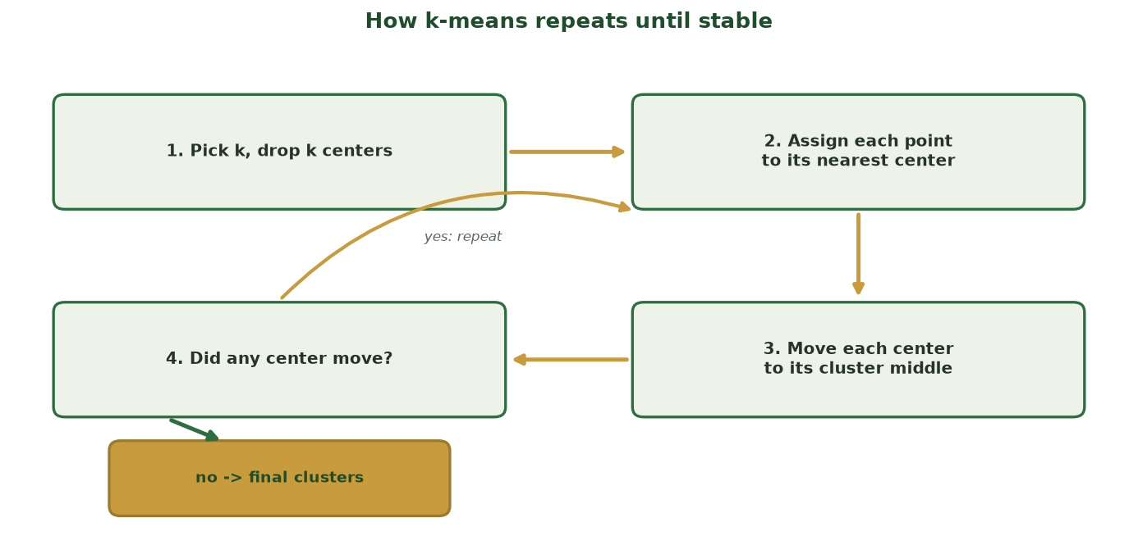
ASSIGN, MOVE, REPEAT - UNTIL NOTHING CHANGES
The k-Means Loop, Step by Step
The loop repeats two steps - assign points to the nearest center, then move each center to its points' middle - until assignments stop changing and the clusters settle.
CIS 350: AI for Cybersecurity · Monday
12
Notes:
Use this diagram to make the k-means loop concrete before the elbow and scaling. Trace it aloud: drop k centers, ASSIGN each point to its nearest center, MOVE each center to the average of its points, then REPEAT. The curved 'yes: repeat' arrow is the iteration; the 'no -> final clusters' pill is convergence. Ask: 'What makes it STOP?' (assignments no longer change). This visual prevents the common belief that k-means runs once - it iterates. ~2 min.

Slide 13
A METHOD FOR K
Choosing k: The Elbow Method
Run k-means for a range of k (say 1 to 8).
For each k, measure 'inertia' - how tight the clusters are (lower = tighter).
Inertia always drops as k rises - more groups fit better.
Look for the 'elbow': where extra groups stop helping much.
That bend is a good, defensible choice of k.
Elbow = where inertia stops dropping fast.
CIS 350: AI for Cybersecurity · Monday
13
Notes:
Explain the elbow method plainly. Inertia = total within-cluster spread; it always decreases with more clusters, so we don't just minimize it - we look for the ELBOW where the curve flattens. Analogy: adding shelves to organize a closet helps a lot at first, then barely. The next slide shows a real elbow. Note it's a guide, not a law - judgment still matters. ~4 min.

Slide 14
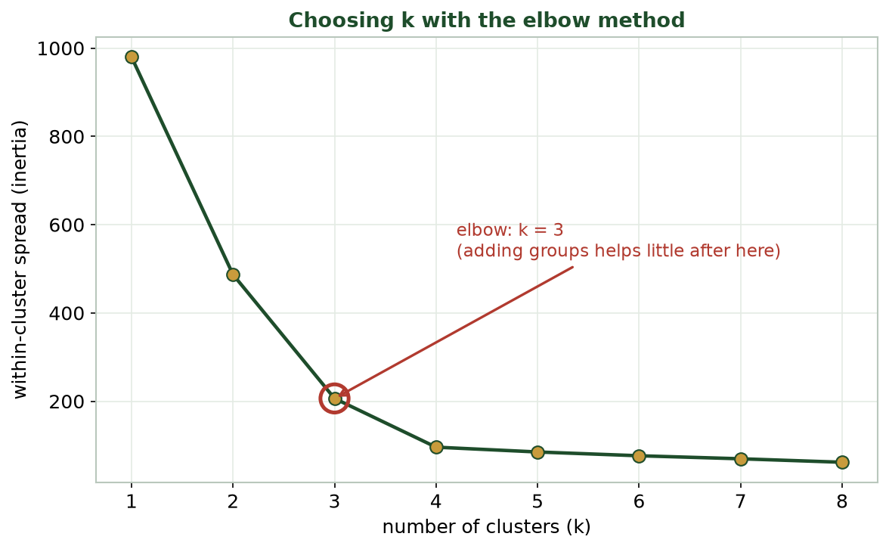
INERTIA VS. NUMBER OF CLUSTERS
The Elbow in Action
Inertia drops steeply to k=3, then flattens - the 'elbow' at k=3 is a sensible choice for this data.
CIS 350: AI for Cybersecurity · Monday
14
Notes:
Read the elbow curve together. Steep drop from 1->3, then it flattens: adding a 4th group barely reduces inertia. So k=3 is the elbow - matching the three behavior groups in our traffic data. Ask: 'Why not just pick k=8 for the lowest inertia?' Answer: those extra groups are meaningless splits (overfitting the noise). ~3 min.

Slide 15
SCALE FIRST!
Why Feature Scaling Matters
Features often have very different ranges (duration: 0-10; bytes: 0-millions).
k-means measures DISTANCE, so a big-range feature dominates everything.
Result: clusters driven by one feature, ignoring the rest.
Fix: STANDARDIZE features first (put them on a comparable scale).
Rule of thumb: always scale before k-means or anomaly detection.
Big-range features hijack distance - scale first.
CIS 350: AI for Cybersecurity · Monday
15
Notes:
This is the most common beginner mistake, so slow down. Because k-means uses distance, a feature measured in millions (bytes) drowns out one measured in single digits (duration) - the clusters end up based on bytes alone. Standardizing (rescaling each feature to comparable spread) fixes it. The next figures show WHY, then the dramatic difference on real data. ~3 min.

Slide 16
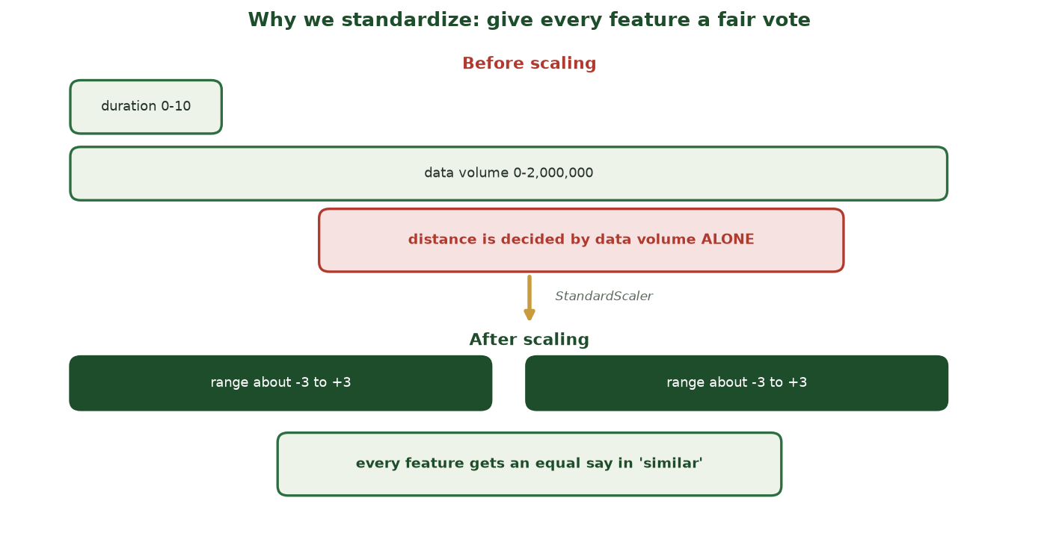
BEFORE VS. AFTER SCALING
Every Feature Gets an Equal Vote
Before scaling, one huge-range feature casts almost the entire 'vote' on distance; after scaling, every feature votes about equally - so 'similar' reflects all of them.
CIS 350: AI for Cybersecurity · Monday
16
Notes:
Use this before/after schematic to explain the MECHANISM behind scaling. Distance is a vote on 'how similar are these two records,' and a feature's range is its voting power. Left: 'bytes' (range in the millions) casts nearly the whole vote, so clusters are really just 'high vs. low bytes.' Right: after standardizing, duration, packets, and failed-connections each get a fair say. Tie back: this is why we ALWAYS scale before a distance-based method. The next slide shows the effect on actual clusters. ~2 min.

Slide 17
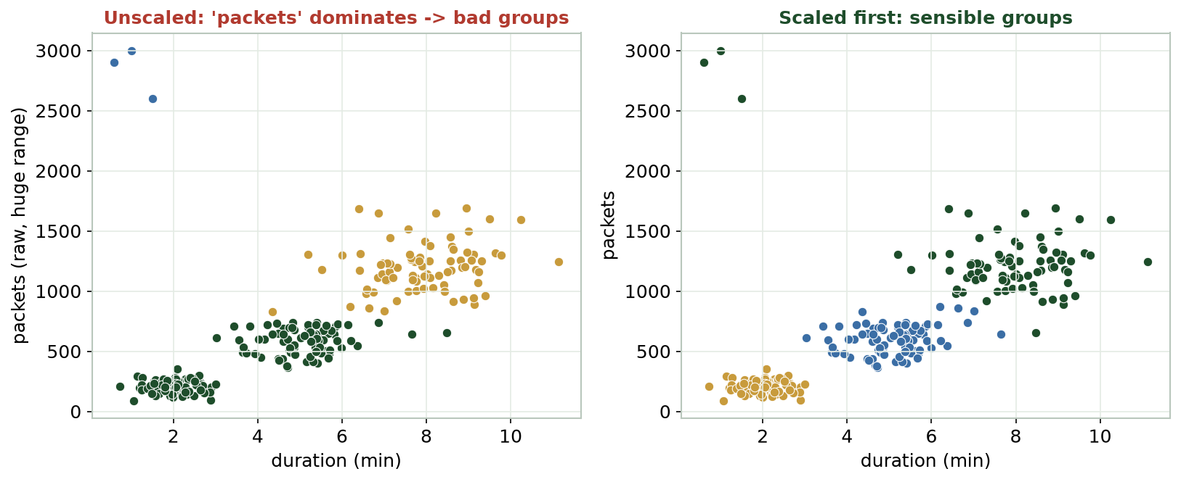
UNSCALED VS. SCALED CLUSTERING
Same Data, Scaling Changes Everything
Left: one huge-range feature dominates and the groups are nonsense. Right: after scaling, the groups make sense.
CIS 350: AI for Cybersecurity · Monday
17
Notes:
Drive the point home visually. Left panel: without scaling, the giant-range feature dominates and the clusters are meaningless stripes. Right panel: after standardizing, the same k-means finds sensible groups. This single step often matters more than the algorithm choice. Students will scale in Lab 5. ~3 min.

Slide 18
SCALE, CHOOSE K, THEN CLUSTER
k-Means Done Well (Colab)
Python · Google Colab
from sklearn.preprocessing import StandardScaler
from sklearn.cluster import KMeans
X = df[['duration', 'data_volume', 'packets', 'failed_conns']]
Xs = StandardScaler().fit_transform(X) # 1) SCALE first
km = KMeans(n_clusters=3, n_init=10) # 2) k from the elbow
df['cluster'] = km.fit_predict(Xs) # 3) assign each row a group
Scaling is one line and prevents the biggest clustering mistake. Still no labels - unsupervised.
CIS 350: AI for Cybersecurity · Monday
18
Notes:
Walk each line: select features, STANDARDIZE (the key new step), then k-means with k from the elbow, and fit_predict to tag each row. Emphasize the order: scale -> choose k -> cluster. This is the exact opening of Lab 5. Reassure: it's the same create->fit pattern from earlier weeks, plus scaling. ~4 min.

Slide 19
⚙️ ACTIVITY · 3 MIN
Pick k and defend it
You run k-means and get this elbow: big drops to k=3, tiny drops after.
What k would you choose, and why?
Your colleague wants k=7 for 'more detail.' What's the risk?
Before clustering, what must you do to features on different scales?
CIS 350: AI for Cybersecurity · Monday
19
Notes:
Consolidate Part 2. Answers: choose k=3 (the elbow); k=7 over-fragments into meaningless groups; scale (standardize) features first. Push students to justify with the elbow and the scaling rule. Pairs 2, discuss 1. ~3 min.

Slide 20
PART 3 · HIERARCHICAL CLUSTERING · ~13 MIN
Building a Tree & Reading Dendrograms
Notes:
Transition: 'k-means needs k up front. Hierarchical clustering lets the data show you the structure first.' ~16 minutes with code and an activity.

Slide 21
MERGE INTO A TREE
Hierarchical Clustering (Recap + Depth)
Start: every record is its own tiny cluster.
Repeatedly merge the two closest clusters.
Continue until everything joins one big cluster.
The record of merges is a TREE called a dendrogram.
You don't pick k up front - you CUT the tree afterward.
Merge nearest repeatedly -> a tree you cut.
CIS 350: AI for Cybersecurity · Monday
21
Notes:
Recap hierarchical clustering from Week 5, then go deeper on the dendrogram. Analogy: building a family tree of similarity - keep pairing the most alike until one family remains. The big advantage over k-means: you SEE the structure and choose the number of groups after, by cutting the tree. ~3 min.

Slide 22
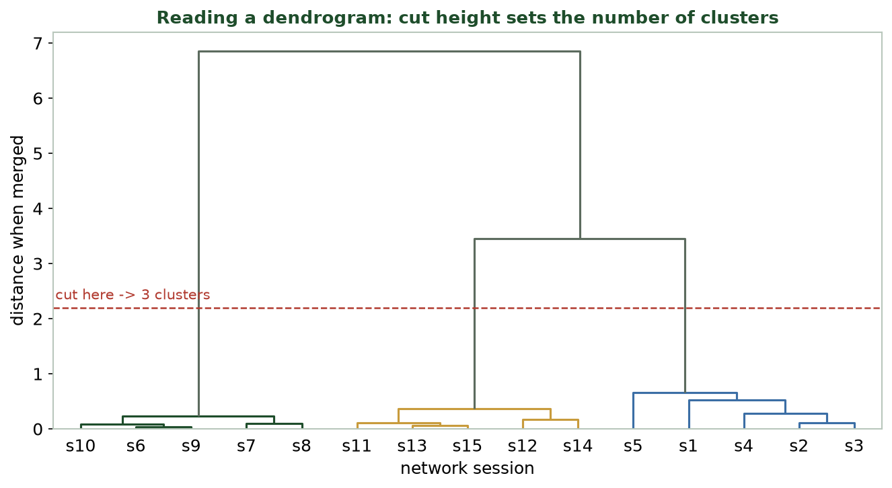
WHERE YOU CUT SETS THE NUMBER OF CLUSTERS
Reading a Dendrogram
Height = how different groups were when merged. A horizontal cut gives that many clusters (here, 3).
CIS 350: AI for Cybersecurity · Monday
22
Notes:
Teach dendrogram reading carefully - a key skill. Leaves are records; branches join as groups merge; the HEIGHT of a join shows how DIFFERENT the merged groups were (higher = more different). A horizontal cut crosses some branches - the number it crosses is your number of clusters. Cutting low (the red line) gives 3 tight groups; cutting high gives fewer, broader groups. ~4 min.

Slide 23
USING THE TREE
Dendrograms Help You Choose
A big vertical jump before a merge = those groups are quite different.
Cut just below a big jump to keep meaningful groups apart.
Cross-check with the elbow method - do they agree on k?
Great for EXPLORING when you don't know how many groups exist.
Heavier to compute than k-means, so best for smaller datasets.
Cut below a big jump; cross-check with the elbow.
CIS 350: AI for Cybersecurity · Monday
23
Notes:
Give practical guidance for using dendrograms to pick k: look for a tall vertical gap (a big jump in merge distance) and cut just below it. Encourage cross-checking with the elbow method - agreement builds confidence. Honest trade-off: hierarchical is more computationally expensive, so k-means wins on large data. ~3 min.

Slide 24
BUILD THE TREE, THEN CUT IT
Hierarchical Clustering (Colab)
Python · Google Colab
from scipy.cluster.hierarchy import linkage, dendrogram
from sklearn.cluster import AgglomerativeClustering
Z = linkage(Xs, method='ward') # build the merge tree (scaled data!)
dendrogram(Z) # visualize where to cut
labels = AgglomerativeClustering(n_clusters=3).fit_predict(Xs) # cut into 3
Same scaled features as k-means. linkage builds the tree; AgglomerativeClustering cuts it.
CIS 350: AI for Cybersecurity · Monday
24
Notes:
Show hierarchical clustering is also a few lines. linkage builds the tree (note we use the SAME scaled data), dendrogram draws it so you can choose where to cut, and AgglomerativeClustering produces the final groups. Students will run this in Lab 5 and compare to k-means. ~3 min.

Slide 25
🌳 ACTIVITY · 3 MIN
Cut the tree
On the dendrogram shown, a big vertical gap sits just above three branches.
How many clusters if you cut through that gap?
What does the HEIGHT of a merge tell you?
Name one case where hierarchical beats k-means.
CIS 350: AI for Cybersecurity · Monday
25
Notes:
Check dendrogram literacy. Answers: cutting through the gap above three branches gives 3 clusters; height = how different the groups were when merged; hierarchical beats k-means when you don't know k or want to see nested structure (and the dataset is modest). Pairs 2, discuss 1. ~3 min.

Slide 26
PART 4 · ARE THE CLUSTERS ANY GOOD? · ~6 MIN
Evaluating & Interpreting Results
Notes:
Transition: 'You have clusters - but are they useful? Let's judge and interpret them.' ~9 minutes.

Slide 27
QUALITY CHECK
Judging Clusters (No Labels to Check Against)
Well-separated, tight groups are a good sign; heavy overlap is not.
Do the clusters tell a sensible STORY from their centers?
Are they stable if you re-run or tweak k slightly?
A 'silhouette score' summarizes separation (higher = better) - optional.
Ultimately: are they USEFUL for the security decision at hand?
Separated + sensible + stable + useful.
CIS 350: AI for Cybersecurity · Monday
27
Notes:
Because there are no labels, we judge clusters by separation, sensibility, stability, and usefulness. Mention the silhouette score as a one-number summary of separation (you can show it in Lab 5) but keep usefulness central: a technically 'good' clustering that doesn't help the analyst is not good. ~3 min.

Slide 28
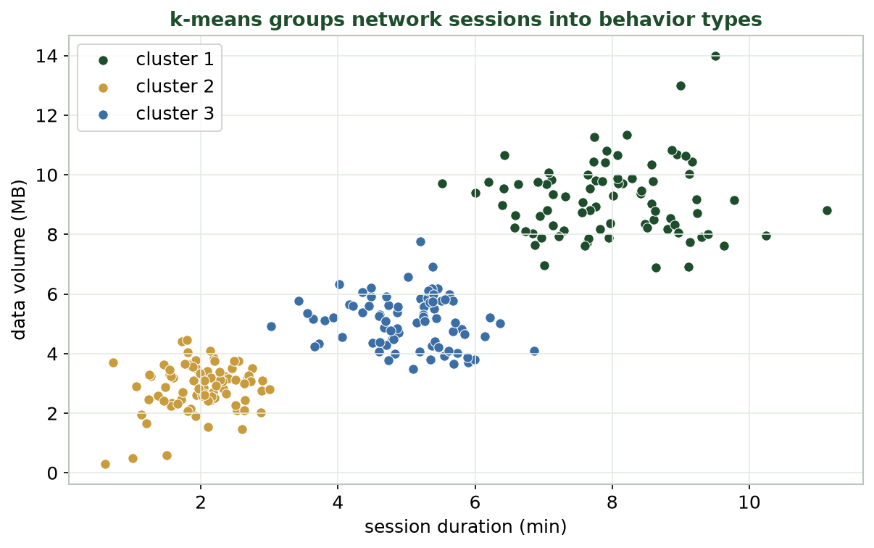
GIVE EACH GROUP A PLAIN-LANGUAGE IDENTITY
Interpreting Traffic Clusters
Three behavior groups emerge: short low-volume (web), long high-volume (bulk/backup), and medium (interactive).
CIS 350: AI for Cybersecurity · Monday
28
Notes:
Model interpretation on the real figure. Describe each group from its position: short + low-volume = quick web sessions; long + high-volume = bulk transfers/backups; medium = interactive. Emphasize the analyst's job: turn clusters into named behaviors, then decide which to watch. This is Objective 4 in action and previews Wednesday's anomalies. ~3 min.

Slide 29
TURNING GROUPS INTO ACTION
From Clusters to Watchlists
Name each cluster by its typical behavior (web, bulk, interactive...).
Flag any cluster that looks risky or unexpected for review.
Watch for tiny 'clusters' or lone points - they may be anomalies.
Clusters define NORMAL; what sits outside is Wednesday's topic.
Interpretation is a human job - the algorithm only groups.
Name groups; flag the odd ones.
CIS 350: AI for Cybersecurity · Monday
29
Notes:
Close Part 4 by connecting clustering to action. Once groups are named, the analyst decides which deserve attention and notices anything that doesn't fit a normal group - the bridge to anomaly detection. Reinforce that the human interprets and decides; the algorithm just forms groups. ~3 min.

Slide 30
🧩 IN-CLASS TASK · 12 MIN
Build a Cluster Profile Card
In groups of 2-3, you get today's three traffic clusters. Build a one-card profile for each (~7 min to build, then we compare cards across the room).
NAME it: give the cluster a plain-language identity (e.g., 'bulk backup', 'quick web').
DESCRIBE it: which features are HIGH and which are LOW (duration, data volume, packets, failed_conns)?
SIZE it: is it a large group (likely normal) or a tiny one (worth a closer look)?
DECIDE: watchlist or ignore - and write ONE sentence justifying that to a manager.
CIS 350: AI for Cybersecurity · Monday
30
Notes:
This is the session's hands-on task - the bridge from 'the algorithm made groups' to 'the analyst gives them meaning.' Hand each group the traffic_clusters figure (or the three cluster centers as a small table). Circulate while they fill in name / high-low features / size / decision. After ~7 min, have 2-3 groups read a card; push on the justification sentence - that is the analyst skill Objective 4 targets, and it is exactly what Lab 5 Part C asks them to write. Expected cards: short+low-volume = quick web (large, normal); long+high-volume = bulk/backup (watch context); a tiny odd group = candidate anomaly (previews Wednesday). Emphasize: naming and the watch/ignore decision are HUMAN judgments the algorithm cannot make. ~12 min.

Slide 31
USE THESE SLIDES AS YOUR STUDY GUIDE
How Today Connects to Lab 5 & Quiz 5
💻 In Lab 5 you will...
📝 Quiz 5 will ask you to...
Scale features, then cluster network traffic with k-means.
Use the elbow method to choose k and read a dendrogram.
Detect anomalies with an isolation forest (Wednesday's topic).
Interpret clusters and flag suspicious activity.
Explain the elbow method and why we scale features.
Read a dendrogram and pick the number of clusters.
Interpret a cluster visualization in security terms.
Contrast k-means with hierarchical clustering.
CIS 350: AI for Cybersecurity · Monday
31
Notes:
Tie the lecture to the assessments. Left = Lab 5 steps (each shown today); right = Quiz 5 question types. Tell students to keep these slides open during the lab and re-read before the quiz. ~1 min.

Slide 32
Key Takeaways
✓
Choose k with the elbow method; the algorithm won't pick it for you.
✓
Always SCALE features before clustering - distance-based methods are hijacked by big-range features.
✓
Hierarchical clustering builds a tree (dendrogram) you cut - great when you don't know k.
✓
Judge clusters by separation, sensibility, stability, and usefulness - then name and act on them.
Notes:
Recap one point per objective. Cold-call: 'Why scale before k-means?' and 'How does a dendrogram help you choose k?' Preview Wednesday: once we know normal behavior, we hunt the anomalies. ~2 min.

Slide 33
WHAT'S NEXT
Looking Ahead: Anomaly Detection & Lab 5
📊 Wednesday: anomaly detection - Isolation Forests and Local Outlier Factor.
We'll flag the sessions that fit NO normal group (novel attacks, exfiltration).
💻 Lab 5 (Clustering & Anomaly Detection) is released - it uses today's exact workflow.
📖 Read Handout 5: Unsupervised Learning and Clustering.
📝 Quiz 5 is Wednesday (unsupervised learning; clustering; anomaly detection).
Wed = anomaly detection; Lab 5 + Quiz 5 this week.
CIS 350: AI for Cybersecurity · Monday
33
Notes:
Assign and preview. Wednesday builds directly on today: clustering defined normal, anomaly detection finds what doesn't fit. Assign Lab 5, Quiz 5, and Handout 5. Tell them today's scaling + clustering code is the foundation for both. ~1-2 min.

Slide 34
🎯 EXIT TICKET · 2 MIN
One minute before you go
On the Canvas exit-ticket quiz or a card:
In one sentence, what is the elbow method for?
Why must we scale features before k-means?
One thing about dendrograms you'd like clarified.
CIS 350: AI for Cybersecurity · Monday
34
Notes:
Close with the exit ticket. The elbow and scaling answers confirm the two core skills landed; use the dendrogram questions to open Wednesday if needed. ~2 min.

Slide 35
SOURCES & FURTHER READING
References & Further Reading
  scikit-learn User Guide - Clustering (KMeans, AgglomerativeClustering).
  SciPy - Hierarchical clustering & dendrograms (docs.scipy.org).
  Google, Machine Learning Crash Course - Clustering.
  NIST, Artificial Intelligence Risk Management Framework (AI RMF 1.0), 2023.
  Clarence Chio & David Freeman, Machine Learning and Security (O'Reilly).
CIS 350: AI for Cybersecurity · Monday
35
Notes:
Appendix slide: references and further reading for students. Post to Canvas or leave visible during the exit ticket - it is not part of the timed lecture. The scikit-learn and SciPy guides are the exact tools used in Lab 5.

