Slide 1

WEEK 5 · WEDNESDAY · 75 MINUTES
Exam 1 & a Preview of Week 6
Online Exam (Weeks 1-4) · What's Next in Unsupervised Learning
CIS 350: AI for Cybersecurity — Smart Defense for the Digital Business
Ramadan Abdunabi, Ph.D. · Computer Information Systems
Notes:
This is exam week. Exam 1 is an online, asynchronous exam taken in Canvas during the exam window (90 minutes, Weeks 1-4). Use the class period to confirm exam logistics and give a short, motivating preview of Week 6. Keep it light - the heavy lifting (studying + the exam) happens online. ~1 min.

Slide 2

WEDNESDAY · 75 MINUTES
Today's Plan
📝
Exam 1 logistics & launch sequence
LockDown, window, format, set-up steps
14 min
🧭
Exam review: metrics + name-apply-justify
How to answer scenario questions
14 min
✍️
Hands-on: practice a full exam scenario
Name -> Apply -> Justify, peer-scored
12 min
🔎
Preview: Week 6 & Lab 5
Unsupervised techniques coming next
15 min
🗓️
Exam 1 taken online (asynchronous)
In Canvas during the exam window
20 min
CIS 350: AI for Cybersecurity · Wednesday
2
Notes:
Frame the session. Exam 1 is taken online (not during class); the last row is that asynchronous block. In class, use the time for logistics, a focused review, and one full practice scenario, then preview Week 6. The row minutes add up to 75. ~1 min.

Slide 3
EXAM LOGISTICS
Exam 1 - Everything You Need to Know
Online via Canvas, proctored with Respondus LockDown Browser.
90 minutes, 100 points, non-cumulative - covers Weeks 1-4 only.
All formats: multiple choice, true/false, short answer, applied scenarios.
Open-notes; individual work - NO collaboration and NO AI assistance.
No heavy math and no coding. Taken any time during the exam window.
Canvas + LockDown · 90 min · 100 pts · Weeks 1-4.
CIS 350: AI for Cybersecurity · Wednesday
3
Notes:
Remove all exam-day uncertainty. State the window dates explicitly, confirm it's open-notes but individual, and walk the format. The most common avoidable problem is LockDown Browser not installed - have students confirm it works now. Point to the Study Guide and Practice Exam on the course site. ~5 min.

Slide 4
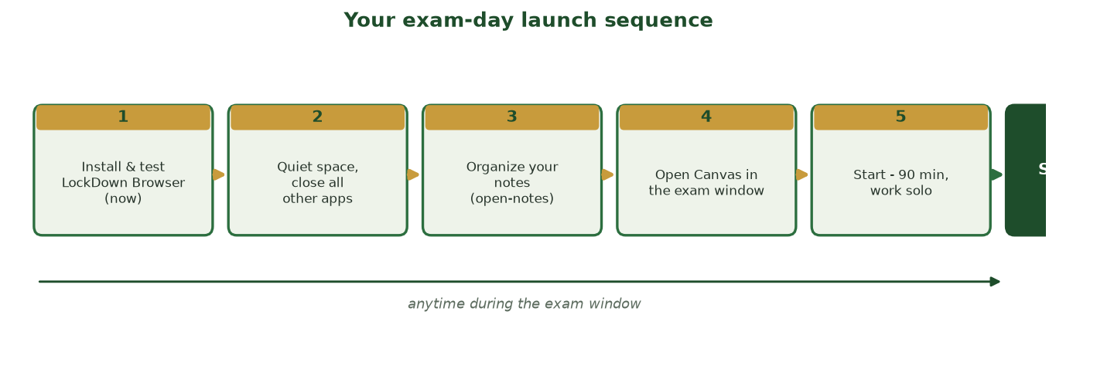
DO THESE FIVE STEPS BEFORE YOU START
Your Exam-Day Launch Sequence
Install & test LockDown Browser now, find a quiet space, organize your notes, open Canvas in the window, then start your 90 minutes solo.
CIS 350: AI for Cybersecurity · Wednesday
4
Notes:
Walk the launch sequence to prevent avoidable exam-day problems. The #1 issue is LockDown Browser not installed - have everyone confirm it works today. Reassure: it's open-notes, taken anytime in the window, individual work only. ~2 min.

Slide 5
HOW TO DO YOUR BEST
Last-Minute Exam Tips
Skim these slides and Handout 4; redo the confusion-matrix practice.
Be able to DEFINE each key term AND give an example.
For scenarios: name the concept, apply it, justify with the trade-off.
Watch the clock - 90 minutes; don't get stuck on one item.
Read every multiple-choice option; beware 'always/never' absolutes.
Define + example; name-apply-justify; watch the clock.
CIS 350: AI for Cybersecurity · Wednesday
5
Notes:
Give concrete, calming test-taking advice. Stress active recall (self-testing beats re-reading) and the three-step structure for applied scenarios. Remind them it's open-notes, so organized notes help - but time management matters at 90 minutes. Reassure: if they can explain the ideas in plain words, they're ready. ~4 min.

Slide 6
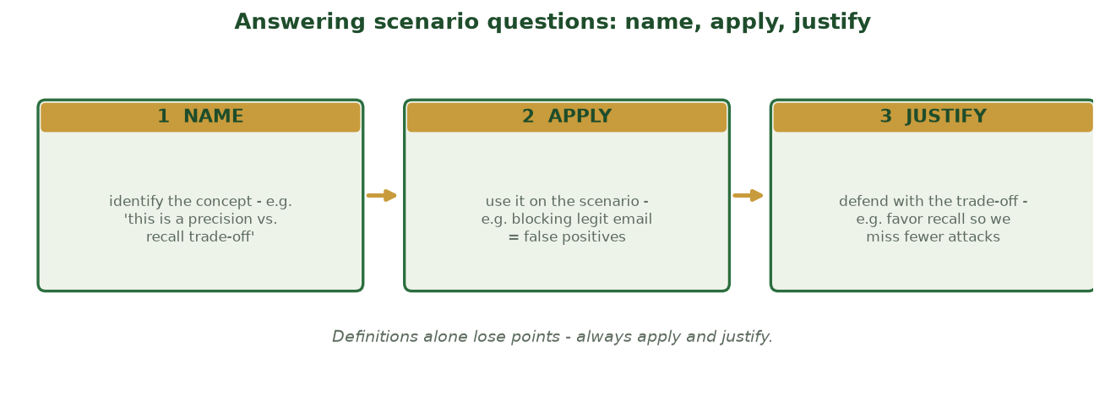
THE 3-MOVE TEMPLATE FOR FULL CREDIT
Answering Scenario Questions: Name, Apply, Justify
NAME the concept, APPLY it to the scenario's specifics, then JUSTIFY your call with the trade-off - a bare definition loses points.
CIS 350: AI for Cybersecurity · Wednesday
6
Notes:
Give students the template that earns full marks on applied scenarios (the hardest exam items). Show the worked example under each move. Then they'll practice it live next. This directly rehearses the Exam 1 Part-D style. ~2 min.

Slide 7
✍️ IN-CLASS TASK · 12 MIN
Practice a Full Exam Scenario (Name, Apply, Justify)
Open your notes - this rehearses the hardest question type under real (open-notes, solo) conditions. A bank's filter flags 100 emails as malicious; 20 of those were actually legitimate (false positives), and separately 5 real phishing emails slipped through (false negatives). Write a full short-answer response.
NAME: which two Week-4 metrics are at play? Describe each in plain words using the numbers.
APPLY: what do the 20 false positives and the 5 false negatives each mean for the bank and its customers?
JUSTIFY: recommend tuning toward higher precision OR higher recall, and defend the trade-off you accept.
Swap papers; score your neighbor's 0-3 (1 pt each: NAMED, APPLIED, JUSTIFIED).
Deliverable: a 4-6 sentence Name->Apply->Justify answer with a peer score and one strength + one gap noted.
CIS 350: AI for Cybersecurity · Wednesday
7
Notes:
Precision = of 100 flagged, how many truly malicious (80/100); recall = of all real phishing, how many caught. The 20 FPs block legitimate business email; the 5 FNs let real phishing through. A bank usually fears a missed attack most -> lean to higher recall, accepting more false-positive friction (either call earns full credit if the trade-off is named). Reinforce: points come from NAME + APPLY + JUSTIFY, not a bare definition. ~12 min.

Slide 8
PREVIEW · WEEK 6 · ~15 MIN
Where Unsupervised Learning Goes Next
Notes:
Transition: 'A quick look at what you'll explore next week - no notes needed, just enjoy it.' ~15 minutes, light and visual.

Slide 9
COMING NEXT
Week 6: Unsupervised Learning Goes Hands-On
Deeper k-means: choosing k well and scaling features.
Hierarchical clustering and reading dendrograms in code.
Anomaly detection with isolation forests and outlier scores.
Real security data: unusual logins, traffic, and behavior.
You'll build and interpret these yourself in Colab.
Deeper clustering + anomaly detection, hands-on.
CIS 350: AI for Cybersecurity · Wednesday
9
Notes:
Preview Week 6 to build momentum. It takes today's intuition and makes it hands-on: choosing k, reading dendrograms in code, and using isolation forests for anomaly detection on real security data. Keep it aspirational - they already understand the ideas; next week they'll DO them. ~3 min.

Slide 10
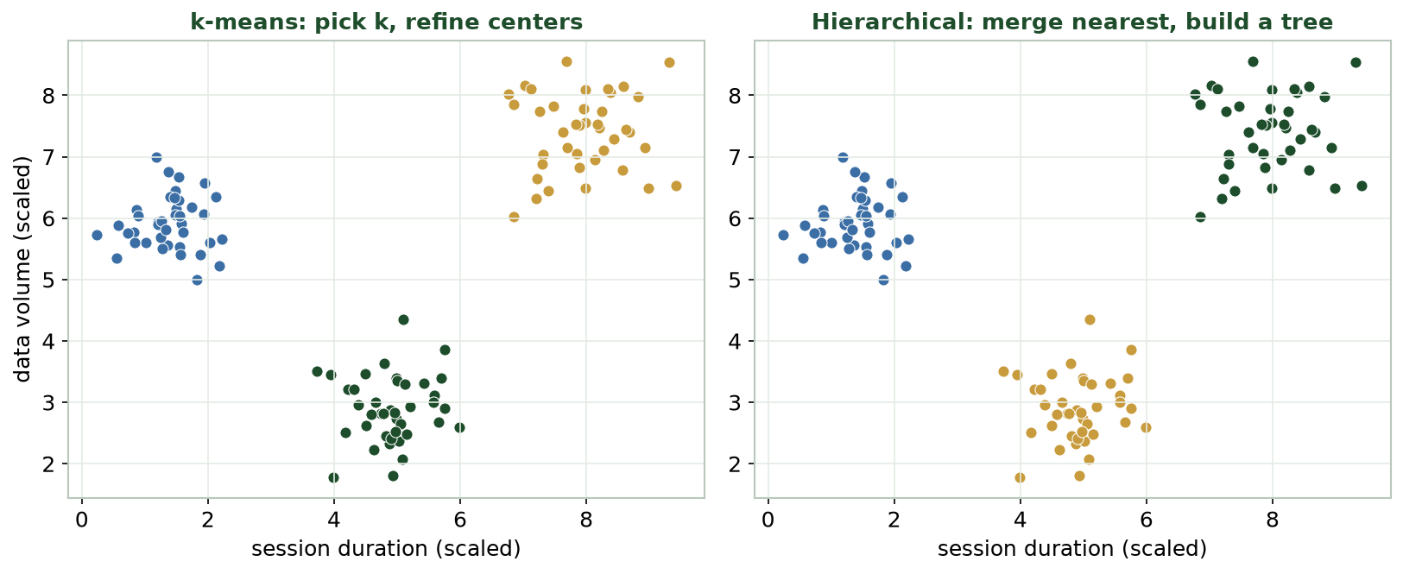
FROM TREE TO FLAGGED ANOMALIES
A Taste of What's Next
You'll compare clustering methods and, in Lab 5, cluster real behavior and flag anomalies yourself.
CIS 350: AI for Cybersecurity · Wednesday
10
Notes:
Show a teaser figure to make Week 6 concrete. Point out they'll produce plots like these themselves and interpret them. Emphasize the continuity: same cluster-then-flag workflow from Monday's demo, now in their own hands. ~3 min.

Slide 11
LAB 5
Lab 5 Preview: Clustering & Anomaly Detection
Load a real, unlabeled dataset in Google Colab.
Cluster it with k-means; describe the groups you find.
Flag anomalies and connect them to a security decision.
Reflect: what did the groups mean, and which mattered?
Released next week - it reuses Monday's exact workflow.
Cluster, flag, interpret - the Monday workflow, hands-on.
CIS 350: AI for Cybersecurity · Wednesday
11
Notes:
Set expectations for Lab 5 so students arrive to Week 6 ready. It mirrors Monday's demo: load unlabeled data, cluster, flag anomalies, and interpret - individually or in pairs, beginner-friendly with starter code. Reassure them today's demo is their template. ~3 min.

Slide 12
🎯 EXIT TICKET · 2 MIN
Before you go / after the exam
On a card or the Canvas exit-ticket quiz:
Confirm: can you launch LockDown Browser successfully?
One topic you want reviewed before you take Exam 1.
One thing about unsupervised learning you're curious to try.
CIS 350: AI for Cybersecurity · Wednesday
12
Notes:
Close by surfacing blockers. The LockDown check catches exam-day problems early; the 'topic to review' answers let you post a targeted Canvas note before the window closes; the curiosity prompt primes Week 6. ~2 min.

Slide 13
EXAM PREP & FURTHER READING
References & Further Reading
  Exam 1 Study Guide and Practice Exam (course site) - primary review resources.
  Handout 4: Regression and Model Metrics (Weeks 1-4 review).
  NIST, Cybersecurity Framework 2.0, 2024; AI Risk Management Framework (AI RMF 1.0), 2023.
  scikit-learn User Guide - Clustering (preview of Week 6).
  Google, Machine Learning Crash Course (developers.google.com/machine-learning).
CIS 350: AI for Cybersecurity · Wednesday
13
Notes:
Appendix slide: study resources for Exam 1 plus a look ahead. Post to Canvas; it is not part of the timed session. Steer students to the Study Guide and Practice Exam first for the exam, and to the scikit-learn clustering guide if they want to explore Week 6 early.

