Slide 1

WEEK 5 · MONDAY · 75 MINUTES
Unsupervised Learning: Finding Patterns Without Labels
Clustering as a Security Tool · k-means vs. Hierarchical · Live Anomaly Demo
CIS 350: AI for Cybersecurity — Smart Defense for the Digital Business
Ramadan Abdunabi, Ph.D. · Computer Information Systems
Notes:
Welcome and frame the unit: 'For four weeks every model learned from labeled answers. Today the data has NO answers - and we let the algorithm find the structure itself.' Keep it intuition-first, no math. Note Exam 1 is an online exam this week (90 minutes, Weeks 1-4, taken in Canvas) - today's new material is NOT on it, so relax and engage. Preview the payoff: by the end we'll cluster real login behavior and spot anomalies. Reach Part 1 by ~minute 8. ~1 min.

Slide 2

🔁 WARM-UP · 5 MIN
What do labels do for us?
With a neighbor, one sentence each:
Weeks 3-4: what did our models need in order to learn?
Give one example of a 'label' we used (spam/ham, risk score...).
Where in security might we have NO labels?
CIS 350: AI for Cybersecurity · Monday
2
Notes:
Retrieval that bridges to today. Pairs 2 min, cold-call 2-3. Expected: models needed LABELED examples; labels were spam/ham or a risk score; no labels for brand-new attacks, raw logs, or un-triaged alerts. Land the pivot: 'Today's data has no label column - so what can we still learn?' ~5 min.

Slide 3
MONDAY · 75 MINUTES
Today's Plan
🔁
Warm-up & orientation
Recall labels; today's roadmap
7 min
🧭
Why unsupervised? No labels
Intuition: when you don't have answers
12 min
🧩
Clustering as a security tool
Grouping traffic, behavior, malware
13 min
⚙️
k-means vs. hierarchical
Two ways to cluster + a loop diagram
14 min
🔬
Live demo: cluster logins -> anomalies
The full workflow in code
12 min
🖐️
Hands-on: cluster the logins by hand
Find the groups + the odd one out
12 min
CIS 350: AI for Cybersecurity · Monday
3
🎯
Wrap & exit
Takeaways; Exam 1 & Week 6
5 min
Notes:
Walk the plan; the row minutes add up to exactly 75. Set expectations: today is a complete tour of unsupervised learning at the intuition level - what it is, clustering, two clustering methods, and a hands-on demo. All four Week 5 objectives are covered today. ~1 min.

Slide 4
UNSUPERVISED LEARNING
This Week's Learning Objectives
1
Explain unsupervised learning as finding patterns in data without labels.
2
Describe clustering and what a 'cluster' means in security data.
3
Identify business and security uses of clustering.
4
Interpret a simple cluster visualization.
CIS 350: AI for Cybersecurity · Monday
4
Notes:
State the four objectives - all covered today. Contrast with prior weeks: no labeled answers this time; the algorithm finds structure itself. Tell students the live demo at the end ties every objective together. ~1 min.

Slide 5
PART 1 · WHY UNSUPERVISED? · ~14 MIN
Learning When You Have No Labels
Notes:
Transition: 'First, the core idea - learning when nobody hands you the answers.' ~14 minutes, ending with a quick sorting activity.

Slide 6
THE DEFINITION
Supervised vs. Unsupervised, in Plain Words
Supervised: data comes WITH labels; we learn to predict them (spam/ham).
Unsupervised: data has NO labels; we learn its structure instead.
Supervised asks 'which category / what number?'
Unsupervised asks 'what natural groups or oddities are in here?'
It does NOT mean 'no human' - we still pick features and interpret.
Labeled -> supervised; unlabeled -> unsupervised.
CIS 350: AI for Cybersecurity · Monday
6
Notes:
Define by contrast - the clearest route for beginners. Hammer the single difference: is there a label column? Head off the top misconception: 'unsupervised' means the DATA has no labels, not that no human is involved - we still choose features, run the method, and interpret. ~3 min.

Slide 7
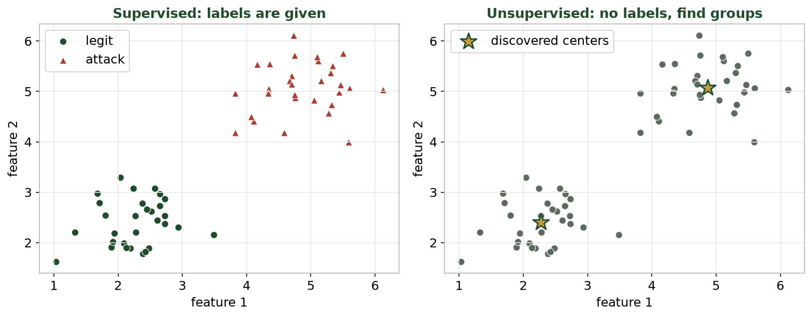
THE KEY DIFFERENCE
Supervised vs. Unsupervised, Side by Side
Left: labels are given (colors). Right: no labels - the algorithm discovers the groups (gold centers) itself.
CIS 350: AI for Cybersecurity · Monday
7
Notes:
Make it visual. Left: points arrive pre-colored by their label - supervised. Right: the SAME points with no colors given; the method finds groups and centers on its own - unsupervised. Ask: 'With no labels, how did it find groups on the right?' Answer: by putting nearby points together - that intuition is clustering, coming in Part 2. ~3 min.

Slide 8
WHY IT MATTERS
Why and When You Don't Have Labels
Labeling is slow and costly - a human must tag every example by hand.
New threats have no label yet - nobody has seen or named them.
Security teams face oceans of raw, unlabeled logs, alerts, and traffic.
Sometimes you don't even know what categories exist yet.
Unsupervised learning works directly on that raw, unlabeled data.
Labels are scarce; unlabeled data is everywhere.
CIS 350: AI for Cybersecurity · Monday
8
Notes:
Motivate the real-world need - the 'why and when' from the objective. Labeled data is a luxury: tagging millions of logins by hand is impractical, novel attacks have no label, and often you don't yet know the categories. Unsupervised methods turn raw data into insight and can surface the unknown - recall Week 4's point that supervised models only catch what they were taught. ~3 min.

Slide 9
WHAT'S IN THE BOX
The Unsupervised Toolbox
Clustering: group similar records together (today's main focus).
Anomaly detection: flag records that fit no normal group (the demo).
Dimensionality reduction: simplify many features into a few (a mention).
All find structure WITHOUT labels.
Everyday analogy: sorting an unlabeled box of photos into piles yourself.
Clustering, anomaly detection, dimensionality reduction.
CIS 350: AI for Cybersecurity · Monday
9
Notes:
Give a quick map so students see the breadth. Name the three unsupervised jobs but keep focus on clustering (today) and anomaly detection (the demo). Use the photo-box analogy: nobody gives you categories, yet you form piles by similarity - that's clustering, and you interpret what each pile means. Ask for a student example (music, a messy drawer). ~3 min.

Slide 10
🧭 ACTIVITY · 2 MIN
Labeled or unlabeled?
For each situation decide: supervised (labeled) or unsupervised (unlabeled)?
Emails marked spam/ham; learn to flag new ones. -> ?
A pile of logins with no idea which are attacks. -> ?
Group customers by behavior with no preset categories. -> ?
CIS 350: AI for Cybersecurity · Monday
10
Notes:
Fast check of the core distinction. Answers: supervised; unsupervised; unsupervised. The tell: are the ANSWERS already attached? Yes -> supervised; no -> unsupervised. Quick cold-call. ~2 min.

Slide 11
PART 2 · CLUSTERING AS A SECURITY TOOL · ~15 MIN
Grouping Traffic, Behavior & Malware
Notes:
Transition: 'The flagship unsupervised tool is clustering - and it's a workhorse in security.' ~15 minutes with an activity.

Slide 12
DEFINITION
Clustering: Grouping Similar Things
Clustering automatically groups data points that are similar.
'Similar' = close together when we plot the records by their features.
Same cluster = alike; different clusters = different.
No labels needed - the method finds the groups from the data.
Each group gets a 'center' - its typical member.
Clustering = auto-group similar points; no labels.
CIS 350: AI for Cybersecurity · Monday
12
Notes:
Define clustering plainly: put similar things together, separate different things, where 'similar' means close in feature space. Each group gets a center summarizing its typical member. Misconception to flag: clusters are GROUPS, not labels - the method won't say 'this is the attack group'; you interpret that. ~3 min.

Slide 13
BUSINESS & SECURITY USES
What Clustering Is Used For
Business: segment customers, power recommendations, organize documents.
Security: group similar NETWORK TRAFFIC to reveal patterns and baselines.
Security: cluster MALWARE SAMPLES into families that behave alike.
Security: profile normal USER BEHAVIOR to define 'typical.'
Common thread: make sense of large, unlabeled data fast.
Segment customers; group traffic, malware, behavior.
CIS 350: AI for Cybersecurity · Monday
13
Notes:
Cover Objective 3 - both sides. Business: segmentation and recommendations students already experience as targeted ads. Security (the focus of this week): group traffic into patterns, malware into families, and users into behavior baselines - all without labels. Emphasize that defining 'normal' behavior is the foundation for spotting abnormal, which the demo will show. ~3 min.

Slide 14
CLUSTERS IN SECURITY
What a 'Cluster' Means in Security Data
A cluster is a group of records that BEHAVE similarly.
Example: short, local, business-hours logins = typical staff.
Another: large late-night transfers from new devices.
A small, odd cluster (or lone point) can signal suspicious activity.
Clusters describe behavior; a human decides which groups matter.
A cluster = a behavior group; you judge which matter.
CIS 350: AI for Cybersecurity · Monday
14
Notes:
Make 'cluster' concrete for security - Objective 2's heart. One cluster is ordinary staff behavior; another is unusual (big late-night transfers, new devices); a tiny outlier group is exactly what an analyst inspects. Emphasize the workflow: clustering surfaces groups; the human investigates. Discussion: 'Which cluster here would you look at first, and why?' ~3 min.

Slide 15
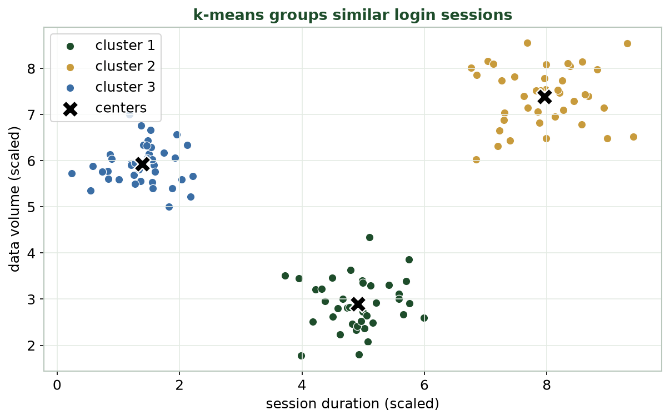
GROUPS EMERGE WITH NO LABELS
Clustering Login Sessions
Each dot is a login; the method found three behavior groups (colors) and their centers (X) with no labels.
CIS 350: AI for Cybersecurity · Monday
15
Notes:
Walk the figure. Each point is one login described by two features (duration, data volume). With no labels, clustering found three natural groups and marked each center with an X. Point out how tight and separated the groups are. Ask: 'What might make one group different?' - short vs long sessions, low vs high transfer. That interpretation is Objective 4, practiced in the demo. ~3 min.

Slide 16
🧩 ACTIVITY · 3 MIN
What could each cluster be?
Look at the three-cluster login plot. With a neighbor:
Describe each cluster in plain words (e.g., 'short, low-volume').
Which cluster looks most like normal staff behavior?
Which cluster would you investigate first, and why?
CIS 350: AI for Cybersecurity · Monday
16
Notes:
Students practice interpreting clusters - the human half of unsupervised learning. Good answers describe groups by features and reason about routine vs unusual. No single right answer; reward sound security reasoning. Pairs 2, discuss 1. ~3 min.

Slide 17
PART 3 · TWO WAYS TO CLUSTER · ~16 MIN
k-means vs. Hierarchical, Explained Visually
Notes:
Transition: 'There's more than one way to cluster. Let's meet the two most common and see how they differ.' ~16 minutes with a comparison activity.

Slide 18
METHOD 1: K-MEANS
How k-Means Works (No Math)
1. You choose k - how many groups to look for (say, 3).
2. Drop k centers; assign each point to its nearest center.
3. Move each center to the middle of its assigned points.
4. Repeat steps 2-3 until the groups stop changing.
Catch: YOU pick k - try a few and keep the one whose groups make sense.
Pick k -> assign to nearest -> move centers -> repeat.
CIS 350: AI for Cybersecurity · Monday
18
Notes:
Explain k-means as a simple repeating recipe, no equations. Analogy: place k 'campfires'; everyone walks to the nearest; each campfire moves to the middle of its crowd; repeat until nobody switches. Be honest that k is a human choice - too small over-merges, too large fragments; try a few and judge usefulness. Students run this in Lab 5. ~4 min.

Slide 19
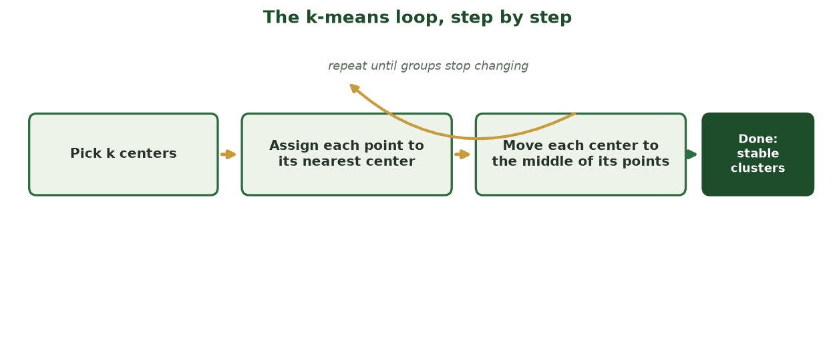
ASSIGN, MOVE, REPEAT - UNTIL STABLE
The k-Means Loop, Step by Step
k-means repeats two steps - assign each point to its nearest center, then move each center to its points' middle - until the groups stop changing.
CIS 350: AI for Cybersecurity · Monday
19
Notes:
Reinforce the recipe visually: pick k centers, assign, move, and repeat until stable. The curved arrow is the loop; it stops when no point switches groups. Emphasize again that YOU choose k. This is exactly what scikit-learn's KMeans automates in Lab 5. ~2 min.

Slide 20
METHOD 2: HIERARCHICAL
How Hierarchical Clustering Works (No Math)
Start with every record as its own tiny cluster.
Repeatedly MERGE the two closest clusters together.
Keep merging until everything joins one big cluster.
The result is a TREE of merges - a 'dendrogram.'
You don't pick k up front - you 'cut' the tree wherever you like.
Merge nearest repeatedly -> a tree you cut.
CIS 350: AI for Cybersecurity · Monday
20
Notes:
Introduce hierarchical clustering by contrast with k-means. Analogy: like building a family tree of similarity - start with individuals, keep pairing up the most alike, until one big family remains. The big advantage: you don't commit to k in advance; you cut the resulting tree at whatever height gives useful groups. The next slide shows that tree. ~3 min.

Slide 21
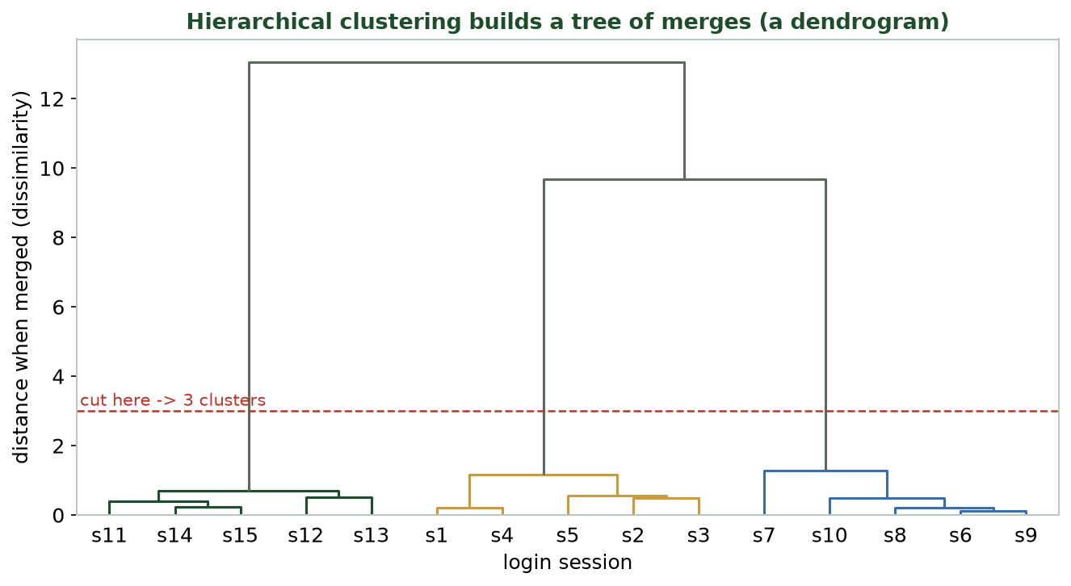
THE HIERARCHICAL 'TREE OF MERGES'
Reading a Dendrogram
Height = how different two groups were when merged. Cut across at a height to choose the number of clusters.
CIS 350: AI for Cybersecurity · Monday
21
Notes:
Teach students to read a dendrogram - part of Objective 4. Each leaf is a login; branches join as groups merge; the HEIGHT of a join shows how different the groups were (higher = more different). Cutting the tree with a horizontal line (the red dashed line) at a chosen height yields that many clusters - here, cutting low gives 3 clear groups. This is the signature hierarchical visual. ~3 min.

Slide 22
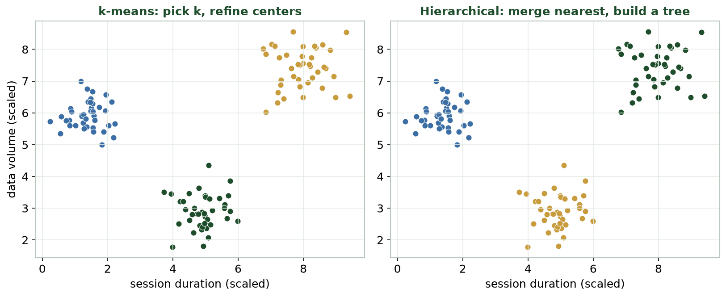
K-MEANS VS. HIERARCHICAL
Same Data, Two Methods
Both methods recover the same three login groups - but k-means needs k up front, hierarchical builds a full tree.
CIS 350: AI for Cybersecurity · Monday
22
Notes:
Show the two methods on the SAME points. Reassure: they often find similar groups (colors may differ - cluster labels are arbitrary). The DIFFERENCE is how they get there and what you must decide: k-means needs k chosen up front and is fast on big data; hierarchical needs no k and gives a full tree to explore but is heavier on large datasets. ~3 min.

Slide 23
MATCH THE METHOD TO THE JOB
Which Should You Use?
⚙️ k-means
🌳 Hierarchical
You have a rough idea of how many groups (k).
Large dataset - it scales well and is fast.
You want simple, round-ish groups.
You don't know k - explore the tree, then cut.
Smaller dataset - it's more computationally heavy.
You want to see nested structure (groups within groups).
CIS 350: AI for Cybersecurity · Monday
23
Notes:
Give a practical decision rule. Reach for k-means when you have a sense of k and lots of data; reach for hierarchical when you want to discover the number of groups or see nested structure and the dataset is modest. Both are unsupervised and label-free. Preview that Week 6 goes deeper on both. ~3 min.

Slide 24
PART 4 · LIVE DEMO · ~16 MIN
Clustering Login Behavior to Spot Anomalies
Notes:
Transition: 'Let's run the whole workflow on real-looking login data - cluster it, then flag the odd ones.' ~16 minutes, ending with a decision discussion. Run it live in Colab if you can.

Slide 25
DEMO SETUP
The Demo: A Month of Logins, No Labels
We have a month of login records - and NO labeled attacks.
Features per login: hour, duration, data volume, failed attempts, device age.
Goal: learn normal behavior, then surface anything that doesn't fit.
Plan: CLUSTER to find behavior groups, then FLAG the outliers.
This is exactly the Lab 5 workflow you'll do next week.
Unlabeled logins -> cluster, then flag anomalies.
CIS 350: AI for Cybersecurity · Monday
25
Notes:
Set up a realistic, label-free security task - where unsupervised learning shines. With no labeled attacks, supervised methods can't help, which motivates clustering + anomaly detection. Lay out the two-step plan students will see in code next. Build anticipation: 'Let's find the suspicious logins nobody labeled.' ~2 min.

Slide 26
THE WHOLE WORKFLOW IN A FEW LINES
Cluster, Then Flag Anomalies
Python · Google Colab
from sklearn.cluster import KMeans
from sklearn.ensemble import IsolationForest
import pandas as pd
logins = pd.read_csv('logins.csv') # no label column!
X = logins[['hour', 'duration', 'data_volume', 'failed', 'device_age']]
logins['cluster'] = KMeans(n_clusters=3, n_init=10).fit_predict(X) # groups
logins['anomaly'] = IsolationForest(contamination=0.02).fit_predict(X) # -1 = odd
Clustering finds the behavior groups; anomaly detection flags the outliers. No labels used.
CIS 350: AI for Cybersecurity · Monday
26
Notes:
Show the whole workflow is a handful of lines - the same scikit-learn create -> fit pattern from Weeks 3-4, but with NO y. KMeans tags each login with a group; IsolationForest flags outliers (-1). Read each line and stress: still no labels. Don't dwell on IsolationForest internals (Week 6) - here it's 'a method that flags odd points.' This IS the Lab 5 pipeline. ~4 min.

Slide 27
INTERPRETING THE GROUPS
Step 1 - Read the Clusters
Cluster 0: short, business-hours, low-volume = routine staff.
Cluster 1: long, high-volume, service accounts = backups/automation.
Cluster 2: evening remote workers, medium volume.
None is inherently 'bad' - they're normal behavior groups.
Cluster numbers are just names, not rankings (0 isn't 'better' than 2).
Name each group; they're all 'normal' behaviors.
CIS 350: AI for Cybersecurity · Monday
27
Notes:
Interpret the clustering output like an analyst - Objective 4 in action. Give each cluster a plain-language identity from its features. Two beginner cautions: these are all NORMAL behavior groups (clustering describes the baseline), and cluster NUMBERS are arbitrary names, not scores. The key question becomes: what falls outside these groups? ~3 min.

Slide 28
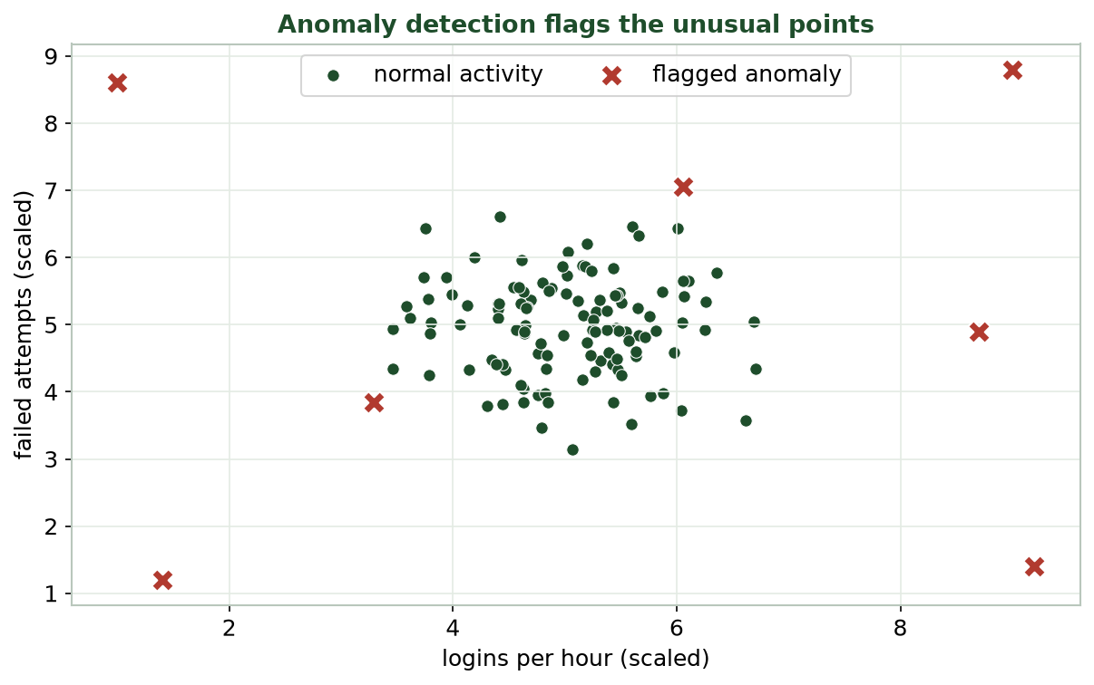
WHAT DOESN'T FIT ANY NORMAL GROUP
Step 2 - Flag the Anomalies
Green = normal logins; red X's don't fit any normal group - 3 a.m. logins, new devices, many failures - and get flagged.
CIS 350: AI for Cybersecurity · Monday
28
Notes:
Bring it home visually. The red points sit outside every normal cluster - think 3 a.m. logins, brand-new devices, many failed attempts - and get flagged for an analyst. Crucially, this used NO labels: clustering defined normal, anomaly detection surfaced the exceptions. That's how unsupervised methods catch attacks nobody labeled yet. ~3 min.

Slide 29
🔬 DISCUSSION · 4 MIN
What would you do?
Your pipeline flags 5 logins as anomalies out of 50,000.
Would you auto-block them or send them for review? Why?
What extra info would help you decide?
What's the risk of setting the anomaly rate too high?
CIS 350: AI for Cybersecurity · Monday
29
Notes:
A judgment discussion connecting to Week 4's trade-offs. Reasonable answers: review rather than auto-block (avoid false-positive harm); extra info like user, location, or recent behavior helps; too high an anomaly rate floods analysts with false alarms (alert fatigue). Pairs 2, discuss 2. ~4 min.

Slide 30
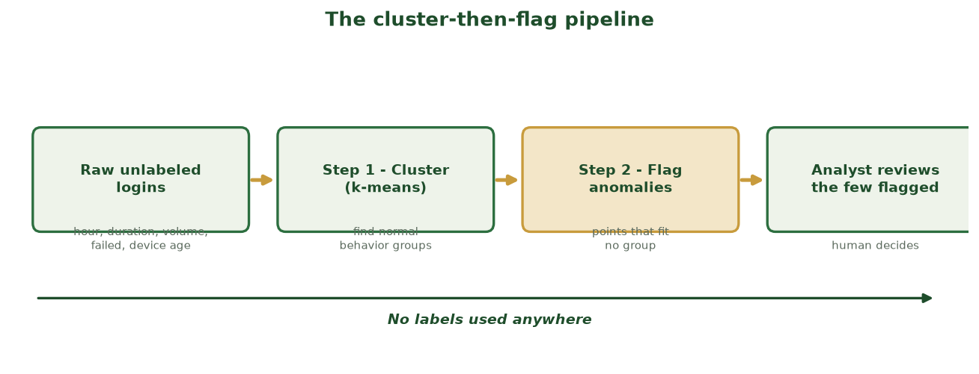
RAW LOGINS -> GROUPS -> A SHORT REVIEW LIST
The Cluster-then-Flag Pipeline
Cluster the unlabeled logins to learn normal behavior groups, flag the points that fit no group, and hand the few anomalies to an analyst - no labels anywhere.
CIS 350: AI for Cybersecurity · Monday
30
Notes:
Summarize the demo as a reusable two-stage pipeline: cluster to find normal groups, then flag what doesn't fit, then a human reviews the few flagged. Stress the baseline arrow: no labels are used anywhere. This is the exact logic students automate in Lab 5 and deepen in Week 6. ~2 min.

Slide 31
🖐️ IN-CLASS TASK · 12 MIN
Cluster the Logins by Hand
You're a SOC analyst with 10 overnight logins (NO labels), each plotted as a dot by session duration (x) and data volume (y). One 3 a.m. point with many failed attempts sits far from the rest. Find the groups and the odd one out - by hand.
Circle the dots that sit close together into 2-3 groups (clusters).
Mark an X at the rough center (middle) of each group.
Give each group a plain-language name (e.g., 'short, low-volume = routine staff').
Circle in red the login that fits no group; note WHY it looks odd (time, failed tries, distance).
Deliverable: the annotated scatter - clusters, centers, names, one red anomaly - + block or review? and why.
CIS 350: AI for Cybersecurity · Monday
31
Notes:
Students do k-means AND anomaly detection by hand. Debrief: ~3 normal groups (routine staff; backups/service accounts; evening interactive) - each X is the 'typical member'; clustering DESCRIBES the baseline, it doesn't label anything 'bad.' The lone 3 a.m. high-failed point fits no cluster = the anomaly. Recommend REVIEW, not auto-block (context should confirm first). This is the demo's cluster-then-flag logic, done by hand. ~12 min.

Slide 32
Key Takeaways
✓
Unsupervised learning finds patterns in data with NO labels.
✓
Clustering groups similar records; in security a cluster is a behavior group you then interpret.
✓
k-means needs k up front and scales well; hierarchical builds a tree (dendrogram) you cut - no k needed.
✓
Cluster then flag: group normal behavior, then surface the anomalies that don't fit - no labels required.
Notes:
Recap one point per objective. Cold-call: 'What makes a task unsupervised?' (no labels), 'k-means vs hierarchical - one difference?' (k up front vs a tree you cut), and 'what does a cluster mean in security?' (a behavior group). ~2 min.

Slide 33
WHAT'S NEXT
Looking Ahead: Exam 1 & Week 6
📝 Exam 1 is an ONLINE exam this week: 90 minutes, 100 points, via Canvas (Weeks 1-4).
It covers Weeks 1-4 - today's unsupervised material is NOT on it.
Prep: Exam 1 Study Guide + Practice Exam on the site; test LockDown Browser in advance.
🔎 Week 6: unsupervised learning goes hands-on - deeper k-means, dendrograms, isolation forests.
💻 Lab 5 (Clustering & Anomaly Detection) reuses today's exact cluster-then-flag workflow.
Exam 1 online (90 min, Weeks 1-4); Week 6 goes hands-on.
CIS 350: AI for Cybersecurity · Monday
33
Notes:
Orient students. Remind them Exam 1 is online this week (90 minutes, 100 points, Weeks 1-4 only - not today's material) and point to the study guide and practice exam; tell them to test LockDown Browser. Build anticipation for Week 6 and Lab 5, which reuse today's workflow. ~2 min.

Slide 34
🎯 EXIT TICKET · 2 MIN
One minute before you go
On the Canvas exit-ticket quiz or a card:
In one sentence, what makes a task 'unsupervised'?
Name one difference between k-means and hierarchical clustering.
One thing from today you'd like clarified.
CIS 350: AI for Cybersecurity · Monday
34
Notes:
Close with the exit ticket. The 'unsupervised' answers confirm Objective 1; the k-means-vs-hierarchical answers confirm Part 3. Use the clarification requests to shape a quick Canvas note before Week 6. ~2 min.

Slide 35
SOURCES & FURTHER READING
References & Further Reading
  NIST, Artificial Intelligence Risk Management Framework (AI RMF 1.0), 2023.
  scikit-learn User Guide - Clustering (scikit-learn.org).
  Google, Machine Learning Crash Course - Clustering (developers.google.com/machine-learning).
  Tom Taulli, Artificial Intelligence Basics: A Non-Technical Introduction (Apress).
  Clarence Chio & David Freeman, Machine Learning and Security (O'Reilly).
CIS 350: AI for Cybersecurity · Monday
35
Notes:
Appendix slide: references and further reading for students. Post to Canvas or leave visible during the exit ticket - it is not part of the timed lecture. Point curious students to the scikit-learn clustering guide and the ML Crash Course as gentle next steps.

