Slide 1
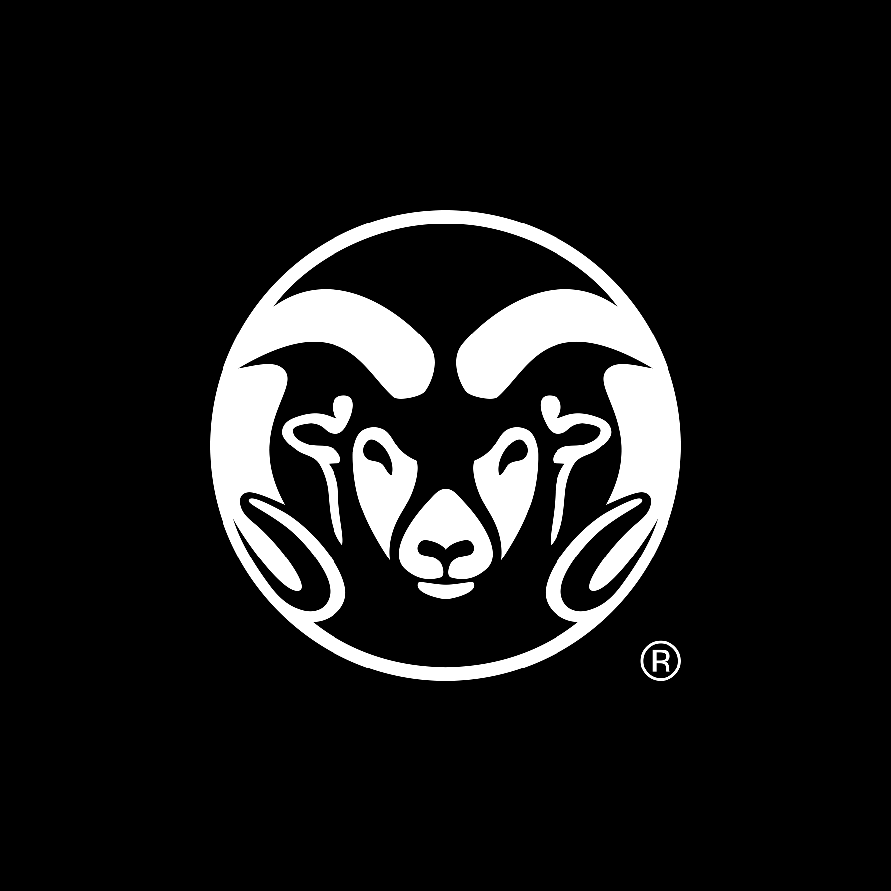
WEEK 4 · WEDNESDAY · 75 MINUTES
Did the Model Get It Right?
Confusion Matrix · False Positives & Negatives · Threshold Trade-offs
CIS 350: AI for Cybersecurity — Smart Defense for the Digital Business
Ramadan Abdunabi, Ph.D. · Computer Information Systems
Notes:
Open with the day's big question: 'We can build models - but did they get it RIGHT? And what kind of mistakes do they make?' This is the most business-relevant lecture yet: every manager must understand false alarms vs missed attacks. Note Exam 1 review is at the end. Reach Part 1 by ~minute 8. ~1 min.

Slide 2

🔁 WARM-UP · 5 MIN
Recap: regression vs classification
With a neighbor, one sentence each:
What does regression predict? What does classification predict?
Give one security example of each.
Why can't we judge a model on its training data?
CIS 350: AI for Cybersecurity · Wednesday
2
Notes:
Reactivate Monday and Week 3. Pairs 2, cold-call 2-3. Expected: regression -> number, classification -> category; risk score vs spam/ham; training-data scores measure memorization. Bridge: 'Today we judge a classifier honestly.' ~5 min.

Slide 3
WEDNESDAY · 75 MINUTES
Today's Plan
🔁
Recap + warm-up
Regression vs classification
6 min
🔢
The confusion matrix
The four outcomes; FP vs FN
18 min
🎯
Beyond accuracy: precision & recall
Why one number isn't enough + diagram
15 min
🎚️
Threshold trade-offs & analyst fatigue
Tuning the alarm + dial diagram
16 min
🧮
Hands-on: confusion matrix + threshold by hand
Build it, tune it
13 min
🎯
Wrap, Exam 1 review & exit
Lab 4 / Quiz 4 + Exam 1
7 min
CIS 350: AI for Cybersecurity · Wednesday
3
Notes:
Preview the plan: warm-up, three content parts, a by-hand task, and wrap - the row minutes add up to exactly 75. Flag that FP vs FN (Part 1) is the single most important business idea of the week. ~1 min.

Slide 4
THIS WEEK'S LEARNING OBJECTIVES
What You'll Be Able to Do
1
Read a confusion matrix and name TP, TN, false positives, and false negatives.
2
Explain why accuracy alone can mislead, especially with class imbalance.
3
Define and contrast precision and recall in plain language.
4
Explain the alert-threshold trade-off and tie it to a business cost.
CIS 350: AI for Cybersecurity · Wednesday
4
Notes:
State Wednesday's four objectives - all prime Exam 1 material. Tell students that by the end they'll be able to look at any classifier's results and say what KIND of mistakes it makes and whether it can be trusted. These are the exact skills Lab 4 and Quiz 4 assess. ~1 min.

Slide 5
PART 1 · FOUR OUTCOMES · ~23 MIN
The Confusion Matrix
Notes:
Transition: 'A single accuracy number hides WHAT KIND of mistakes a model makes. The confusion matrix reveals them.' ~23 minutes, ending with an activity.

Slide 6
RECALL FROM WEEK 3
Accuracy: a Good Start, but Only a Start
Accuracy = percent of predictions that are correct.
Easy to understand and report - but it can hide serious problems.
It treats every mistake as equal, which in security they are NOT.
Missing an attack and raising a false alarm have very different costs.
To see the difference, we break results into four outcomes.
One number is not the whole story.
CIS 350: AI for Cybersecurity · Wednesday
6
Notes:
Start from accuracy (familiar) and expose its blind spot: it lumps all errors together, but in security a missed attack and a false alarm are worlds apart. This motivates the confusion matrix. Recall the Week 2/3 imbalance warning. ~3 min.

Slide 7
THE VOCABULARY
The Four Outcomes of a Prediction
True Positive (TP): flagged spam, and it WAS spam. Correct catch.
True Negative (TN): passed a real email, and it WAS legit. Correct pass.
False Positive (FP): flagged a real email as spam. A FALSE ALARM.
False Negative (FN): let spam through as legit. A MISSED ATTACK.
Every prediction lands in exactly one of these four boxes.
TP, TN, FP, FN.
CIS 350: AI for Cybersecurity · Wednesday
7
Notes:
Define the four outcomes with the spam framing - objective on FP/FN. Emphasize the two error types by name: FALSE ALARM (FP) and MISSED ATTACK (FN). Students must be able to say these in plain English. The plot on the next slide shows them in a grid. ~3 min.

Slide 8
EVERYDAY ANALOGY
An Everyday Analogy: a Medical Test
Think of a medical test for a disease - it can be wrong in two different ways.
False positive: test says 'sick' but you're healthy - a false alarm (needless worry).
False negative: test says 'healthy' but you're sick - a missed case (dangerous).
Spam filters, fraud checks, and phishing detectors face these exact two errors.
Naming the error type immediately tells you its real-world cost.
FP = false alarm; FN = missed case.
CIS 350: AI for Cybersecurity · Wednesday
8
Notes:
Use the medical-test analogy - the most intuitive way to make FP vs FN stick. Everyone grasps that a missed cancer (FN) and a false cancer scare (FP) are both bad but in very different ways. Map it straight back to security: same two errors, different costs. Ask which is worse for a cancer screen (usually FN) to preview that the answer is context-dependent. This primes the confusion-matrix figure next. ~2 min.

Slide 9
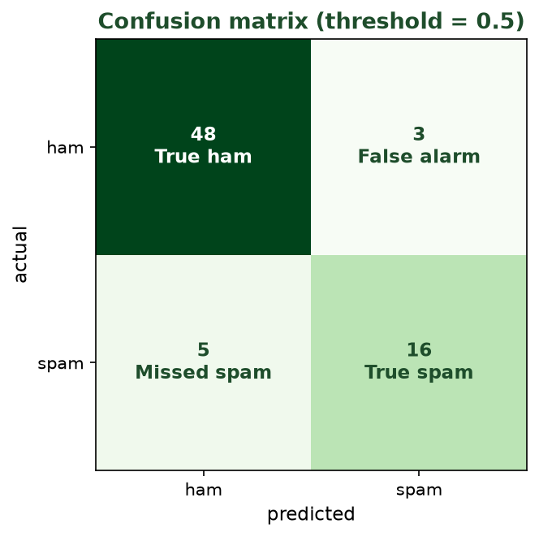
CORRECT PREDICTIONS ON THE DIAGONAL, ERRORS OFF IT
The Confusion Matrix
Rows = actual, columns = predicted. Off-diagonal cells are the two error types: false alarms and missed spam.
CIS 350: AI for Cybersecurity · Wednesday
9
Notes:
Walk the grid: diagonal = correct (true ham, true spam); off-diagonal = the two errors. Point to the false-alarm and missed-spam cells and name their real-world consequences. This is the picture behind every evaluation conversation. ~3 min.

Slide 10
WHY IT MATTERS TO THE BUSINESS
False Positive vs. False Negative - the Cost Question
False alarm (FP): a real, maybe important, email gets quarantined - lost productivity, lost trust.
Missed attack (FN): a phishing email reaches the inbox - possible breach.
Different settings weigh these differently: a hospital vs a marketing team.
There is usually a trade-off: reducing one error tends to increase the other.
Security leaders must decide which mistake they can least afford.
FP vs FN is a business decision.
CIS 350: AI for Cybersecurity · Wednesday
10
Notes:
This is the business heart of the week. Make it concrete: is it worse to quarantine a real invoice (FP) or to let ransomware through (FN)? The answer depends on context. Plant that reducing one error usually raises the other - the trade-off we'll tune in Part 3. ~3 min.

Slide 11
ONE FUNCTION REVEALS THE FOUR CELLS
Confusion Matrix in Code
Python · Google Colab
from sklearn.metrics import confusion_matrix, accuracy_score
preds = model.predict(X_test)
print(accuracy_score(y_test, preds)) # one number
print(confusion_matrix(y_test, preds)) # [[TN, FP],
# [FN, TP]]
You'll run exactly this in Lab 4 to judge the phishing detector.
CIS 350: AI for Cybersecurity · Wednesday
11
Notes:
Show that the confusion matrix is one function call. Explain the standard layout ([[TN, FP],[FN, TP]]) so students can read Lab 4's output. Contrast the single accuracy number with the richer matrix. ~3 min.

Slide 12
🔢 ACTIVITY · 6 MIN
Name that outcome
For each case, name the outcome (TP / TN / FP / FN) and its real-world effect.
The filter flags a phishing email as spam. -> ?
The filter lets a phishing email into the inbox. -> ?
The filter sends your boss's real email to spam. -> ?
The filter delivers a normal newsletter normally. -> ?
CIS 350: AI for Cybersecurity · Wednesday
12
Notes:
Students classify outcomes. Answers: TP (good catch); FN (missed attack - dangerous); FP (false alarm - lost email); TN (correct). Ask which of the two errors is worse here and why. Pairs 3, discuss 3. ~6 min.

Slide 13
PART 2 · BEYOND ACCURACY · ~18 MIN
Precision & Recall
Notes:
Transition: 'Two numbers capture the trade-off accuracy hides: precision and recall.' ~18 minutes with an activity.

Slide 14
THE PROBLEM
Why Accuracy Misleads (Again)
Recall the imbalance trap: if 95% of email is legit, 'always legit' scores 95%.
That model catches ZERO spam - useless, despite high accuracy.
We need measures that focus on the class we care about (spam / attacks).
Enter precision and recall - two simple, powerful ideas.
Accuracy can be high yet useless.
CIS 350: AI for Cybersecurity · Wednesday
14
Notes:
Re-anchor the imbalance trap with a number so precision/recall feel necessary, not academic. A 'do-nothing' model can look great on accuracy while missing every attack. ~3 min.

Slide 15
TWO QUESTIONS
Precision and Recall, in Plain English
PRECISION: of the emails we FLAGGED as spam, how many really were? (few false alarms)
RECALL: of the emails that REALLY were spam, how many did we catch? (few misses)
High precision = we rarely cry wolf. High recall = we rarely miss.
There's tension: cranking up one often lowers the other.
Pick which to favor based on the cost of each error.
Precision = of flagged, right? Recall = of real, caught?
CIS 350: AI for Cybersecurity · Wednesday
15
Notes:
Define both with the 'of the... how many...' phrasing that sticks. Precision watches false alarms; recall watches misses. Give the mnemonic: precision = trust the alarms; recall = catch the threats. Note the tension, which the plot shows next. ~3 min.

Slide 16
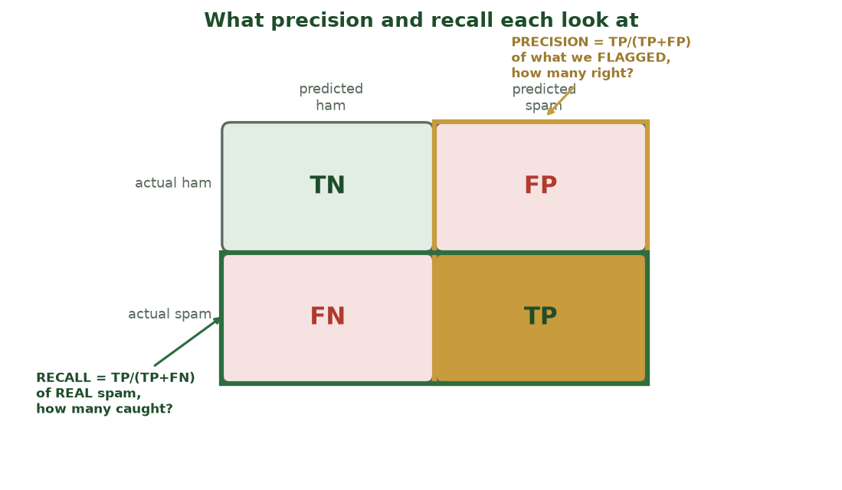
SAME MATRIX, TWO DIFFERENT VIEWS
What Precision and Recall Each Look At
Precision divides the 'predicted spam' COLUMN (of what we flagged, how many right?); recall divides the 'actual spam' ROW (of real spam, how many caught?).
CIS 350: AI for Cybersecurity · Wednesday
16
Notes:
Anchor precision and recall to the confusion matrix cells. The amber box = the predicted-spam column (precision = TP/(TP+FP)); the green box = the actual-spam row (recall = TP/(TP+FN)). They share the TP corner but divide by different totals - that's why they can move in opposite directions. ~2 min.

Slide 17
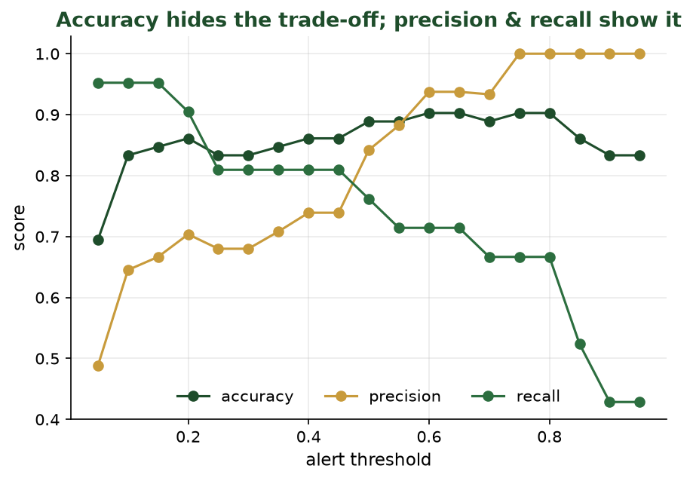
AS THE THRESHOLD CHANGES
Accuracy Hides It; Precision & Recall Show It
Accuracy looks flat and comfortable, while precision and recall move in opposite directions - the real trade-off.
CIS 350: AI for Cybersecurity · Wednesday
17
Notes:
The key evaluation plot. Point out accuracy barely moves while precision and recall diverge - proving accuracy hides the trade-off. As we demand more confidence before flagging, precision rises but recall falls. This directly sets up thresholds in Part 3. ~3 min.

Slide 18
TWO MORE ONE-LINE METRICS
Precision & Recall in Code
Python · Google Colab
from sklearn.metrics import precision_score, recall_score
precision_score(y_test, preds, pos_label='spam') # of flagged, how many right
recall_score(y_test, preds, pos_label='spam') # of real spam, how many caught
Lab 4 asks you to compute and compare these for the URL detector.
CIS 350: AI for Cybersecurity · Wednesday
18
Notes:
Show precision/recall are as easy to compute as accuracy. Note pos_label picks the class we care about (spam). Students will report these in Lab 4. ~3 min.

Slide 19
🎯 ACTIVITY · 6 MIN
Precision or recall?
For each system, decide whether you'd favor high precision or high recall - and why.
Airport threat scanner (missing a real threat is catastrophic).
Spam filter for a CEO's inbox (losing a real email is very costly).
Malware quarantine on a hospital network.
A marketing team's promotions folder.
CIS 350: AI for Cybersecurity · Wednesday
19
Notes:
Students reason about the trade-off. Guidance: threat scanner -> recall (never miss); CEO inbox -> precision (don't lose real mail); hospital malware -> recall (don't miss); marketing folder -> either, low stakes. The point: the RIGHT metric depends on which error is worse. Pairs 3, discuss 3. ~6 min.

Slide 20
PART 3 · TUNING THE ALARM · ~19 MIN
Threshold Trade-offs & Analyst Fatigue
Notes:
Transition: 'Most classifiers output a probability - and WE choose the cutoff. That one knob controls the FP/FN balance.' ~19 minutes with an activity.

Slide 21
THE ONE KNOB
The Threshold Is a Dial You Control
Most classifiers output a probability (e.g., 'this email is 0.82 likely spam').
We pick a threshold: flag as spam if the probability is above the cutoff.
Lower threshold = flag more -> catch more spam (higher recall) but more false alarms.
Higher threshold = flag less -> fewer false alarms (higher precision) but miss more.
The threshold is a business decision, not just a technical one.
Lower = catch more + more false alarms.
CIS 350: AI for Cybersecurity · Wednesday
21
Notes:
Reveal the threshold as the control that ties everything together. It's not baked in - you choose it. Walk both directions (lower vs higher) and their effects on the two errors. Emphasize it's a policy choice reflecting which error is costlier. ~3 min.

Slide 22
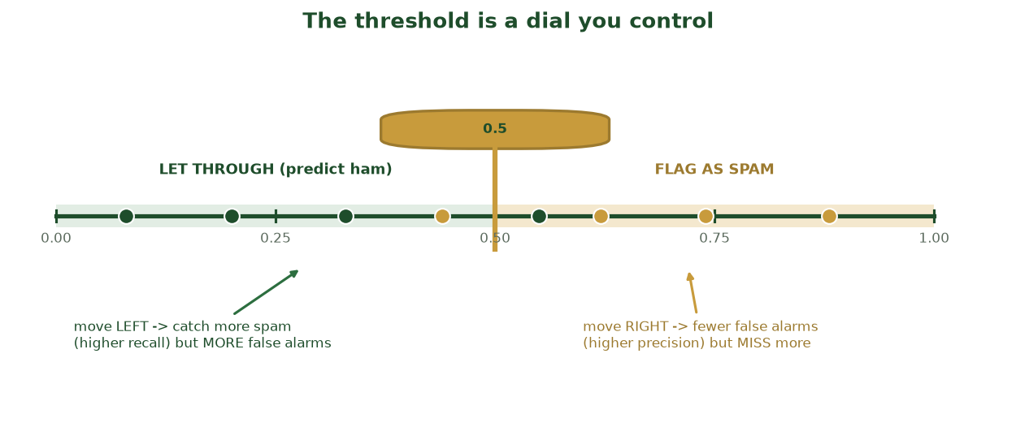
SLIDE IT TO TRADE MISSES VS. FALSE ALARMS
The Threshold Is a Dial You Control
Everything left of the cutoff is let through; everything right is flagged. Sliding left catches more spam (higher recall); sliding right cuts false alarms (higher precision).
CIS 350: AI for Cybersecurity · Wednesday
22
Notes:
Make the threshold a literal dial. Point at the dots crossing the cutoff as you 'slide' it: move left -> catch more spam but more false alarms; move right -> fewer false alarms but miss more. It's a policy choice about which error costs more. Sets up the by-hand tuning task. ~2 min.

Slide 23
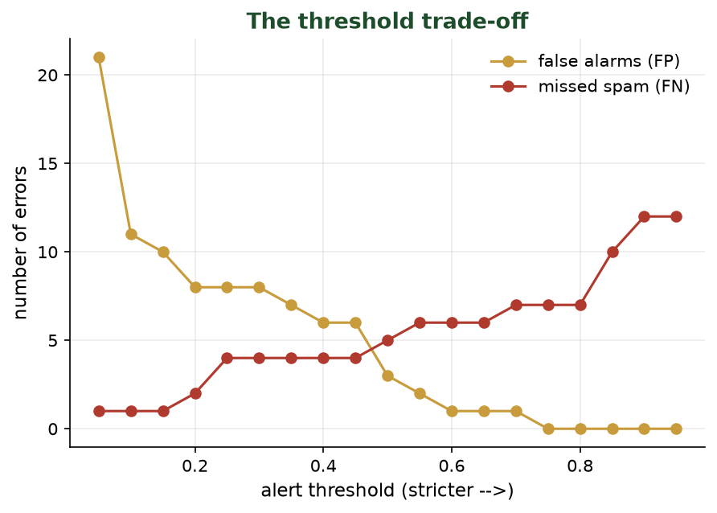
STRICTER ALERTS: FEWER FALSE ALARMS, MORE MISSES
The Threshold Trade-off
As the threshold gets stricter, false alarms (FP) fall but missed spam (FN) rises. You cannot minimize both at once.
CIS 350: AI for Cybersecurity · Wednesday
23
Notes:
The trade-off in one picture. Trace it: moving the threshold right cuts false alarms but lets more spam through. There's no free lunch - you choose where to sit based on costs. This is exactly the slider students adjust in Lab 4. ~4 min.

Slide 24
A REAL OPERATIONAL PROBLEM
Analyst Fatigue: When Alerts Cry Wolf
Set the threshold too low and analysts drown in false alarms.
Overwhelmed teams start ignoring alerts - including the real ones.
This 'alert fatigue' is a top reason real breaches get missed.
The fix isn't just a better model - it's a well-chosen threshold and good triage.
AI helps by ranking alerts so humans focus on the riskiest first (Week 4 regression!).
Too many false alarms -> real ones ignored.
CIS 350: AI for Cybersecurity · Wednesday
24
Notes:
Connect metrics to human reality - a favorite of security managers. Too many false alarms cause alert fatigue, and fatigued analysts miss real attacks (recall Week 1). Tie back to Monday: a risk SCORE (regression) can rank alerts so the worst rise to the top. ~3 min.

Slide 25
USE PROBABILITIES, NOT JUST LABELS
Adjusting the Threshold in Code
Python · Google Colab
prob = model.predict_proba(X_test)[:, 1] # probability of 'spam'
preds_default = (prob >= 0.5) # standard cutoff
preds_strict = (prob >= 0.8) # stricter: fewer false alarms, more misses
preds_loose = (prob >= 0.3) # looser: catch more, more false alarms
In Lab 4 you'll slide this cutoff and watch the confusion matrix change.
CIS 350: AI for Cybersecurity · Wednesday
25
Notes:
Show that changing the threshold is trivial in code - it's just comparing probabilities to a cutoff. Students will sweep this in Lab 4 and watch FP/FN move. Reinforce predict_proba gives the probability behind the label. ~3 min.

Slide 26
🎚️ ACTIVITY · 6 MIN
Set the threshold
You run the spam filter for a hospital. Attacks are dangerous; a lost email is annoying but survivable.
Would you set a lower or higher threshold? Why?
Which error are you choosing to accept more of?
What else (besides the model) could reduce the downside?
CIS 350: AI for Cybersecurity · Wednesday
26
Notes:
Students make a real policy call. Reasonable answer: lower threshold to raise recall (don't miss attacks), accepting more false alarms; mitigate the downside with triage, a quarantine folder, and user training. Reinforce that context drives the choice. Pairs 3, discuss 3. ~6 min.

Slide 27
🧮 IN-CLASS TASK · 13 MIN
Build the Confusion Matrix and Tune the Threshold by Hand
You run the phishing filter for a hospital. Your worksheet lists 10 emails, each with the model's spam probability (0-1) and its true label. Turn probabilities into decisions at two thresholds and compare.
At threshold 0.5, label each email spam if probability >= 0.5, else ham.
Tally all 10 into a 2x2 confusion matrix (TP, TN, FP, FN); compute accuracy, precision, recall.
Repeat at threshold 0.8; note which counts moved and how precision & recall changed.
Recommend a threshold for the hospital and name which error (false alarm or missed attack) you accept more of.
Deliverable: two confusion matrices, the three metrics at each threshold, and a one-sentence recommendation.
CIS 350: AI for Cybersecurity · Wednesday
27
Notes:
Walk the tallies on the board. Going 0.5 -> 0.8 flips borderline spam to 'ham': FP drops (precision rises), FN rises (recall falls), accuracy barely moves (it hides the trade-off). For a hospital the costly error is a MISSED attack (FN), so favor RECALL with the looser threshold and accept more false alarms, mitigated by a quarantine folder. This is the by-hand version of the Lab 4 slider. ~13 min.

Slide 28
USE THESE SLIDES AS YOUR STUDY GUIDE
How Today Connects to Lab 4 & Quiz 4
💻 In Lab 4 you will...
📝 Quiz 4 will ask you to...
Compute accuracy AND a confusion matrix for a phishing detector.
Report precision and recall, not just accuracy.
Slide the alert threshold and watch false alarms vs misses change.
Recommend a threshold for a given business context.
Read a confusion matrix and name TP/TN/FP/FN.
Define false positive and false negative in a security scenario.
Explain why accuracy alone can mislead.
Reason about a precision/recall or threshold trade-off.
CIS 350: AI for Cybersecurity · Wednesday
28
Notes:
Connect Wednesday to the assessments. Left = Lab 4 tasks (each shown today); right = Quiz 4 question types. Tell students these slides ARE the study guide for both, and that Exam 1 (Weeks 1-4) draws heavily on this evaluation vocabulary. ~2 min.

Slide 29
Key Takeaways
✓
A confusion matrix splits results into TP, TN, and the two errors: FP (false alarm) and FN (missed attack).
✓
Accuracy can mislead; precision (of flagged, how many right) and recall (of real, how many caught) show the trade-off.
✓
The alert threshold is a dial: stricter = fewer false alarms but more misses.
✓
Choosing the threshold is a business decision about which error you can least afford (and avoiding alert fatigue).
Notes:
Recap the four points slowly - this vocabulary is the backbone of Exam 1. Cold-call two students: 'Define false positive and false negative for a spam filter' and 'which error is worse for a hospital, and why?' Listen for whether they tie each error to a real cost, not just the definition. Remind them the confusion matrix, precision/recall, and the threshold dial all describe the SAME underlying FP/FN trade-off from different angles. ~2 min.

Slide 30
LOOKING AHEAD
Exam 1 Review & What's Next
📝 Exam 1 (covers Weeks 1-4) is coming - see the schedule for the exact date.
Review: CIA triad & threats (Wk1), data/features/labels (Wk2), supervised learning (Wk3), evaluation (Wk4).
💻 Finish Lab 4 ('Judging a Phishing URL Detector') - due Monday of Week 5.
✅ Complete Quiz 4 on Canvas; 📖 review Handout 4.
Bring questions to the Exam 1 review session.
Exam 1 covers Weeks 1-4; point to the review session.
CIS 350: AI for Cybersecurity · Wednesday
30
Notes:
Frame Week 4 as the capstone of the first month and orient students for Exam 1 (Weeks 1-4). Give a one-line map of what each week contributed. Assign Lab 4 and Quiz 4, and invite exam questions. ~1 min.

Slide 31
🎟️ EXIT TICKET · 2 MIN
One minute before you go
On the Canvas exit-ticket quiz or a card:
In one sentence each, define a false positive and a false negative.
Which error is worse for the system you'd most like to protect, and why?
One topic you want reviewed before Exam 1.
CIS 350: AI for Cybersecurity · Wednesday
31
Notes:
Close with the exit ticket. The FP/FN definitions are a quick formative check that the week's core vocabulary landed - if many are shaky, budget a few minutes at the start of the Exam 1 review. The 'which error is worse and why' answers reveal whether students can reason about cost, not just recite terms. Tally the 'one topic to review' responses and let them shape the review session's agenda. ~2 min.

