Slide 1

WEEK 4 · MONDAY · 75 MINUTES
Regression: Predicting a Number
Regression vs Classification · Scoring How Risky a Login Looks
CIS 350: AI for Cybersecurity — Smart Defense for the Digital Business
Ramadan Abdunabi, Ph.D. · Computer Information Systems
Notes:
Open by connecting to Week 3: 'Last week we predicted a CATEGORY - spam or ham. This week we predict a NUMBER - like how risky a login looks - and then learn how to judge whether any model is actually any good.' Keep the no-math reassurance; there's code on the slides but you'll walk every line. Note Exam 1 (Weeks 1-4) is coming, so this week ties the first month together. Reach Part 1 by ~minute 8. ~1 min.

Slide 2

🔁 WARM-UP · 5 MIN
Recap: supervised learning
With a neighbor, one sentence each:
What is classification? Give a security example.
What are features and a label?
Why do we keep a separate test set?
CIS 350: AI for Cybersecurity · Monday
2
Notes:
Retrieval of Week 3 essentials, which regression builds on. Pairs 2 min, cold-call 2-3. Expected: classification predicts a category (spam/ham); features = input clues, label = the answer; the test set gives an honest score on unseen data. Bridge: 'Today the answer is a number instead of a category.' ~5 min.

Slide 3
MONDAY · 75 MINUTES
Today's Plan
🔁
Recap + warm-up
Week 3 supervised learning
6 min
📈
Regression intuition
Predicting a number, not a category + diagram
18 min
↔️
Classification vs regression
When to use which + diagram
14 min
🧪
Demo: scoring login risk
Data, code, and evaluating a regressor
18 min
🧮
Hands-on: hand-score five logins
Be the regression model
12 min
🎯
Wrap-up & exit
Lab 4 / Quiz 4 + takeaways
7 min
CIS 350: AI for Cybersecurity · Monday
3
Notes:
Walk the plan: warm-up, three content parts, a hands-on scoring task, and wrap - the row minutes add up to exactly 75. Flag Part 3 as a hands-on demo with real data and code (a preview of Lab 4). ~1 min.

Slide 4
THIS WEEK'S LEARNING OBJECTIVES
What You'll Be Able to Do
1
Explain regression as predicting a number instead of a category.
2
Contrast regression with classification and match each to security tasks.
3
Read how well a regression model predicts (predicted vs. actual).
4
Set up the evaluation ideas we'll deepen on Wednesday (accuracy, errors).
CIS 350: AI for Cybersecurity · Monday
4
Notes:
Read the four objectives aloud; each maps directly to a Quiz 4 question type and to a Lab 4 step, so tell students these ARE the study targets. Objective 1 is today's core idea (number vs category); objectives 2-3 are the hands-on skills they'll practice in the demo and lab; objective 4 is the bridge to Wednesday's evaluation deep-dive and to Exam 1. Keep it brief - you'll return to each as you go. ~1 min.

Slide 5
PART 1 · A NUMBER, NOT A CATEGORY · ~20 MIN
Regression Intuition
Notes:
Transition: 'Classification answers which-category; regression answers how-much or how-many.' ~20 minutes, ending with a quick activity.

Slide 6
DEFINITION
Regression = Predicting a Number
Classification predicts a category (spam / ham). Regression predicts a NUMBER.
Examples: a risk score (0-100), expected dollar loss, days until a patch is needed.
The model learns a relationship between features and a numeric target.
Same supervised setup as Week 3 - labeled examples - but the label is now a number.
Today's running example: score how risky a login attempt looks.
Category -> classification; number -> regression.
CIS 350: AI for Cybersecurity · Monday
6
Notes:
Define regression plainly - objective 1. The ONLY change from Week 3 is the label type: a number instead of a category. Give three security examples (risk score, expected loss, time-to-patch) so it generalizes. Introduce the login-risk example you'll build in Part 3. ~3 min.

Slide 7
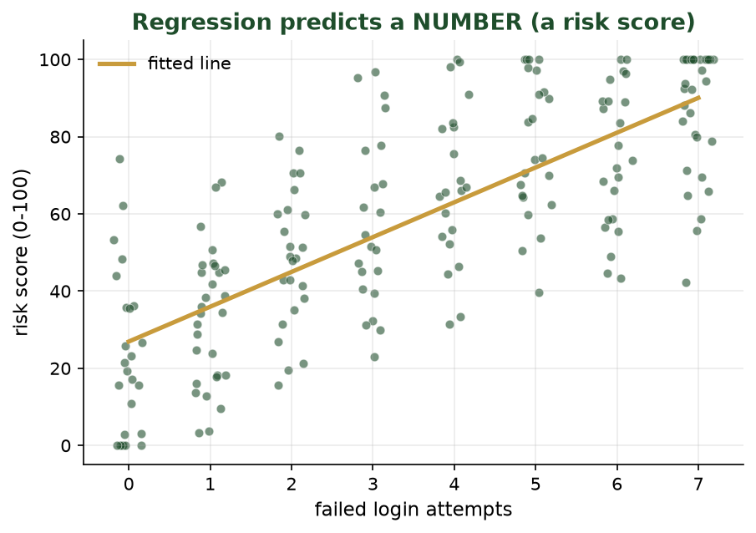
A FITTED LINE THROUGH THE DATA
Regression Predicts a Number
More failed logins -> higher risk score. Regression fits a line (or curve) and reads a NUMBER off it.
CIS 350: AI for Cybersecurity · Monday
7
Notes:
Use the scatter to make regression visual. Each dot is a login; the gold line is the model's learned relationship. For a new login you read the predicted risk NUMBER off the line. Contrast with Week 3's class regions: here the output is continuous, not a category. ~3 min.

Slide 8
WHY IT MATTERS
Where Regression Shows Up in Security
Risk scoring: how suspicious is this login, transaction, or file? (0-100)
Expected loss: how many dollars might this incident cost?
Time-to-event: how long until this system likely needs patching?
Volume forecasting: how many alerts should we expect next hour?
A number lets you RANK and PRIORITIZE - not just label yes/no.
Numbers let you rank and prioritize.
CIS 350: AI for Cybersecurity · Monday
8
Notes:
Motivate regression for business/security: numbers enable ranking and prioritization, which yes/no labels can't. A risk SCORE lets an analyst work the top 10 riskiest logins first. Tie to Week 1's risk idea (threat x vulnerability x impact) - regression can estimate that impact number. ~3 min.

Slide 9
THE IDEA
How Regression Works (No Math)
It finds the line/curve that best fits the labeled examples.
'Best fit' = the line that makes the prediction errors as small as possible.
For a new example, plug in its features and read the predicted number.
More or better features usually means better predictions.
Same guess-check-adjust training loop from Week 2 - just aiming at a number.
Fit the best line; read off the prediction.
CIS 350: AI for Cybersecurity · Monday
9
Notes:
Explain fitting without equations: the model draws the line that minimizes the gap between predictions and actual values (errors). Reuse the guess-check-adjust framing from Week 2. Keep it conceptual; the code comes in Part 3. ~3 min.

Slide 10
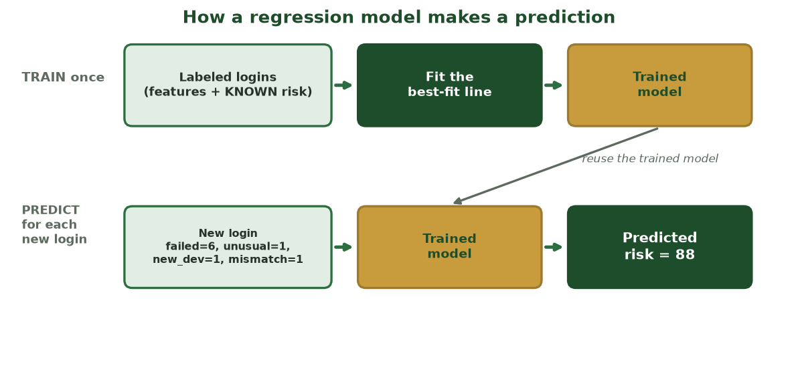
TRAIN ONCE, THEN PREDICT PER LOGIN
How a Regression Model Makes a Prediction
Labeled logins train a best-fit model; a brand-new login's features flow through that SAME model to get a risk number.
CIS 350: AI for Cybersecurity · Monday
10
Notes:
Make the two phases concrete: top row trains the model on logins with KNOWN risk; bottom row reuses that trained model to score a new login (risk = 88). Same create->fit->predict pattern as Week 3, but the output is a NUMBER. Sets up the demo. ~2 min.

Slide 11
EVERYDAY ANALOGY
Regression in Everyday Life
You already do regression in your head every day.
Predicting a house's price from its size, location, and age.
Guessing your final grade from your scores so far.
Estimating drive time from distance and traffic.
Each time you predict a NUMBER from some clues (features).
You already estimate numbers from clues.
CIS 350: AI for Cybersecurity · Monday
11
Notes:
Ground regression in familiar experience before the security specifics - a UDL-friendly analogy. Ask students to name a number they 'predicted' recently (arrival time, a tip, a grade). Each is regression: features in, a number out. This makes the risk-score example feel natural, not technical. Watch for the misconception that regression must involve a straight line - it just means predicting a number. ~2 min.

Slide 12
📈 ACTIVITY · 6 MIN
Number or category?
For each task, decide: regression (a number) or classification (a category)?
Is this email spam or not? -> ?
How risky is this login, from 0 to 100? -> ?
Which malware family is this file? -> ?
How many dollars might this breach cost? -> ?
CIS 350: AI for Cybersecurity · Monday
12
Notes:
Students sort tasks by output type. Answers: classification; regression; classification; regression. The tell: is the answer a category or a number? Pairs 3, discuss 3. ~6 min.

Slide 13
PART 2 · TWO TOOLS · ~16 MIN
Classification vs Regression
Notes:
Transition: 'Now let's put the two side by side and learn when to reach for each.' ~16 minutes with an activity.

Slide 14
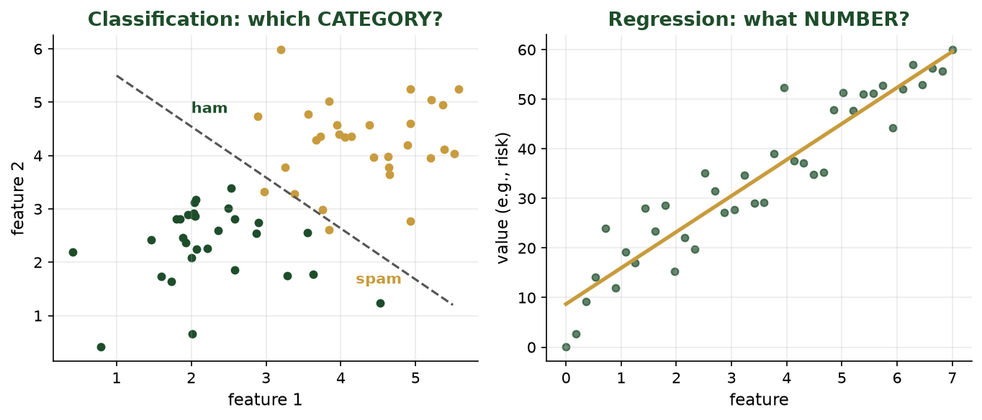
CATEGORY VS NUMBER, SIDE BY SIDE
Two Questions, Two Tools
Left: classification draws a boundary between categories. Right: regression fits a line to predict a value.
CIS 350: AI for Cybersecurity · Monday
14
Notes:
Contrast the two visually. Left panel: classification carves the space into categories (a boundary). Right panel: regression fits a trend to predict a continuous value. Same labeled-data setup; different question and different output. ~3 min.

Slide 15
MATCH THE TOOL TO THE QUESTION
When to Use Which
🏷️ Classification
📈 Regression
Answer is a category / class.
'Is this spam?' 'Fraud or not?'
Judged with accuracy, precision, recall.
Output: a label (often with a probability).
Answer is a number on a scale.
'How risky?' 'How much loss?'
Judged with error size and R-squared.
Output: a number you can rank by.
CIS 350: AI for Cybersecurity · Monday
15
Notes:
Give a crisp decision rule: if you can list the possible answers as categories, it's classification; if the answer is a quantity on a scale, it's regression. Preview that each is judged differently (accuracy/precision/recall vs error/R-squared) - Wednesday deepens classification metrics. ~3 min.

Slide 16
WORKED EXAMPLE
Same Login, Two Different Questions
Take one suspicious login. We can ask it two different questions.
CLASSIFICATION: 'Is this login malicious - yes or no?' -> a category.
REGRESSION: 'How risky is this login, 0 to 100?' -> a number.
The category triggers a yes/no action (block or allow).
The number lets you RANK many logins and work the riskiest first.
Same data, two questions: label vs score.
CIS 350: AI for Cybersecurity · Monday
16
Notes:
Cement the distinction with ONE concrete security example seen both ways. The same login can be classified (malicious? yes/no) or scored (risk 0-100). Emphasize the practical payoff: a score lets an analyst triage and rank a flood of alerts, while a label triggers a fixed action. Point out that many real systems use BOTH - produce a score, then apply a threshold to decide the action. That threshold idea is exactly what Wednesday is about, so plant the seed here. ~4 min.

Slide 17
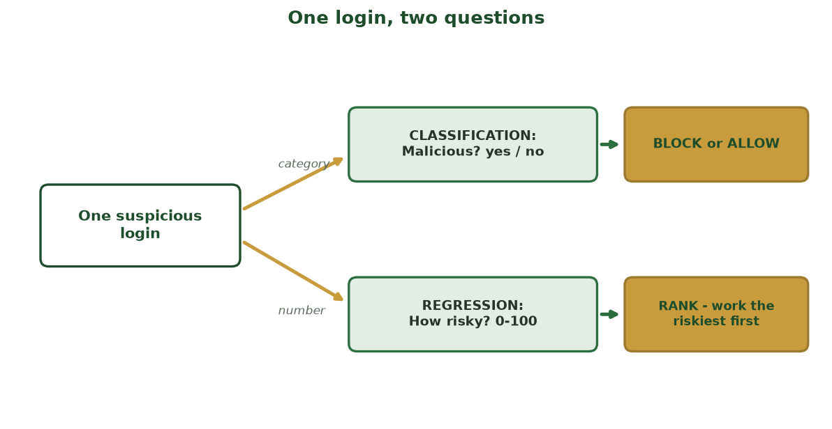
CATEGORY VS. NUMBER -> DIFFERENT ACTIONS
One Login, Two Questions
Classification asks 'malicious? yes/no' -> block or allow; regression asks 'how risky, 0-100?' -> rank and triage.
CIS 350: AI for Cybersecurity · Monday
17
Notes:
Show the fork visually: the SAME login yields a category (block/allow) or a number (rank the riskiest first). This is the practical payoff - a score lets an analyst triage a flood of alerts. Note real systems often produce a score, then apply a threshold (Wednesday). ~2 min.

Slide 18
↔️ ACTIVITY · 6 MIN
Pick the right tool
For each security need, choose classification or regression - and name one feature you'd use.
Flag transactions as fraud / not fraud.
Estimate how many days until a server must be patched.
Rank logins by how suspicious they are.
Decide if a file is malware or safe.
CIS 350: AI for Cybersecurity · Monday
18
Notes:
Students choose and justify. Answers: classification; regression; regression (ranking by a score); classification. Push them to name a sensible feature for each (amount/location; software age; failed logins; file behavior). Pairs 3, discuss 3. ~6 min.

Slide 19
PART 3 · HANDS-ON · ~24 MIN
Demo: Scoring How Risky a Login Looks
Notes:
Transition: 'Let's build a regression model that scores login risk - the same tools as Lab 4.' ~24 minutes with data, code, and an evaluation plot. Run it live in Colab if you can.

Slide 20
EACH ROW IS ONE LOGIN; THE TARGET IS A NUMBER
Our Login-Risk Dataset
failed | unusual_hr | new_device | country_mismatch | risk
0 | 0 | 0 | 0 | 4
5 | 1 | 0 | 0 | 58
2 | 0 | 1 | 0 | 41
6 | 1 | 1 | 1 | 97
1 | 0 | 0 | 0 | 12
3 | 0 | 0 | 1 | 44
Four features and a numeric target (risk 0-100) - the label is a number, so this is regression.
CIS 350: AI for Cybersecurity · Monday
20
Notes:
Show the data so 'numeric label' is concrete. Point at the gold 'risk' column - it's a number, not a category, which is what makes this regression. Read one row aloud (row 4: many risk factors -> risk 97). This mirrors the Lab 4 dataset. ~3 min.

Slide 21
SAME X/Y IDEA, NUMERIC TARGET
Load Data: Features (X) and a Numeric Label (y)
Python · Google Colab
import pandas as pd
df = pd.read_csv('logins.csv')
X = df[['failed_logins', 'unusual_hour',
'new_device', 'country_mismatch']] # features
y = df['risk_score'] # a NUMBER (0-100)
Identical setup to Week 3 - only the label is numeric now.
CIS 350: AI for Cybersecurity · Monday
21
Notes:
Reinforce continuity: X/y exactly like Week 3, but y is a number. Read each line plainly. This is the opening of the Lab 4 notebook. ~3 min.

Slide 22
CREATE -> FIT -> PREDICT, SAME AS ALWAYS
Train a Regression Model
Python · Google Colab
from sklearn.linear_model import LinearRegression
from sklearn.model_selection import train_test_split
X_train, X_test, y_train, y_test = train_test_split(
X, y, test_size=0.2, random_state=1)
model = LinearRegression().fit(X_train, y_train) # train
model.predict([[6, 1, 1, 1]]) # a very risky login -> ~ high score
Same workflow as the classifier - just a different model class.
CIS 350: AI for Cybersecurity · Monday
22
Notes:
Emphasize the unified scikit-learn pattern: create -> fit -> predict, identical to Week 3's tree/kNN - only the model class changed (LinearRegression). The prediction is a number. Students swap models by changing one line. ~4 min.

Slide 23
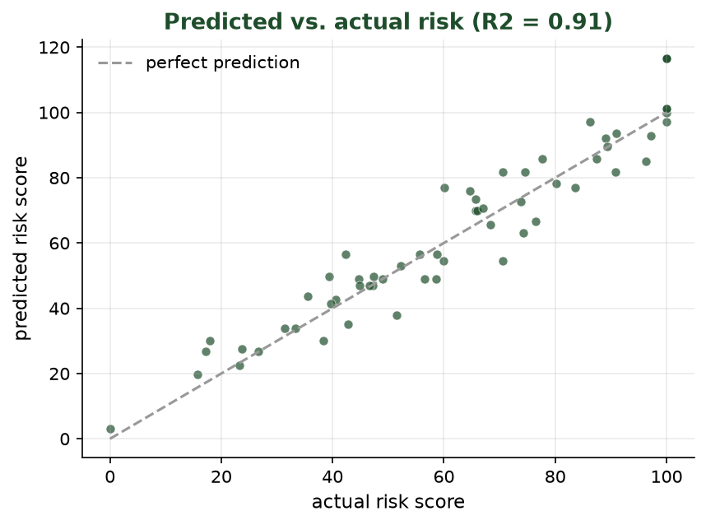
PREDICTED VS. ACTUAL RISK
How Good Are the Predictions?
Dots near the dashed line = good predictions. R-squared summarizes how much of the variation the model captures (1.0 = perfect).
CIS 350: AI for Cybersecurity · Monday
23
Notes:
Introduce evaluating a REGRESSOR: plot predicted vs actual; points hugging the diagonal = accurate. R-squared (0 to 1) is a one-number summary of fit quality - higher is better. This is the regression counterpart to classification accuracy, and previews Wednesday's evaluation theme. ~4 min.

Slide 24
JUDGING A REGRESSOR
Reading Regression Quality (Plain Language)
Error = how far predictions land from the truth (smaller is better).
R-squared: 1.0 = perfect, 0 = no better than guessing the average.
A risk model doesn't need to be perfect - it needs to RANK logins usefully.
Always sanity-check: are the biggest predicted risks actually the riskiest?
Wednesday: how we judge CLASSIFIERS - accuracy, confusion matrix, precision, recall.
Small error + useful ranking = good enough.
CIS 350: AI for Cybersecurity · Monday
24
Notes:
Give students plain criteria for a regressor: small error, decent R-squared, and - crucially - useful ranking. A risk score that reliably puts the worst logins on top is valuable even if imperfect. End by teeing up Wednesday's classifier evaluation. ~4 min.

Slide 25
🧪 ACTIVITY · 6 MIN
Would you trust this risk model?
A login-risk model gives a new login a score of 88 / 100.
What would you want to know before acting on that 88?
Which one feature likely pushed the score up?
How could you check the model ranks risky logins above safe ones?
CIS 350: AI for Cybersecurity · Monday
25
Notes:
Students think like analysts. Good answers: ask about error/R-squared and what 'high' means; a factor like country_mismatch or new_device likely drove it; check by sorting predictions and eyeballing the top vs bottom. Pairs 3, discuss 3. ~6 min.

Slide 26
🧮 IN-CLASS TASK · 12 MIN
Hand-Score Five Logins (Be the Regression Model)
You are the analyst standing in for the model. Using a points table - failed x8, unusual_hour x18, new_device x22, country_mismatch x25 - score five NEW logins, rank them, then check against the model's 'actual risk' column.
For each login, multiply each feature by its points and add them up; cap the total at 100 = your predicted risk.
Write each predicted score in the 'your score' column.
Rank the five logins high-to-low = your investigation queue (1 = first).
Compare to the 'actual risk' column; write the error (your score - actual) for each.
Deliverable: 5 predicted scores, a 1-5 ranking, the errors, and one sentence: did your ranking match the model's?
CIS 350: AI for Cybersecurity · Monday
26
Notes:
Model the example failed=6/unusual=1/new=1/mismatch=1 -> 8*6+18+22+25 = 113 -> capped at 100 (clearly #1); a quiet 1/0/0/0 -> 8 (last). Debrief: individual scores land a few points off 'actual' (the real model has noise), yet the RANKING is almost always identical - a risk score need not be exact to be useful, it just needs to sort the worst to the top. This is the by-hand version of Lab 4. ~12 min.

Slide 27
USE THESE SLIDES AS YOUR STUDY GUIDE
How Today Connects to Lab 4 & Quiz 4
💻 In Lab 4 you will...
📝 Quiz 4 will ask you to...
Load a login/URL dataset and separate features from a target.
Train and use a model, then read predictions.
Judge quality with predicted-vs-actual and simple metrics.
Connect a numeric score to a real security decision.
Tell regression from classification for a given task.
Explain what a risk score buys you (ranking).
Interpret predicted-vs-actual and R-squared at a basic level.
Set up the accuracy / confusion-matrix ideas from Wednesday.
CIS 350: AI for Cybersecurity · Monday
27
Notes:
Tie the lecture to the assessments. Left = Lab 4 steps (each shown as code/plot today); right = Quiz 4 question types (each maps to an objective). Tell students to keep these slides open during the lab and re-read before the quiz. ~2 min.

Slide 28
Key Takeaways
✓
Regression predicts a NUMBER; classification predicts a category - same labeled-data setup.
✓
Numbers (risk scores, expected loss) let you rank and prioritize, not just label yes/no.
✓
The scikit-learn workflow is identical: create -> fit -> predict; only the model changes.
✓
Judge a regressor by its error and R-squared - and by whether its ranking is useful.
Notes:
Recap one point per objective, pausing on each so it lands. Cold-call two students: 'Give me a security task that's regression, and one that's classification' - and have them name the tell (number vs category). If they hesitate, that signals what to revisit Wednesday. Reassure them the scikit-learn workflow they saw is the SAME one they'll use all semester - only the model class changes. ~2 min.

Slide 29
LOOKING AHEAD
Before Wednesday
💻 Lab 4 - 'Judging a Phishing URL Detector' is released (evaluate a model, adjust its threshold).
📝 Quiz 4 is Wednesday (regression vs classification; confusion matrix; false positives).
📖 Read Handout 4: Regression and Model Metrics.
📊 Wednesday: did the model get it right? Confusion matrix, precision/recall, and Exam 1 review.
Assign Lab 4, Quiz 4, Handout 4; note Exam 1 is near.
CIS 350: AI for Cybersecurity · Monday
29
Notes:
Assign and preview. Wednesday shifts from building models to JUDGING them, and includes Exam 1 review (Exam 1 covers Weeks 1-4). Remind them Lab 4 is about evaluation, matching Wednesday. ~1-2 min.

Slide 30
🎟️ EXIT TICKET · 2 MIN
One minute before you go
In the Canvas exit-ticket quiz or on a card:
In one sentence, how is regression different from classification?
Name one security task that calls for a risk SCORE.
One thing you'd like more explanation on.
CIS 350: AI for Cybersecurity · Monday
30
Notes:
Close with the exit ticket - a 60-second formative check and an attendance signal. Scan the regression-vs-classification answers before Wednesday: if many blur the two, open Wednesday with a 30-second re-cap. The 'name a task needing a risk score' answers tell you whether the ranking payoff landed, and the 'more explanation on' responses surface muddy points to address next class. ~2 min.

