Slide 1

WEEK 3 · WEDNESDAY · 75 MINUTES
Two Classifiers Up Close
Decision Trees · k-Nearest Neighbors · Live Spam-Classifier Demo
CIS 350: AI for Cybersecurity — Smart Defense for the Digital Business
Ramadan Abdunabi, Ph.D. · Computer Information Systems
Notes:
Open with energy: 'Monday we learned HOW supervised learning works. Today we meet two friendly classifiers and watch one get trained live - the exact code you'll run in Lab 3.' Both classifiers are visual and intuitive; promise no math. Have the Colab notebook open in the background if you can. Reach Part 1 by ~minute 6.

Slide 2

🔁 WARM-UP · 5 MIN
Recap: supervised learning & train/test
With a neighbor, one sentence each:
What is supervised learning?
Why do we keep a separate test set?
What is overfitting?
CIS 350: AI for Cybersecurity · Wednesday
2
Notes:
Quick retrieval of Monday's core. Pairs 2, cold-call 2-3. Expected: learning a features-to-label pattern from labeled examples; to measure performance honestly on unseen data; memorizing training data so it fails on new data. Bridge: 'Now let's see two ways a model actually makes the decision.' ~5 min.

Slide 3
WEDNESDAY · 75 MINUTES
Today's Plan
🌳
Decision trees
A flowchart learned from data + split diagram
20 min
👥
k-Nearest Neighbors
You are what your neighbors are
17 min
💻
Live demo: train a spam classifier
Step by step in Colab
18 min
🥊
Hands-on: classifier bake-off (tree vs k-NN)
Run both on the same emails
12 min
🔁
Recap + warm-up
Supervised learning, train/test
4 min
🎯
Wrap-up & exit
Lab 3 / Quiz 3 + takeaways
4 min
CIS 350: AI for Cybersecurity · Wednesday
3
Notes:
Preview the two classifiers and the live demo. Tell students both are beginner-friendly, each has a code example, and the demo is exactly Lab 3. ~1 min.

Slide 4
PART 1 · A FLOWCHART FROM DATA · ~22 MIN
Decision Trees
Notes:
Transition: 'Our first classifier is the most intuitive - a flowchart the computer learns.' ~22 minutes, ending with a hands-on tree-building activity.

Slide 5
THE IDEA
Decision Trees: a Flowchart Learned From Data
A decision tree asks a series of yes/no questions about the features.
Each question splits the emails into smaller, purer groups.
Follow the branches until a final answer (a 'leaf'): spam or ham.
The computer LEARNS which questions to ask, and in what order, from labeled data.
It picks the question that best separates spam from ham at each step.
Learned yes/no questions on features.
CIS 350: AI for Cybersecurity · Wednesday
5
Notes:
Introduce trees as a flowchart - but stress the computer LEARNS the questions and order from data; we don't write them. Each split makes groups 'purer' (more all-spam or all-ham). The figure next makes it concrete. ~3 min.

Slide 6
FOLLOW THE BRANCHES TO AN ANSWER
Reading a Decision Tree
More than 3 links?
No
Yes
Any urgent words?
SPAM (likely)
No
Yes
HAM (legit)
SPAM (likely)
Each box tests ONE feature. This tree's shape was learned from the labeled data.
CIS 350: AI for Cybersecurity · Wednesday
6
Notes:
Trace a sample email top-down: 'More than 3 links? Yes -> spam. No -> any urgent words? Yes -> spam, No -> ham.' Trace one spam and one ham email live. Emphasize each box tests one feature and the tree was learned, not written. Real trees can be deeper. ~4 min.

Slide 7
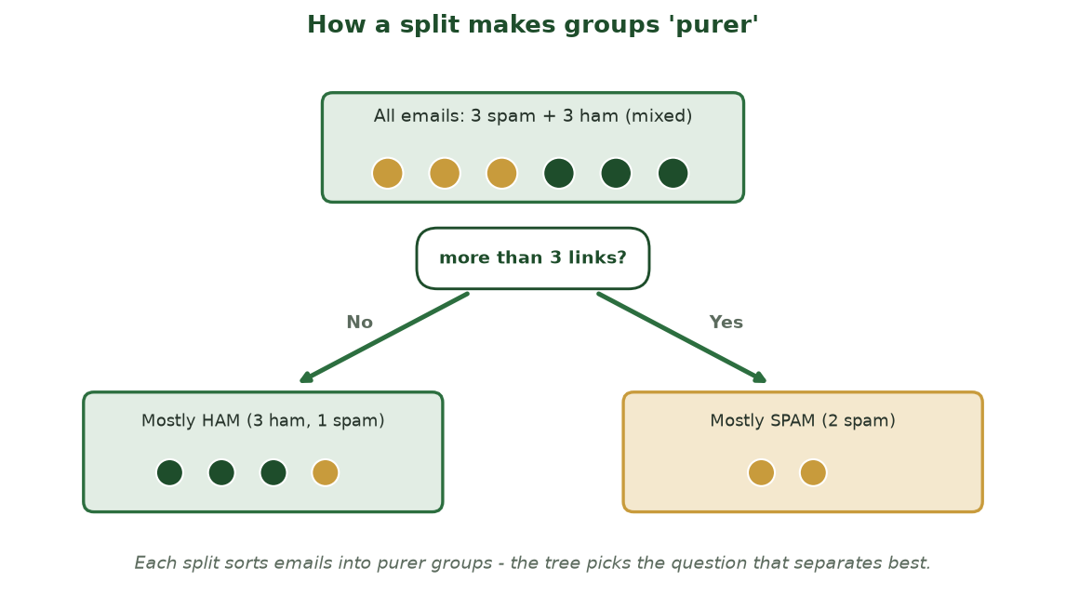
WHY THE TREE PICKS EACH QUESTION
How a Split Makes Groups 'Purer'
One question ('more than 3 links?') splits a mixed group into a mostly-ham group and a mostly-spam group.
CIS 350: AI for Cybersecurity · Wednesday
7
Notes:
Show WHY a tree asks the questions it does: each split sorts a mixed group into purer subgroups. Point at the dots - the split cleanly peels off the spam. The tree greedily picks whichever question makes the child groups purest. This demystifies 'the computer learns the questions.' ~2 min.

Slide 8
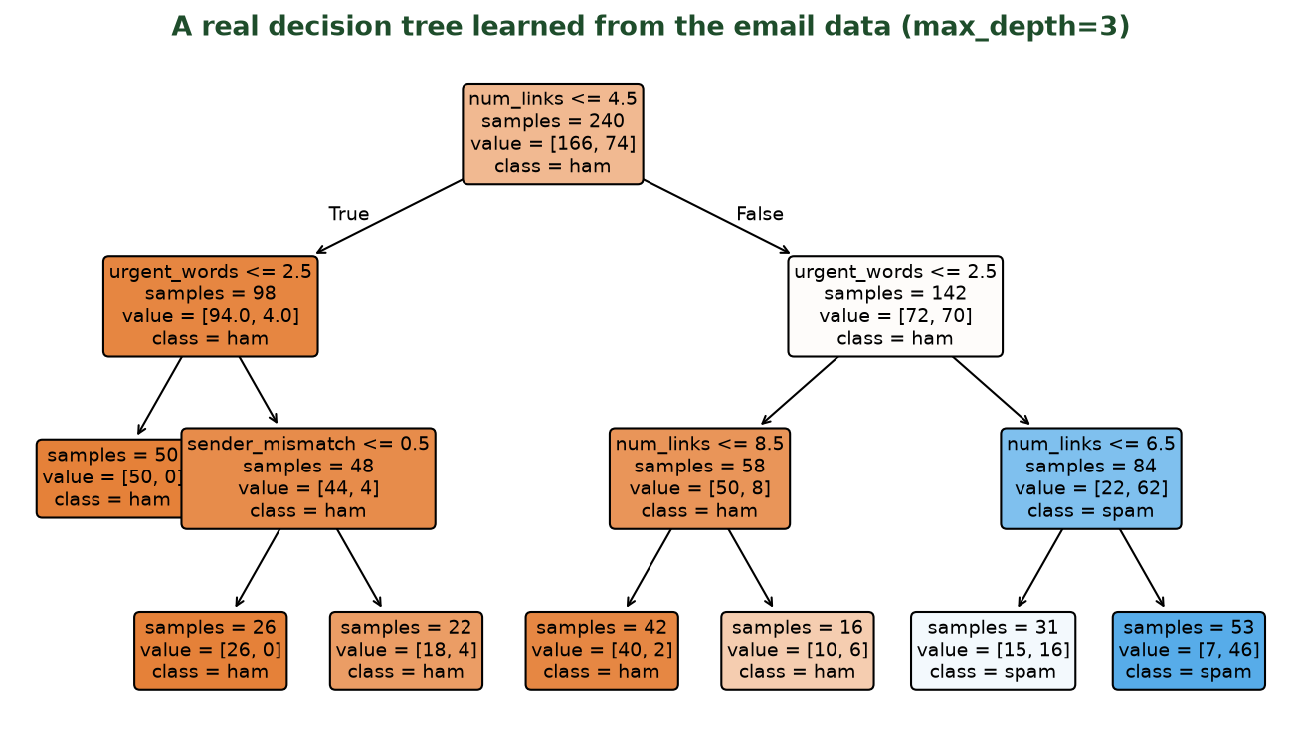
TRAINED ON OUR 240 EMAILS (MAX_DEPTH=3)
A Real Learned Tree
scikit-learn learned these exact questions from the data. Darker boxes are more certain; each leaf gives a class.
CIS 350: AI for Cybersecurity · Wednesday
8
Notes:
This is a REAL tree scikit-learn learned from the dataset - not a hand-drawn schematic. Walk the root split (the most informative feature) and follow one path to a leaf. Note the color shading shows class purity/confidence and the 'samples' counts show how many emails reached each node. Connect it back to the schematic on the previous slide: same idea, real output. They'll generate this in Lab 3. ~4 min.

Slide 9
THREE LINES - SAME AS LAB 3
Training a Decision Tree (Code)
Python · Google Colab
from sklearn.tree import DecisionTreeClassifier
model = DecisionTreeClassifier(max_depth=3) # limit depth = avoid overfitting
model.fit(X_train, y_train) # learn the questions
model.predict([[6, 1, 1, 2]]) # 6 links, attach, mismatch, 2 urgent -> ['spam']
CIS 350: AI for Cybersecurity · Wednesday
9
Notes:
Show how little code a tree takes. Explain max_depth=3 is the main 'knob' that prevents the tree from growing a path for every email (overfitting - Monday). .fit() learns the questions; .predict() on a new feature list returns a label. Point out the new-email features are in the same order as the columns. This is straight out of Lab 3. ~4 min.

Slide 10
STRENGTHS
Why Decision Trees Are Popular
Easy to read: you can follow the exact path to a decision.
Explainable: great when you must justify why an email was flagged.
Handle numbers and categories with little preparation.
Fast to train and to use.
A natural fit when humans must trust and audit the model.
Transparent and explainable.
CIS 350: AI for Cybersecurity · Wednesday
10
Notes:
Sell transparency. In security/business you often must explain WHY something was flagged (to an analyst, manager, or regulator) - a tree gives the exact path. Connects to the explainability theme later in the course; contrast with 'black-box' models. ~3 min.

Slide 11
LIMITS
The Catch: Trees Can Overfit
A tree that keeps splitting can grow a unique path for every training email.
That memorizes the data - classic overfitting (Monday).
Looks perfect in training but fails on new email.
Fix: limit depth (max_depth) or 'prune' the tree.
The train/test split is how we catch it.
Deep trees memorize; limit depth.
CIS 350: AI for Cybersecurity · Wednesday
11
Notes:
Tie back to Monday's overfitting. A tree grown too deep carves a leaf per training example - memorization. The fix is max_depth/pruning, which students will adjust in Lab 3 and watch test accuracy change. The test set detects the problem. ~3 min.

Slide 12
🌳 ACTIVITY · 7 MIN
Build a tiny decision tree
Given 5 labeled emails, design a 2-question tree by hand.
Which feature would you split on FIRST to best separate spam from ham? Why?
What second question handles the unclear group?
Draw your tree and test it on a new email.
CIS 350: AI for Cybersecurity · Wednesday
12
Notes:
Students act as the learning algorithm: pick the most informative first split (usually #links or sender mismatch), then a second split for the ambiguous group. Builds intuition for how a tree chooses splits. Have a pair share at the board. Pairs 4, discuss 3. ~7 min.

Slide 13
PART 2 · YOU ARE YOUR NEIGHBORS · ~20 MIN
k-Nearest Neighbors (k-NN)
Notes:
Transition: 'Our second classifier is even simpler - it barely trains, it just remembers.' ~20 minutes with a hands-on activity.

Slide 14
THE IDEA
k-Nearest Neighbors: You Are What Your Neighbors Are
To classify a new email, find the 'k' most similar past emails (its neighbors).
Look at THEIR labels and take a majority vote.
If most neighbors are spam, call the new email spam.
'Similar' = close in feature values (similar link counts, urgent words...).
Almost no training - it just remembers the labeled examples.
Find similar past emails; vote.
CIS 350: AI for Cybersecurity · Wednesday
14
Notes:
Introduce k-NN with the neighbor metaphor: find the k most similar past examples and let them vote. Contrast with trees - k-NN barely trains, it memorizes and compares at prediction time. The figure makes it visual next. ~3 min.

Slide 15
FIND THE NEAREST NEIGHBORS, TAKE A VOTE
How k-NN Classifies
legitimate (ham)
spam
?
The new email (?) has 3 nearest neighbors: 2 legit + 1 spam -> predict LEGIT by majority vote.
CIS 350: AI for Cybersecurity · Wednesday
15
Notes:
Walk the plot: the new email sits between the legit and spam clusters; its 3 nearest neighbors are 2 legit + 1 spam, so majority vote = legit. Stress 'nearest' = closest in feature values, and that the choice of k changes the answer (next slide). ~4 min.

Slide 16
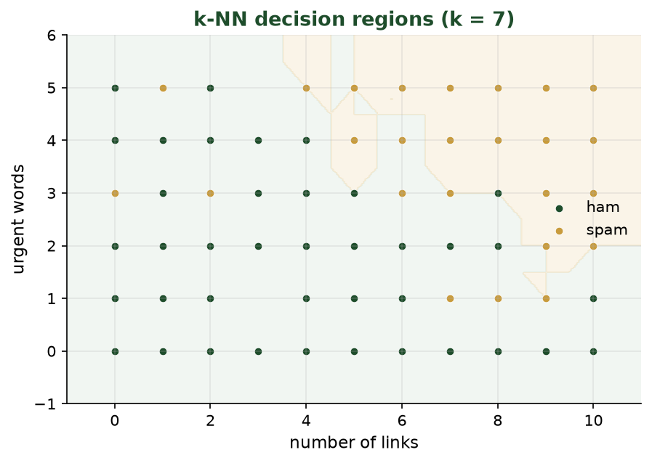
WHAT THE MODEL ACTUALLY CARVES OUT (K = 7)
k-NN Decision Regions
Green region = predicted legit, gold region = predicted spam. A new email is classified by which region it lands in.
CIS 350: AI for Cybersecurity · Wednesday
16
Notes:
This is k-NN's 'map.' The shaded regions show how every possible email (by links and urgent words) would be classified; the dots are the training emails. Point out the boundary is wiggly, not a straight line - that flexibility is k-NN's strength and its overfitting risk. A new email is labeled by the region it falls in. Lowering k makes the boundary more jagged. ~4 min.

Slide 17
SAME PATTERN, DIFFERENT CLASSIFIER
Training k-NN (Code)
Python · Google Colab
from sklearn.neighbors import KNeighborsClassifier
model = KNeighborsClassifier(n_neighbors=3) # k = 3 neighbors vote
model.fit(X_train, y_train) # just remembers the examples
model.predict([[6, 1, 1, 2]]) # -> ['spam']
CIS 350: AI for Cybersecurity · Wednesday
17
Notes:
Reinforce the unified scikit-learn pattern: create -> fit -> predict, identical to the tree - only the class name changed. That consistency is empowering: learn one workflow, swap the model. n_neighbors=3 is k. In Lab 3 (or its extension) they can swap the tree for k-NN by changing one line. ~3 min.

Slide 18
THE ONE KNOB
Choosing k (How Many Neighbors)
k = how many neighbors get to vote.
k too small (k=1): one weird neighbor can flip the answer (overfitting).
k too large: votes blur together and ignore local detail (underfitting).
Pick k by testing values on the held-back test set.
Use small odd numbers (3, 5, 7) to avoid tie votes.
Small k = jumpy; large k = blurry.
CIS 350: AI for Cybersecurity · Wednesday
18
Notes:
k is k-NN's main dial. Small k is jumpy and can overfit to one odd neighbor; large k smooths too much. Professional habit: try several k and pick the best on the test set (Monday's idea). Odd k avoids ties. ~3 min.

Slide 19
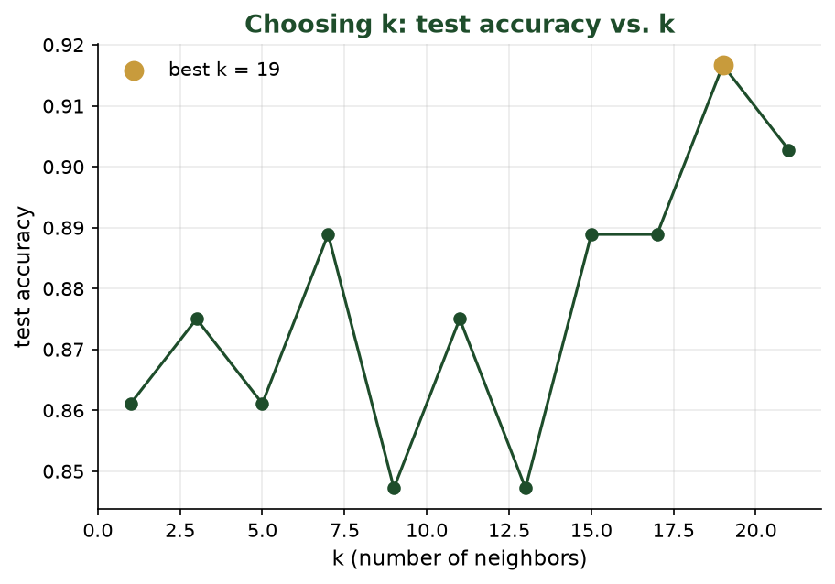
TEST ACCURACY FOR DIFFERENT K
Choosing k Is an Experiment
We try many values of k and keep the one that scores best on the held-back test set (the gold dot).
CIS 350: AI for Cybersecurity · Wednesday
19
Notes:
Reinforce that we don't guess k - we measure it. This real plot tries k = 1, 3, 5, ... and records test accuracy; the gold dot marks the best. Tie back to Monday: we choose settings using the test set, never by eyeballing training data. Note very small k is jumpy (left) and very large k can blur (right). ~3 min.

Slide 20
TWO BEGINNER-FRIENDLY CLASSIFIERS
Decision Trees vs. k-NN
🌳 Decision tree
👥 k-Nearest Neighbors
Learns yes/no questions from data.
Very easy to read and explain.
Trains up front; fast to predict.
Can overfit if grown too deep (limit depth).
Classifies by similarity to past examples.
Almost no training - just remembers.
Simple idea, slower on huge datasets.
Sensitive to k and to feature scaling.
CIS 350: AI for Cybersecurity · Wednesday
20
Notes:
Side-by-side so students choose intuitively. Trees = explainable, train up front; k-NN = simplest idea, lazy, sensitive to k and scaling. Neither is 'best' - depends on the problem and whether you need explainability. ~3 min.

Slide 21
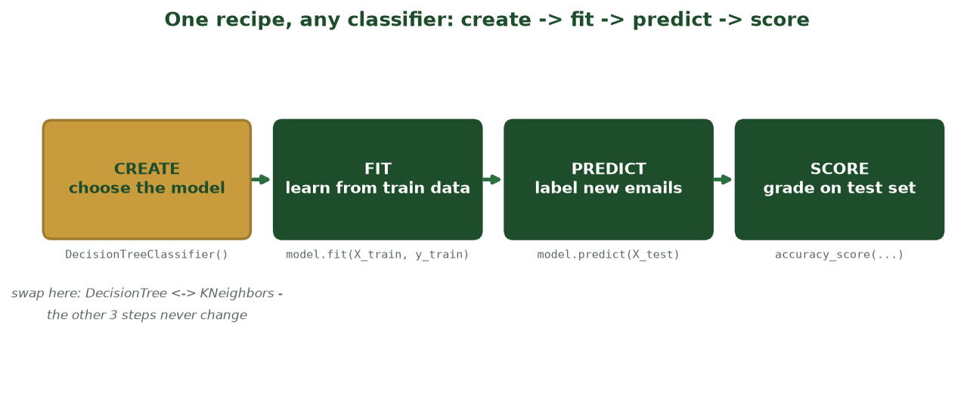
CREATE -> FIT -> PREDICT -> SCORE
One Recipe, Any Classifier
Every scikit-learn model uses the same four steps - switching from a tree to k-NN changes only the first line.
CIS 350: AI for Cybersecurity · Wednesday
21
Notes:
Reinforce the empowering pattern: create -> fit -> predict -> score is identical for every model. Only the CREATE line changes (gold box) when you swap DecisionTree for KNeighbors; the other three lines are the same. Learn one workflow, use any classifier - exactly what Lab 3 does. ~2 min.

Slide 22
👥 ACTIVITY · 6 MIN
Classify with k-NN by hand
A new email's 5 nearest past emails are: 3 spam, 2 ham.
With k = 3 (the 3 closest are 2 spam, 1 ham), what's the prediction?
With k = 5, what's the prediction?
Why might k = 1 be risky here?
CIS 350: AI for Cybersecurity · Wednesday
22
Notes:
Students apply majority vote. k=3 (2 spam,1 ham) -> spam; k=5 (3 spam,2 ham) -> spam; k=1 risks letting a single, possibly mislabeled, closest neighbor decide. Pairs 3, discuss 3. ~6 min.

Slide 23
PART 3 · WATCH IT LEARN · ~22 MIN
Live Demo: Training a Spam Classifier
Notes:
Transition: 'Let's put it together and train a real classifier, step by step - this IS Lab 3.' ~22 minutes. Run it live in Colab if possible; otherwise the next slides are your script.

Slide 24
SET UP THE DATA
Demo Steps 1-3: Load, Split
Python · Google Colab
import pandas as pd
from sklearn.model_selection import train_test_split
df = pd.read_csv('emails.csv') # labeled phishing dataset
X = df[['num_links','has_attachment','sender_mismatch','urgent_words']]
y = df['label']
X_train, X_test, y_train, y_test = train_test_split(
X, y, test_size=0.2, random_state=42)
CIS 350: AI for Cybersecurity · Wednesday
24
Notes:
Narrate the first half of the demo. Recall X = features, y = label from Monday. train_test_split enforces the golden rule automatically. If live, run this cell and show X.head() and the train/test sizes. This is the opening of the Lab 3 notebook verbatim. ~4 min.

Slide 25
WATCH IT LEARN
Demo Steps 4-5: Train, Predict, Score
Python · Google Colab
from sklearn.tree import DecisionTreeClassifier
from sklearn.metrics import accuracy_score
model = DecisionTreeClassifier(max_depth=3)
model.fit(X_train, y_train) # <- training happens here
preds = model.predict(X_test)
print('accuracy:', accuracy_score(y_test, preds)) # accuracy: 0.92
CIS 350: AI for Cybersecurity · Wednesday
25
Notes:
Finish the build: create, fit (the actual learning), predict on the held-back test set, and score. If live, run it and let them see the accuracy print. Emphasize .fit() is the guess-check-adjust loop in action. Then move to interpreting the result on the next slide. ~4 min.

Slide 26
PREDICTIONS VS. THE TRUE LABELS
Reading the Results
email | predicted | actual | result
#1 (6 links, urgent) | spam | spam | correct
#2 (0 links) | ham | ham | correct
#3 (8 links, attach) | spam | spam | correct
#4 (2 links, newsletter) | spam | ham | wrong
#5 (1 link) | ham | ham | correct
4 of 5 correct here = 80% on this tiny sample. The model wrongly flagged a real newsletter (a false positive) - exactly what Week 4 helps us measure.
CIS 350: AI for Cybersecurity · Wednesday
26
Notes:
Make 'accuracy' concrete by showing predictions next to the truth. Walk the one wrong row (#4): the model flagged a legitimate newsletter as spam - a false positive, which annoys real users. This previews Week 4 (confusion matrix, precision/recall) and reinforces that one number hides what KIND of mistakes happen. ~4 min.

Slide 27
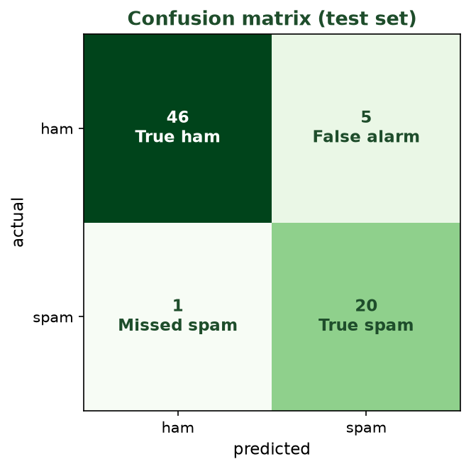
BEYOND A SINGLE ACCURACY NUMBER
Confusion Matrix: What KIND of Mistakes?
Rows = actual, columns = predicted. The off-diagonal cells are the errors: false alarms vs. missed spam.
CIS 350: AI for Cybersecurity · Wednesday
27
Notes:
This previews Week 4 and answers 'what kind of mistakes?' Walk the four cells: true ham, true spam (correct), then the two error types - 'false alarm' (a real email flagged as spam, which annoys users) and 'missed spam' (spam that slipped through). Stress these two errors have very different costs, which is why accuracy alone isn't enough. This is the bridge to next week. ~4 min.

Slide 28
USING IT FOR REAL
Predict a Brand-New Email + Pitfalls to Watch
new_email = [[7, 1, 1, 4]] # 7 links, attachment, mismatch, 4 urgent words
model.predict(new_email) -> ['spam']
Pitfalls: don't peek at the test set; watch the train-vs-test gap (overfitting).
A single accuracy can hide failures on the rare class (imbalance).
Garbage in, garbage out - results are only as good as the labeled data.
Predict new email; stay skeptical.
CIS 350: AI for Cybersecurity · Wednesday
28
Notes:
Show the payoff: feed a brand-new email's features and get a label. Then consolidate the week's cautions into a checklist (peeking, overfitting gap, imbalance, GIGO). This is the 'be a critical user' slide - the judgment the course builds. The new_email line is in the Lab 3 extension. ~3 min.

Slide 29
💻 ACTIVITY · 6 MIN
Interpret the demo result
The classifier scored 94% on the test set and flagged a new 6-link email as spam.
Do you trust the 94%? What would you ask first?
Which feature probably drove the 'spam' decision?
What would worry you if 99% of training emails were ham?
CIS 350: AI for Cybersecurity · Wednesday
29
Notes:
Students critique a result rather than just produce one. Good answers: ask about class balance, test size, and the train-vs-test gap before trusting 94%; #links likely drove it; heavy imbalance means accuracy may hide missed spam. Rehearses Week 4 thinking. Pairs 3, discuss 3. ~6 min.

Slide 30
🥊 IN-CLASS TASK · 12 MIN
Classifier Bake-Off: Tree vs. k-NN on the Same Emails
You get 6 labeled reference emails (plotted by num_links and urgent_words), a fixed 2-question tree ('more than 3 links?' then 'any urgent words?'), and 3 brand-new emails. Run BOTH classifiers - no code.
TREE: for each new email, follow the tree branches to a leaf; record spam or ham.
k-NN (k=3): for each new email, find the 3 closest reference emails and take a majority vote.
Fill a 3-row table: [tree prediction | k-NN prediction | agree?].
Circle the email where they DISAGREE and note which feature values made them differ.
Deliverable: the filled table + one sentence on which model you'd deploy for a security team, and why.
CIS 350: AI for Cybersecurity · Wednesday
30
Notes:
Both models agree on clear cases and split on a borderline one (e.g., 4 links, 0 urgent words: the tree fires 'spam' on >3 links, k-NN may vote 'ham' by neighbors). Debrief: neither is universally right; a tree gives an explainable path for a manager/auditor, k-NN depends on k and scaling; we choose by testing on held-back data (Monday's golden rule). Bridge to Lab 3's one-line model swap. ~12 min.

Slide 31
USE THESE SLIDES AS YOUR STUDY GUIDE
How Today Connects to Lab 3 & Quiz 3
💻 In Lab 3 you will...
📝 Quiz 3 will ask you to...
Run this exact load -> split -> fit -> predict pipeline on the email dataset.
Train a DecisionTreeClassifier and read its accuracy.
Change max_depth and watch test accuracy change (overfitting).
Predict the label of a brand-new email.
Explain how a decision tree makes a decision.
Explain how k-NN makes a decision (and the role of k).
Compare trees vs k-NN.
Read predictions vs actual labels and spot a false positive.
CIS 350: AI for Cybersecurity · Wednesday
31
Notes:
Connect Wednesday explicitly to the assessments. Left = the precise Lab 3 actions (every one appeared as code today); right = Quiz 3 question types (each maps to an objective). Tell students: keep these slides open during Lab 3 and re-read before the quiz. ~2 min.

Slide 32
Key Takeaways
✓
A decision tree is a flowchart of yes/no feature questions, learned from labeled data.
✓
k-NN classifies a new example by majority vote of its most similar past examples.
✓
Trees are explainable; k-NN is simple - both can overfit, so we test on held-back data.
✓
Every classifier follows the same code: create -> fit -> predict -> score. That's Lab 3.
Notes:
Recap the four points; cold-call 'tree vs k-NN - one difference.' Make sure the create/fit/predict/score pattern is crystal clear before Lab 3. ~2 min.

Slide 33
LOOKING AHEAD
This Week & Next
💻 Work on Lab 3 ('Build Your First Spam Classifier') - due Monday of Week 4.
✅ Complete Quiz 3 on Canvas if you haven't already.
📖 Review Handout 3; bring questions to office hours.
📊 Next week: Did the model get it right? Regression & evaluation (confusion matrix, false positives).
Lab 3 due Wk4 Mon; preview Week 4.
CIS 350: AI for Cybersecurity · Wednesday
33
Notes:
Assign Lab 3 (due Monday of Week 4) and Quiz 3. Preview Week 4: judging models honestly - the confusion matrix, false positives vs false negatives, and why accuracy isn't enough (today's #4 false positive is the hook). ~1-2 min.

Slide 34
🎟️ EXIT TICKET · 2 MIN
One minute before you go
On the Canvas exit-ticket quiz or a card:
In one sentence, how does a decision tree decide?
In one sentence, how does k-NN decide?
One question you still have.
CIS 350: AI for Cybersecurity · Wednesday
34
Notes:
Close with the exit ticket; check students can articulate both classifiers in their own words before Lab 3. ~2 min.

