Slide 1

WEEK 3 · MONDAY · 75 MINUTES
Supervised Learning: Teaching with Labels
Learning From Labels · Classification · Train vs Test
CIS 350: AI for Cybersecurity — Smart Defense for the Digital Business
Ramadan Abdunabi, Ph.D. · Computer Information Systems
Notes:
Open with momentum: 'Week 1 - what we protect. Week 2 - data, features, and labels. Today we finally TEACH a machine to make a decision.' Promise the payoff up front: Wednesday you'll watch a spam classifier get trained line by line, and in Lab 3 you'll build one yourself. Keep the no-math, no-experience-needed reassurance - today has real code on the slides, but you'll walk them through every line. Confirm Handout 3 is open. Reach Part 1 by ~minute 7.

Slide 2

🔁 WARM-UP · 6 MIN
Recap: features & labels
From last week, with a neighbor:
In a dataset, what is a feature? What is a label?
In the phishing table, name two features and the label.
Why does data quality matter?
CIS 350: AI for Cybersecurity · Monday
2
Notes:
Retrieval warm-up that sets up today perfectly. Pairs 2 min, cold-call 3-4. Expected: feature = input clue, label = answer to predict; features = num_links/urgent_words/etc., label = spam/ham; quality matters because garbage in, garbage out. Bridge: 'Those labels are the teacher - today we USE them to train a model.' ~6 min.

Slide 3
MONDAY · 75 MINUTES
Today's Plan
🏷️
Supervised learning intuition
Learning from labeled examples + diagrams
17 min
📧
Classification & the spam-filter story
Predicting a category
13 min
✂️
Training vs testing
Why we never grade on seen questions
18 min
🔬
Hands-on: split, train & grade by hand
Be the data scientist - no code
12 min
🔁
Recap + warm-up
Features & labels
5 min
🎯
Wrap-up & exit
Lab 3 / Quiz 3 + takeaways
10 min
CIS 350: AI for Cybersecurity · Monday
3
Notes:
Walk the three content parts plus warm-up and wrap. Flag Part 3 (train vs test) as the biggest and most important idea today. Mention there are code and data examples on the slides that mirror Lab 3. ~1 min.

Slide 4
THIS WEEK'S LEARNING OBJECTIVES
What You'll Be Able to Do
1
Explain supervised learning as learning from labeled examples.
2
Describe the difference between training data and testing data.
3
Walk through how a classifier decides between classes.
4
Connect classification to spam and phishing detection.
CIS 350: AI for Cybersecurity · Monday
4
Notes:
Read the four objectives; Quiz 3 maps directly to them. Objective 2 (train vs test) is the one students most often get wrong - flag that you'll spend real time and a code example on it. ~1 min.

Slide 5
PART 1 · THE BIG IDEA · ~18 MIN
Supervised Learning Intuition
Notes:
Transition: 'Last week we built labeled datasets. Supervised learning is what we DO with those labels.' ~18 minutes, ending with a hands-on activity.

Slide 6
DEFINITION
Supervised Learning = Learning From Labeled Examples
We show a model many examples, each tagged with the correct answer (the label).
The model learns the pattern linking features to the label.
Then it labels brand-new examples it has never seen.
'Supervised' = a teacher provided the right answers during training.
It's the most common, practical style of ML in security.
A teacher (the labels) supervises the learning.
CIS 350: AI for Cybersecurity · Monday
6
Notes:
Define supervised learning plainly - objective 1. 'Supervised' = the labels act as a teacher giving right answers. Stress the goal is to generalize to NEW examples, not memorize old ones (foreshadows train/test). Anchor to Week 2: those labeled datasets are the raw material. ~3 min.

Slide 7
INTUITION
The Teaching Analogy: Flashcards
Teaching a child 'dog vs not-dog' with flashcards: each card = a picture (features) + the answer (label).
After enough cards, the child recognizes dogs they've never seen.
A model learns the same way - with numbers instead of intuition.
No card states the rule 'a dog has fur and four legs' - the pattern is LEARNED, not told.
Contrast with last week's rule-based approach, where a human writes the rule.
Show labeled examples; the pattern is learned, not told.
CIS 350: AI for Cybersecurity · Monday
7
Notes:
Use flashcards to make 'learning from examples' friendly. Punch line: we never hand-write the rule; the learner infers it from many labeled examples - the opposite of the rule-based filter from Week 2. Ask: 'How would you teach a kid cat vs dog?' (show examples). ~3 min.

Slide 8
EACH ROW IS AN EMAIL; THE LABEL IS THE ANSWER
Our Labeled Data (the 'teacher')
#links | attach | mismatch | urgent | label
5 | 1 | 1 | 3 | spam
8 | 1 | 1 | 5 | spam
1 | 0 | 0 | 0 | ham
0 | 0 | 0 | 0 | ham
6 | 1 | 1 | 2 | spam
2 | 0 | 0 | 1 | ham
Four FEATURES (links, attachment, sender mismatch, urgent words) and one LABEL (spam/ham). This is the exact dataset you'll train on in Lab 3.
CIS 350: AI for Cybersecurity · Monday
8
Notes:
Show the actual labeled data so 'examples with answers' is concrete, not abstract. Read one spam row and one ham row aloud and point at the gold label column. Note the clean separation (spam = more links + urgent words). Tell them this is the SAME dataset they explored in Lab 2 and will train on in Lab 3 - continuity matters. ~3 min.

Slide 9
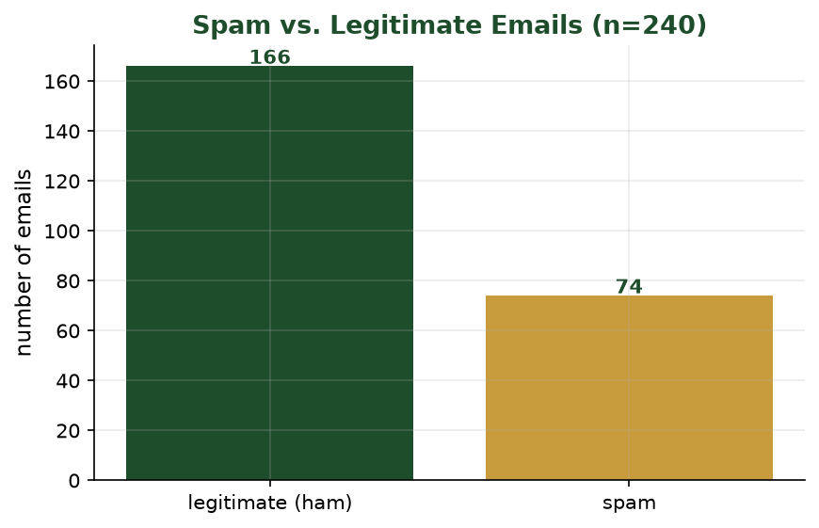
HOW MANY OF EACH CLASS?
Visualizing Our Data
A quick bar chart of the full 240-email dataset - more legitimate mail than spam.
CIS 350: AI for Cybersecurity · Monday
9
Notes:
Show the real class counts before any modeling - this is the analyst's first look (recall Week 2 visualization). Point out the mild imbalance (more ham than spam) and remind them why that matters for accuracy. This chart comes from the same dataset they'll train on in Lab 3. ~2 min.

Slide 10
THE SHAPES YOU'LL USE IN CODE
From Data to Model: Features (X) and Label (y)
Python · Google Colab
import pandas as pd
df = pd.read_csv('emails.csv') # the labeled dataset above
# FEATURES the model learns from (inputs):
X = df[['num_links', 'has_attachment',
'sender_mismatch', 'urgent_words']]
# LABEL we want to predict (the answer):
y = df['label']
CIS 350: AI for Cybersecurity · Monday
10
Notes:
First code slide - keep it calm and slow. Introduce the universal convention: capital X = the features (a table of inputs), lowercase y = the label (the answer). Point back at the data table: X is the white columns, y is the gold column. This exact X/y split appears in Lab 3 and in every scikit-learn example they'll ever see. Don't rush; let the convention sink in. ~3 min.

Slide 11
WHERE THIS FITS
Supervised vs. Unsupervised (Quick Contrast)
Supervised: we HAVE labels and learn to predict them (spam vs ham). Today.
Unsupervised: NO labels - the model finds natural groupings on its own (Week 6).
Supervised answers 'is this spam?'; unsupervised asks 'what groups exist here?'
You need labeled data for supervised learning - which is why labels are precious.
Labels present = supervised.
CIS 350: AI for Cybersecurity · Monday
11
Notes:
A 2-minute placement on Week 2's map of four ML styles. Supervised needs labels and predicts them; unsupervised has none and discovers structure (Week 6). Reinforce why labeled data is valuable. ~2 min.

Slide 12
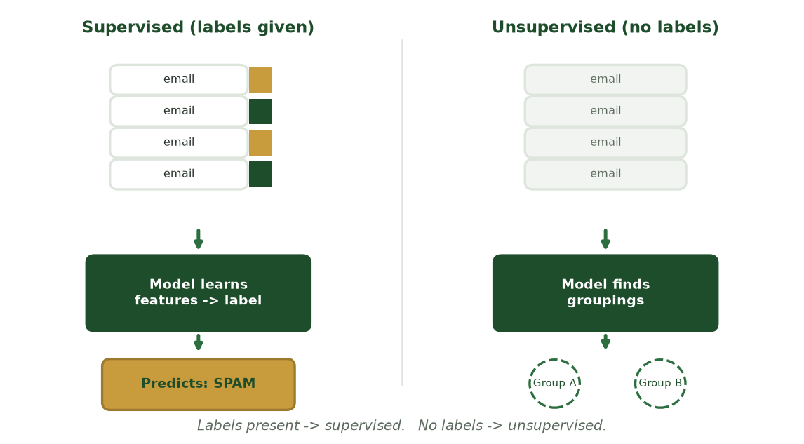
LABELS PRESENT -> SUPERVISED
Supervised vs. Unsupervised at a Glance
With labels, the model learns features -> answer and predicts; with no labels, it just finds natural groupings.
CIS 350: AI for Cybersecurity · Monday
12
Notes:
Reinforce the contrast visually before the poll: left, labeled emails train a model that predicts spam; right, unlabeled emails only yield unnamed groups. The one-line rule at the bottom - labels present -> supervised - is the takeaway. Unsupervised is Week 6. ~2 min.

Slide 13
🧠 ACTIVITY · 6 MIN
Be the model
Four labeled emails, then a NEW one arrives - you classify it.
Spam: 7 links + urgent. Spam: 5 links + urgent. Ham: 0 links, none. Ham: 1 link, none.
NEW email: 6 links, 3 urgent words -> spam or ham?
What rule did YOU just use? That's what the model learns from labels.
CIS 350: AI for Cybersecurity · Monday
13
Notes:
Make students BE the classifier. Almost everyone says spam for the new email. The reveal: the rule you used (more links + urgent words -> spam) is exactly the pattern a model infers from labels - nobody told you the rule. Pairs 2-3, discuss 3. ~6 min.

Slide 14
PART 2 · PREDICTING A CATEGORY · ~16 MIN
Classification & the Spam-Filter Story
Notes:
Transition: 'When the label is a category, the task is called classification.' ~16 minutes, with the spam filter as the running story.

Slide 15
THE TASK
Classification = Predicting a Category
Classification predicts which CLASS (category) an example belongs to.
Spam vs ham. Fraud vs legitimate. Malware vs safe file.
The classes are the possible labels the model can output.
(Predicting a NUMBER instead - like a risk score - is regression, coming in Week 4.)
Today: two-class (binary) classification - the most common security setup.
Classification = pick a category.
CIS 350: AI for Cybersecurity · Monday
15
Notes:
Define classification - objective 3 setup. Contrast with regression (a number), which is next week, so students don't conflate them. Give several security examples. Note we focus on binary classification today. ~3 min.

Slide 16
END TO END
The Spam-Filter Story, Start to Finish
1) Collect thousands of emails, each labeled spam or ham.
2) Turn each email into features (links, attachment, sender mismatch, urgent words).
3) Train a classifier on those labeled examples.
4) A new email arrives - extract its features.
5) The model predicts: spam or ham (often with a confidence score).
Collect -> featurize -> train -> predict.
CIS 350: AI for Cybersecurity · Monday
16
Notes:
Walk the full lifecycle - the spine of objective 4 and a direct preview of Lab 3. Each step recalls prior material (labels, features). Mention confidence scores: models often say '92% likely spam,' which matters when we set thresholds in Week 4. ~3 min.

Slide 17
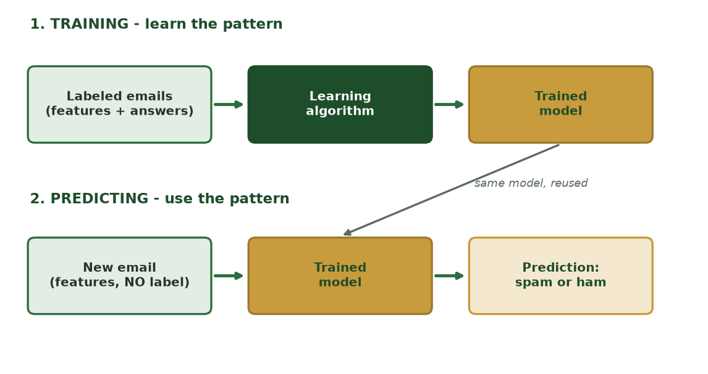
LEARN THE PATTERN, THEN USE IT
Two Jobs: Training vs. Predicting
Training turns labeled examples into a trained model; prediction reuses that SAME model to label a brand-new email.
CIS 350: AI for Cybersecurity · Monday
17
Notes:
Make the two phases explicit - students conflate them. Top lane: labeled emails + algorithm -> trained model (learning). Bottom lane: a new, unlabeled email flows through the SAME model -> a prediction. The dashed arrow stresses the model is trained once, then reused. Sets up train/test next. ~2 min.

Slide 18
THE DECISION
How a Classifier Actually Decides
It learns which feature values lean toward each class (many links -> leans spam).
For a new example, it weighs all features together.
It picks the best-supported class - and can report its confidence.
Different algorithms weigh evidence differently (we meet two on Wednesday).
Key point: the decision comes from patterns in the DATA, not hand-written rules.
Weigh the features, pick the best-supported class.
CIS 350: AI for Cybersecurity · Monday
18
Notes:
Objective 3 head-on. In plain terms the model learns which feature values point to which class, then weighs them for a new example. Tease Wednesday: decision trees and k-NN weigh evidence in different, visual ways. ~3 min.

Slide 19
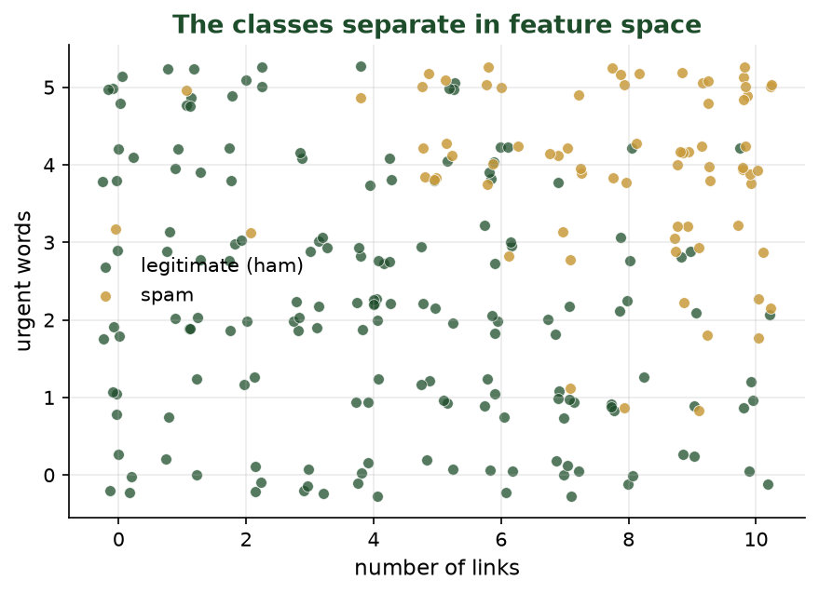
THE CLASSES SEPARATE IN FEATURE SPACE
Why the Model Can Decide
Each dot is an email: green = legitimate, gold = spam. Spam clusters toward more links and more urgent words.
CIS 350: AI for Cybersecurity · Monday
19
Notes:
This scatter is the visual intuition for HOW a classifier decides. Each dot is an email plotted by two features (links vs urgent words); the colors form two clusters. A classifier simply learns where to draw the boundary between them. Ask students to eyeball where they'd draw the line - that's exactly what the model does, in more dimensions. ~3 min.

Slide 20
OBJECTIVE 4
Connecting Classification to Phishing Detection
Phishing detection is classification: features in -> 'phishing' or 'legitimate' out.
Useful features: look-alike sender, link count, urgent language, attachments, mismatched URLs.
A trained classifier scores every incoming email automatically, in milliseconds.
Same idea powers fraud detection, malware detection, and intrusion alerts.
This is exactly the tool you'll build in Lab 3.
Phishing detection = classification in action.
CIS 350: AI for Cybersecurity · Monday
20
Notes:
Close Part 2 by nailing objective 4: phishing detection IS classification. List the real features a phishing classifier uses, and note the same pattern generalizes to fraud/malware/intrusion. End by pointing to Lab 3 so students see the through-line from lecture to lab. ~3 min.

Slide 21
📧 ACTIVITY · 6 MIN
Classify these emails
Using only the features, call each spam or ham - and name the deciding feature.
8 links, attachment, sender mismatch, 4 urgent words.
0 links, no attachment, matching sender, 0 urgent words.
2 links, no attachment, matching sender, 1 urgent word (a real newsletter?).
CIS 350: AI for Cybersecurity · Monday
21
Notes:
Students classify and name the deciding feature. Answers: clearly spam; clearly ham; the third is deliberately borderline to spark debate about confidence and false positives. That ambiguity sets up Week 4's error measures. Pairs 3, discuss 3. ~6 min.

Slide 22
PART 3 · THE GOLDEN RULE · ~24 MIN
Training vs Testing
Notes:
Transition: 'Here's the idea that separates people who get ML from people who don't.' ~24 minutes - the most important part of the day. Slow down; use the data and code examples to make it stick.

Slide 23
THE SETUP
Why We Split Data: Train vs Test
Split labeled data into two parts BEFORE training.
Training set (~80%): the model learns from these.
Test set (~20%): hidden during training, used only to grade the model.
The test set stands in for 'new email the model has never seen.'
Goal: measure how well the model GENERALIZES, not how well it memorizes.
Train on most; grade on held-back test data.
CIS 350: AI for Cybersecurity · Monday
23
Notes:
Introduce the split - objective 2. Use ~80/20 but say it varies. Crucial framing: the test set is a stand-in for real, unseen email; we care about generalization. The next two slides show this as data and as code. ~4 min.

Slide 24
SAME DATA, TWO JOBS
What the Split Looks Like (Data)
#links | attach | mismatch | urgent | label | set
5 | 1 | 1 | 3 | spam | train
1 | 0 | 0 | 0 | ham | train
8 | 1 | 1 | 5 | spam | train
0 | 0 | 0 | 0 | ham | train
6 | 1 | 1 | 2 | spam | TEST
2 | 0 | 0 | 1 | ham | TEST
The model trains only on the 'train' rows. The 'TEST' rows are hidden until grading - so the score reflects performance on emails it never studied.
CIS 350: AI for Cybersecurity · Monday
24
Notes:
Make the split tangible with the actual rows. Point to the gold 'set' column: the model studies the train rows and never sees the TEST rows until we grade it. Stress the test rows are chosen randomly in practice. This is what train_test_split does on the next slide. ~3 min.

Slide 25
ONE LINE DOES IT FOR YOU
Splitting in Code
Python · Google Colab
from sklearn.model_selection import train_test_split
# hold back 20% as a test set the model never trains on
X_train, X_test, y_train, y_test = train_test_split(
X, y, test_size=0.2, random_state=42)
print(len(X_train), 'training emails')
print(len(X_test), 'test emails (held back)')
CIS 350: AI for Cybersecurity · Monday
25
Notes:
Show that the golden rule is enforced by one function. Explain each piece: test_size=0.2 keeps 20% for testing; random_state=42 just makes the random split reproducible so everyone gets the same rows (useful for grading Lab 3). Reassure: they don't memorize syntax - they understand what it DOES. This exact line is in the Lab 3 starter. ~4 min.

Slide 26
REMEMBER THIS
The Golden Rule: Don't Grade on Seen Questions
Never test a model on the exact examples it trained on.
That's like putting the homework (with answers) on the final exam.
Students would score 100% - and you'd learn nothing about real understanding.
Testing on fresh data is the only honest measure of real-world performance.
Break this rule and your 'great' accuracy is a lie.
Exam analogy: fresh questions only.
CIS 350: AI for Cybersecurity · Monday
26
Notes:
THE slide of the day - the exam analogy lands every time. Grading on training data is like putting the exact homework on the final: 100% score, zero insight. Hammer that honest evaluation needs fresh data. Students who internalize this avoid the most common ML mistake (and a Quiz 3 question). ~4 min.

Slide 27
THE CLASSIC TRAP
Overfitting: Memorizing Instead of Learning
Overfitting = the model memorizes training data instead of learning the real pattern.
Signature: near-perfect on training data, but poor on new (test) data.
Like a student who memorized answers but can't handle a reworded question.
Causes: too little data, or a model too complex for the problem.
The train/test split is how we DETECT overfitting.
Great on training, bad on new = overfitting.
CIS 350: AI for Cybersecurity · Monday
27
Notes:
Name the failure mode the golden rule guards against. Reuse the memorizing-student analogy. The diagnostic signature (high train, low test) is exactly what the split reveals. We'll see pruning (trees) and k choice (k-NN) on Wednesday as ways to fight it. ~4 min.

Slide 28
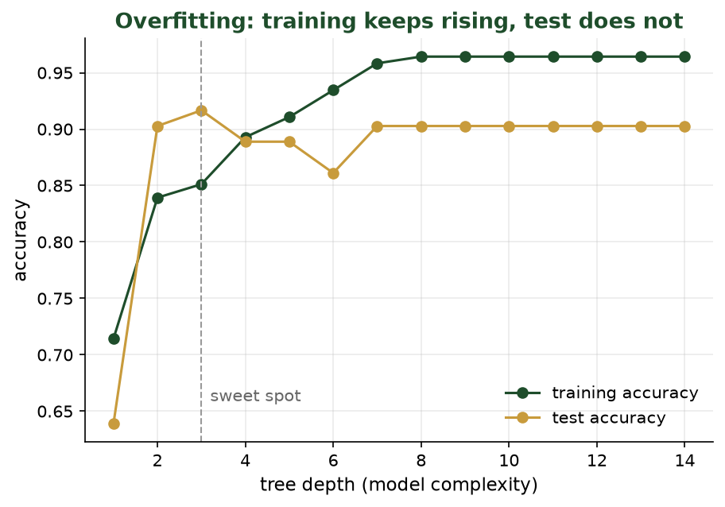
TRAINING ACCURACY VS. TEST ACCURACY
Overfitting in One Picture
As the tree gets deeper, training accuracy keeps climbing - but test accuracy levels off. The growing gap IS overfitting.
CIS 350: AI for Cybersecurity · Monday
28
Notes:
This is the payoff plot for the whole train/test section, from a real experiment on our data. Trace the two lines: training accuracy (green) marches toward 100% as depth grows, but test accuracy (gold) peaks then flattens/declines. The widening gap is overfitting made visible, and the dashed 'sweet spot' is the depth we'd choose. In Lab 3 students change max_depth and watch this happen. ~4 min.

Slide 29
HOW EVERY SUPERVISED PROJECT RUNS
The Train / Test Workflow
📥
All data
✂️
Split
🏋️
Train
(80%)
🧪
Test
(20%)
📊
Evaluate
The test set is sealed away during training, then used to grade the model on fresh examples - just like a real exam.
CIS 350: AI for Cybersecurity · Monday
29
Notes:
Walk the pipeline: all data -> split -> train on ~80% -> test on the held-back ~20% -> evaluate. The test set is sealed until the end. This is the exact workflow of Lab 3 and Wednesday's live demo. Evaluation (accuracy and better metrics) is next week's deep dive. ~3 min.

Slide 30
THE WHOLE LOOP IN FIVE LINES
Train, Predict, Score - in Code
Python · Google Colab
from sklearn.tree import DecisionTreeClassifier
from sklearn.metrics import accuracy_score
model = DecisionTreeClassifier(max_depth=3) # create
model.fit(X_train, y_train) # train (learn!)
preds = model.predict(X_test) # predict on held-back data
print(accuracy_score(y_test, preds)) # e.g. 0.92
CIS 350: AI for Cybersecurity · Monday
30
Notes:
Tie everything together with the core five lines. Map each to a concept: create the model, .fit() IS the guess-check-adjust training from Week 2, .predict() labels the held-back test set, and accuracy_score grades it. The 0.92 is illustrative. Students will run these exact lines in Lab 3 - say so. Don't belabor syntax; emphasize the meaning. ~4 min.

Slide 31
MEASURING SUCCESS
How We Grade: Accuracy (and Its Limits)
Accuracy = % of test emails labeled correctly (e.g., 92 of 100 = 92%).
Simple and intuitive - a good first score.
But recall class imbalance (Week 2): accuracy alone can mislead.
If 95% of email is ham, always guessing 'ham' scores 95% yet catches no spam.
Next week: precision, recall, and the confusion matrix fix this.
Accuracy now; better metrics in Week 4.
CIS 350: AI for Cybersecurity · Monday
31
Notes:
Introduce accuracy, then immediately connect to Week 2's imbalance warning so students stay skeptical of a single number. Preview Week 4's better metrics. Keep light - today's goal is the honest train/test habit. ~3 min.

Slide 32
✂️ ACTIVITY · 7 MIN
Why did it ace training but fail real email?
A team's spam filter scored 99% on training data but only 70% on new email.
What is this problem called?
What likely went wrong?
Name one thing they could try to fix it.
CIS 350: AI for Cybersecurity · Monday
32
Notes:
Diagnosis activity that cements the part. Answers: overfitting; the model memorized the training set (too complex, too little/unrepresentative data, or they peeked at test data); fixes - more/cleaner data, a simpler model (lower max_depth), proper train/test discipline. Pairs 3-4, discuss 3. ~7 min.

Slide 33
🔬 IN-CLASS TASK · 12 MIN
Be the Data Scientist: Split, Train & Grade by Hand
You get a printed table of 10 labeled emails (the four features + spam/ham label). Play all three roles of an ML pipeline - split, 'train' a rule, and honestly grade it - with NO code.
SPLIT: circle rows 1-8 as TRAIN and rows 9-10 as TEST; cover the TEST labels so you can't see them.
TRAIN: using only the 8 train rows, write one if-then rule (e.g., 'num_links>=4 OR urgent_words>=2 -> spam').
SCORE ON TRAIN: apply your rule to the 8 train rows; train accuracy = correct / 8.
SCORE ON TEST: apply the SAME rule to the 2 hidden rows, then uncover them; test accuracy = correct / 2.
Deliverable: your rule, per-row right/wrong marks, both accuracies, and one sentence on what a big train-vs-test gap means.
CIS 350: AI for Cybersecurity · Monday
33
Notes:
Students perform train_test_split, .fit(), and accuracy_score BY HAND. Debrief: a rule fit to the train rows scores high there but usually a notch lower on the 2 hidden test rows; grading only on hidden rows IS the golden rule; a big high-train/low-test gap is exactly overfitting. This is the manual version of Lab 3. ~12 min.

Slide 34
USE THESE SLIDES AS YOUR STUDY GUIDE
How Today Connects to Lab 3 & Quiz 3
💻 In Lab 3 you will...
📝 Quiz 3 will ask you to...
Load the labeled email dataset with pandas (the table you saw today).
Split it with train_test_split (the golden rule, in code).
Train a DecisionTreeClassifier and predict on the test set.
Report accuracy and try the model on a new email.
Define supervised learning and give an example.
Explain why we keep a separate test set.
Identify features vs the label in a small dataset.
Recognize overfitting from a train-vs-test accuracy gap.
CIS 350: AI for Cybersecurity · Monday
34
Notes:
Explicitly connect the lecture to the assessments so students see the slides as a study guide. Left = the exact Lab 3 steps (each appeared as code today); right = the kinds of questions Quiz 3 asks (each maps to an objective). Tell them: re-read these slides before the quiz and keep them open during the lab. ~2 min.

Slide 35
Key Takeaways
✓
Supervised learning = learning a features-to-label pattern from labeled examples.
✓
Classification predicts a category (spam vs ham); the model weighs features to decide.
✓
Always split data: train on most, grade on a held-back test set (the golden rule).
✓
Overfitting (great on training, poor on new data) is the trap the split detects.
Notes:
Recap one point per objective. Cold-call: 'Why can't we test on the training data?' to confirm the golden rule landed. ~2 min.

Slide 36
LOOKING AHEAD
Before Wednesday
💻 Lab 3 - 'Build Your First Spam Classifier' is released today (decision tree in Colab).
📝 Quiz 3 is Wednesday (supervised learning; train/test; classification).
📖 Read Handout 3: Supervised Learning Basics.
🌳 Wednesday: decision trees and k-NN up close, plus a live spam-classifier demo.
Assign Lab 3, Quiz 3, Handout 3.
CIS 350: AI for Cybersecurity · Monday
36
Notes:
Assign and preview. Lab 3 reuses today's exact code and dataset. Quiz 3 covers today. Build excitement for Wednesday's live demo. ~1-2 min.

Slide 37
🎟️ EXIT TICKET · 2 MIN
One minute before you go
In the Canvas exit-ticket quiz or on a card:
In one sentence, what is supervised learning?
Why do we keep a separate test set?
One thing you'd like more explanation on.
CIS 350: AI for Cybersecurity · Monday
37
Notes:
Close with the exit ticket; scan the train/test answers to confirm the key idea before Wednesday's classifiers. ~2 min.

