Slide 1

WEEK 2 · WEDNESDAY · 75 MINUTES
Anatomy of a Dataset
Rows, Columns, Features & Labels · Data Quality · Seeing Patterns
CIS 350: AI for Cybersecurity — Smart Defense for the Digital Business
Ramadan Abdunabi, Ph.D. · Computer Information Systems
Notes:
Connect to Monday: 'Monday we said data is the fuel. Today we learn how that fuel is shaped so a model can actually use it - and you'll use these exact ideas in Lab 2.' Keep the no-math reassurance. Preview the payoff: by the end they'll read ANY dataset in terms of rows, features, and labels - the single most reusable skill in the course. Reach Part 1 by minute 6-7.

Slide 2

🔁 WARM-UP · 5 MIN
Recap: AI vs ML vs rules
With a neighbor, one sentence each:
What is the difference between AI and machine learning?
Give one task better solved with rules, and one with ML.
Name two security data sources.
CIS 350: AI for Cybersecurity · Wednesday
2
Notes:
Retrieval warm-up to reactivate Monday. Pairs answer for 2 minutes; cold-call 2-3. Expected: AI = broad field, ML = learning from examples; rules for simple/stable (account lockout), ML for novel/complex (phishing); sources = logs, email, traffic, endpoints, users. Bridge: 'You named the sources - now let's see how that data is organized so AI can learn from it.' ~5 min.

Slide 3
WEDNESDAY · 75 MINUTES
Today's Plan
🧱
Anatomy of a dataset
Rows, columns, features, labels + extraction diagram
22 min
🧹
Data quality (garbage in, garbage out)
Why messy data breaks tools
16 min
📊
Visualizing data + phishing demo
Charts that reveal threats
18 min
✏️
Hands-on: draw the line (be the classifier)
Separate spam from ham by eye
12 min
🔁
Recap + warm-up
AI vs ML vs rules
4 min
🎯
Wrap-up & exit
Takeaways + Lab 2
3 min
CIS 350: AI for Cybersecurity · Wednesday
3
Notes:
Preview the three content parts and the minute budgets; flag Part 1 (anatomy) as the foundation and Part 3 ends with a hands-on phishing demo that previews Lab 2. ~1 min.

Slide 4
PART 1 · STRUCTURE · ~24 MIN
The Anatomy of a Dataset
Notes:
Transition into the core of the week and the most important concept so far: how data is structured for machine learning. ~24 minutes, ending with an activity. Slow down here - everything later depends on rows, features, and labels.

Slide 5
START SIMPLE
A Dataset Is Just a Smart Spreadsheet
Picture a table with rows and columns - like a spreadsheet you already know.
Each ROW is one example, record, or observation (e.g., one email).
Each COLUMN is one piece of information about every row.
A dataset is simply many examples described the same way.
In Lab 2 you'll open exactly this kind of table with pandas.
Rows = examples, columns = information.
CIS 350: AI for Cybersecurity · Wednesday
5
Notes:
Disarm any fear with the spreadsheet analogy everyone knows - this is objective 4. Define rows (examples) and columns (information) plainly. Ask: 'In a dataset of credit-card transactions, what is one row?' (one transaction). Tell them Lab 2 opens this exact structure with pandas, so today's vocabulary makes the lab easy. ~3 min.

Slide 6
ROWS, COLUMNS, FEATURES, AND A LABEL
Example: a Phishing-Email Dataset
#links | attachment? | sender mismatch? | urgent words | LABEL
5 | yes | yes | 3 | spam
1 | no | no | 0 | ham
8 | yes | yes | 5 | spam
2 | no | no | 1 | ham
0 | no | no | 0 | ham
Each ROW is one email (a record). Each green COLUMN is a feature (a clue). The gold column is the LABEL - the answer we want the model to predict.
CIS 350: AI for Cybersecurity · Wednesday
6
Notes:
The anchor visual - spend real time here. Walk ONE row aloud: 'this email had 5 links, an attachment, a mismatched sender, 3 urgent words - and it's labeled spam.' Point physically: the green columns are features (clues), the gold column is the label (the answer). Contrast a spam row with a ham row so the pattern is visible to the eye. This is the same shape as the Lab 2 data. ~4 min.

Slide 7
LAB 2 STARTS EXACTLY HERE
Open the Dataset in pandas
Python · Google Colab
import pandas as pd
df = pd.read_csv('emails.csv')
print(df.shape) # (240, 5) -> 240 rows, 5 columns
df.head(3) # peek at 3 example emails (rows)
df['label'].value_counts() # the label column: spam vs ham
A DataFrame is the spreadsheet from the previous slide, in code.
CIS 350: AI for Cybersecurity · Wednesday
7
Notes:
Bridge the table to code: a pandas DataFrame IS the table they just saw. Walk df.shape (rows x columns = examples x information), df.head() (peek), and value_counts() (the label breakdown). Reassure: this is the first cell of Lab 2, and they already understand every piece from the table. Keep it slow and concrete. ~3 min.

Slide 8
THE ROWS
Rows = Records (One Example Each)
Every row is one complete example the model can learn from.
One email, one login attempt, one transaction, one network connection.
More rows usually means more to learn from (if the data is good).
Rows should be independent examples of the same kind of thing.
Quick check: if you can't say what 'one row' is, the dataset isn't defined yet.
One row = one example/record.
CIS 350: AI for Cybersecurity · Wednesday
8
Notes:
Reinforce the row concept because students often blur it. Hammer 'one row = one example of the same kind of thing.' Give several domains (email, login, transaction) so it generalizes. The quick check is a practical habit: defining 'what is one row?' is the first step in any data project, and it's the first thing they'll establish in Lab 2. ~3 min.

Slide 9
THE COLUMNS
Columns = Features (and Their Types)
Each column is a feature: one measurable clue about every row.
Numeric features: counts or amounts (number of links, transaction $).
Categorical features: categories (country, device type, yes/no flags).
Text-derived features: pulled from words (contains 'urgent', look-alike sender).
Good features capture what actually separates the classes.
Numeric, categorical, text-derived.
CIS 350: AI for Cybersecurity · Wednesday
9
Notes:
Deepen the column idea by naming feature TYPES - students will meet all three in Lab 2 and beyond. Point back at the phishing table: link count is numeric, attachment yes/no is categorical, 'urgent words' is text-derived. The closing line previews feature quality: features only help if they actually distinguish spam from ham. ~3-4 min.

Slide 10
REMEMBER THIS
Features vs. Label - the Key Distinction
FEATURES = the clues/inputs the model looks at (links, attachment, sender mismatch).
LABEL = the answer we want to predict (spam or not spam).
Supervised learning = learning to predict the LABEL from the FEATURES.
Only labeled data can train a supervised model - labels are precious.
Choosing and creating good features is called 'feature engineering.'
Features in, label out.
CIS 350: AI for Cybersecurity · Wednesday
10
Notes:
The single most important distinction of the week - say that out loud. Features = clues/inputs; label = the answer to predict. Repeat the mantra 'features in, label out.' Stress that labels are expensive to create (someone had to mark each email), which connects to data quality next. Introduce 'feature engineering' as a term they'll hear again. ~4 min.

Slide 11
FEATURES IN, PREDICTION OUT
How a Model Uses a Dataset
📋
Features
links, attachment,
sender, words
🤖
Model
learned
pattern
🏷️
Prediction
spam
or ham
During TRAINING the model also sees the real labels, so it can check and improve its guesses. Later it predicts labels for brand-new emails it has never seen.
CIS 350: AI for Cybersecurity · Wednesday
11
Notes:
Walk the pipeline left to right: features -> model -> prediction. The critical nuance for next week: during TRAINING the model also sees the real labels so it can check and correct (that's the guess/check/adjust loop from Monday); later it predicts labels for brand-new, unlabeled emails. This training-vs-prediction distinction sets up Week 3's supervised learning and the train/test split. ~3-4 min.

Slide 12
GOOD TO KNOW
Two Flavors of Data: Structured vs Unstructured
Structured data fits neatly in rows and columns (a login log, a transactions table).
Unstructured data does not (the raw text of an email, an image, a PDF).
A lot of security data is unstructured - so we EXTRACT features to structure it.
Example: from a raw email we count links, flag attachments, and detect urgent words.
That extraction step is what turned raw emails into our phishing table.
We turn unstructured data into features.
CIS 350: AI for Cybersecurity · Wednesday
12
Notes:
Add the real-world wrinkle that explains where the table came from. Structured data is already tabular; unstructured (raw email text, images) is not - so we extract features to give it structure. Tie directly back to the phishing table: those columns were CREATED from messy raw emails, which is part of what Lab 2 explores. ~3 min.

Slide 13
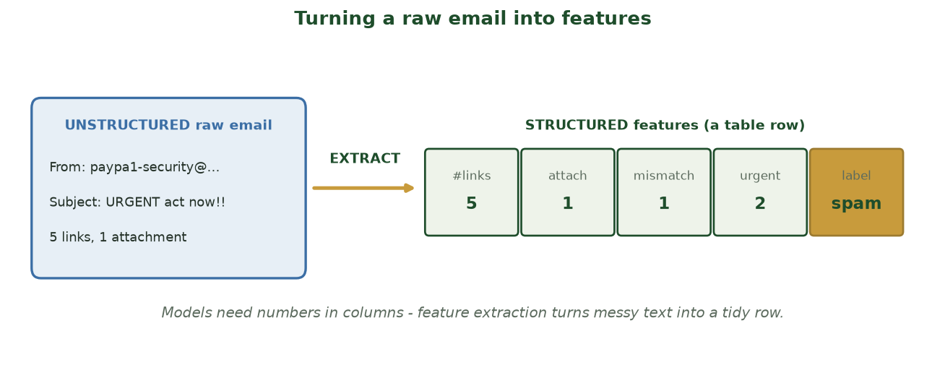
FEATURE EXTRACTION, VISUALIZED
Turning a Raw Email Into Features
A messy, unstructured email becomes one tidy structured row: #links, attachment, mismatch, urgent words, label.
CIS 350: AI for Cybersecurity · Wednesday
13
Notes:
Show exactly how the phishing table was born. Point at the raw email on the left (unstructured) and the tidy feature row on the right (structured). The 'EXTRACT' arrow is the human/engineering step that creates columns a model can use. This is what Lab 2 explores. ~2 min.

Slide 14
🧱 ACTIVITY · 7 MIN
Find the features and the label
Imagine a dataset to detect fraudulent transactions. As a group:
List four useful FEATURES (clues) you'd include.
What is the LABEL you're trying to predict?
Which one feature do you think matters most, and why?
CIS 350: AI for Cybersecurity · Wednesday
14
Notes:
Groups design a fraud dataset. 4 minutes to brainstorm, 3 to share. Expected features: amount, location, time of day, merchant type, device/IP; label: fraud / not fraud. Push them to justify the most important feature (e.g., 'amount far above this user's normal'). Reinforce features vs label as groups report. ~7 min.

Slide 15
PART 2 · TRUST THE FUEL · ~18 MIN
Data Quality: Garbage In, Garbage Out
Notes:
Transition: 'A model is only as trustworthy as its data - so let's look at what goes wrong.' ~18 minutes with an activity. Frame data quality as where the real ML work actually happens.

Slide 16
THE HARD TRUTH
Why Data Quality Decides Everything
A model trained on bad data learns the wrong lesson - confidently.
In security that means missed attacks or endless false alarms.
Cleaning and checking data is most of the real work in AI - often 80% of the time.
You cannot fix bad data by adding a fancier algorithm on top.
'Garbage in, garbage out' is the rule that governs every AI project.
Most real ML work is data work.
CIS 350: AI for Cybersecurity · Wednesday
16
Notes:
Reset a common misconception: students think AI is about clever algorithms; in reality most of the work is data wrangling (often ~80%). A model trained on bad data is confidently wrong - dangerous in security. Make 'garbage in, garbage out' the headline of this part. The next slides catalog the specific problems. ~3 min.

Slide 17
WHAT TO WATCH FOR
Common Data-Quality Problems
❓
⚖️
🏷️
🪞
Missing values
Imbalance
Mislabeled
Bias
Blank fields the model can't read.
999 normal, 1 attack - the rare case gets ignored.
Spam marked 'ham' teaches the wrong answer.
Data that doesn't represent the real world.
CIS 350: AI for Cybersecurity · Wednesday
17
Notes:
Catalog the four big problems with a security frame: missing values (blank fields), imbalance (attacks are rare), mislabeled (poisons supervised learning), bias (doesn't represent reality). Imbalance and mislabeling are the two that bite security teams hardest - flag that the next slide dwells on imbalance because it's so common and so deceptive. ~4 min.

Slide 18
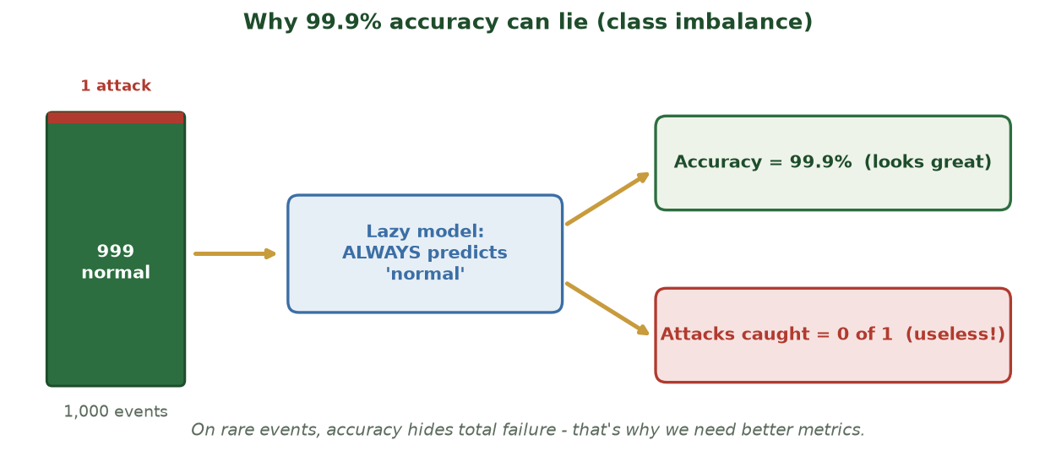
THE CLASS-IMBALANCE TRAP, VISUALIZED
Why 99.9% Accuracy Can Lie
With 999 normal events and 1 attack, a model that always says 'normal' scores 99.9% - yet catches zero attacks.
CIS 350: AI for Cybersecurity · Wednesday
18
Notes:
Use the diagram to make the imbalance trap unforgettable BEFORE the deep-dive slide. Trace it: 1,000 events (999 normal, 1 attack) -> a lazy 'always normal' model -> 99.9% accuracy but 0 attacks caught. That's why accuracy alone is dangerous on rare events - the setup for Week 4's better metrics. ~2 min.

Slide 19
THE TRAP
Deep-Dive: Class Imbalance (Why Accuracy Lies)
In security, attacks are RARE: maybe 1 in 1,000 events is malicious.
A lazy model that always says 'normal' is then 99.9% accurate...
...but it catches ZERO attacks - useless, despite the great-looking score.
Lesson: high accuracy can hide total failure on the cases that matter.
Fixes: collect more attack examples, resample, or use better metrics (Week 4).
99.9% accurate and catches nothing.
CIS 350: AI for Cybersecurity · Wednesday
19
Notes:
This is the most important data-quality idea for security, so give it its own slide. Walk the math slowly: if 1 in 1,000 events is an attack, a model that always predicts 'normal' scores 99.9% accuracy yet catches nothing. That's why accuracy alone is a trap - a direct setup for Week 4's confusion matrix and precision/recall. Name fixes briefly (more attack data, resampling, better metrics). ~4 min.

Slide 20
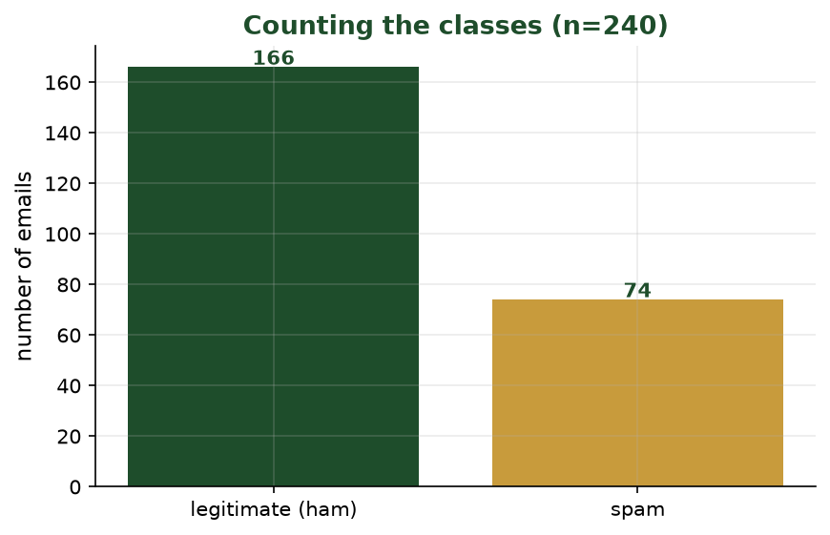
MORE LEGITIMATE MAIL THAN SPAM
Imbalance, Visualized
A bar chart of our 240 emails. Because one class is larger, plain accuracy can mislead (recall Week 2 Monday).
CIS 350: AI for Cybersecurity · Wednesday
20
Notes:
Make imbalance concrete with the real counts. Point out the taller 'legitimate' bar: a model that always guessed 'legitimate' would look accurate yet catch no spam. This is exactly the 'accuracy lies' trap. Ask: 'If 80% are legitimate, what accuracy does a do-nothing model get?' (80%). ~3 min.

Slide 21
SO WHAT?
Quality Problems Have Real Security Costs
Too many false positives -> analysts get alert fatigue and miss real threats.
Too many false negatives -> real attacks slip through unnoticed.
Biased data -> the tool works for some users or situations but not others.
Mislabeled data -> the model confidently learns the wrong thing.
Always ask: where did this data come from, and what might be missing?
Bad data has real-world costs.
CIS 350: AI for Cybersecurity · Wednesday
21
Notes:
Connect quality to consequences students already met in Week 1 (analyst fatigue, missed attacks). Spell out the four cost paths. Leave them with the analyst's habit-question: 'where did this data come from, and what might be missing?' - the single best instinct for evaluating any AI claim. ~3-4 min.

Slide 22
MAKING IT BETTER
How to Improve Data Quality
Clean: fix or remove errors, handle missing values, drop duplicates.
Balance: gather more rare-class examples or resample to fix imbalance.
Relabel: double-check labels - especially on the cases that matter most.
Document: record where data came from and how it was prepared.
Re-check often: data drifts as attackers and users change over time.
Clean, balance, relabel, document.
CIS 350: AI for Cybersecurity · Wednesday
22
Notes:
Give students a constructive toolkit so the section isn't just doom. Each fix maps to a problem from two slides ago (clean -> missing; balance -> imbalance; relabel -> mislabeled; document -> bias/trust). Add 'data drifts over time' to plant the idea that models need maintenance - they don't stay correct forever. This previews responsible-AI practices later in the course. ~3 min.

Slide 23
🧹 ACTIVITY · 6 MIN
Spot the data problem
A team trains a 'malicious login' detector. What could go wrong with their data?
Their data has 50,000 normal logins and only 12 attacks. -> ?
Half the 'time' fields are blank. -> ?
All attack examples came from one country. -> ?
CIS 350: AI for Cybersecurity · Wednesday
23
Notes:
Students diagnose a detector's data. Pairs 3 minutes, discuss 3. Answers: 50,000 vs 12 = imbalance; blank time fields = missing values; attacks from one country = bias. Push them to propose a FIX for each using the previous slide (collect more attacks/resample; impute or drop; diversify the data). ~6 min.

Slide 24
PART 3 · SEE IT · ~22 MIN
Visualizing Data to Spot Threats
Notes:
Transition: 'Before you model data, you look at it - charts are an analyst's first move.' ~22 minutes, ending with a worked phishing example, a Lab 2 demo preview, and an activity. Tie back to the bar chart they already made in Lab 1.

Slide 25
PICK THE RIGHT ONE
Charts Make Patterns Obvious
📊
📈
🔵
📐
Bar chart
Line chart
Scatter plot
Histogram
Compare counts (top attack types).
Track change over time (logins per hour).
Spot outliers and relationships.
See the spread (password lengths).
CIS 350: AI for Cybersecurity · Wednesday
25
Notes:
Match the chart to the question: bar = compare counts; line = change over time; scatter = relationships and outliers; histogram = the spread of one value. Remind them they already built a bar chart in Lab 1, so this is a toolkit, not new material. The next slides show what these charts reveal and then a worked phishing example. ~3-4 min.

Slide 26
READING THE PICTURE
What Charts Reveal in Security Data
A sudden SPIKE in a line chart -> a possible attack or outage.
An OUTLIER dot far from the rest -> unusual, worth investigating.
A tall BAR -> the most common attack to defend against first.
A lopsided HISTOGRAM -> most values cluster, a few extremes stand out.
A picture often surfaces problems faster than rows of numbers.
Spikes, outliers, tall bars.
CIS 350: AI for Cybersecurity · Wednesday
26
Notes:
Teach them to READ charts, not just make them. Each visual cue maps to a security action: spike = investigate a time window; outlier = investigate one entity; tall bar = prioritize a defense. The meta-point: the human eye catches spikes and outliers instantly, far faster than scanning a table - which is why visualization is an analyst's first move. ~3-4 min.

Slide 27
FROM A TABLE TO AN INSIGHT
Worked Example: Picturing the Phishing Data
700
300
legitimate
phishing
A bar chart of our dataset shows far more legitimate mail than phishing - that imbalance matters when we train and judge a model (recall Part 2).
CIS 350: AI for Cybersecurity · Wednesday
27
Notes:
Make visualization concrete with our own dataset. The two bars show many more legitimate emails than phishing - a real, visible class imbalance, tying Part 3 back to Part 2. Point out that a histogram of link counts would likely show spam clustered at higher link counts than ham - that's a feature that separates the classes, exactly what they'll look for in Lab 2. Ask: 'What does this imbalance mean for measuring accuracy?' ~4 min.

Slide 28
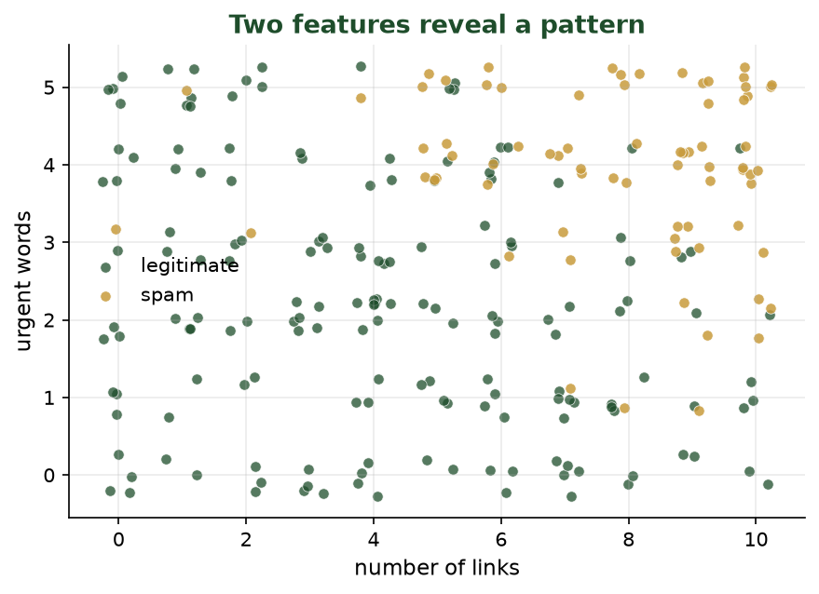
EACH DOT IS AN EMAIL, COLORED BY CLASS
Seeing the Pattern: a Scatter Plot
Spam (gold) clusters toward more links and more urgent words - the features really do separate the classes.
CIS 350: AI for Cybersecurity · Wednesday
28
Notes:
This is the 'aha' visual of the week. Each dot is an email plotted by two features; the colors form two clusters. This is WHY a classifier can work (and it's the bridge to Week 3). Ask students to eyeball where they'd draw a dividing line - that's what a model learns to do. ~3 min.

Slide 29
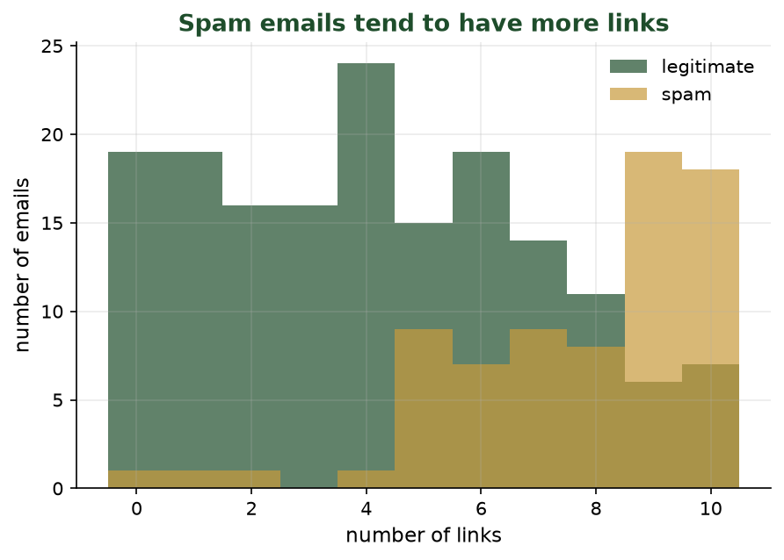
HOW MANY LINKS DO EMAILS HAVE?
A Histogram Tells a Story
Legitimate emails pile up at 0-2 links; spam spreads to higher counts. 'Number of links' is a useful feature.
CIS 350: AI for Cybersecurity · Wednesday
29
Notes:
Histograms show the SPREAD of one feature. Point out the green (legit) emails cluster at low link counts while gold (spam) reaches higher - so link count helps separate the classes. This is exactly the kind of chart students will make in Lab 2 to decide which features matter. ~3 min.

Slide 30
THREE LINES, THREE VIEWS OF THE DATA
Making These Charts in pandas
Python · Google Colab
import matplotlib.pyplot as plt
df['label'].value_counts().plot(kind='bar') # the counts bar
df.groupby('label')['num_links'].mean() # avg links per class
df[df.label=='spam']['num_links'].hist() # spread for spam
plt.show()
You'll run these exact lines in Lab 2.
CIS 350: AI for Cybersecurity · Wednesday
30
Notes:
Close the loop: the plots they just saw come from a few friendly lines. Map each line to the chart it makes (bar of counts, average by class, histogram). Reassure that Lab 2 provides this scaffolding - they fill small blanks. value_counts and groupby are recurring tools. ~3 min.

Slide 31
WHAT LAB 2 LOOKS LIKE
Demo Preview: Exploring a Phishing Dataset (Lab 2)
Load a real phishing-email dataset with pandas (like opening a spreadsheet).
Count phishing vs legitimate messages with value_counts() - just like Lab 1.
Chart suspicious words and link counts to compare spam vs ham.
Decide: which features best separate phishing from real mail?
Same gentle, guided, fill-in-the-blank style as Lab 1.
Live-demo a cell or two if you can.
CIS 350: AI for Cybersecurity · Wednesday
31
Notes:
Set up Lab 2 so it feels familiar and unintimidating. If a projector is available, run a cell or two live - load the data, call value_counts(), show one chart. Otherwise walk the structure. Emphasize it's the same fill-in-the-blank style as Lab 1, and it directly applies today's vocabulary (rows, features, labels) and skills (counting, charting). ~4 min.

Slide 32
📊 ACTIVITY · 6 MIN
What chart would you use?
Pick a chart type for each security question - and say why.
How do login attempts change across 24 hours?
Which five attack types are most common this month?
Are there a few transactions with unusually large amounts?
CIS 350: AI for Cybersecurity · Wednesday
32
Notes:
Students match chart to question and justify. Pairs 3, discuss 3. Answers: logins across 24 hours = line (change over time); five most common attack types = bar (compare counts); a few unusually large transactions = scatter or histogram (outliers/spread). Reinforce that there's rarely one 'right' chart, but some clearly fit better. ~6 min.

Slide 33
✏️ IN-CLASS TASK · 12 MIN
Draw the Line: Be the Classifier
Each pair gets the scatter plot of emails by number of links (x) and urgent words (y): green dots = legitimate, gold dots = spam, plus three black '?' emails. You are the classifier.
Draw ONE straight line that best separates spam (gold) from legitimate (green).
For each '?' point, predict spam or legitimate based on which side of your line it falls.
Count how many of the known emails your line misclassifies (green on the spam side, or vice versa).
Write one sentence: which single feature - links or urgent words - does more of the separating?
Deliverable: the marked-up plot with your line, 3 labeled '?' points, a miscount, and your one-sentence note.
CIS 350: AI for Cybersecurity · Wednesday
33
Notes:
Students BECOME the classifier - this makes 'the model draws a boundary' concrete and previews Week 3. Debrief: most lines misclassify a couple of borderline points (nobody is perfect - that's why we measure error in Week 4); number of links usually separates more than urgent words. A real classifier does exactly this, in more dimensions. ~12 min.

Slide 34
Key Takeaways
✓
A dataset is rows (records) and columns; features are the clues, the label is the answer.
✓
Supervised learning predicts the label from the features - good features matter most.
✓
Data quality (missing, imbalanced, mislabeled, biased) makes or breaks a model - garbage in, garbage out.
✓
Visualizing data reveals spikes, outliers, and patterns faster than raw numbers.
Notes:
Recap the four points. Make students do the work: have someone define features vs label one more time (the must-keep idea) and someone name a data-quality problem with why it's dangerous. ~2 min.

Slide 35
LOOKING AHEAD
This Week & Next
💻 Work on Lab 2 ('Exploring Security Data') - due Monday of Week 3.
✅ Complete Quiz 2 on Canvas if you haven't already.
📖 Review Handout 2; bring questions to office hours.
🏷️ Next week: Supervised Learning - teaching models with labels (your first classifier!).
Lab 2 due Wk3 Mon; preview Week 3.
CIS 350: AI for Cybersecurity · Wednesday
35
Notes:
Assign Lab 2 (due Monday of Week 3) and Quiz 2; tell them to review Handout 2. Build anticipation for Week 3: they'll train their FIRST classifier and the spam filter becomes real - 'next week you teach a machine to make a decision.' ~1-2 min.

Slide 36
🎟️ EXIT TICKET · 2 MIN
One minute before you go
On the Canvas exit-ticket quiz or a card:
In one sentence, what's the difference between a feature and a label?
Name one data-quality problem and why it's dangerous in security.
One question you still have.
CIS 350: AI for Cybersecurity · Wednesday
36
Notes:
Close with the 2-minute exit ticket. Specifically scan the feature-vs-label answers to confirm the week's key idea landed before you move on to supervised learning next week. ~2 min.

