Slide 1

WEEK 2 · MONDAY · 75 MINUTES
Data, the Fuel of AI
What AI Really Is · Rules vs Learning · Everyday AI · Security Data
CIS 350: AI for Cybersecurity — Smart Defense for the Digital Business
Ramadan Abdunabi, Ph.D. · Computer Information Systems
Notes:
Open with energy and connect to Week 1: 'Last week we learned WHAT we protect - assets, the CIA triad, the threats. This week we meet the engine behind modern defense: DATA, and the AI that learns from it.' Reassure the room: still no heavy math, and you don't need to code to follow today - the gentle coding comes in Lab 2. Preview the payoff: by Friday they'll explore a real security dataset. Confirm the screen is visible and Handout 2 is open. Aim to reach Part 1 by minute 7.

Slide 2

🔁 WARM-UP · 6 MIN
Recap: name that term
Quick retrieval from Week 1 with a neighbor.
What does the CIA triad stand for?
Name two common attack types.
Why are people the most-targeted layer?
CIS 350: AI for Cybersecurity · Monday
2
Notes:
Retrieval practice cements memory far better than re-reading, so start by pulling Week 1 back up. Give pairs 2 minutes, then cold-call gently for 3-4. Expected answers: CIA = Confidentiality, Integrity, Availability; attacks = phishing, malware, ransomware, DoS, insider; people are targeted because fooling a human is easier than breaking encryption and one click bypasses controls. Bridge line to today: 'Every one of those attacks leaves a trail of DATA - and data is what AI learns from.' ~6 min.

Slide 3
MONDAY · 75 MINUTES
Today's Plan
🧠
What AI actually is (minus the hype)
Plain-language AI and ML + diagrams
16 min
⚙️
Rules vs learning from data
Two ways software decides
12 min
🔨
Hands-on: the spam-rule arms race
Build it, break it, repeat
12 min
🏢
Everyday AI in business
Recommendations, fraud, spam, chatbots
10 min
🗂️
Where security data comes from
Logs, email, traffic, users
18 min
🎯
Recap, warm-up & wrap
Plus Lab 2 / Quiz 2
7 min
CIS 350: AI for Cybersecurity · Monday
3
Notes:
Walk the four content parts plus the wrap so students see the 75-minute arc and when the activities land. Note the minute budgets are real and you'll keep pace. Tell them this maps exactly to the four learning objectives on the next slide. ~1 min.

Slide 4
THIS WEEK'S LEARNING OBJECTIVES
What You'll Be Able to Do
1
Define artificial intelligence and machine learning in plain language.
2
Distinguish AI, ML, and traditional rule-based software.
3
Identify common sources of security data (logs, emails, network traffic).
4
Read a dataset in terms of rows, features, and labels (begun today, finished Wednesday).
CIS 350: AI for Cybersecurity · Monday
4
Notes:
Read the four objectives and tell students Quiz 2 maps directly to them. Note objective 4 starts today and is completed Wednesday. Keep brief. ~1 min.

Slide 5
PART 1 · MINUS THE HYPE · ~16 MIN
What AI Actually Is
Notes:
Transition into the conceptual foundation: 'Before we touch security data, let's demystify the two words everyone throws around - AI and machine learning.' ~16 minutes, ending with a poll. Energy up.

Slide 6
DEFINITION
Artificial Intelligence, in Plain Language
AI = getting computers to do tasks that normally need human intelligence.
Examples: recognizing faces, understanding language, detecting fraud, recommending products.
It is not magic and not conscious - it is math finding patterns in data.
AI is the big umbrella term; machine learning is the part driving today's boom.
Our working definition all semester: software that learns patterns from data to make decisions.
Decisions, not consciousness.
CIS 350: AI for Cybersecurity · Monday
6
Notes:
Demystify AI in plain words; this is objective 1. Kill the sci-fi image directly - AI is not a robot brain, it is pattern-finding at scale. Draw the umbrella relationship: AI is the field, ML is the engine behind the current excitement. Ask the class: 'Name one AI you've already used today' - expect maps, autocomplete, recommendations, face unlock. Hold the working definition up; you'll reuse it. ~3 min.

Slide 7
MINUS THE HYPE
What AI Is NOT (Cutting Through the Hype)
NOT conscious or 'thinking' - it has no understanding or intent.
NOT always right - it makes confident mistakes, especially on bad data.
NOT magic - every result traces back to data and math you can inspect.
NOT a replacement for judgment - in security, humans stay in the loop.
Healthy mindset: powerful tool, not an oracle. Always ask 'why did it decide that?'
Skepticism is a security skill.
CIS 350: AI for Cybersecurity · Monday
7
Notes:
This slide directly serves the 'minus the hype' theme. Students arrive with media-driven extremes - either AI is magic or it's coming for everyone. Replace both with a calm, accurate picture: it's a powerful pattern tool that is often wrong and always explainable in principle. Tie to security: a model that flags fraud can be wrong, so analysts verify - humans stay in the loop. Plant the habit of asking 'why did it decide that?', which returns in the ethics/explainability weeks. ~3 min.

Slide 8
THE CORE IDEA
Machine Learning: Learning From Examples
Traditional software: a human writes every rule by hand.
Machine learning: we show the computer many labeled examples and it learns the pattern itself.
Spam filter example: show 10,000 emails marked 'spam' or 'not spam' - it learns to tell them apart.
Nobody writes 'if subject = X then spam' - the model discovers the clues on its own.
More good examples usually means a better model.
It learns the rules instead of being given them.
CIS 350: AI for Cybersecurity · Monday
8
Notes:
The conceptual heart of objective 2. Make the contrast crisp: traditional software = humans write rules; ML = the machine infers rules from labeled examples. Anchor with the spam filter - it recurs all semester, so make it land. Emphasize nobody hand-coded the rule; the model found the pattern. Reinforce 'more good examples -> better model,' which sets up Wednesday's data-quality theme. ~3 min.

Slide 9
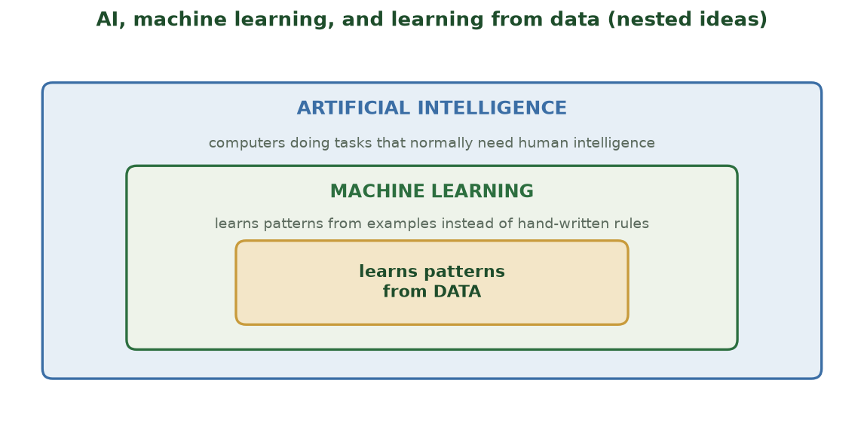
NESTED IDEAS, NOT COMPETING ONES
AI, ML, and Learning From Data
AI is the big umbrella; machine learning is the part inside it that learns patterns from data.
CIS 350: AI for Cybersecurity · Monday
9
Notes:
Use this nested picture to fix the vocabulary once and for all: AI is the broad field, machine learning is the subset driving today's boom, and its engine is 'learn patterns from data.' Point to each ring as you name it. This prevents the common mix-up of using 'AI' and 'ML' interchangeably. ~2 min.

Slide 10
DEMYSTIFYING TRAINING
How Does a Model Actually 'Learn'? (No Math)
Step 1 - GUESS: the model makes a prediction (spam or not).
Step 2 - CHECK: compare the guess to the real answer (the label).
Step 3 - ADJUST: nudge its internal numbers to be a little more right next time.
Repeat this over thousands of examples until predictions get good.
That loop - guess, check, adjust - is all 'training' really means.
Guess -> check -> adjust, repeated.
CIS 350: AI for Cybersecurity · Monday
10
Notes:
Students often think 'learning' is mysterious; this removes the mystery without a single equation. Use a relatable analogy: learning to shoot a basketball - shoot, see how far off, adjust, repeat. The model does the same with numbers. Stress this requires labeled examples (the 'real answer'), which is why labels matter so much on Wednesday. Don't go deeper than guess/check/adjust today. ~3 min.

Slide 11
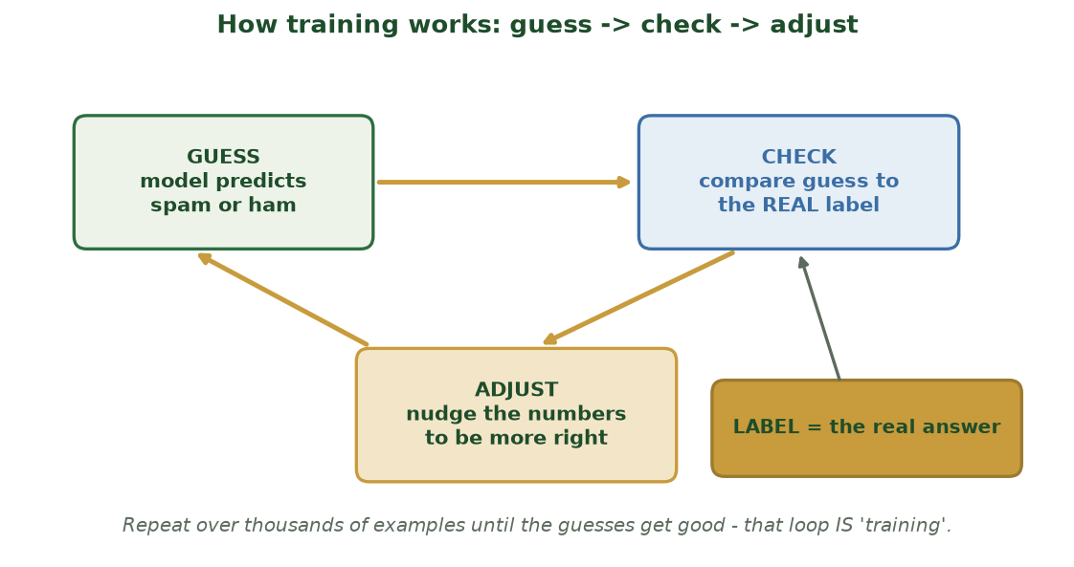
'TRAINING' IS JUST A REPEATING LOOP
How Training Works: Guess -> Check -> Adjust
The model guesses, compares its guess to the real label, and nudges its numbers - repeated over many examples.
CIS 350: AI for Cybersecurity · Monday
11
Notes:
Make 'training' concrete and unmysterious with the loop diagram. Trace it: guess (spam/ham) -> check against the real label -> adjust the numbers -> guess again, better. The LABEL is what makes 'check' possible - that's why labeled data matters. ~2 min.

Slide 12
THE MAP AHEAD
Four Styles of Machine Learning (Preview)
🏷️ Supervised - learn from labeled examples (spam vs not spam). Most of this course.
🔍 Unsupervised - find patterns with no labels (group similar logins). Week 6.
🧩 Semi-supervised - a few labels plus lots of unlabeled data. Week 7.
🎮 Reinforcement - learn by trial, reward, and penalty. Week 7.
Today and the next few weeks focus on supervised learning.
Plant vocabulary; depth comes later.
CIS 350: AI for Cybersecurity · Monday
12
Notes:
A 60-second tour, not a deep dive - you're planting vocabulary you will return to. Name each style with its one-line idea and the week it's covered, so students don't feel they must master it now. Emphasize supervised learning is the near-term focus because it matches the labeled spam example. ~2 min.

Slide 13
✋ QUICK POLL · 6 MIN
AI... or just a program?
Thumbs up = uses machine learning; thumbs down = plain fixed rules. Discuss the close calls.
A calculator adding two numbers. (rules)
Your phone suggesting the next word as you type. (ML)
A thermostat turning on at 70 degrees. (rules)
Email moving a message to Spam on its own. (ML)
CIS 350: AI for Cybersecurity · Monday
13
Notes:
Run the thumbs poll; read each item, take the vote, then discuss for ~4 minutes. Answers: calculator = rules; next-word suggestion = ML; thermostat = rules; spam auto-sort = ML. The teaching point is the boundary between fixed rules and learned patterns - the thermostat vs autocomplete pair usually sparks good debate. This wraps Part 1. ~6 min.

Slide 14
PART 2 · TWO WAYS TO DECIDE · ~14 MIN
Rules vs Learning From Data
Notes:
Transition: 'We've seen what AI is - now, HOW does software decide? Two ways: hand-written rules, or learning from data.' ~14 minutes with one activity. Frame it as a practical choice security teams make.

Slide 15
SAME GOAL, VERY DIFFERENT APPROACH
Two Ways to Build a Spam Filter
📝 Rule-based (traditional)
🤖 Machine learning
A human writes rules: 'if subject has FREE, mark spam.'
Easy to understand and explain to a manager.
Breaks when attackers change wording (F-R-E-E, Fr33).
Someone must keep writing new rules forever.
Great for simple, stable problems.
Learns patterns from thousands of labeled emails.
Adapts to new tricks without hand-written rules.
Weighs dozens of subtle clues at once.
Needs good data and is harder to fully explain.
Great for complex, changing problems.
CIS 350: AI for Cybersecurity · Monday
15
Notes:
This side-by-side is the spine of Part 2 and objective 2. Walk the left column (clear but brittle, endless maintenance) then the right (adaptive but data-hungry and harder to explain). Ask: 'Which would you rather maintain for five years?' Set up the next three slides, which dig into when each approach wins. ~3-4 min.

Slide 16
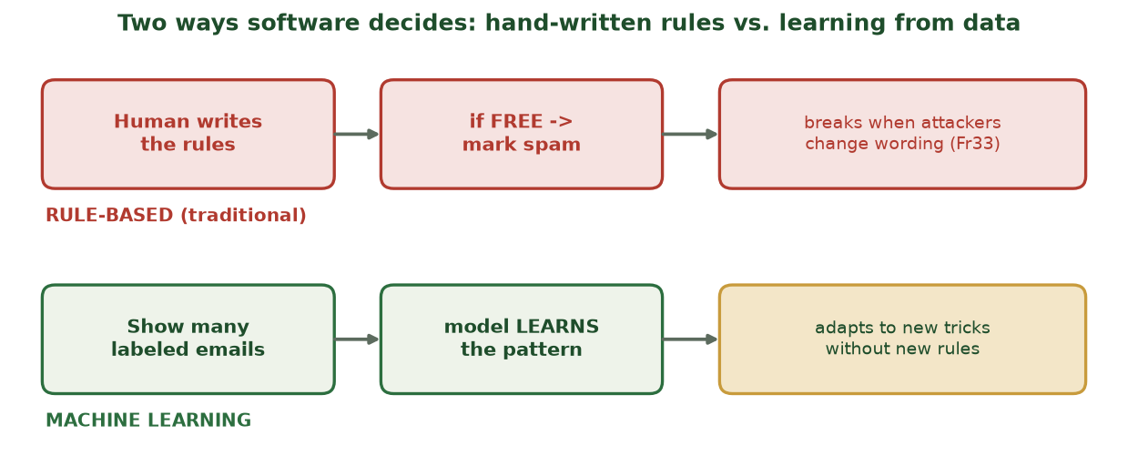
RULES VS. LEARNING FROM DATA
Two Ways to Decide, Side by Side
Hand-written rules break when attackers change wording; a model learns the pattern and adapts.
CIS 350: AI for Cybersecurity · Monday
16
Notes:
Reinforce the two-paths idea visually. Trace the red (rule-based) path: a human writes a rule that an attacker trivially bypasses ('Fr33'), forcing endless new rules. Then the green (ML) path: show labeled examples, the model learns the pattern and adapts. This picture is the anchor for the whole part. ~2 min.

Slide 17
CHOOSING AN APPROACH
Rules Are Great - Until They Aren't
Rules win when the problem is simple, stable, and easy to state.
Example: 'lock the account after 5 wrong passwords.' Clear and effective.
Rules give you transparency - you can read exactly why something happened.
But they struggle when attackers constantly change tactics.
Neither approach is 'better' - you fit the tool to the problem.
Fit the tool to the problem.
CIS 350: AI for Cybersecurity · Monday
17
Notes:
Make the balanced case so students don't think 'ML good, rules bad.' Rules shine for simple, stable, explainable policies - account lockout, password length, firewall allow/deny. Give one security example. The honest framing: it's about fit, not fashion. Sets up the brittleness example next. ~3 min.

Slide 18
WORKED EXAMPLE
A Rule in Action - and How It Breaks
Rule: 'If the subject line contains FREE, mark it spam.' Simple and fast.
It works... until an attacker writes 'F-R-E-E', 'Fr33', or 'no cost'.
So you add another rule. Then another. The list never ends.
This cat-and-mouse is why pure rule lists lose to creative attackers.
It is exactly the gap machine learning was built to fill.
Let students invent the bypasses.
CIS 350: AI for Cybersecurity · Monday
18
Notes:
Make the brittleness vivid and interactive: put the FREE rule up and ask the class to BREAK it. They will instantly suggest F-R-E-E, Fr33, 'no cost,' emojis, etc. Each bypass forces a new rule and the list explodes - that's the cat-and-mouse problem. Letting students do the creating is what makes it memorable, and it earns the payoff on the next slide. ~3-4 min.

Slide 19
🔨 IN-CLASS TASK · 12 MIN
Build It, Break It: the Spam-Rule Arms Race
In pairs, run an 'escalation ladder' with three sample spam subject lines (e.g., 'FREE prize - claim now', 'You WON a gift card', 'Urgent: verify your account'). One partner defends with rules; the other attacks.
DEFENDER writes Rule #1: one keyword condition to flag spam (e.g., 'if subject contains FREE -> spam').
ATTACKER rewrites the message to evade it ('Fr33', 'F-R-E-E', 'no cost') and logs the bypass.
Repeat for FOUR rounds - Rule #2, #3, #4 - keeping a running tally of rules written.
Write one sentence: what happened to the rule list's length, and would a 5th round finally win?
Deliverable: a 4-round Rule -> Bypass ladder + a rule count + a one-sentence conclusion.
CIS 350: AI for Cybersecurity · Monday
19
Notes:
This task makes the brittleness of rules visceral - students SEE the rule list explode while the attacker keeps winning. Debrief: the list grows every round and never 'wins' against a creative attacker; that endless cat-and-mouse is exactly the gap machine learning fills (next slide). ~12 min.

Slide 20
THE PAYOFF
Why Learning Wins as Threats Evolve
Attackers change wording, links, and tactics constantly.
An ML filter retrains on fresh labeled examples and keeps up automatically.
It can weigh dozens of subtle clues at once, not just one keyword.
Trade-off: it needs good, labeled data and is harder to fully explain.
In practice, real systems combine BOTH: fast rules plus an adaptive model.
Real systems layer rules AND ML.
CIS 350: AI for Cybersecurity · Monday
20
Notes:
Pay off the brittleness example. ML keeps up because it retrains on new labeled data and weighs many clues together, not one keyword. Be honest about the trade-offs (needs good data; harder to explain) to keep it balanced - this connects to the ethics/explainability weeks. End on the real-world truth: production systems usually layer fast rules in front of an adaptive model. ~3 min.

Slide 21
⚙️ ACTIVITY · 6 MIN
Rules or learning?
For each task, decide: hand-written rules, or machine learning? Why?
Lock an account after 5 failed logins.
Decide if a never-seen email is phishing.
Require passwords to be at least 12 characters.
Spot a brand-new type of fraud in millions of transactions.
CIS 350: AI for Cybersecurity · Monday
21
Notes:
Students decide rules vs ML and justify. Pairs 3 minutes, discuss 3. Answers: lock after 5 fails = rules (simple, stable); classify a never-seen email = ML (novel, complex); 12-char passwords = rules (fixed policy); brand-new fraud in millions of transactions = ML (scale + novelty). Name the pattern out loud: simple+stable -> rules; novel+complex+big-data -> learning. ~6 min.

Slide 22
PART 3 · YOU USE IT DAILY · ~12 MIN
Everyday AI in Business
Notes:
Transition: 'You already rely on this stuff every day - let's name it, then connect it to security.' ~12 minutes. Keep it brisk and relatable before pivoting to security data in Part 4.

Slide 23
FOUR EVERYDAY EXAMPLES
AI Is Already All Around You
🛒
💳
📧
💬
Recommendations
Fraud alerts
Spam filters
Chatbots
'Customers also bought...' suggestions.
Your bank flags a strange charge in seconds.
Email sorts junk from real mail automatically.
Assistants that understand plain-language questions.
CIS 350: AI for Cybersecurity · Monday
23
Notes:
Make AI relatable before the security specifics - this is the 'everyday AI in business' theme. Walk the four examples and ask which they noticed this week. The point: AI is already woven into business; security is one more high-stakes application of the same idea. The next two slides go a level deeper on how a couple of these work. ~2 min.

Slide 24
SAME PATTERN, DIFFERENT DATA
How Two of These Actually Work
🛒 Recommendations
💳 Fraud alerts
Learns from what huge numbers of customers viewed and bought.
Finds 'people like you' patterns and suggests the next item.
Business value: more sales, longer engagement.
Learns the pattern of YOUR normal spending.
Flags transactions that look unusual (amount, place, time).
Business value: stops losses in seconds, builds trust.
CIS 350: AI for Cybersecurity · Monday
24
Notes:
Go one level deeper so 'AI in business' isn't hand-wavy. Both are the SAME idea from Part 1 - learn a pattern from data, then act on new cases. Recommendations learn 'people like you'; fraud alerts learn 'your normal' and flag deviations (foreshadowing anomaly detection in Week 6). Tie the business value back to dollars and trust, the language executives care about. ~3 min.

Slide 25
FROM BUSINESS TO SECURITY
Spam Filters & Chatbots - and the Security Tie-In
Spam filters: learn from labeled emails to sort junk from real mail (our anchor example).
Chatbots / LLMs: learn language patterns to answer questions in plain English.
Security tie-in: the SAME techniques detect phishing, fraud, and intrusions.
The flip side (Week 8+): attackers use these tools too - AI-written phishing, deepfakes.
That dual-use reality is exactly why this course pairs AI with security.
Same tech, defense and offense.
CIS 350: AI for Cybersecurity · Monday
25
Notes:
Bridge everyday AI to the course's core thesis. Spam filtering is literally the supervised example from Part 1; chatbots/LLMs show language AI. The key move: the same pattern-learning powers security detection - and, as Week 8 will show, attackers use it too. This dual-use framing motivates why we study both sides. Keep it tight; it bridges into Part 4. ~3 min.

Slide 26
🏢 DISCUSS · 4 MIN
Spot the AI in a business you know
Think of a company you use (store, bank, streaming, social app).
Where is AI making a decision for you in that company?
What data do you think it learned from?
What could go wrong if that data were biased or wrong?
CIS 350: AI for Cybersecurity · Monday
26
Notes:
A short think-pair-share to make it personal and surface the data angle that Part 4 and Wednesday build on. Give ~2 minutes to think/talk and ~2 to share. Listen for answers that name the DATA behind the AI (purchase history, viewing history, transactions) - that's the hook into 'where does security data come from?' next. ~4 min.

Slide 27
PART 4 · THE FUEL · ~22 MIN
Where Security Data Comes From
Notes:
Transition to the heart of objective 3: 'AI is only as good as its fuel - so where does security data come from?' ~22 minutes, the biggest part, with deep-dives into each source and a closing activity that previews Lab 2. Energy up - this connects directly to what they'll do in the lab.

Slide 28
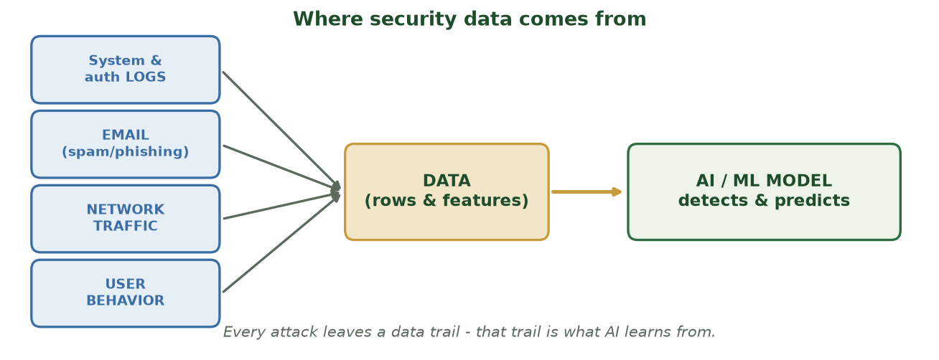
DATA IS THE FUEL FOR AI DEFENSE
The Big Picture: Sources to Model
Logs, email, network traffic, and user behavior become DATA - which an AI/ML model learns from to detect and predict.
CIS 350: AI for Cybersecurity · Monday
28
Notes:
Open Part 4 with the overview pipeline before drilling into each source. The takeaway line: every attack leaves a data trail, and that trail is exactly what AI learns from. This frames 'data as fuel' and motivates the five sources on the next slide. ~2 min.

Slide 29
FIVE RICH SOURCES
Security Data Is Everywhere
📜
📧
🌐
💻
👤
System logs
Email
Network traffic
Endpoints
User activity
Who did what, when (logins, access, changes).
Messages, senders, links, attachments.
What's flowing in and out of the network.
Laptops, phones, servers - processes & files.
Clicks, downloads, normal vs unusual behavior.
CIS 350: AI for Cybersecurity · Monday
29
Notes:
Objective 3. Introduce the five major sources and what each answers. Quick interaction: 'To investigate a stolen password, which would you check first?' (logs). Tell students the next three slides open up logs, email/network, and endpoint/user data so the sources feel concrete, not just labels. ~3 min.

Slide 30
SOURCE 1 OF 5
Source Deep-Dive: System Logs
A log is a timestamped record of an event: 'user X logged in from IP Y at 3:02 a.m.'
Logs come from servers, applications, firewalls, and operating systems.
They answer: who, what, when, where - the backbone of most investigations.
Security example: 100 failed logins in a minute can signal a brute-force attack.
Challenge: there are millions of log lines - too many for humans alone (enter AI).
Logs = the who/what/when/where.
CIS 350: AI for Cybersecurity · Monday
30
Notes:
Make logs concrete by reading a sample line aloud and naming its parts (user, IP, time, action). Logs are the most common security data source and the backbone of investigations. The volume point is important: millions of lines per day is exactly why we need AI to find the needle - it foreshadows the anomaly-detection labs. Ask what a burst of failed logins might mean. ~4 min.

Slide 31
TWO MORE RICH SOURCES
Source Deep-Dive: Email & Network Traffic
📧 Email data
🌐 Network traffic
Sender address, subject, links, attachments, headers.
Powers phishing and spam detection (our running example).
Features we can extract: link count, look-alike sender, urgent words.
Records of connections: source, destination, size, timing.
Reveals data leaving to unknown servers or unusual volumes.
Used to spot intrusions, malware 'phoning home,' and DDoS.
CIS 350: AI for Cybersecurity · Monday
31
Notes:
Two sources side by side. For email, connect directly to the phishing dataset they'll see Wednesday and in Lab 2 - point out the features we can pull from a raw email. For network traffic, give the vivid image of a laptop quietly 'phoning home' to an attacker's server, or a flood signaling DDoS. Emphasize that raw data becomes useful only after we extract features (Wednesday's topic). ~4 min.

Slide 32
SOURCES 4 & 5 OF 5
Source Deep-Dive: Endpoints & User Activity
Endpoints = the devices: laptops, phones, servers - their processes, files, and settings.
Endpoint data catches malware running, new unknown programs, or risky configurations.
User activity = clicks, downloads, file access, login times - a behavior fingerprint.
Security example: an account suddenly downloading thousands of files at midnight.
Combining sources (logs + endpoint + user) gives the full story of an incident.
Devices and behavior patterns.
CIS 350: AI for Cybersecurity · Monday
32
Notes:
Round out the five sources. Endpoints tell you what's happening ON the machine; user activity builds a behavioral baseline so deviations stand out (again foreshadowing anomaly detection). The key takeaway across all five: real investigations COMBINE sources - no single source tells the whole story. This sets up the closing activity. ~4 min.

Slide 33
THE BIG POINT
Why Data Is the 'Fuel'
AI models are only as good as the data they learn from.
More relevant, accurate examples usually means smarter detection.
'Garbage in, garbage out' - bad data produces bad security decisions.
Security teams collect, clean, and label data before any AI can help.
Privacy matters: this data is sensitive and must be handled responsibly.
Garbage in, garbage out.
CIS 350: AI for Cybersecurity · Monday
33
Notes:
Drive home why this whole part matters: the model is only as good as its fuel. Introduce 'garbage in, garbage out' here and tell students it's Wednesday's entire middle section. Give the cautionary example: a spam filter trained on mislabeled mail confidently learns the wrong thing. Flag privacy - this data is sensitive (a thread for the ethics weeks). ~3-4 min.

Slide 34
MAKING THE FUEL USABLE
From Raw Data to a Usable Dataset
Raw security data is messy - it isn't ready for AI as-is.
1) Collect it from the sources (logs, email, network traffic).
2) Clean it - fix errors, handle missing or duplicate entries.
3) Label it - mark examples (for instance, 'phishing' vs 'legitimate').
4) Pick features - the clues the model learns from (Wednesday's topic!).
Collect, clean, label, feature-ize.
CIS 350: AI for Cybersecurity · Monday
34
Notes:
Walk the pipeline that turns messy raw data into something a model can use. Make step 4 a cliffhanger: picking features is literally Wednesday's whole session, and Lab 2 starts at step 1 with a real phishing dataset. This is the bridge slide from today into Wednesday. ~3 min.

Slide 35
THE ANALYST'S OPENING MOVES (PREVIEW OF LAB 2)
A First Look in pandas
Python · Google Colab
import pandas as pd
df = pd.read_csv('emails.csv') # the labeled security data
df.head() # first rows: features + label
df.shape # (rows, columns) -> (240, 5)
df['label'].value_counts() # how many spam vs ham
These exact lines start Lab 2 - no need to memorize them.
CIS 350: AI for Cybersecurity · Monday
35
Notes:
Show students that exploring data is just a few friendly lines - this lowers coding anxiety before Lab 2. Read each line aloud in plain English: read the file, peek at the top, check the size, count the classes. Note value_counts() is the same tool from Lab 1's password counts. Tell them they don't memorize syntax - they understand what each line DOES. This is literally the start of the Lab 2 notebook. ~3 min.

Slide 36
🔎 ACTIVITY · 7 MIN
Where would you look?
Match each situation to the data source you'd investigate first.
An account logged in from another country at 3 a.m. -> ?
A wave of look-alike emails hits the finance team. -> ?
A laptop is suddenly sending data to an unknown server. -> ?
A user keeps downloading huge files they never touched before. -> ?
CIS 350: AI for Cybersecurity · Monday
36
Notes:
Closing activity that rehearses an analyst's instincts. Pairs 3-4 minutes, discuss 3. Answers: foreign 3 a.m. login = logs; look-alike emails = email; laptop to unknown server = network traffic (and endpoint); huge unusual downloads = user activity. Reinforce the recurring point: real cases pull from several sources at once. ~7 min.

Slide 37
Key Takeaways
✓
AI = computers doing intelligence-like tasks; ML = learning patterns from labeled examples.
✓
Rules are hand-written and clear; ML adapts to complex, changing problems but needs good data.
✓
Everyday AI (recommendations, fraud, spam, chatbots) is the same idea security uses to defend.
✓
Security data comes from logs, email, network traffic, endpoints, and user activity - and data is the fuel.
Notes:
Recap the four points - one per objective. Make students do the work: have someone restate AI vs ML in a sentence, and someone name a data source plus a question it answers. Active recall here predicts Quiz 2 performance. ~2 min.

Slide 38
LOOKING AHEAD
Before Wednesday
💻 Lab 2 - 'Exploring Security Data' is released today (pandas + a phishing dataset).
📝 Quiz 2 is Wednesday (AI vs ML vs rules; data sources; features & labels).
📖 Read Handout 2: Introduction to Data and AI.
🧱 Wednesday: the anatomy of a dataset - rows, columns, features, and labels.
Assign Lab 2, Quiz 2, Handout 2.
CIS 350: AI for Cybersecurity · Monday
38
Notes:
Assign clearly and preview Wednesday. Lab 2 is the same gentle, guided style as Lab 1 (pandas + a phishing dataset). Quiz 2 covers exactly today's objectives. Read Handout 2. Wednesday finishes objective 4 - the anatomy of a dataset. ~1-2 min.

Slide 39
🎟️ EXIT TICKET · 2 MIN
One minute before you go
In the Canvas exit-ticket quiz or on a card:
In your own words, what's the difference between AI and ML?
Name one security data source and one question it could answer.
One thing you'd like more explanation on.
CIS 350: AI for Cybersecurity · Monday
39
Notes:
Close with a 2-minute exit ticket; tell students you'll read them and open Wednesday with the muddiest points. It cements learning and gives you feedback to adjust. ~2 min.

