Slide 1

WEEK 1 · WEDNESDAY · 75 MINUTES
The Threat Landscape & the Human Factor
Attacks · Defenses · Why People Are the #1 Target
CIS 350: AI for Cybersecurity — Smart Defense for the Digital Business
Ramadan Abdunabi, Ph.D. · Computer Information Systems

Slide 2

🔁 WARM-UP POLL · 5 MIN
60-second recap: the CIA triad
Without your notes — what do C, I, and A stand for, and one example of each?
Turn to a neighbor and explain all three in plain English.
We'll crowdsource the best one-line definition for each.
Bridge: today we meet the threats that try to break them.
CIS 350: AI for Cybersecurity · Week 1 · Wednesday
2

Slide 3
WEDNESDAY · 75 MINUTES
Today's Plan
🔁
Warm-up: CIA triad recap
Think–pair–share before we meet the threats
5 min
🗺️
The attack landscape
Phishing, malware, ransomware, DoS, insiders (+ anatomy diagram)
22 min
🛡️
Defensive strategies
Prevent · Detect · Respond + Swiss-cheese + mini tabletop
18 min
🧱
Hands-on: stack the defenses
Design a layered defense-in-depth plan
12 min
👤
The human factor
Social engineering & the human firewall
13 min
🎯
Wrap-up & exit ticket
Takeaways and what's next
5 min
CIS 350: AI for Cybersecurity · Week 1 · Wednesday
3

Slide 4
PART 1 · KNOW YOUR ENEMY · ~28 MIN
The Attack Landscape

Slide 5
A FIELD GUIDE
Five Attacks You'll Meet Again and Again
🎣
🦠
🔐
🌊
👤
Phishing
Malware
Ransomware
Denial of Service
Insider Threat
Tricking people into clicking or sharing secrets.
Malicious software that infects systems.
Locks your files and demands payment.
Floods a system until it goes down.
Risk from people on the inside.
CIS 350: AI for Cybersecurity · Week 1 · Wednesday
5

Slide 6
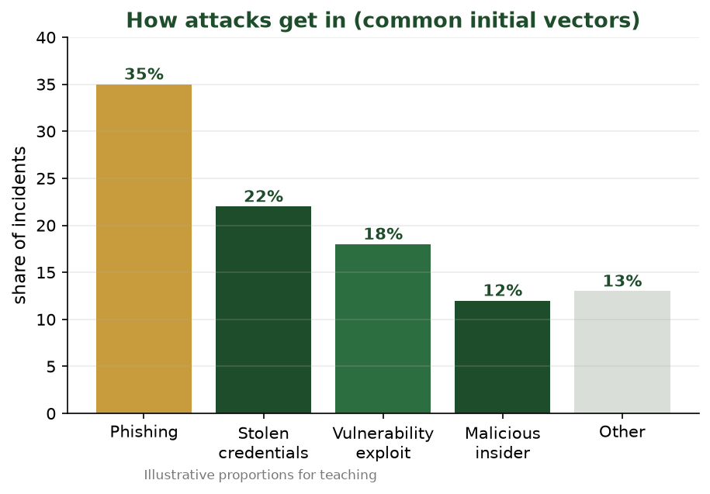
THE COMMON INITIAL VECTORS
How Attacks Actually Get In
Phishing leads the way in. Most attacks start by targeting a person, not breaking encryption.
CIS 350: AI for Cybersecurity · Week 1 · Wednesday
6

Slide 7
ATTACK SPOTLIGHT 1
Phishing — the #1 Way In
A fake message that looks legitimate and pushes you to act fast.
Goal: steal credentials, plant malware, or trigger a payment.
It's cheap, scalable, and now AI-written — so it's grammatically perfect.
Most major breaches start with a single successful phishing message.
CIS 350: AI for Cybersecurity · Week 1 · Wednesday
7

Slide 8
SAME TRICK, DIFFERENT CHANNEL & TARGET
Phishing Comes in Many Flavors
🎯
🐳
📱
📞
💸
Spear phishing
Whaling
Smishing
Vishing
BEC
Tailored to you using real personal details.
Targets executives and other 'big fish'.
Phishing by SMS / text message.
Voice calls, often faking IT or a bank.
Business Email Compromise — fake boss/vendor invoices.
Business Email Compromise (BEC) quietly causes some of the largest financial losses of any attack type — no malware required, just a convincing email.
CIS 350: AI for Cybersecurity · Week 1 · Wednesday
8

Slide 9
DEFENSE STARTS WITH AWARENESS
How to Spot a Phish — Red Flags
⏰ Urgency or threats: 'Your account closes in 24 hours!'
🔗 Mismatched links: the text says one site, the link goes elsewhere.
✉️ Look-alike senders: micros0ft-support.com, paypa1.com.
📎 Unexpected attachments or requests for passwords / payment / gift cards.
🙋 Generic greetings, odd tone, or 'keep this confidential.'
Golden rule: slow down and verify through a separate, trusted channel.
CIS 350: AI for Cybersecurity · Week 1 · Wednesday
9

Slide 10
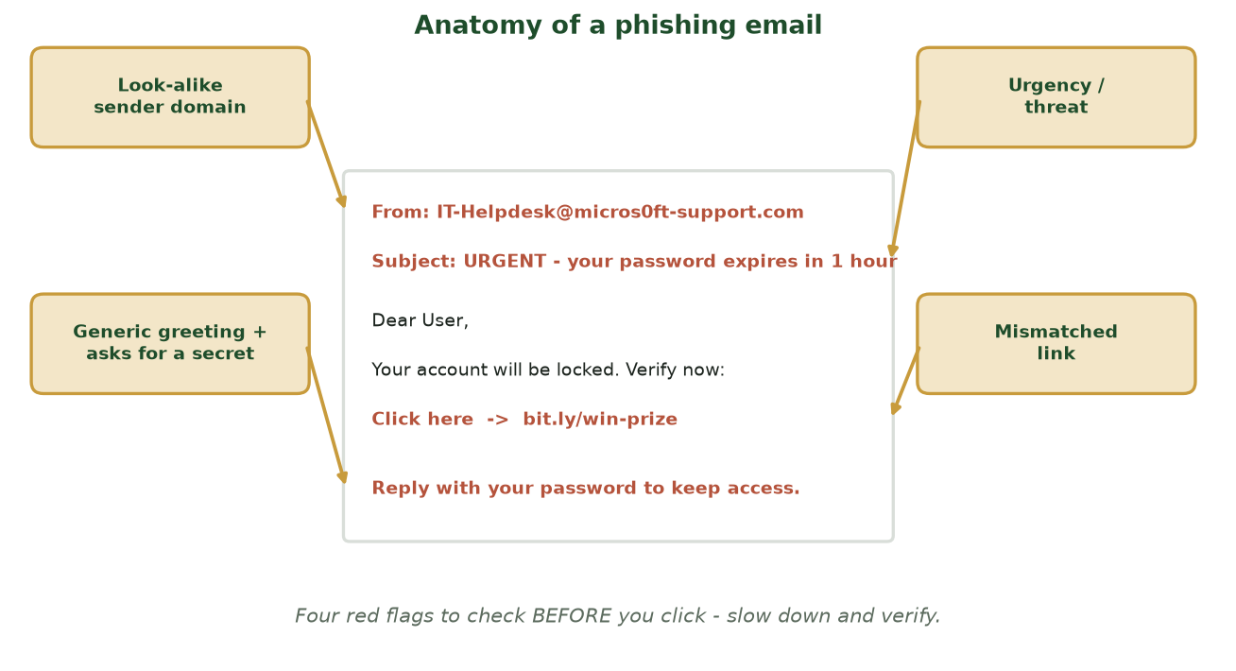
WHERE TO LOOK BEFORE YOU CLICK
Anatomy of a Phishing Email
The same fake email, with the four tell-tale red flags labeled: look-alike sender, urgency, mismatched link, and a request for a secret.
CIS 350: AI for Cybersecurity · Week 1 · Wednesday
10

Slide 11
🎣 ACTIVITY · 6 MIN
Spot the Phish
Here's an email to the finance team. Find every red flag before you'd click.
"From: IT-Helpdesk@micros0ft-support.com" — look closely at the spelling.
"URGENT: your password expires in 1 hour — verify now to avoid lockout."
"Click here to keep your account" → link points to bit.ly/win-prize.
PAIR UP (3 min): list the red flags, then decide — click, delete, or report?
CIS 350: AI for Cybersecurity · Week 1 · Wednesday
11

Slide 12
AN ATTACKER'S TOOLBOX
Malware — Malicious Software
🦠
🐴
🕵️
🤖
Virus / Worm
Trojan
Spyware
Botnet
Self-spreading code; worms need no clicks.
Hides inside something that looks safe.
Secretly watches and steals data/keystrokes.
Hijacked machines controlled in an army.
CIS 350: AI for Cybersecurity · Week 1 · Wednesday
12

Slide 13
ATTACK SPOTLIGHT 2
Ransomware — Malware That Holds You Hostage
Encrypts your files, then demands payment for the key.
Modern 'double extortion': steals a copy first — 'pay or we leak it.'
Spreads via phishing, stolen passwords, and unpatched systems.
Business impact: downtime, lost data, ransom, legal fines, lost trust.
Paying is risky and discouraged — backups are the real defense.
Recovery and downtime usually cost far more than the ransom itself.
CIS 350: AI for Cybersecurity · Week 1 · Wednesday
13

Slide 14
DIFFERENT ATTACKS, DIFFERENT DEFENSES
Two More to Know
🌊 Denial of Service (DoS / DDoS)
👤 Insider Threats
Flood a site or service with junk traffic until real users can't get in.
'DDoS' uses a botnet — thousands of machines attacking at once.
Goal: disruption, extortion, or distraction from another attack.
Defenses: traffic filtering, rate limits, CDNs, cloud scrubbing.
Malicious: an employee steals data or sabotages systems.
Negligent: a careless click, lost laptop, or misconfigured share.
Compromised: an outsider using a real employee's stolen account.
Defenses: least privilege, monitoring, offboarding, a speak-up culture.
CIS 350: AI for Cybersecurity · Week 1 · Wednesday
14

Slide 15
🗂️ ACTIVITY · 6 MIN
Classify the Attack
For each scenario, name the attack type — and one defense that would help.
Staff get a text: 'I'm your CEO, buy gift cards now.' → ?
The store website is unreachable on Black Friday from junk traffic. → ?
A departing employee emails the client list to a personal account. → ?
An invoice email asks to 'update' the vendor's bank account number. → ?
CIS 350: AI for Cybersecurity · Week 1 · Wednesday
15

Slide 16
PART 2 · DEFENDING THE BUSINESS · ~20 MIN
Prevent · Detect · Respond

Slide 17
THE CORE IDEA
Defense in Depth — Layers, Not a Single Wall
No single control is perfect, so we stack many independent layers.
Think of slices of Swiss cheese: the holes rarely line up.
Layers span people, process, and technology — not just firewalls.
If one layer fails, the next one still has a chance to stop the attack.
CIS 350: AI for Cybersecurity · Week 1 · Wednesday
17

Slide 18
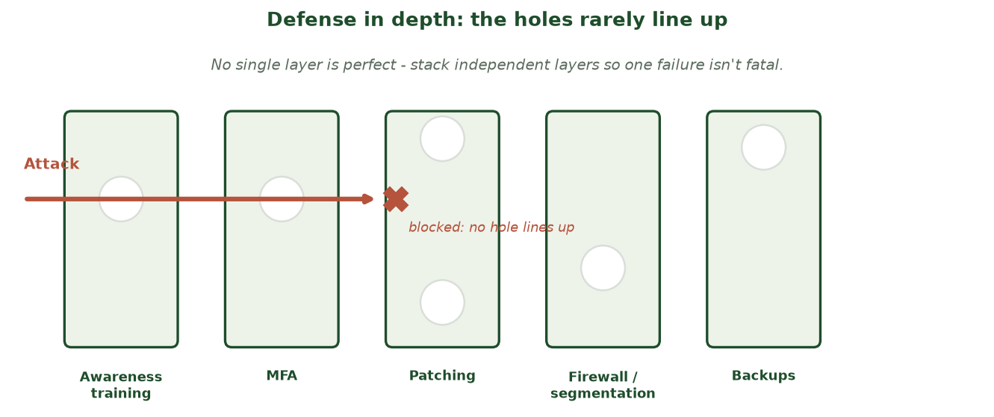
HOLES RARELY LINE UP
Defense in Depth: the Swiss-Cheese Model
An attack slips through the gaps in the first layers but is stopped where a later layer has no matching hole.
CIS 350: AI for Cybersecurity · Week 1 · Wednesday
18

Slide 19
EVERY PROGRAM NEEDS ALL THREE
Prevent → Detect → Respond
🛡️
Prevent
Stop attacks before they land: training, MFA, patching, least privilege, firewalls, segmentation.
🔎
Detect
Catch what slips through: logging, SIEM, IDS/IPS, and AI-powered anomaly detection.
🚑
Respond
Limit damage: contain, eradicate, recover, and learn from every incident.
AI shows up most in Detection — finding the needle in millions of events — which is exactly what your labs build.
CIS 350: AI for Cybersecurity · Week 1 · Wednesday
19

Slide 20
A CALM, REPEATABLE 6-STEP PLAYBOOK
When Prevention Fails: Incident Response
1
2
3
4
5
6
Prepare
Identify
Contain
Eradicate
Recover
Learn
The goal isn't to never get hit — it's to detect fast, contain the damage, recover, and come back stronger. Practiced teams lose far less.
CIS 350: AI for Cybersecurity · Week 1 · Wednesday
20

Slide 21
🚨 MINI TABLETOP · 7 MIN
You've been hit — what now?
Scenario: an employee reports their files are encrypted with a ransom note. In groups, put the response in order.
What's your VERY first move — pay, pull the plug, or call IT? Why?
Order these: notify leadership · isolate the machine · restore from backup · find patient zero.
Who needs to know, and who should NOT be told yet?
We'll compare your playbook to the 6-step lifecycle.
CIS 350: AI for Cybersecurity · Week 1 · Wednesday
21

Slide 22
PART 3 · THE HUMAN FACTOR · ~17 MIN
Why People Are the #1 Target

Slide 23
ATTACKERS TARGET PEOPLE, NOT JUST COMPUTERS
The Human Factor
Computers follow rules; people can be rushed, tricked, or tired.
It's often easier to fool a person than to break strong encryption.
One click can hand over the keys — bypassing every firewall.
Good news: trained, alert people are the best early-warning system.
Security is everyone's job — not just the IT department's.
~2 in 3
breaches involve a human element
Verizon Data Breach Investigations Report
CIS 350: AI for Cybersecurity · Week 1 · Wednesday
23

Slide 24
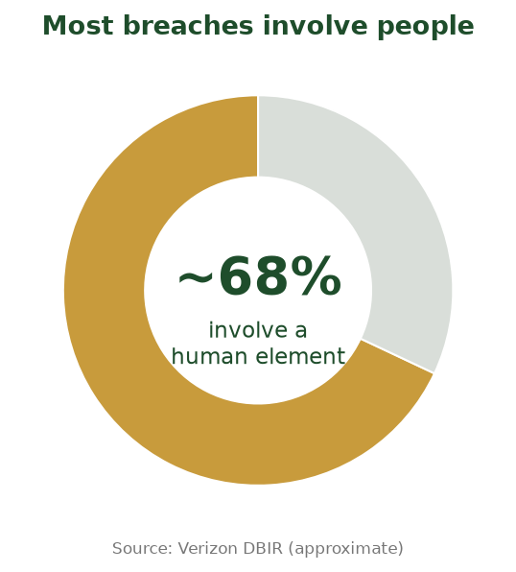
THE HUMAN ELEMENT, VISUALIZED
People Are the #1 Target
Around two-thirds of breaches involve a human element - which is why awareness is a core control.
CIS 350: AI for Cybersecurity · Week 1 · Wednesday
24

Slide 25
THE MENTAL SHORTCUTS ATTACKERS EXPLOIT
The Psychology of Social Engineering
⏰
👔
🪙
👥
Urgency
Authority
Scarcity
Social proof
'Act now or lose access' shuts down careful thinking.
Pretending to be the CEO, IT, or police.
'Only 2 left!' / 'limited-time' pressure.
'Everyone on your team already did this.'
🤝
😱
🎁
🙏
Liking / Trust
Fear
Reward / Bait
Reciprocity
Impersonating a friend, coworker, or vendor.
'Your computer is infected — call this number.'
'You won!' or a free USB in the parking lot.
A small 'favor' first, then a bigger ask.
CIS 350: AI for Cybersecurity · Week 1 · Wednesday
25

Slide 26
SAME GOAL, MANY TACTICS
Social Engineering Comes in Many Forms
🎣 Phishing / smishing / vishing — fake messages and calls.
🎭 Pretexting — inventing a believable story ('I'm from IT, verify your login').
🪤 Baiting — leaving infected USB drives or 'free' downloads.
🚶 Tailgating — following someone through a secure door.
💸 Business Email Compromise — fake invoices and 'urgent' wire requests.
CIS 350: AI for Cybersecurity · Week 1 · Wednesday
26

Slide 27
YOU ARE A CONTROL
Building the 'Human Firewall'
Pause on urgency — attackers weaponize hurry. Slow down.
Verify through a second channel — call the person on a known number.
Never share passwords or one-time codes; legitimate IT won't ask.
Report suspicious messages — fast reporting stops attacks early.
Build a no-blame culture: it's safer to ask 'is this real?' than to click.
Awareness is a security control as real as any firewall.
CIS 350: AI for Cybersecurity · Week 1 · Wednesday
27

Slide 28
🤔 SCENARIO · 5 MIN
What would you do?
You get a text: "Hi, it's your manager. I'm in a meeting — please buy four $100 gift cards and send me the codes. I'll reimburse you. Thanks!"
List two clues this is a scam (which psychology triggers are in play?).
What's the safest next step — and who would you contact to verify?
Why do attackers love gift cards and 'I'm in a meeting' excuses?
CIS 350: AI for Cybersecurity · Week 1 · Wednesday
28

Slide 29
🧱 IN-CLASS TASK · 12 MIN
Stack the Defenses: a Defense-in-Depth Plan
Front Range Bookkeeping is a 20-person accounting firm that stores clients' financial records and moves money for them. Last week staff got a wave of phishing plus a fake-CEO gift-card text (BEC). In groups, design a layered defense so no single failure sinks the firm.
Name the firm's top asset and the single most likely attack (phishing, malware, ransomware, DoS, insider).
Fill a three-column layer card: 2 PREVENT controls, 1 DETECT control, 1 RESPOND action.
For your chosen attack, mark which layer most likely stops it — and name the 'hole' if that layer fails.
Circle the ONE layer that would hurt most if removed, and say why.
Deliverable: a Prevent / Detect / Respond layer card with ≥4 named controls + one 'if this fails…' note.
CIS 350: AI for Cybersecurity · Week 1 · Wednesday
29

Slide 30
Key Takeaways
✓
The common attacks: phishing, malware, ransomware, DoS, and insider threats.
✓
Defense in depth layers Prevention, Detection, and Response — no single wall.
✓
When prevention fails, a practiced incident-response playbook limits the damage.
✓
People are the most-targeted layer — awareness is a core security control.

Slide 31
LOOKING AHEAD
This Week & Next
💻 Finish Lab 1 ('Hello, Colab') — due Monday of Week 2.
✅ Complete Quiz 1 on Canvas if you haven't already.
📖 Re-skim Handout 1; bring questions to office hours.
🔎 Next week: Data — the fuel of AI, and where security data comes from.
CIS 350: AI for Cybersecurity · Week 1 · Wednesday
31

Slide 32
🎟️ EXIT TICKET · 2 MIN
One minute before you go
On a notecard or the Canvas exit-ticket quiz:
Name one attack from today and one defense against it.
Which social-engineering trigger do you think would fool YOU most? Why?
One question you still have — I'll start there next time.
CIS 350: AI for Cybersecurity · Week 1 · Wednesday
32

