Slide 1

WEEK 1 · MONDAY · 75 MINUTES
Welcome to Cybersecurity
Course Map · Why It Matters · Core Concepts · The CIA Triad
CIS 350: AI for Cybersecurity — Smart Defense for the Digital Business
Ramadan Abdunabi, Ph.D. · Computer Information Systems

Slide 2

MONDAY · 75 MINUTES
Today's Plan
🧭
Course overview & expectations
How this class works, grading, tools, and policies
14 min
🔎
Warm-up: have you been breached?
Think–pair–share + a live check
5 min
💡
Why AI + cybersecurity matters
The business case and your career
9 min
🧱
Core security concepts
Assets, threats, vulnerabilities, risk — with diagrams
16 min
📋
Hands-on: build a risk register
Rank real risks for a small business
12 min
🛡️
The CIA triad
The three goals behind every decision
12 min
CIS 350: AI for Cybersecurity · Week 1 · Monday
2
📰
Real breaches & wrap-up
What they cost + what's next
7 min

Slide 3
PART 1 · COURSE OVERVIEW & EXPECTATIONS · ~18 MIN
Welcome to CIS 350

Slide 4
WELCOME
Your Instructor & How to Reach Me
Ramadan Abdunabi, Ph.D. — Senior Clinical Professor, Computer Information Systems.
Office: 017 Rockwell Hall. Email: ramadan.abdunabi@colostate.edu.
Email is the best way to reach me — I reply within 2 business days.
Office hours and the full schedule live on the course website and Canvas.
Use Canvas messages for quick logistics; check announcements regularly.
Course website: abdunabi-cis350-ai-cybersecurity-course.pages.dev · All work submitted in Canvas.
CIS 350: AI for Cybersecurity · Week 1 · Monday
4

Slide 5
THE BIG PICTURE
What This Course Is — and Isn't
A practical, intuition-first tour of AI for cybersecurity in business.
No heavy math and no prior coding required — every lab gives you starter code.
You'll learn by doing: build spam filters, fraud and anomaly detectors, and more.
  Not a programming course — it's about thinking clearly about risk and AI.
  Not about memorizing tools — it's about ideas you can use in any business role.
CIS 350: AI for Cybersecurity · Week 1 · Monday
5

Slide 6
WEEK 1 LEARNING OBJECTIVES
What You'll Be Able to Do
1
Explain why cybersecurity matters to modern businesses.
2
Define confidentiality, integrity, and availability (the CIA triad).
3
Identify common threats, vulnerabilities, and attack types.
4
Describe the role of human behavior in security incidents.
CIS 350: AI for Cybersecurity · Week 1 · Monday
6

Slide 7
FIVE WAYS YOU'LL LEARN
How the Course Works
🎓
💻
📝
🧪
🚩
Lectures
Labs
Quizzes
Exams
CTF & Tabletop
Mon & Wed, interactive, real examples — not just slides.
12 guided Python labs in Google Colab. 35% of grade.
12 short online quizzes on Canvas. 25% of grade.
4 non-cumulative exams, online. 40% of grade.
Hands-on Capture-the-Flag + an incident exercise.
CIS 350: AI for Cybersecurity · Week 1 · Monday
7

Slide 8
100% TOTAL — NO SINGLE THING CAN SINK YOU
How You're Graded
40%
35%
Steady effort wins:
Weekly quizzes keep you current.
Labs build a real portfolio.
Exams are non-cumulative (4 weeks each).
Lowest stress, highest learning.
25%
🗂️ Quizzes (12)
💻 Labs (12)
🧪 Exams (4)
CIS 350: AI for Cybersecurity · Week 1 · Monday
8

Slide 9
READ THE SYLLABUS — HERE ARE THE HIGHLIGHTS
Expectations & Key Policies
✅ What I expect
🤖 Generative-AI policy
Attend and participate — quizzes are on Wednesdays.
Submit on time. Late labs: −10%/day up to 48 hours.
Do your own work; cite collaboration when allowed.
Ask early — questions are welcome, not a weakness.
Labs & quizzes: AI tools are NOT permitted — your work must be your own.
Readings/research: AI is OK to explore, but disclose it and stay responsible.
When unsure whether AI is allowed, ask before you use it.
We study AI — using it honestly is part of the lesson.
CIS 350: AI for Cybersecurity · Week 1 · Monday
9

Slide 10
A LAPTOP AND A GOOGLE ACCOUNT
Everything You Need Is Free
🐍
🎯
🚩
🏛️
📚
Python + Colab
Hacker101
CTFd
CISA Exercises
Two paperbacks
Browser-based, nothing to install.
Beginner hacking & CTF lessons.
Capture-the-Flag platform.
Free tabletop incident scenarios.
Plain-language AI & security intros.
All assessments are online via Canvas. Exams are proctored with Respondus LockDown Browser — install it before Exam 1. We'll practice with low-stakes Quiz 1 first.
CIS 350: AI for Cybersecurity · Week 1 · Monday
10

Slide 11
🔎 THINK · PAIR · SHARE · 6 MIN
Have YOU already been breached?
Most of us have had data leaked in a breach without ever knowing it.
THINK (1 min): jot down 5 online accounts you used this week.
PAIR (2 min): which hold the most sensitive data (money, identity, health)?
SHARE (3 min): we'll check haveibeenpwned.com together — who's been 'pwned'?
CIS 350: AI for Cybersecurity · Week 1 · Monday
11

Slide 12
PART 2 · WHY IT MATTERS · ~10 MIN
AI + Cybersecurity = a Business Superpower

Slide 13
THE BUSINESS CASE
Why Cybersecurity Matters Now
Every company runs on data and software — so every company is a target.
Attacks are constant: phishing, ransomware, and fraud hit firms of all sizes.
The average data breach now costs about $4.88M globally (IBM, 2024).
Customers, regulators, and boards now treat security as a business issue.
Small mistakes scale fast — one click can cost millions.
CIS 350: AI for Cybersecurity · Week 1 · Monday
13

Slide 14
WHY THIS COURSE PAIRS THEM
AI Is Now on Both Sides of the Fight
🦹 Attackers use AI to…
🛡️ Defenders use AI to…
Write flawless, personalized phishing at massive scale.
Generate malware variants that dodge simple filters.
Clone voices and faces (deepfakes) to impersonate people.
Automate scanning for weak, exposed systems.
Flag spam, fraud, and phishing in milliseconds.
Spot unusual logins and traffic (anomaly detection).
Triage thousands of alerts so humans focus on real threats.
Predict and prioritize the risks that matter most.
CIS 350: AI for Cybersecurity · Week 1 · Monday
14

Slide 15
WHAT'S IN IT FOR YOU
Why This Is a Career Superpower
Security skills are in demand across every industry — not just tech.
AI literacy + security sense is a rare, well-paid combination.
You'll be the person who can talk to both engineers and executives.
Roles: analyst, risk & governance, product, consulting, management.
By Week 15 you'll have 12 completed AI-security labs to show employers.
CIS 350: AI for Cybersecurity · Week 1 · Monday
15

Slide 16
PART 3 · CORE SECURITY CONCEPTS · ~15 MIN
The Vocabulary of Security

Slide 17
SPEAK THE LANGUAGE OF SECURITY
Four Words You'll Use All Semester
💎
🎯
🚪
⚠️
Asset
Threat
Vulnerability
Risk
Anything worth protecting: data, money, systems, reputation, people.
Anyone or anything that could cause harm.
A weakness that a threat can exploit.
The chance harm actually happens — and how bad it would be.
CIS 350: AI for Cybersecurity · Week 1 · Monday
17

Slide 18
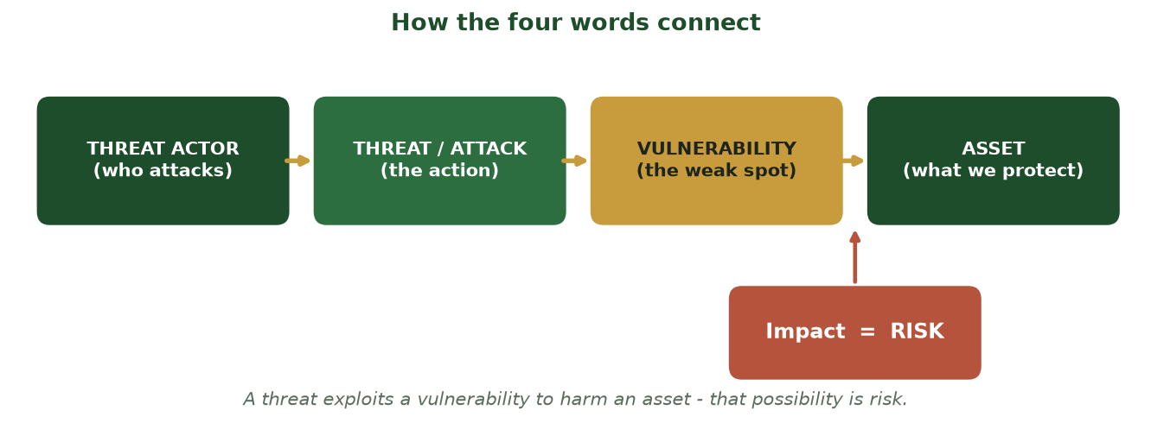
THREAT → VULNERABILITY → ASSET = RISK
How the Four Words Connect
A threat actor uses a threat to exploit a vulnerability in an asset — that possibility of harm is the risk.
CIS 350: AI for Cybersecurity · Week 1 · Monday
18

Slide 19
KNOW YOUR ADVERSARY
Who Are the Threat Actors?
💰 Cybercriminals — in it for money: ransomware, fraud, theft.
🏴 Hacktivists — pushing a cause or making a statement.
🌍 Nation-states — espionage and sabotage, very well resourced.
🧑‍💼 Insiders — employees or partners, malicious or simply careless.
🧒 'Script kiddies' — beginners using ready-made tools for kicks.
CIS 350: AI for Cybersecurity · Week 1 · Monday
19

Slide 20
WHERE WEAKNESS LIVES
Vulnerabilities & the Attack Surface
A vulnerability is any weakness: unpatched software, weak passwords, misconfigurations.
The 'attack surface' = every possible way in (apps, devices, people, cloud, vendors).
More devices, apps, and remote work = a bigger surface to defend.
  Humans are part of the attack surface too — often the easiest part.
CIS 350: AI for Cybersecurity · Week 1 · Monday
20

Slide 21
WHY WE DON'T FIX EVERYTHING AT ONCE
Risk = Threat × Vulnerability × Impact
🎯
Threat
×
🚪
Vulnerability
×
💥
Impact
= RISK
We can't fix everything — so we rank risks and handle the biggest first. Four choices:
🛠️
📜
🙅
👍
Mitigate
Transfer
Avoid
Accept
Reduce it with controls (MFA, patching).
Share it — e.g., cyber insurance.
Don't do the risky thing at all.
Knowingly live with a small risk.
CIS 350: AI for Cybersecurity · Week 1 · Monday
21

Slide 22
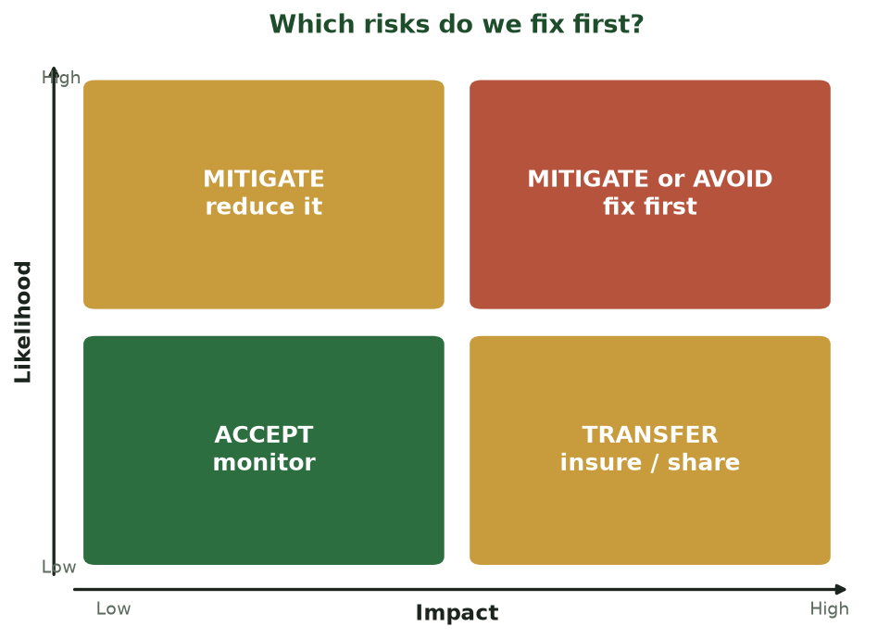
LIKELIHOOD × IMPACT → THE RIGHT RESPONSE
Which Risks Do We Fix First?
We can't fix everything at once — rank by likelihood and impact, then Mitigate / Avoid / Transfer / Accept.
CIS 350: AI for Cybersecurity · Week 1 · Monday
22

Slide 23
PART 4 · THE CIA TRIAD · ~14 MIN
Three Goals Behind Every Security Decision

Slide 24
CONFIDENTIALITY · INTEGRITY · AVAILABILITY
The CIA Triad
Confidentiality
Only the right people can see the data.
C
Integrity
Data is accurate and untampered.
I
A
Availability
It's there when you need it.
CIS 350: AI for Cybersecurity · Week 1 · Monday
24

Slide 25
C OF THE TRIAD
Confidentiality — Keep Secrets Secret
Goal: only authorized people can read sensitive data.
How: encryption, strong access controls, least privilege, good passwords + MFA.
Broken when: data leaks, stolen passwords, an email to the wrong person.
  Business example: customer SSNs, salaries, health records, trade secrets.
CIS 350: AI for Cybersecurity · Week 1 · Monday
25

Slide 26
I OF THE TRIAD
Integrity — Trust the Data
Goal: data and systems are accurate and have not been altered.
How: hashing/checksums, change controls, digital signatures, audit logs.
Broken when: a hacker edits bank balances, grades, or shipping addresses.
  If you can't trust the data, you can't trust any decision made from it.
CIS 350: AI for Cybersecurity · Week 1 · Monday
26

Slide 27
A OF THE TRIAD
Availability — There When You Need It
Goal: systems and data are accessible to the right people on time.
How: backups, redundancy, failover, DDoS protection, capacity planning.
Broken when: ransomware locks files or a DDoS attack knocks a site offline.
  A hospital that can't reach patient records is a safety emergency, not just IT.
CIS 350: AI for Cybersecurity · Week 1 · Monday
27

Slide 28
✋ QUICK POLL · 5 MIN
Which leg of the CIA triad broke?
Hold up 1 finger for C, 2 for I, 3 for A. Some scenarios break more than one!
A student secretly changes a grade in the school system. → I
10 million email + password pairs are leaked online. → C
A DDoS attack takes an airline's booking site down all day. → A
Ransomware steals a copy of files, then encrypts the originals. → C + A
CIS 350: AI for Cybersecurity · Week 1 · Monday
28

Slide 29
PART 5 · REAL HEADLINES · ~12 MIN
Famous Breaches & What They Cost

Slide 30
CASE STUDY
Real Headlines, Real Costs
🏦 Equifax (2017)
What happened
Attackers exploited one unpatched web vulnerability that IT missed.
Impact
≈147 million people's personal data exposed; settlement up to ~$700M.
CIA broken
Confidentiality (huge personal-data exposure).
Lesson
Patch known weaknesses fast — 'boring' basics prevent disasters.
CIS 350: AI for Cybersecurity · Week 1 · Monday
30

Slide 31
CASE STUDY
Real Headlines, Real Costs
⛽ Colonial Pipeline (2021)
What happened
Ransomware hit the largest U.S. fuel pipeline; one leaked password was enough.
Impact
Pipeline shut down; East-Coast fuel shortages; ~$4.4M ransom paid.
CIA broken
Availability (operations halted) + Confidentiality.
Lesson
MFA and segmentation matter; downtime can dwarf the ransom.
CIS 350: AI for Cybersecurity · Week 1 · Monday
31

Slide 32
CASE STUDY
Real Headlines, Real Costs
💻 WannaCry (2017)
What happened
Ransomware worm spread worldwide through an unpatched Windows flaw.
Impact
~200,000 computers in 150 countries; hospitals diverted patients.
CIA broken
Availability (systems locked) + Integrity.
Lesson
Updates and offline backups are frontline defenses.
CIS 350: AI for Cybersecurity · Week 1 · Monday
32

Slide 33
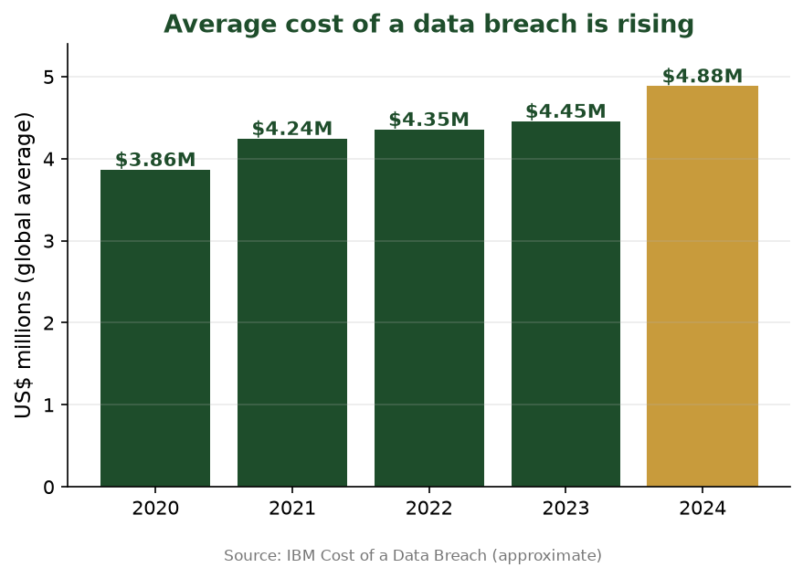
WHY LEADERSHIP NOW CARES
The Cost Keeps Climbing
The global average cost of a data breach has risen toward ~$4.88M (IBM). Security is now a business issue.
CIS 350: AI for Cybersecurity · Week 1 · Monday
33

Slide 34
THE PATTERN
What Do These Breaches Have in Common?
Rarely 'genius' hacking — usually a missed patch, weak password, or a click.
Roughly 2 in 3 breaches involve a human element (Verizon DBIR).
The basics — patching, MFA, backups, training — stop most attacks.
Technology is only half the story. People are the other half.
Wednesday: the full attack landscape and why people are the #1 target.
CIS 350: AI for Cybersecurity · Week 1 · Monday
34

Slide 35
📋 IN-CLASS TASK · 12 MIN
Build a One-Page Risk Register
"Ram's Threads" is a student-run online T-shirt shop: it stores customer names, addresses, and saved card info, keeps its designs in a shared Google Drive, and runs the whole store on one laptop at the founder's apartment. In pairs, build a mini risk register using today's vocabulary.
List 3 ASSETS the shop must protect (data, systems, money, or reputation).
For each asset, name one realistic THREAT and the VULNERABILITY it would exploit.
Mark which CIA leg(s) each risk threatens; rate its Likelihood and Impact (Low/High).
Place each on the likelihood–impact grid, then pick a response: Mitigate / Transfer / Avoid / Accept + a control.
Deliverable: a 3-row table — Asset | Threat | Vulnerability | CIA | Likelihood×Impact | Response + control.
CIS 350: AI for Cybersecurity · Week 1 · Monday
35

Slide 36
Key Takeaways
✓
Security manages risk = threat × vulnerability × impact, to protect assets.
✓
The CIA triad — Confidentiality, Integrity, Availability — frames every decision.
✓
Breaches are common and costly, and usually involve people, not just code.
✓
AI now powers both attackers and defenders — that's why this course exists.

Slide 37
YOUR FIRST LAB - WE PROVIDE THE CODE, YOU RUN IT
Sneak Peek: Lab 1 in Colab
Python · Google Colab
import pandas as pd
# a sample of leaked passwords (one per line)
pw = pd.Series(open('leaked_passwords.txt').read().split())
pw.value_counts().head(10) # the 10 most common passwords
(pw.str.len() < 8).mean() * 100 # % shorter than 8 characters
No coding experience needed - Lab 1 walks you through every line.
CIS 350: AI for Cybersecurity · Week 1 · Monday
37

Slide 38
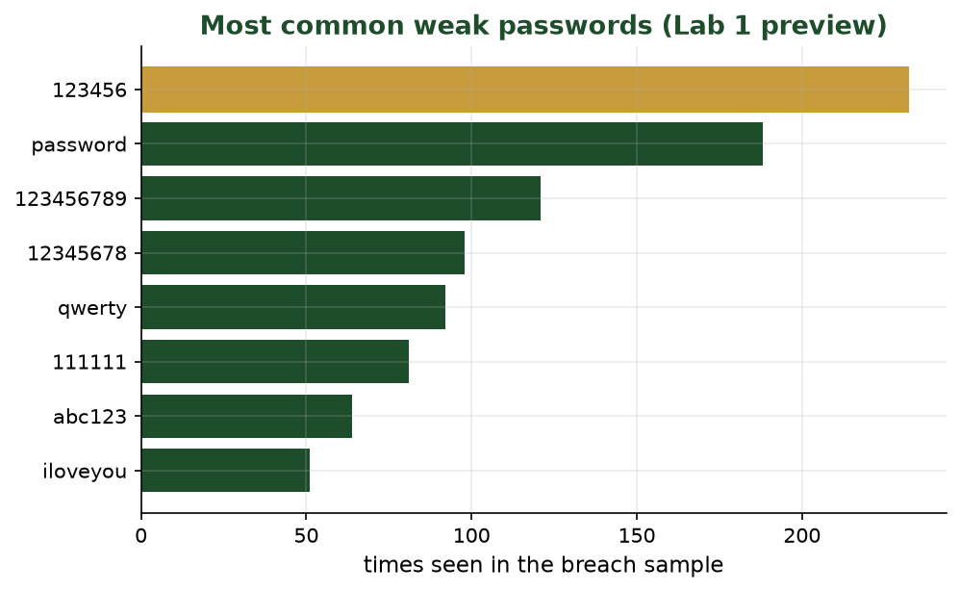
THE MOST COMMON (WORST) PASSWORDS
What Lab 1 Reveals
People reuse a tiny set of weak passwords - which is why credential attacks work. You'll find these in Lab 1.
CIS 350: AI for Cybersecurity · Week 1 · Monday
38

Slide 39
LOOKING AHEAD
Before Wednesday
💻 Start Lab 1 — 'Hello, Colab' (released today; no coding experience needed).
📝 Quiz 1 is Wednesday, online via Canvas — covers today's basics.
📖 Read Handout 1: Cybersecurity Fundamentals.
🔐 Reminder: quizzes, labs & exams are online; exams use LockDown Browser.
CIS 350: AI for Cybersecurity · Week 1 · Monday
39

Slide 40
🎟️ EXIT TICKET · 2 MIN
One minute before you go
On a notecard or in the Canvas exit-ticket quiz, answer briefly:
Name one asset in your own life and one threat to it.
Which leg of the CIA triad feels most important to you, and why?
What's one thing you're still unsure about? (I'll address it Wednesday.)
CIS 350: AI for Cybersecurity · Week 1 · Monday
40

