Slide 1

LAB BOOTCAMP · BOOTCAMP · 75 MINUTES
Python & Google Colab Bootcamp
Your Lab Survival Guide · Everything You Need Before Lab 1
CIS 350: AI for Cybersecurity — Smart Defense for the Digital Business
Ramadan Abdunabi, Ph.D. · Computer Information Systems
Notes:
This deck is a standalone survival guide for the weekly Colab labs. Students can self-study it before Lab 1, and it stays linked on the course website all semester. If taught live, it fills a 75-minute session; if self-paced, students should work through the two Try-It-Now activities. Message to open with: 'You do NOT need to be a programmer for this course. Every lab gives you working starter code - your job is to run it, change small pieces, and interpret the results.' ~1 min.

Slide 2

BOOTCAMP · 75 MINUTES
Today's Plan
🚀
What is Colab & how labs work
Browser Python, zero install, the weekly lab rhythm
8 min
🗺️
Tour of the Colab window
Cells, the run button, saving your copy + Try It Now #1
12 min
🐍
Python crash course
Variables, lists, imports, pandas - every line explained
20 min
🧪
Anatomy of a lab notebook
TODO cells, guided questions, the five-step lab shape
12 min
📤
Submitting on Canvas
Run all, download .ipynb, upload - the six steps
8 min
🛠️
When things go wrong
Reading error messages + the fix-it playbook
10 min
CIS 350: AI for Cybersecurity · Bootcamp
2
✅
Your practice checklist
Prove you're lab-ready in 10 minutes + Try It Now #2
5 min
Notes:
Walk the plan - rows sum to exactly 75 minutes for a live session. Emphasize that parts 2, 5, and 6 are the ones that prevent lost work and lost points; part 3 is the only 'programming' and it is gentler than it sounds. ~1 min.

Slide 3
BOOTCAMP LEARNING OBJECTIVES
What You'll Be Able to Do
1
Open Google Colab, create a notebook, and run code and text cells.
2
Save your own copy of a lab starter so your work is never lost.
3
Read and lightly modify beginner Python: variables, lists, imports, pandas.
4
Recognize the five-step shape every CIS 350 lab follows.
5
Export a finished notebook and submit it correctly on Canvas.
CIS 350: AI for Cybersecurity · Bootcamp
3
6
Read a Python error message and fix the three most common mistakes.
Notes:
Six concrete, checkable skills. Every one of them is exercised by the practice checklist at the end, so tell students: 'if you can do the checklist, you are ready for all twelve labs.' ~1 min.

Slide 4
PART 1 · ZERO INSTALL, ZERO COST · ~8 MIN
What Is Google Colab?
Notes:
~8 minutes. Goal: remove the fear. Colab is just a webpage; nothing can be broken permanently.

Slide 5
THE TOOL
Colab = Python in Your Browser
Google Colab is a free website that runs Python code on Google's computers.
Nothing to install - if you can open Google Docs, you can use Colab.
You only need: a laptop, a browser, and your Google account.
Your notebooks save to Google Drive, like any other Google document.
The libraries our labs use (pandas, scikit-learn, matplotlib) are pre-installed.
colab.research.google.com - bookmark it now.
CIS 350: AI for Cybersecurity · Bootcamp
5
Notes:
Demystify: Colab is a Google Doc that can run code. The code executes on Google's servers ('the runtime'), not on the student's laptop, so a weak laptop is fine and nothing installed on their machine can break. Common worry to preempt: 'What if I ruin the notebook?' - you can't; you can always re-open the original starter from Canvas. ~3 min.

Slide 6
THE RHYTHM
How Labs Work in This Course
A new lab is released on Canvas most Mondays and due the following Monday.
Each lab is a Colab notebook with working starter code + TODOs + questions.
Worth 50 points; work solo or in a pair (both must understand everything).
Graded on: code runs correctly · code is readable · your interpretation of results.
AI tools (ChatGPT, Copilot, etc.) are NOT permitted on labs, quizzes, or exams.
Late policy: 10% per day, up to 48 hours.
Release Monday -> due next Monday on Canvas.
CIS 350: AI for Cybersecurity · Bootcamp
6
Notes:
Set the semester rhythm once so it never surprises anyone. Stress the third grading criterion: interpretation. Students who only make code run lose the points that live in the guided questions - 'in your own words' answers are graded seriously. State the AI policy plainly and why: the labs teach the exact reasoning the quizzes and exams test, so outsourcing them costs points twice. ~3 min.

Slide 7
PART 2 · AROUND THE WINDOW IN 12 MINUTES · ~12 MIN
Tour of the Colab Interface
Notes:
~12 minutes including the first Try-It-Now. If live, share your screen and click along.

Slide 8
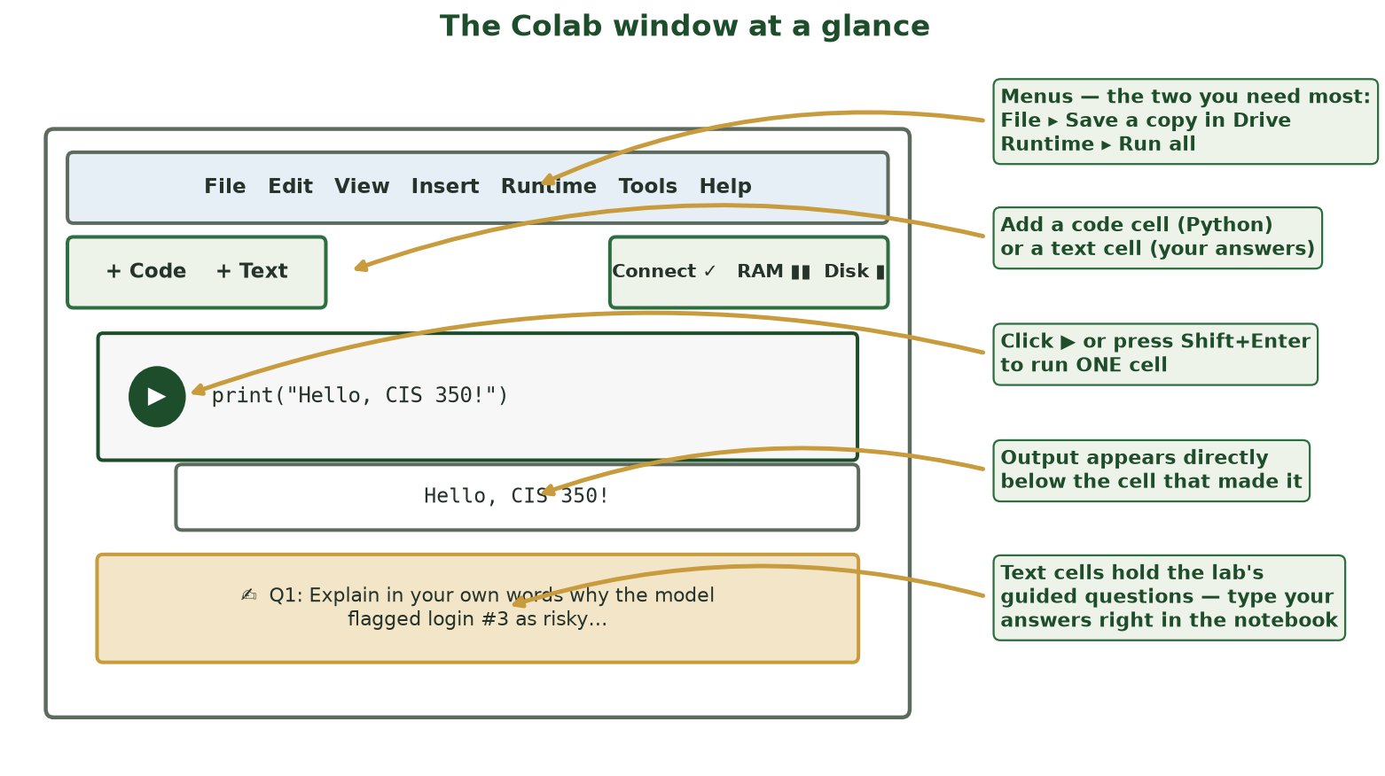
FIVE THINGS - THAT'S THE WHOLE INTERFACE
The Colab Window at a Glance
Menus, the two cell buttons, the play button, the output area, and text cells. Everything you'll do lives here.
CIS 350: AI for Cybersecurity · Bootcamp
8
Notes:
Walk the five callouts clockwise. The two menu commands worth memorizing: File > Save a copy in Drive, and Runtime > Run all. Point at the play button: hovering over a code cell reveals it; Shift+Enter does the same. Note the Connect/RAM indicator: green check = your free cloud computer is attached. Students don't need anything else on day one. ~3 min.

Slide 9
BUILDING BLOCKS
Two Kinds of Cells - Code and Text
CODE cells contain Python. Click ▶ (or press Shift+Enter) to run one.
Output (numbers, tables, plots) appears immediately BELOW the cell.
TEXT cells hold formatted writing - lab instructions and question prompts.
You answer guided questions by typing into text cells (double-click to edit).
A notebook is just these two cell types stacked top to bottom.
Code -> run it. Text -> read it, or type your answer in it.
CIS 350: AI for Cybersecurity · Bootcamp
9
Notes:
The cell is the unit of everything. Misconception to kill early: students try to type answers into code cells (Python then errors on plain English) or paste code into text cells (it won't run). Rule of thumb: grey background with ▶ = code; white/formatted = text. Double-click a text cell to edit, Shift+Enter to render it back. ~3 min.

Slide 10
MENTAL MODEL
The #1 Rule: Cells Remember, In the Order You Ran Them
Running a cell stores its variables in the notebook's memory (the 'runtime').
Later cells can use variables created by earlier cells - that's by design.
If you run cells OUT OF ORDER, you can get errors or stale results.
Fix-everything button: Runtime ▸ Run all - executes top to bottom, cleanly.
If Colab disconnects (idle too long), just Reconnect and Run all again.
Confused notebook? Runtime ▸ Run all.
CIS 350: AI for Cybersecurity · Bootcamp
10
Notes:
This is THE conceptual stumbling block of notebooks. Analogy: a recipe - you can't frost a cake (cell 9) before baking it (cell 3). The number in brackets next to a cell shows run order. Teach the universal fix now - Runtime > Run all - because half of all 'my lab is broken' office-hours visits are out-of-order execution. Disconnects after ~90 idle minutes are normal and lose nothing that was saved. ~3 min.

Slide 11
⌨️ TRY IT NOW #1 · 3 MIN
Your first notebook (3 minutes)
Open colab.research.google.com and do this:
Click 'New notebook'.
In the code cell, type: print("Hello, CIS 350!") - then press Shift+Enter.
Click '+ Text', type your name, and press Shift+Enter to render it.
Find File ▸ Save a copy in Drive - notice where the notebook lives now.
CIS 350: AI for Cybersecurity · Bootcamp
11
Notes:
Three minutes, everyone hands-on. Circulate for the two classic snags: smart quotes if they typed in a word processor first (retype the quotes in Colab), and not being signed into a Google account. Success = they see the printed text and a rendered name. That IS the whole mechanical skill of the course - everything else is reading and thinking. ~3 min.

Slide 12
PART 3 · JUST ENOUGH PYTHON · ~20 MIN
A Crash Course for Our Labs
Notes:
~20 minutes. Four code slides, every line explained. Keep repeating: starter code is always provided; students modify small pieces, never write from scratch.

Slide 13
LINE BY LINE - NOTHING HIDDEN
Variables: Naming Your Data
Python · Google Colab
# A variable is a labeled box that stores a value.
num_failed_logins = 7 # a whole number (integer)
risk_score = 82.5 # a decimal number (float)
username = "alice" # text goes in quotes (a 'string')
# print() shows a value below the cell.
print(username, "risk:", risk_score)
# -> alice risk: 82.5
Variables are labeled boxes. Create them with =, look inside with print().
CIS 350: AI for Cybersecurity · Bootcamp
13
Notes:
First real Python. The = sign STORES (it is not algebra); quotes mean text; names can't contain spaces (that's what the underscores are for). Have students predict the print output before revealing the last line. Typical error: forgetting quotes around text -> NameError - which links ahead to the error-reading slide. ~4 min.

Slide 14
SECURITY DATA COMES IN BATCHES
Lists and Loops: Many Values at Once
Python · Google Colab
# A list holds several values in one variable, in order.
alerts = ["phishing email", "failed login", "malware download"]
print(len(alerts)) # len() counts items -> 3
print(alerts[0]) # positions start at 0 -> phishing email
# A for-loop repeats an action for EACH item in the list.
for alert in alerts:
print("Investigate:", alert)
Lists hold batches of data; loops visit every item. Note positions start at 0!
CIS 350: AI for Cybersecurity · Bootcamp
14
Notes:
Two ideas, both intuition-friendly: a list is a numbered row of boxes (numbering starts at 0 - the single most common beginner surprise), and a for-loop is 'do this for each one.' The indented line belongs to the loop - indentation is grammar in Python, not decoration. In labs, loops appear ready-written; students read them more than write them. ~4 min.

Slide 15
WHY EVERY LAB STARTS WITH IMPORT LINES
Imports: Borrowing Professional Tools
Python · Google Colab
# Libraries are toolboxes of code written by experts.
import pandas as pd # tables of data
from sklearn.tree import DecisionTreeClassifier # ML models
import matplotlib.pyplot as plt # plots and charts
# 'as pd' is a nickname so we can type pd.read_csv(...)
# In Colab these are ALREADY INSTALLED - importing just unlocks them.
emails = pd.read_csv("emails.csv") # load a data table
emails.head() # peek at the first 5 rows
import = open the toolbox. pandas reads tables; .head() shows the first five rows.
CIS 350: AI for Cybersecurity · Bootcamp
15
Notes:
Reassure: nobody writes machine learning from scratch in this course - we import it. The import cell is always the FIRST cell of a lab, which is why 'NameError: pd is not defined' almost always means 'you skipped the first cell' (Run all fixes it). pd.read_csv turns a spreadsheet-like file into a table variable; .head() is the habit of looking at data before trusting it - Week 2 makes a whole lesson of that. ~4 min.

Slide 16
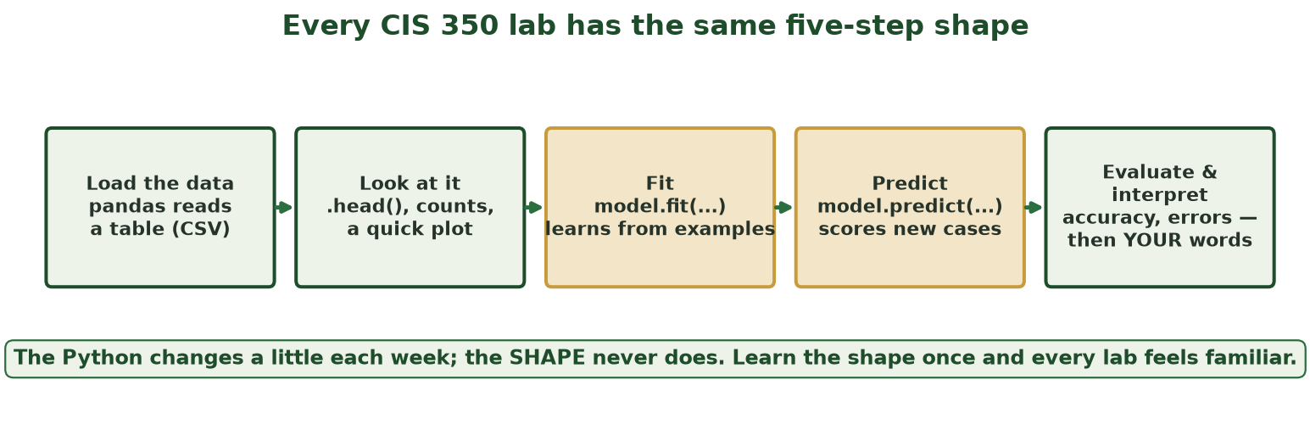
LEARN IT ONCE, REUSE IT TWELVE TIMES
Every Lab Has the Same Shape
Load → look → fit → predict → evaluate-and-interpret. The Python varies a little; the shape never does.
CIS 350: AI for Cybersecurity · Bootcamp
16
Notes:
The big picture that makes twelve labs feel like one: load data with pandas, look at it, fit a model, predict on new cases, evaluate and interpret. Highlight the amber middle: fit/predict is the same two lines in Week 3's spam classifier and Week 13's privacy lab. The last step is where their grade concentrates - numbers plus THEIR interpretation. ~3 min.

Slide 17
PREVIEW - WEEK 3 TEACHES THIS PROPERLY
fit() and predict(): the Two-Line Heart of Every Lab
Python · Google Colab
# X = the features (input clues), y = the labels (right answers)
model = DecisionTreeClassifier() # 1. create a blank model
model.fit(X_train, y_train) # 2. LEARN from labeled examples
predictions = model.predict(X_test) # 3. label new, unseen cases
print(predictions[:5]) # peek at the first 5 answers
# That's it. Every model in this course: create -> fit -> predict.
Don't memorize the details - recognize the pattern. It appears in every single lab.
CIS 350: AI for Cybersecurity · Bootcamp
17
Notes:
Preview, not mastery - Week 3 builds this carefully with the spam example. Today's goal is only that the pattern looks familiar when they meet it: create, fit (learn), predict (apply). Analogy: fit = studying with an answer key; predict = taking the quiz. If time is tight, this slide can be 60 seconds of 'you will see these exact lines again.' ~3 min.

Slide 18
PART 4 · READING A LAB NOTEBOOK · ~12 MIN
TODOs, Questions, and Where Points Live
Notes:
~12 minutes. Show how a lab starter is structured so nothing about Lab 1 is a surprise.

Slide 19
STRUCTURE
What You'll Find Inside a Lab Starter
Header cell: lab title, objectives, points, and your name goes here first.
Setup cells: imports + a cell that downloads the week's dataset. Run these first.
Worked sections: complete code with explanations - run and read.
TODO cells: '# TODO:' marks the small pieces YOU complete or change.
Guided questions: text cells where you answer in your own words.
A final checklist cell before submission.
Everything is labeled - a lab is a guided path, not a blank page.
CIS 350: AI for Cybersecurity · Bootcamp
19
Notes:
Open any lab starter alongside this slide if teaching live. TODOs are deliberately small: change a threshold, complete one line, add one feature. The guided questions carry heavy points and ask 'why', not 'what' - e.g. 'Why did accuracy drop when...?' Encourage answering immediately after each section while the result is on screen. ~4 min.

Slide 20
FIVE RULES
The Golden Rules of Lab Notebooks
Rule 1: Save a copy in Drive BEFORE you start (or your edits vanish).
Rule 2: Run cells top-to-bottom; when confused, Runtime ▸ Run all.
Rule 3: Don't delete provided cells - graders follow the same path you did.
Rule 4: Answer questions in your own words - we grade thinking, not vocabulary.
Rule 5: Before submitting, Run all one final time so every output is visible.
Rules 1 and 5 are the point-savers.
CIS 350: AI for Cybersecurity · Bootcamp
20
Notes:
These five rules prevent nearly every avoidable point loss. Rule 1: the Canvas link opens the INSTRUCTOR'S notebook in view mode - without saving a copy, work is lost on close. Rule 5 exists because graders see the notebook exactly as submitted: a missing output is ungradable even if the code was right. Have students recite rules 1 and 5 back to you. ~4 min.

Slide 21
HABITS THAT SEPARATE SMOOTH LABS FROM PAINFUL ONES
Do This · Not That
😌 ✅ Do
😱 ❌ Not that
Save a copy in Drive first thing
Read the error's last line, then fix
Run all before you download
Answer questions as you go
Start early - runtimes disconnect at deadline crunch
Work in the shared starter link
Paste errors into an AI tool (not permitted)
Submit with blank outputs
Leave all questions for 11:58 pm
Delete cells that 'look unneeded'
CIS 350: AI for Cybersecurity · Bootcamp
21
Notes:
Quick contrast slide - read a few pairs aloud with the story behind them (every 'not that' is a real student incident). The AI-tool line is policy, not just advice: labs are individual/pair work and AI assistance is not permitted; office hours, the TA, and the Canvas discussion board are the sanctioned help channels and they are fast. ~2 min.

Slide 22
PART 5 · FROM NOTEBOOK TO GRADEBOOK · ~8 MIN
Submitting Your Lab on Canvas
Notes:
~8 minutes. Mechanical but crucial - a perfect lab submitted wrong scores zero until resolved.

Slide 23
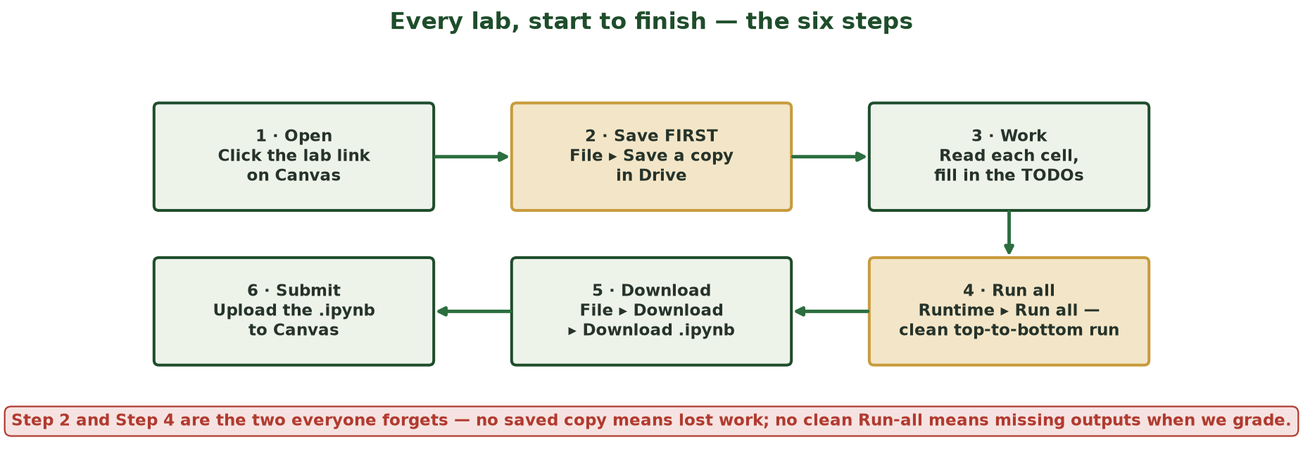
THE SIX STEPS - TWO OF THEM EVERYONE FORGETS
Every Lab, Start to Finish
Open → save a copy → work → Run all → download .ipynb → upload to Canvas. Amber steps = the ones that cost points when skipped.
CIS 350: AI for Cybersecurity · Bootcamp
23
Notes:
Trace the loop start to finish. The two amber boxes are the forgettable ones: save-a-copy (step 2, protects the work) and Run-all (step 4, makes the work visible to graders). Step 5 detail: File > Download > 'Download .ipynb' - NOT .py, which strips outputs and text answers. Canvas accepts the .ipynb file directly like any file upload. ~4 min.

Slide 24
FINAL MINUTE
Pre-Submission Checklist (60 Seconds That Protect 50 Points)
☐ Your name (and partner's name) is in the header cell.
☐ Runtime ▸ Run all completes with no red error boxes.
☐ Every plot and table you're asked about is visible below its cell.
☐ Every guided question has an answer in your own words.
☐ File downloaded as .ipynb and uploaded to the correct Canvas assignment.
☐ Submitted before Monday 10:00 am (late = 10%/day, max 48 h).
This exact checklist appears at the bottom of every lab.
CIS 350: AI for Cybersecurity · Bootcamp
24
Notes:
This literal checklist closes every lab starter, so practicing it here builds the habit. The second box is the money box: 'Run all with no errors' catches out-of-order execution, missed imports, and half-finished TODOs all at once. Pairs submit ONE notebook with both names unless the assignment says otherwise. ~4 min.

Slide 25
PART 6 · WHEN THINGS GO WRONG · ~10 MIN
Errors Are Normal - Here's the Playbook
Notes:
~10 minutes. Normalize errors: professionals see them all day; the skill is reading, not avoiding.

Slide 26
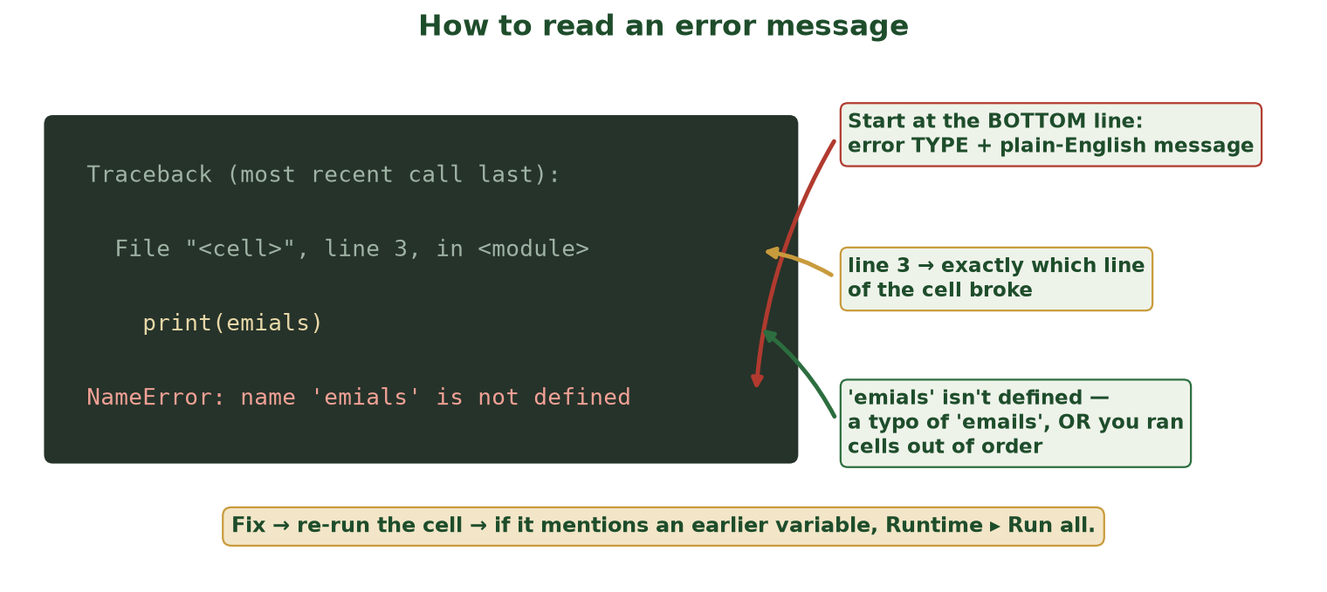
BOTTOM LINE FIRST - ALWAYS
How to Read an Error Message
Python errors look scary but follow one format: the LAST line names the problem; the line number shows where.
CIS 350: AI for Cybersecurity · Bootcamp
26
Notes:
Teach the reading order: last line first (error type + message), then the line number, then the quoted code. The example is the classic typo ('emials'), which produces the same NameError as running cells out of order - so the fix path is: check spelling, then Run all. Students who learn to read the bottom line solve most of their own errors without help. ~3 min.

Slide 27
AND THE 10-SECOND FIX FOR EACH
The Four Errors You'll Actually Meet
Error you see | What it means | The fix
NameError: 'X' is not defined | Typo, or you skipped an earlier cell | Fix spelling · Runtime ▸ Run all
SyntaxError: invalid syntax | Broken 'grammar' - quotes/parentheses | Check the pointed-at line for pairs
FileNotFoundError | The dataset wasn't downloaded yet | Re-run the setup/download cell
'Runtime disconnected' | Idle too long - totally normal | Reconnect, then Runtime ▸ Run all
CIS 350: AI for Cybersecurity · Bootcamp
27
Notes:
Four rows cover ~90% of real lab issues. Walk each: NameError is the out-of-order/typo twin from the previous slide; SyntaxError means look for an unclosed quote or parenthesis on that exact line; FileNotFoundError means the data cell didn't run; disconnects lose nothing saved and Run-all restores the session. Encourage screenshotting this table. ~4 min.

Slide 28
SUPPORT PATH
Getting Help - the Right Order
1. Read the error's last line - you'll fix most problems yourself.
2. Check the lab's Troubleshooting section - it predicts the common snags.
3. Ask on the Canvas discussion board (screenshots welcome, no answers spoiled).
4. Come to office hours or ask the TA - that's what we're here for.
Remember: AI tools are not permitted on graded work - but WE are unlimited.
Stuck > 15 minutes on one error? Move to step 3 or 4.
CIS 350: AI for Cybersecurity · Bootcamp
28
Notes:
Give explicit permission to ask for help early - the 15-minute rule prevents the death spiral of a student stuck alone on a typo at midnight. Board posts help everyone (others hit the same snag). Reiterate the AI policy positively: the humans are the sanctioned unlimited resource. ~3 min.

Slide 29
Key Takeaways
✓
Colab is Python in the browser - free, nothing to install, can't be broken.
✓
Cells remember in run order; Runtime ▸ Run all fixes a confused notebook.
✓
Every lab: load → look → fit → predict → interpret. Same shape, twelve times.
✓
Save a copy FIRST; Run all LAST; download .ipynb; upload to Canvas.
✓
Errors are normal: read the bottom line, fix, re-run - and ask for help early.
Notes:
Recap the five takeaways as one story: open it, own it (save a copy), run it, read it, submit it. Point students at the practice checklist on the next slide as the self-test of readiness. ~2 min.

Slide 30
🏁 TRY IT NOW #2 · 5 MIN
The 10-minute lab-readiness checklist
In your own new Colab notebook, prove all six skills:
Create a variable with your name and print a greeting with it.
Make a list of 3 suspicious email signs; loop over it printing 'Red flag: ...'.
Run: import pandas as pd - then print(pd.__version__).
Add a text cell answering: 'What does Runtime ▸ Run all do, and when do I use it?'
File ▸ Download ▸ Download .ipynb - confirm the file lands on your computer.
Bonus: cause a NameError on purpose, read the last line, then fix it.
CIS 350: AI for Cybersecurity · Bootcamp
30
Notes:
The exit ticket / homework. Anyone who completes all six items has every mechanical skill the twelve labs require. If live: start it in the last 5 minutes and let students finish at home; the bonus (deliberately causing and fixing an error) is the single best confidence builder - errors stop being scary once you've made one on purpose. ~5 min.

Slide 31
REFERENCES & FURTHER READING
Keep Learning (Optional, All Free)
Colab's own intro: colab.research.google.com ▸ 'Welcome to Colaboratory'.
Google's Python Class (free): developers.google.com/edu/python.
Kaggle Learn 'Python' and 'Pandas' micro-courses: kaggle.com/learn.
The course Resources page links all tools: Colab, CTFd, Hacker101, CISA.
Bring questions to Week 1 office hours - the best time to fix setup issues.
None of these are required - the labs teach everything as you go.
CIS 350: AI for Cybersecurity · Bootcamp
31
Notes:
Optional enrichment only - reassure students the labs are self-contained. Kaggle's Python micro-course is the best fit for anyone who wants extra reps before Lab 3's first model. Close by repeating the promise from slide 1: starter code is always provided; the course grades thinking, not typing. ~1 min.

